Slide 1

Title :Cardiac Cycle
Class : Dpt,BS(RIT,MLT,OTT)1st
Subject title (code): Physiology
Lecturer: Dr Hajira

Slide 2
Learning Objectives
Define the cardiac cycle.
Explain the phases of the cardiac cycle in sequence.
Describe pressure and volume changes in the heart.
Explain the opening and closing of cardiac valves.

Slide 3
Definition of the Cardiac Cycle
The cardiac cycle is the complete sequence of electrical and mechanical events occurring during one heartbeat.
It includes:
Contraction of the atria (atrial systole).
Contraction of the ventricles (ventricular systole).
Relaxation of the atria and ventricles (diastole).

Slide 4
Opening and closing of cardiac valves.
Changes in chamber pressure and blood volume.
Production of heart sounds.
At a heart rate of 75 beats/minute, one cardiac cycle lasts approximately 0.8 seconds.

Slide 5
Duration of the Cardiac Cycle
Phase Approximate duration
Atrial systole 0.1 s
Ventricular systole 0.3 s
Complete ventricular diastole 0.5 s
Total cardiac cycle 0.8 s

Slide 6
At a heart rate of 75 beats/minute:
Important clarification: These intervals overlap and should not be added together as separate, non-overlapping periods. Atrial systole occurs during late ventricular diastole. The overall cycle is approximately 0.8 seconds at this heart rate.
As heart rate increases, diastole generally shortens more than systole.

Slide 7
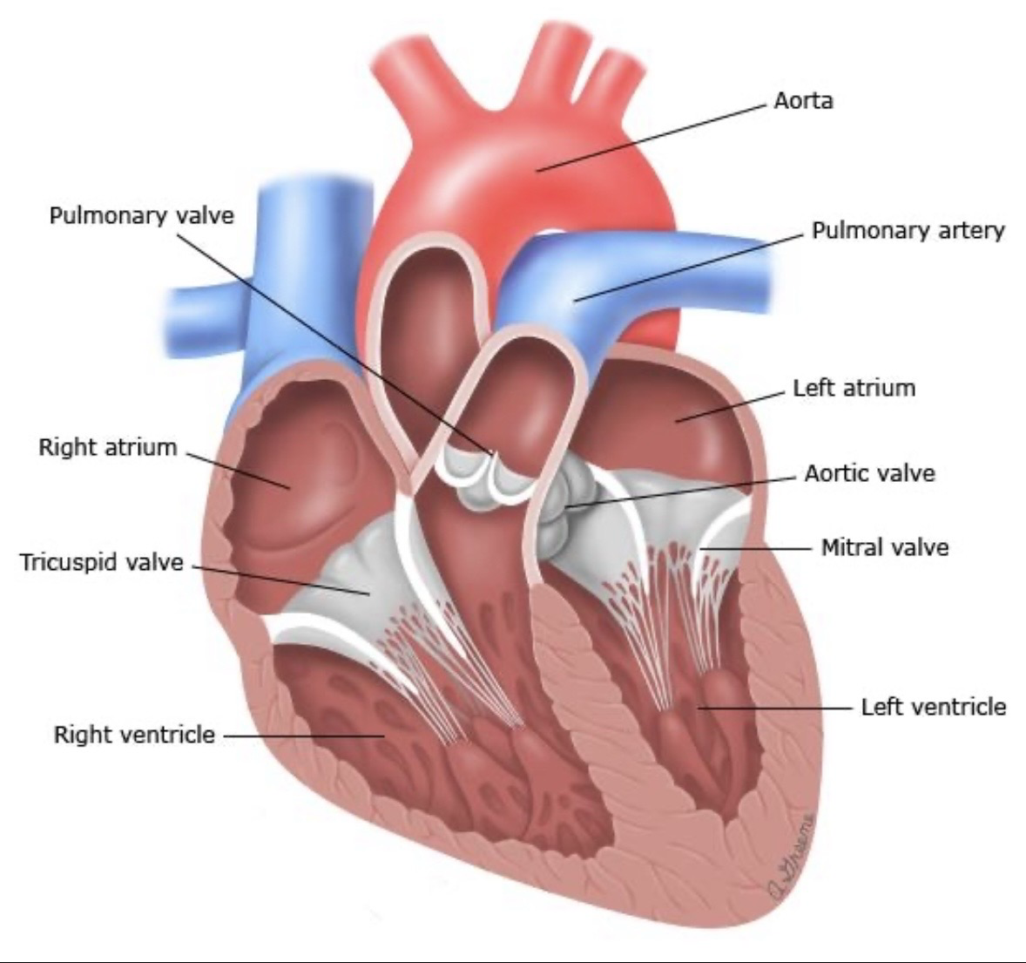
Chambers and Valves of the Heart

Slide 8
The heart contains four chambers:
Right atrium: receives deoxygenated blood from the body.
Right ventricle: pumps blood to the lungs.
Left atrium: receives oxygenated blood from the lungs.
Left ventricle: pumps blood into systemic circulation.

Slide 9
Four major valves:
Tricuspid valve: between right atrium and right ventricle.
Pulmonary valve: between right ventricle and pulmonary trunk.
Mitral valve: between left atrium and left ventricle.
Aortic valve: between left ventricle and aorta.
Valves maintain one-way blood flow by responding to pressure differences.

Slide 10
Systole: Contraction and ejection phase of a cardiac chamber.
Diastole: Relaxation and filling phase of a cardiac chamber.
Atrial systole: Atrial contraction that completes ventricular filling.
Ventricular systole: Ventricular contraction that ejects blood into the pulmonary trunk and aorta.

Slide 11
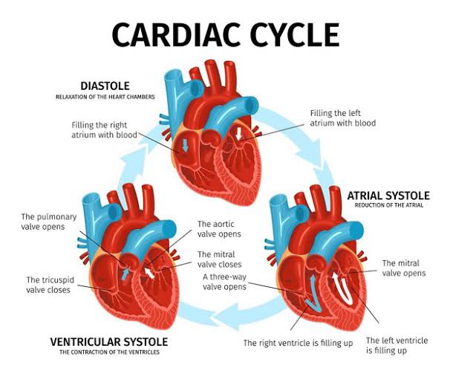

Slide 12
End-diastolic volume (EDV): Blood volume in a ventricle at the end of diastole.
End-systolic volume (ESV): Blood volume remaining in a ventricle after systolic ejection.
Stroke volume (SV): Blood volume ejected by one ventricle per beat.

Slide 13
Overview of the Phases
The cardiac cycle can be divided into the following major phases:
Atrial systole.
Isovolumetric ventricular contraction.
Rapid ventricular ejection.

Slide 14
Reduced ventricular ejection.
Isovolumetric ventricular relaxation.
Rapid ventricular filling.
Reduced ventricular filling (diastasis).
These phases occur continuously and repeat with every heartbeat.

Slide 15
Phase 1 — Atrial Systole
Both atria contract.
Blood moves from the atria into the ventricles.
Mitral and tricuspid valves are open.
Aortic and pulmonary valves are closed.
The ventricles complete their filling.
Duration: Approximately 0.1 seconds.

Slide 16
Phase 2 — Isovolumetric Contraction
The ventricles begin to contract.
The mitral and tricuspid valves close.
All four valves are temporarily closed.
Ventricular pressure increases.
Blood volume inside the ventricles remains unchanged.
Important: The first heart sound (S1) occurs due to closure of the AV valves and associated vibrations.

Slide 17
Phase 3 — Rapid Ventricular Ejection
Ventricular pressure becomes greater than the pressure in the aorta and pulmonary artery.
Aortic and pulmonary valves open.
Blood is pumped rapidly out of the ventricles.
Ventricular volume decreases.

Slide 18
Phase 4 — Reduced Ventricular Ejection
Ventricular contraction begins to decrease.
Blood continues to leave the ventricles, but more slowly.
Ventricular pressure starts falling.
The ventricles begin preparing for relaxation.
The aortic and pulmonary valves close at the end of ejection.
Closure of the semilunar valves produces the second heart sound (S2).

Slide 19
Phase 5 — Isovolumetric Relaxation
The ventricles relax.
All four valves are temporarily closed.
Ventricular pressure decreases.
Ventricular blood volume remains unchanged.
When ventricular pressure falls below atrial pressure, the AV valves open.

Slide 20
Phase 6 — Rapid Ventricular Filling
Mitral and tricuspid valves open.
Blood flows rapidly from the atria into the ventricles.
The ventricles fill with blood.
Aortic and pulmonary valves remain closed.

Slide 21
Phase 7 — Reduced Ventricular Filling
Blood continues to flow passively into the ventricles.
The rate of filling becomes slower.
The heart remains relaxed.
The next atrial contraction starts the cycle again.

Slide 22


