Slide 1

Class : BS Psychology 1st
Lecturer : Mahnoor syed
Topic: Sensation, Perception
and Attention
Subject: PSY-301 | Introduction to Psychology – I
1

Slide 2
Learning objectives
Define sensation, perception, and attention and explain how they differ.
Describe major sensory processes and the basic functions of vision and audition.
Explain perceptual factors, kinds of perception, depth and distance, temporal perception, and auditory perception.
Distinguish subjective and objective factors in attention and explain span of attention.
2

Slide 3
Sensation, perception, and attention
Sensation: detecting physical energy through sensory receptors and sending neural signals to the brain.
Perception: organizing and interpreting sensory information to give it meaning.
Attention: selectively focusing limited mental resources on some information while filtering other input.
Example: you hear a bell (sensation), recognize it as the class bell (perception), and turn toward it (attention).
4

Slide 4
Characteristics of sensation
Receptors: specialized cells respond to particular forms of stimulation, such as light, pressure, or chemicals.
Thresholds: the absolute threshold is the weakest stimulus detected about half the time; the difference threshold is the smallest noticeable change.
Adaptation: sensitivity may decrease during constant stimulation—for example, you stop noticing a watch on your wrist.
Coding: the nervous system represents stimulus type, intensity, location, and timing through patterns of neural activity.
5

Slide 5
Major functions and types of sensation
Vision: detects light and supports colour, form, movement, and spatial orientation.
Audition: detects sound waves and supports speech, music, and locating sound sources.
Somatic senses: touch, pressure, temperature, pain, and body position help us interact safely with the environment.
Chemical senses: smell and taste detect airborne and dissolved chemicals, supporting food selection and hazard detection.
Vestibular sense: inner-ear structures help maintain balance and detect head movement.
6

Slide 6
Vision: how light becomes a visual experience
Light enters through the cornea and pupil; the iris adjusts pupil size to regulate incoming light.
The lens changes shape to focus light on the retina (accommodation).
Rods are especially useful in dim light; cones support colour vision and fine detail, especially in bright light.
Photoreceptors convert light into neural signals, which travel through the optic nerve to visual areas of the brain.
Example: moving from bright sunlight into a dark room feels difficult at first because the visual system needs time to adapt.
7

Slide 7
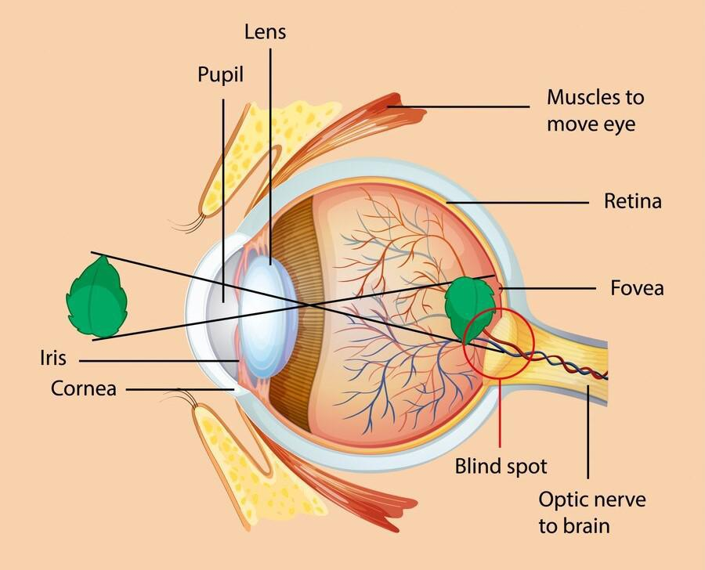
The eye: key structures and functions
Cornea: transparent front surface; begins bending light.
Iris and pupil: control how much light enters the eye.
Lens: focuses light on the retina; changes shape for near and far objects.
Retina: light-sensitive layer containing rods and cones.
Optic nerve: carries visual information from the retina toward the brain.
Fovea: area of highest visual acuity, with a high concentration of cones.
8

Slide 8
Vision: common terms and examples
Accommodation: the lens adjusts focus; reading a nearby page requires a different focus than looking across the room.
Dark adaptation: sensitivity increases after entering a dark space.
Colour vision: cones respond to different wavelength ranges; colour experience also depends on neural processing.
Visual acuity: clarity of fine detail; it is typically greatest when an image falls on the fovea.
Optical illusion: visual perception can be influenced by context, showing that perception is an interpretation—not a simple camera-like copy.
9

Slide 9
Audition: how sound becomes hearing
Sound waves enter the outer ear and travel through the auditory canal to vibrate the eardrum.
The middle-ear ossicles (malleus, incus, stapes) transmit and amplify vibration.
In the inner ear, movement in the cochlea stimulates hair cells that convert vibration into neural signals.
Signals travel through the auditory nerve to brain regions that process pitch, loudness, and sound patterns.
Example: the ear converts a teacher’s spoken words into neural signals; the brain interprets them as meaningful speech.
10

Slide 10
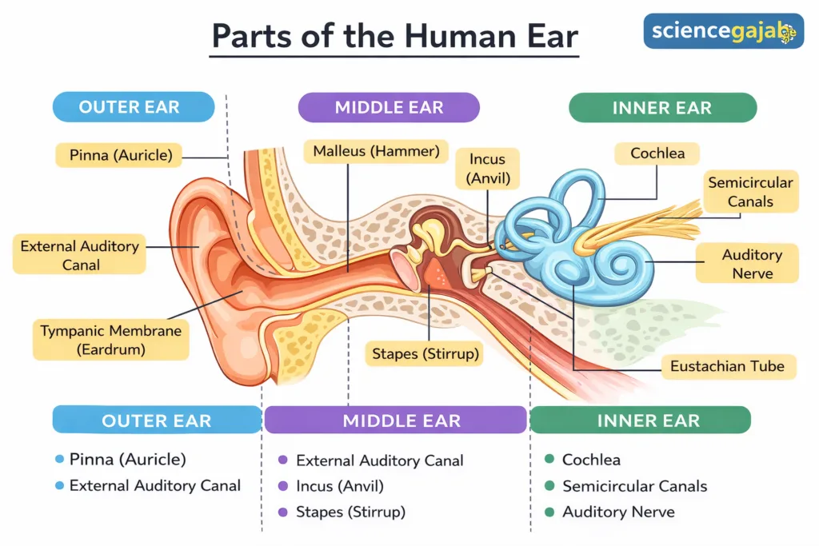
The ear: structure and function
Outer ear: pinna and auditory canal collect and guide sound.
Middle ear: eardrum and three ossicles transfer vibrations.
Inner ear: cochlea supports hearing; vestibular organs contribute to balance.
Hair cells: sensory receptors in the cochlea translate mechanical movement into neural activity.
Auditory nerve: carries information toward the brain for interpretation.
11

Slide 11
Auditory sensation: pitch, loudness, and location
Pitch: perception of how high or low a sound is; related to sound frequency.
Loudness: perceived intensity; related to sound amplitude, but also affected by context and hearing sensitivity.
Timbre: sound quality that helps distinguish instruments or voices even when pitch and loudness are similar.
Sound localization: the brain compares timing and intensity differences at the two ears to estimate where a sound comes from.
Example: you can often tell whether a phone rings to your left or right without seeing it.
12

Slide 12
Perception: nature and process
Perception organizes sensory input into meaningful objects, events, and relationships.
Bottom-up processing starts with incoming sensory details; top-down processing uses expectations, knowledge, and context.
Perception is usually fast and useful, but it can be influenced by ambiguity, prior experience, and assumptions.
Example: you can read a familiar word despite a missing letter because context helps the brain interpret the visual pattern.
13

Slide 13
Factors in perception: objective
Stimulus features: intensity, size, contrast, movement, novelty, and clarity can influence what is noticed and perceived.
Proximity and arrangement: the spatial relationship among parts affects whether they are seen as one group or separate objects.
Environmental conditions: lighting, noise, distance, and viewing angle can change the sensory information available.
Example: a bright red sign against a pale wall is easier to notice than a small grey sign against a similar background.
14

Slide 14
Factors in perception: subjective
Experience and learning: familiarity helps people recognize patterns and objects.
Needs, motives, and emotions: what matters to us can influence interpretation and attention.
Expectations and set: a person may interpret an unclear sound as their name if they are waiting for someone to call them.
Culture and individual differences: learned meanings and personal histories can influence how situations are interpreted.
Important: subjective influence does not mean perception is arbitrary; the stimulus still constrains what is perceived.
15

Slide 15
Social factors in perception
Social perception involves forming impressions and interpreting other people’s behaviour, emotions, and intentions.
Roles, social norms, stereotypes, and cultural expectations may influence judgments.
Context matters: the same behaviour can be interpreted differently depending on the situation and relationship.
Example: a quiet classmate may be perceived as shy in one setting and as attentive in another.
Good practice: check evidence and consider alternative explanations before judging another person.
16

Slide 16
Kinds of perception
Form perception: recognizing shapes, patterns, and objects.
Colour perception: experiencing colour based on light wavelengths and visual processing.
Movement perception: detecting change in an object’s position over time.
Depth and distance perception: judging three-dimensional space and how far away objects are.
Temporal perception: experiencing duration, order, and timing.
Auditory perception: organizing sounds into speech, music, and environmental events.
17

Slide 17
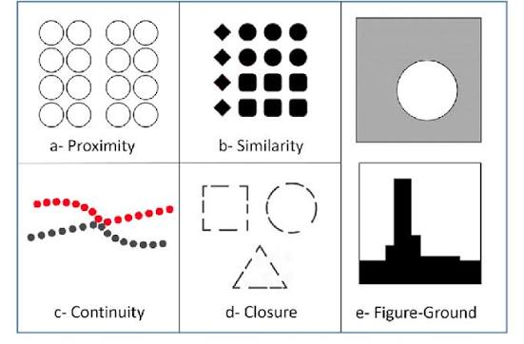
Gestalt principles: how we organize visual input
Figure–ground: we distinguish a focal object from its background.
Proximity: items close together tend to be perceived as a group.
Similarity: similar items tend to be grouped together.
Continuity and closure: we prefer smooth patterns and may mentally complete incomplete figures.
Example: students sitting in closely spaced rows may be perceived as groups even before anyone speaks.
18

Slide 18
Spatial perception: depth and distance
Depth perception allows us to experience the world in three dimensions and estimate how far objects are from us.
Binocular cue—retinal disparity: the two eyes receive slightly different images; the brain uses the difference to judge depth.
Binocular cue—convergence: the eyes turn inward more for nearby objects; muscle feedback provides a distance cue.
Monocular cues: relative size, interposition, linear perspective, texture gradient, height in the visual field, light/shadow, and motion parallax.
Example: railway tracks appear to converge in the distance, even though we know they remain parallel.
19

Slide 19
Monocular depth cues: everyday examples
Relative size: if two similar objects form different retinal images, the smaller-looking one is often judged farther away.
Interposition: an object that blocks another is usually perceived as closer.
Linear perspective: parallel lines appear to converge with distance.
Texture gradient: surface details appear denser and less distinct farther away.
Motion parallax: as you move, nearby objects seem to shift faster across your view than distant objects.
20

Slide 20
Perceptual constancies
Size constancy: we perceive an object as roughly the same size despite changes in retinal image size.
Shape constancy: a door is perceived as rectangular even when viewed at an angle.
Brightness/colour constancy: objects tend to appear relatively stable under different illumination.
Example: a friend walking away produces a smaller retinal image, but you do not normally perceive the friend as physically shrinking.
21

Slide 21
Temporal perception
Temporal perception is the experience and judgment of duration, sequence, and timing.
Attention, emotion, activity, expectation, and memory can alter subjective estimates of time.
Time may seem to pass quickly during absorbing activities and slowly during boredom or discomfort.
People often estimate duration retrospectively using how much information or change they remember.
Example: a 10-minute wait may feel long when you are anxious, but short when you are engaged in conversation.
22

Slide 22
Auditory perception
The auditory system organizes sound by pitch, loudness, timbre, timing, and location.
Speech perception uses acoustic cues together with language knowledge and context.
Auditory grouping helps us follow one voice among several sounds (the cocktail-party effect).
Auditory illusions show that the brain actively interprets sound rather than simply recording it.
Example: in a crowded room, you may focus on one friend’s voice while other conversations continue in the background.
23

Slide 23
Attention: meaning and importance
Attention is the selection and concentration of mental activity on a limited part of available information.
Selective attention helps prioritize relevant input; sustained attention supports focus over time.
Divided attention means attempting to handle more than one task; performance often declines when tasks compete for the same resources.
Example: listening carefully to a lecture while replying to messages can reduce understanding of both.
24

Slide 24
Factors affecting attention: objective
Intensity and size: bright lights, loud sounds, or large objects can attract attention.
Contrast and change: a sudden movement or a contrasting colour stands out from its surroundings.
Novelty and repetition: new or unexpected stimuli often capture attention; repetition can also make a signal noticeable.
Movement and clarity: moving or clearly presented information may be easier to notice.
Example: a fire alarm attracts attention because it is loud, sudden, and meaningful.
25

Slide 25
Factors affecting attention: subjective
Interest: people focus more readily on topics they find engaging.
Needs and motives: hunger can make food-related cues more noticeable.
Emotions and mood: anxiety may make threat-related information more salient.
Habits, goals, and expectations: a student looking for a specific term in a text notices it more quickly.
Example: a person expecting an important call may notice their phone vibration immediately.
26

Slide 26
Span of attention
Span of attention is the amount of information that can be apprehended in a brief glance or attended to at one time.
The span is limited and varies with familiarity, grouping, practice, stimulus complexity, and individual circumstances.
Chunking combines separate items into meaningful units, increasing the amount of information handled as a group.
Example: a phone number is easier to remember when grouped into smaller chunks rather than treated as one long string.
Note: span of attention is not identical to attention span, which commonly refers to how long someone can maintain focus.
27

Slide 27
Attention span and maintaining focus
Sustained attention is the ability to keep attention on a task over time.
Fatigue, distractions, stress, task difficulty, and low interest can reduce sustained focus.
Clear goals, short breaks, active note-taking, and reducing notifications can support concentration.
Example: dividing a long reading into focused sections with brief breaks may help a student remain engaged.
Do not confuse span of attention (amount at one time) with attention span (how long focus is maintained).
28

Slide 28
Examples
A student hears a notification but keeps listening to the lecturer: sensation occurs, while attention is directed elsewhere.
A road looks narrower in the distance: linear perspective supports depth perception.
A familiar face is recognized in a dim corridor: prior experience and top-down processing assist perception.
A loud, sudden crash interrupts a conversation: intensity and novelty capture attention.
A lecture seems shorter when interesting: engagement can influence subjective time perception.
29

Slide 29
Summary
Sensation detects stimulation; perception organizes and interprets it; attention selects what receives mental focus.
The eye transforms light into neural signals; the ear transforms sound vibration into neural signals.
Perception is influenced by stimulus properties, experience, expectations, social context, and organizing principles.
Depth uses binocular and monocular cues; temporal perception concerns duration and sequence.
Attention is affected by objective and subjective factors; its span is limited but can be supported by grouping and good study habits.
30

Slide 30
References
Myers, D. G. (2013). Introduction to psychology. Open University Press. (Recommended text listed in the course outline.)
32

