Slide 1
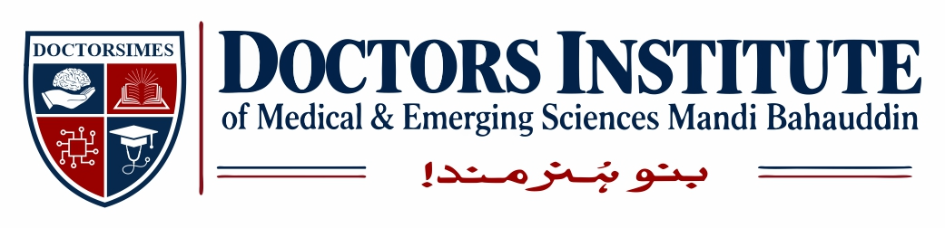
Topic : Control of microorganisms by physical and chemical method
For BS MLT/OTT/RIT (3rd semester)
AHP-403
Doctors Institute Of Medical and Emerging Sciences
Lecturer : Zia Fatima

Slide 2
Learning Objectives
Define microbial control and its importance.
Differentiate sterilization, disinfection and antisepsis.
Explain the major physical methods of microbial control.
Describe the major chemical agents used to control microorganisms.
Explain the mechanisms, uses and limitations of these methods.
Differentiate between sterilization and disinfection.

Slide 3
Introduction to Microbial Control
Microbial control refers to the destruction, removal or inhibition of microorganisms using physical or chemical methods.
Microbial control is important in:
Medical and clinical laboratories.
Hospitals and operation theatres.
Microbiology laboratories.
Pharmaceutical industries.
Food preparation and preservation.
Prevention and control of infectious diseases.

Slide 4
Continued---
Main purpose:
To reduce the risk of infection, prevent contamination and maintain safe laboratory conditions.
Microorganisms are not equally resistant to control methods.
The effectiveness of a method depends on the organism, its resistance, the material being treated and the conditions of treatment.

Slide 5
Important Terms Used in Microbial Control
1. Sterilization :
The process that destroys or removes all forms of microbial life, including bacterial endospores, when a validated sterilization process is properly applied.
2. Disinfection :
The process of eliminating many or all pathogenic microorganisms on inanimate objects, but it does not necessarily destroy bacterial endospores.

Slide 6
Continued---
3. Antisepsis :
The use of antimicrobial chemicals on living tissues, such as skin, to reduce or inhibit microorganisms.
4. Decontamination :
Treatment that makes an item or surface safe to handle by removing or reducing microbial contamination and associated hazards.
5. Sanitization :
A process that reduces microbial contamination to a level considered acceptable under applicable public-health standards.
Important distinction: Cleaning physically removes dirt and organic material. It is an essential preliminary step because remaining soil can interfere with disinfection and sterilization.

Slide 7
Cidal and Static Actions
Microbial control agents may kill microorganisms or inhibit their growth.
Term Meaning
Bactericidal Kills bacteria
Bacteriostatic Inhibits bacterial growth
Fungicidal Kills fungi
Fungistatic Inhibits fungal growth
Virucidal Inactivates viruses
Spor icidal (sporicidal) Destroys bacterial spores
Remember: An agent described as bactericidal is not automatically sporicidal. Its activity depends on the particular agent, concentration and treatment conditions.

Slide 8
Classification of Methods of Microbial Control
A. Physical methods
Sunlight
Drying
Dry heat
Moist heat
Filtration
Radiation
Ultrasonic and sonic vibration
B. Chemical methods
Alcohols
Aldehydes
Dyes
Halogens
Phenols
Gases

Slide 9
1- Sunlight
Sunlight is a natural physical method of microbial control.
Mechanism of action
Sunlight contains ultraviolet (UV), visible and infrared radiation.
UV radiation can damage microbial DNA.
Sunlight exposure may reduce the number of microorganisms on exposed surfaces.
Infrared radiation contributes to heating.
Uses and importance
Natural reduction of microorganisms on exposed surfaces.
Contribution to microbial reduction in exposed water and the environment.
UV radiation is used in controlled systems for specific disinfection applications.

Slide 10
Continued---
Limitations :
Its effect depends on exposure time, intensity, weather and the type of microorganism.
Shadows, dust and organic matter can protect microorganisms.
Natural sunlight is not a reliable method for sterilizing medical instruments or laboratory materials.

Slide 11
2- Drying (Desiccation)
Definition:
Desiccation is the removal of water from a material or environment.
Mechanism of action
Microorganisms require available water for growth and metabolic activities. Drying reduces available water and inhibits the growth of many microorganisms.
Examples
Drying food to improve preservation.
Drying certain laboratory materials before storage.
Preservation of selected microbial cultures by controlled drying or freeze-drying.

Slide 12
Continued---
Advantages :
Simple and economical in suitable applications.
Reduces the growth of many microorganisms.
Can help preserve selected materials.
Limitations :
Drying does not kill all microorganisms.
Some bacteria, bacterial endospores and fungi can survive for long periods under dry conditions.
Dried microorganisms may become active again when suitable moisture and nutrients return.
Key point: Desiccation usually inhibits growth; it must not be considered equivalent to sterilization.

Slide 13
3- Dry Heat
Dry heat destroys microorganisms mainly through oxidation, dehydration and damage to cellular components, including proteins.
Common methods
1. Flaming
Direct exposure to a flame.
Used for suitable laboratory instruments, such as metal inoculating loops, according to laboratory procedures.
2. Incineration
Destruction by burning at high temperature.
Used for appropriate contaminated waste in authorised incineration systems.

Slide 14
Continued---
3-Hot-air oven :
Uses heated air to sterilize suitable heat-resistant materials.
Commonly used for glassware and certain metal instruments.
A commonly cited hot-air oven cycle is 170°C for 2 hours, but the correct validated cycle depends on the equipment, load and applicable protocol.
Advantages :
Suitable for materials that may be damaged by moisture.
Useful for appropriate glassware and heat-stable items.

Slide 15
Continued---
Limitations :
Heat penetration is slower than with moist heat.
Requires suitable exposure time and temperature.
Not suitable for many plastics, rubber materials or heat-sensitive substances.

Slide 16
4- Moist Heat
Moist heat uses hot water or steam to control microorganisms.
Mechanism of action :
Moist heat denatures proteins and damages essential cellular structures. It generally transfers heat more effectively than dry heat.
Important methods
1. Boiling :
Water is heated to its boiling point.
Kills many vegetative bacteria and other susceptible microorganisms.
Does not reliably destroy all bacterial endospores.
Therefore, boiling is not considered a dependable sterilization method.

Slide 17
Continued---
2. Pasteurization :
A controlled heat treatment used mainly for liquids such as milk.
Reduces pathogenic microorganisms and spoilage organisms.
It is not equivalent to sterilization.
3.Steam under pressure (autoclaving) :
Steam is used under pressure to achieve temperatures above the normal boiling point of water.
Commonly used to sterilize suitable culture media, laboratory equipment and heat-resistant materials.
4. Other moist-heat treatments :
Heating below boiling may be used for specific purposes.
The exact process depends on the material and the required degree of microbial control.

Slide 18
Autoclaving
An autoclave is a device that uses saturated steam under pressure to sterilize suitable materials.
Principle :
Pressure allows steam to reach a temperature above 100°C. When saturated steam contacts a cooler load, it condenses and transfers heat, helping destroy microorganisms and bacterial endospores.
Commonly cited cycle
Temperature: 121°C
Pressure: approximately 15 psi gauge pressure above atmospheric pressure
Exposure time: often 15–20 minutes for suitable loads, but longer cycles may be required.

Slide 19
Continued---
Important:
The exposure time is not universal. It depends on the load, container size, volume, packing and validated cycle. The holding time begins only when the required conditions are achieved throughout the load.
Uses :
Suitable culture media.
Appropriate reusable laboratory instruments.
Suitable laboratory waste before disposal.
Other heat- and moisture-resistant materials.

Slide 20
Continued---
Limitations and precautions :
Unsuitable for many heat-sensitive materials and oils.
Air must be adequately removed for effective steam penetration.
Loads must be arranged correctly.
Sterilization must be monitored using appropriate physical, chemical and biological indicators.

Slide 21
Dry heat vs Moist heat
Feature Dry heat Moist heat
Main agent Hot air or direct flame Hot water or steam
Main mechanism Oxidation, dehydration and Mainly protein denaturation
protein dmage and damage
Heat transfer Generally slower Generally more efficient
Common equipment Hot-air oven Autoclave
Suitable material Appropriate glassware and Suitable media, instruments ,
heat stable items heat resistant maerial

Slide 22
Continued---
Effect on endospores Effective with a validated cycle Effective with a validated steam-
major sterilization cycle
limitation Longer exposure often needed Heat and moisture may damage
some materials
Exam point: Both dry heat and moist heat can sterilize suitable materials when the correct validated conditions are used

Slide 23
5- Filtration
Definition:
Filtration is a physical method that removes microorganisms by passing a liquid or gas through a filter.
Unlike heat, filtration usually removes microorganisms rather than killing them.
Types of filtration
1. Membrane filtration :
Used for suitable heat-sensitive liquids.
Can remove bacteria from solutions such as certain antibiotic or vitamin preparations.
A membrane with a nominal pore size around 0.22 µm is commonly used for bacterial removal from compatible solutions.

Slide 24
Continued---
HEPA filtration :
Used to remove airborne particles, including many microorganisms carried on particles.
Important in biological safety cabinets and certain controlled air systems.
Uses :
Processing suitable heat-sensitive solutions.
Reducing airborne particulate contamination.
Supporting contamination control in laboratories.
Limitations :
Ordinary bacterial-retention filters may not reliably remove all viruses or very small organisms.
Filter selection depends on the target organism and the liquid or gas.
Filters can become blocked or damaged; correct handling and integrity are important.

Slide 25
6- Radiation
Radiation controls microorganisms by damaging essential cellular components, especially nucleic acids.
There are two main types.
A. Non-ionizing radiation :
Example: Ultraviolet (UV) radiation
Damages DNA, including by producing pyrimidine dimers.
Used for specific air, water and exposed-surface disinfection applications.
Has limited penetration, so microorganisms shielded by dust, organic material or shadows may survive.

Slide 26
Continued---
2-Ionizing radiation :
Examples: Gamma rays, X-rays and high-energy electron beams.
Can penetrate suitable materials more deeply than UV radiation.
Produces damage to DNA and other cellular components.
Used industrially to sterilize selected disposable medical supplies and other compatible products.
Limitations :
Radiation methods require suitable equipment and controlled conditions.
UV is not a substitute for sterilizing instruments throughout their full surfaces and internal spaces.
Ionizing radiation requires specialised facilities and radiation-safety controls.

Slide 27
Ultrasonic and Sonic Vibration
Definition:
Sonication uses high-frequency sound waves to produce physical effects in a liquid.
Mechanism
Sound waves produce pressure changes in the liquid.
These changes may cause cavitation, which is the formation and collapse of tiny bubbles.
Cavitation can disrupt cells and help detach contaminants from surfaces.
Uses
Breaking open cells to release intracellular material in research laboratories.
Cleaning suitable instruments and laboratory objects in ultrasonic cleaners.

Slide 28
Continued---
Limitations :
Sonication alone is not a dependable method for sterilizing instruments or solutions.
Cleaning an instrument is different from sterilizing it.
The effectiveness depends on the equipment, conditions and purpose of use .

Slide 29
Part II — Chemical Methods of Microbial Control
Introduction to Chemical Agents
Chemical agents are substances used to kill microorganisms or inhibit their growth.
They are selected according to the intended use, the microorganism involved and the material being treated.
Classification according to use
Antiseptics: Used on living tissues, such as skin.
Disinfectants: Used on inanimate objects and surfaces.
Chemical sterilants: Used under specified conditions to destroy all forms of microbial life, including bacterial endospores

Slide 30
Continued---
Factors affecting the activity of chemical agents
Type of microorganism.
Concentration of the chemical.
Duration of contact.
Temperature and pH, where relevant.
Presence of blood, proteins or other organic material.
Nature of the surface or material.
Ability of the agent to reach the contaminated area.
Important: No single chemical agent is suitable for every microorganism, surface or medical instrument.

Slide 31
Alcohols
The two commonly used alcohols in microbial control are:
Ethyl alcohol (ethanol).
Isopropyl alcohol (isopropanol).
Mechanism of action
Alcohols act mainly by denaturing proteins and disrupting lipid-containing cell membranes.
Uses
Skin antisepsis in appropriate clinical applications.
Disinfection of suitable small surfaces and equipment.
Cleaning certain laboratory and healthcare items when compatible with the material.

Slide 32
Continued---
Advantages :
Act rapidly against many vegetative bacteria.
Effective against many fungi and enveloped viruses under appropriate conditions.
Evaporate quickly and generally leave little residue.
Limitations :
Do not destroy bacterial endospores.
Evaporate quickly, which may reduce the required contact time.
May damage some materials with repeated use.
Are flammable.
Important concentration point: Alcohol solutions in the range of approximately 60–90% are generally effective for many applications; 70% alcohol is a familiar example. The appropriate product and concentration depend on the intended use. Alcohol alone is not a sterilant.

Slide 33
Aldehydes
Aldehydes are chemical agents capable of reacting with proteins and nucleic acids.
Important examples
1. Glutaraldehyde :
Used for high-level disinfection of certain heat-sensitive medical devices.
Can act as a chemical sterilant under specified conditions and sufficiently long exposure.
Requires appropriate ventilation, personal protective equipment and strict adherence to product instructions.
2. Formaldehyde :
Has antimicrobial activity through chemical reactions with cellular components.
Has had uses in specialised disinfection and fumigation applications.
Its use is restricted by significant toxicity and occupational-health concerns.

Slide 34
Continued---
Mechanism of action :
Aldehydes react with proteins and nucleic acids, disrupting essential cellular functions.
Limitations and precautions :
Can irritate the eyes, skin and respiratory tract.
Require correct concentration and exposure time.
Some formulations present significant health risks.
Must only be used for approved applications under appropriate safety procedures.
Exam point: Glutaraldehyde is an important example of an aldehyde used for high-level disinfection of compatible heat-sensitive equipment

Slide 35
Dyes
Certain dyes have antimicrobial activity and have been used to inhibit the growth of selected microorganisms.
Examples
Crystal violet.
Acridine dyes, such as acriflavine.
Mechanism of action
Depending on the dye, antimicrobial activity may involve interaction with cellular components, interference with nucleic-acid functions or disruption of essential microbial processes.

Slide 36
Continued---
Uses and importance :
Some dyes have historical and specialised uses in microbial control.
Selected dyes have been used in culture media to inhibit certain microorganisms while allowing others to grow.
Crystal violet is used in microbiology as a component of Gram staining; this staining role should not be confused with a general-purpose disinfectant application.
Limitations :
Their activity varies between dyes and microorganisms.
They are not universal disinfectants or sterilants.
Many have limited applications compared with modern chemical disinfectants.

Slide 37
Halogens
Halogens are chemical elements whose compounds are widely used for microbial control. The most important examples in routine disinfection are chlorine and iodine.
A. Chlorine
Examples: Sodium hypochlorite solutions and other chlorine-releasing products.
Mechanism of action
Chlorine produces reactive chemical species that oxidise or damage essential microbial components.

Slide 38
Continued---
Uses :
Disinfection of appropriate environmental surfaces.
Water disinfection.
Decontamination of selected laboratory spills under an approved procedure.
Limitations :
Organic material can reduce effectiveness.
Some formulations are corrosive.
Incorrect mixing with other chemicals can release dangerous gases.

Slide 39
Iodine
Examples: Iodine preparations and iodophors.
Mechanism of action :
Iodine reacts with and damages essential cellular components, including proteins.
Uses :
Skin an tisepsis in suitable formulations.
Certain clinical antiseptic applications.
Limitations :
May cause irritation or staining.
Suitability depends on the formulation and intended use.
Safety point: Never mix chlorine-containing products with acids or ammonia-containing cleaners.

Slide 40
Phenols and Phenolic Compounds
Phenol, also known as carbolic acid, is historically important in the development of antiseptic practices.
Modern phenolic compounds are used in certain disinfectant formulations.
Mechanism of action :
Phenolic compounds may:
Disrupt cell membranes.
Damage membrane function.
Denature proteins.
Uses :
Disinfection of certain environmental surfaces.
Use in selected healthcare and institutional disinfectant formulations.

Slide 41
Continued---
Advantages :
Some formulations retain activity in the presence of limited organic material.
Certain phenolic products are effective against a range of vegetative bacteria and enveloped viruses.
Limitations :
Activity varies between compounds and microorganisms.
They are not reliable sterilants against bacterial endospores.
Some formulations may irritate skin and have toxic effects.
Their use must follow the product label and institutional infection-control policy.

Slide 42
Gaseous Chemical Agents
Some gases and vapours can control microorganisms in specialised sterilization systems.
1. Ethylene oxide (EtO) :
Mechanism: Alkylates proteins and nucleic acids, interfering with essential cellular functions.
Uses:
Sterilization of selected heat-sensitive medical devices.
Processing of compatible materials that cannot tolerate conventional steam sterilization.

Slide 43
Continued---
Advantages:
Can penetrate suitable packaging and complex device structures.
Useful for selected heat- and moisture-sensitive materials.
Limitations:
Toxic and flammable.
Requires specialised equipment and controlled aeration to remove residual gas.
Requires strict occupational and environmental safety measures.

Slide 44
Continued---
2. Formaldehyde gas or vapour :
Has antimicrobial activity through chemical reactions with cellular components.
Has been used in specialised applications.
Its use is limited by toxicity and occupational-health concerns.
Important distinction: Not every gas disinfects or sterilizes effectively. A gaseous method must be validated for the organism, material and intended application.

Slide 45
Factors to Consider When Selecting a Control Method
The selection of a microbial-control method depends on:
The type and number of microorganisms present.
The presence of resistant forms, particularly bacterial endospores.
Whether sterilization, high-level disinfection or routine disinfection is required.
Whether the material can tolerate heat, moisture or chemicals.
The presence of organic matter.

Slide 46
Continued---
The required exposure time and concentration.
Safety for laboratory workers, patients and the environment.
The availability of suitable equipment and a validated procedure.
Clinical relevance: A method suitable for a laboratory bench may not be suitable for a surgical instrument entering sterile tissue. The required level of processing depends on the intended use of the item.

Slide 47
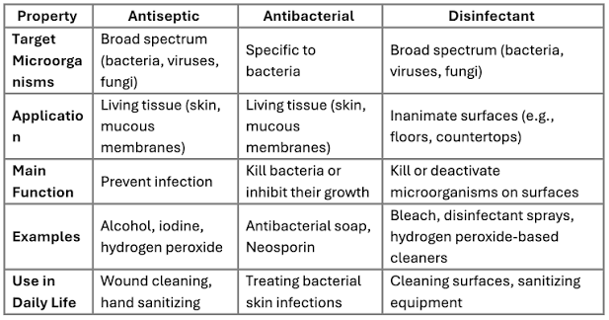

Slide 48
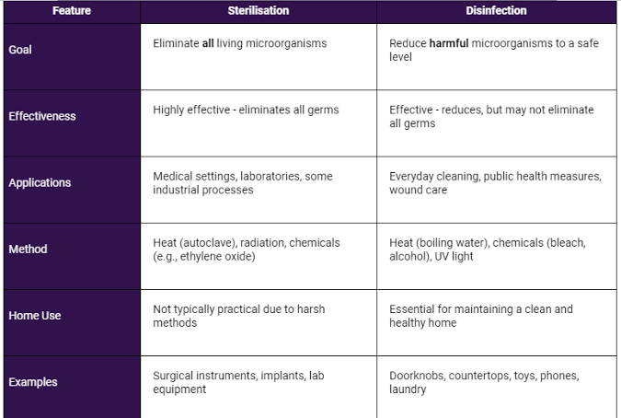

Slide 49
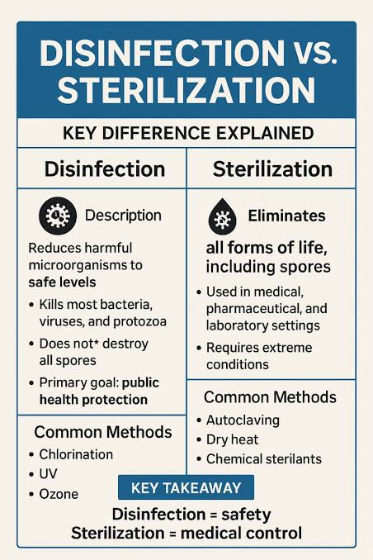

Slide 50
Thankyou

