Slide 1

Topic: Alternative Methods of Input
FSC-II (OTT/RIT/CT/PT/NUR)
(Doctors Institute of Medical & Emerging Sciences)
Lecturer: Aiza Munir

Slide 2

Learning Outcomes
Hand Devices
Optical Devices
Audio-Visual Devices
Summary

Slide 3
Alternative Methods of Input
Hand Devices, Optical Devices, and Audio-Visual Technologies

Slide 4

Introduction
Beyond Keyboards: Modern input devices that allow users to interact with computers faster and without standard typing.
Three Categories: Divided into Hand devices, Optical devices, and Audio-Visual devices.

Slide 5

Hand Devices
Definition: Input hardware operated directly using human hands or fingers.
Functionality: Provides control for tapping, dragging, zooming, and drawing directly on screens.

Slide 6
Hand Devices (Examples)
Touchscreens & Stylus: Direct screen contact on phones and ATMs; digital pens for precise drawing and digital signatures.
Gesture Recognition: Motion-tracking devices (like Microsoft Kinect and Leap Motion) that turn hand movements into computer commands.

Slide 7
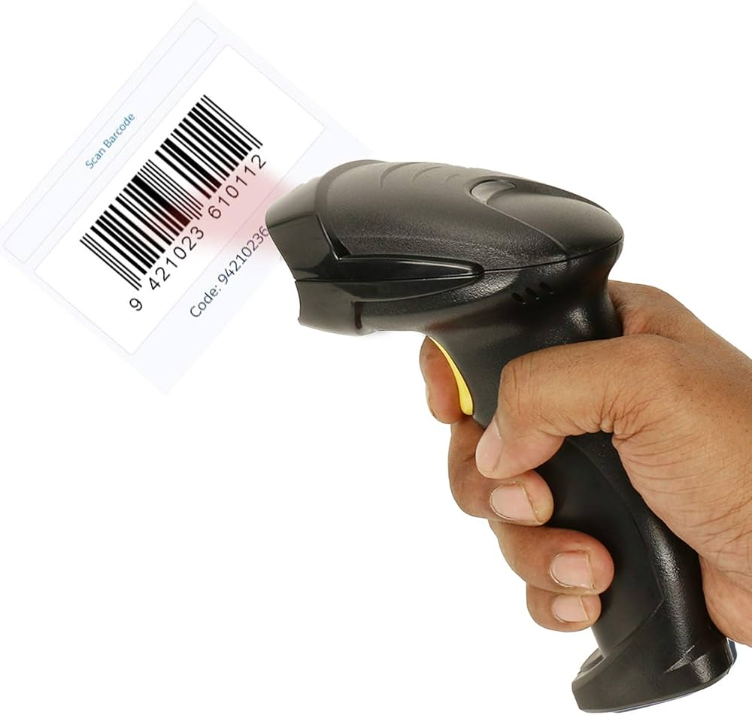
Optical Devices
Definition: Input devices that use light beams and optical sensors to detect physical movements and marks.
Functionality: Delivers high precision and instantly converts printed or handwritten data into digital form.

Slide 8
Optical Devices (Examples)
Optical Mouse & Barcode Readers: LEDs track surface movement for cursor control; scanners read retail barcodes instantly.
Optical Character Recognition (OCR): Scans printed or handwritten text from paper and converts it into editable digital files.

Slide 9
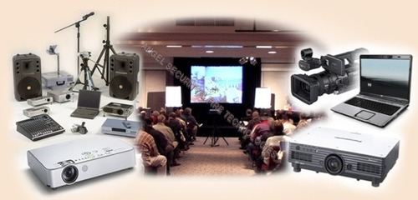
Audio-Visual Devices
Definition: Hardware that captures sound, human speech, video, and visual cues from the surroundings.
Functionality: Enables hands-free accessibility and immersive multimedia interaction without touching a keyboard.

Slide 10

Audio-Visual Devices (Examples)
Microphones & Webcams: Microphones convert speech to text for voice commands; webcams capture video for online meetings.
AR & VR Devices: Combine head tracking, 3D visual displays, and spatial audio to immerse users in virtual worlds.

Slide 11
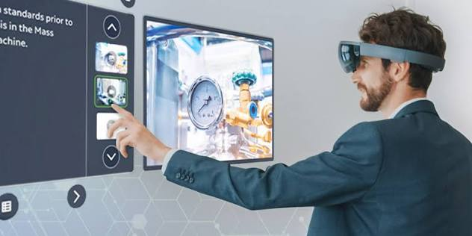

Slide 12
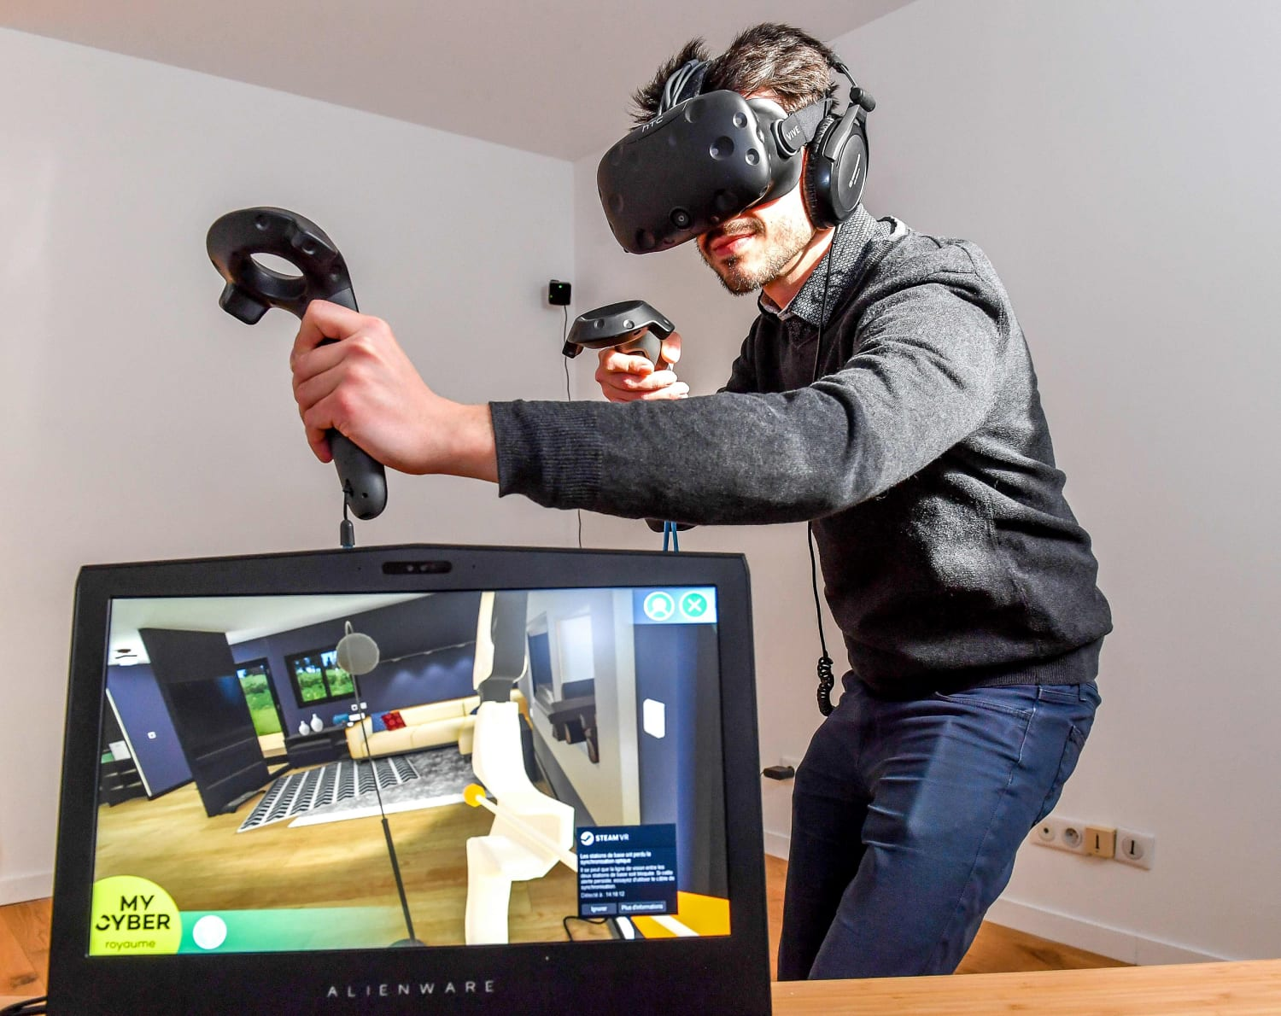

Slide 13
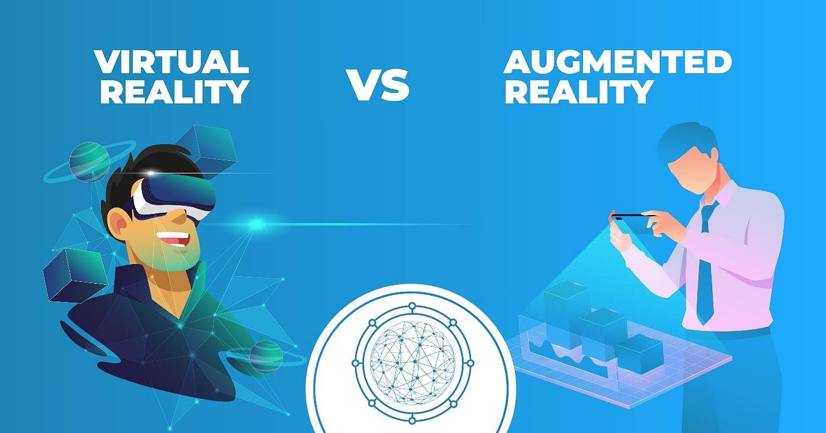

Slide 14
Summary & Key Benefits
Natural Interaction: Users can speak, wave, or touch naturally instead of relying only on keyboards.
Speed & Accuracy: Optical scanning and voice input eliminate human typing errors and save time.

Slide 15


