Slide 1

Topic: The Measurements
FSC-I (OTT/RIT/CT/PT/NUR)
(Doctors Institute of Medical & Emerging Sciences)
Lecturer: Aiza Munir

Slide 2

Learning Outcomes
Supplementary Units
Radian & Steradian
Scientific Notation

Slide 3

Supplementary Units (Introduction)
What are they?
The General Conference on Weights and Measures did not place certain SI units under base or derived units.
These units were categorized separately as supplementary units.

Slide 4
Nature:
  They represent purely geometrical quantities.
The Two Units:
  Plane angle
  Solid angle

Slide 5
Table of Supplementary Units
Physical Quantity | SI Unit | Symbol | Dimension
Plane angle | Radian | rad | Two-dimensional (2D)
Solid angle | Steradian | sr | Three-dimensional (3D)

Slide 6
Physical Quantities
Radian:
The radian is the plane angle between two radii of a circle which cut off on the circumference an arc equal in length to the radius.
Steradian:
The steradian is the solid angle (three-dimensional angle) subtended at the center of a sphere by an area of its surface equal to the square of the radius of the sphere.

Slide 7
Derived Units
SI units for measuring all other physical quantities are derived from the base and supplementary units. These units are called derived units.
For example: velocity, acceleration, and force are derived quantities and their units are obtained from the appropriate base units.

Slide 8
Scientific Notation
Definition:
Scientific notation, also called standard form, is a method of expressing very large or very small numbers conveniently by using powers of 10.
It is commonly used in physics and other sciences because physical quantities may have values that are extremely large or extremely small.

Slide 9
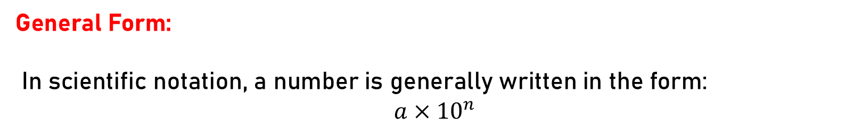
General Form:
In scientific notation, a number is generally written in the form:
$$a×{10}^{n}$$

Slide 10
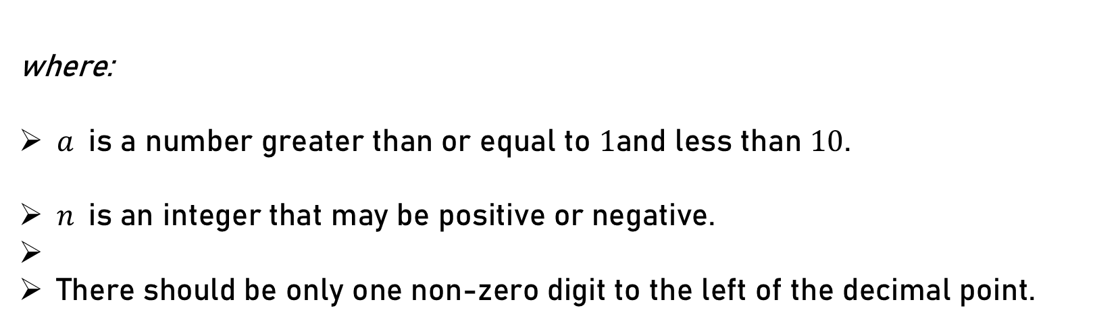
where:
$a$is a number greater than or equal to $1$and less than $10$.
$n$is an integer that may be positive or negative.
There should be only one non-zero digit to the left of the decimal point.

Slide 11

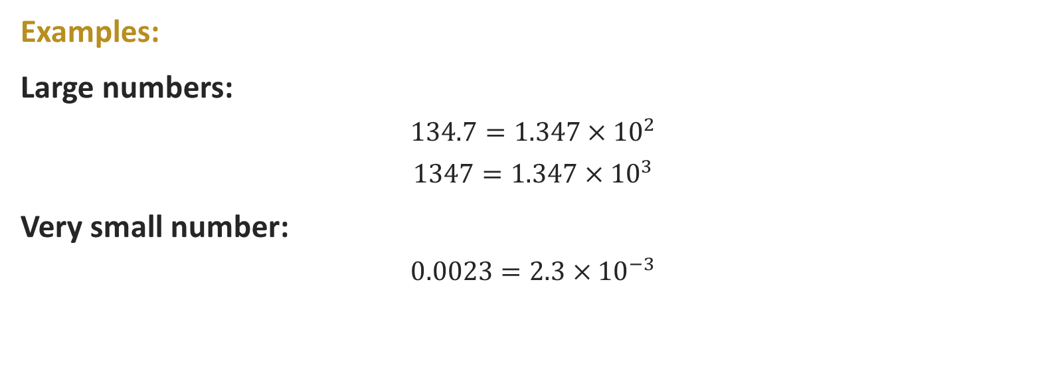
Examples:
Large numbers:
  $$134.7=1.347×{10}^{2}$$
  $$1347=1.347×{10}^{3}$$
Very small number:
  $$0.0023=2.3×{10}^{−3}$$

Slide 12
Key Points:
A positive power of 10 is generally used for large numbers, whereas a negative power of 10 is generally used for very small numbers.
Scientific notation makes calculations and the expression of physical quantities easier and more convenient.

Slide 13


