Slide 1

Patient Care
For BS OTT- 3rd Semester
ADNAN RAMZAN

Slide 2


Slide 3
Patient Care: Introduction
Patient care means providing support to improve the patient’s health.
It includes physical, emotional, social, and psychological care.
Patient care may be direct or indirect.
Direct care involves contact between healthcare staff and the patient.
Indirect care supports the patient without direct physical contact.
Good patient care improves comfort, safety, and recovery.
Surgical patients need special care before, during, and after surgery.
Maslow’s hierarchy helps healthcare workers identify patient needs.

Slide 4
Meaning of Patient Care
Patient care is the planned care provided to a sick or injured person.
The main aim is to maintain health and promote recovery.
Patient care includes assessment, treatment, monitoring, and support.
It should be safe, respectful, and patient-centered.
Healthcare workers should understand the patient’s individual needs.
Physical needs should be managed along with emotional needs.
Communication is an important part of effective patient care.
Proper patient care can reduce complications and improve outcomes.

Slide 5
Types of Patient Care
Patient care can generally be divided into direct and indirect care.
Direct care involves direct interaction with the patient.
Examples include checking vital signs and giving medications.
Indirect care is performed away from direct patient contact.
Examples include documentation and preparing equipment.
Both types of care are important for patient safety.
Direct and indirect care work together during treatment.
Surgical patients require both types of care throughout their journey.

Slide 6
Direct Patient Care
Direct patient care means providing care while interacting with the patient.
The healthcare worker observes and responds to patient needs.
Vital signs may be checked directly at the bedside.
Medication and prescribed treatments may be provided directly.
Wound care and dressing changes are examples of direct care.
Helping a patient with hygiene and mobility is also direct care.
Communication and emotional support are important parts of direct care.
Direct care helps build trust between the patient and healthcare team.

Slide 7
Examples of Direct Care
Assessing the patient’s level of consciousness is direct care.
Measuring temperature, pulse, respiration, and blood pressure is direct care.
Giving medication according to the prescribed order is direct care.
Changing a surgical dressing is direct patient care.
Helping the patient move safely after surgery is direct care.
Providing personal hygiene and comfort measures is direct care.
Monitoring pain and providing appropriate support is direct care.
Explaining procedures and answering patient questions is direct care.

Slide 8
Indirect Patient Care
Indirect care supports the patient without continuous direct contact.
It is usually performed away from the patient’s bedside.
Documentation of patient information is an example of indirect care.
Preparing instruments and equipment is indirect care.
Planning patient care is also an indirect activity.
Communicating patient information to the healthcare team is important.
Maintaining records helps ensure continuity of care.
Indirect care improves the quality, safety, and organization of treatment.

Slide 9
Examples of Indirect Care
Preparing the operating room before a surgical procedure is indirect care.
Checking surgical instruments and equipment is indirect care.
Maintaining sterilization records is an indirect activity.
Preparing the patient’s documentation supports safe care.
Recording medications and treatments is an indirect activity.
Communicating important patient information to other staff is indirect care.
Planning the surgical procedure and required supplies is indirect care.
Proper indirect care helps prevent errors and delays during treatment.

Slide 10
8. Direct vs Indirect Care
Direct care involves physical or verbal contact with the patient.
Indirect care usually occurs without direct patient contact.
Direct care focuses on immediate patient needs.
Indirect care supports the overall care process.
Giving medication is an example of direct care.
Preparing medication or checking records can be indirect care.
Both types of care are necessary for safe patient management.
Effective healthcare requires a balance between direct and indirect care.

Slide 11
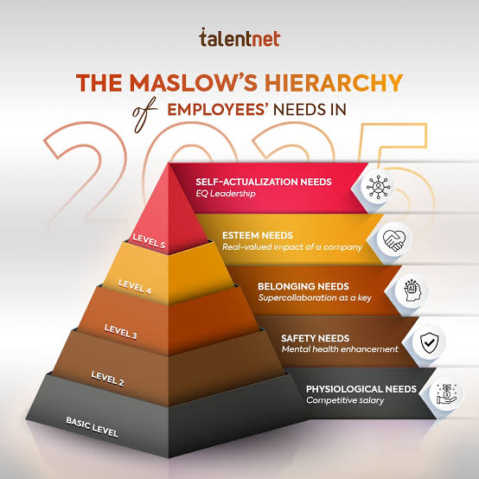

Slide 12
Maslow’s Hierarchy of Needs
Maslow’s hierarchy explains human needs in a specific order.
It was proposed by psychologist Abraham Maslow.
Human needs are commonly shown as a five-level pyramid.
The first level contains basic physiological needs.
The second level is safety and security.
The third level is love and belonging.
The fourth level is esteem and respect.
The fifth level is self-actualization and personal development.

Slide 13
Physiological Needs in Surgical Care
Physiological needs are the most basic needs of a patient.
They include oxygen, food, water and sleep.
Pain control is an important physiological need in surgical patients.
Breathing and oxygenation should be monitored carefully.
Fluid and electrolyte balance should be maintained.
Body temperature should be monitored and maintained.
Nutrition should be provided according to the patient’s condition.
Meeting basic needs is the first priority in surgical care.

Slide 14
Safety Needs in Surgical Care
Safety is the second major level of Maslow’s hierarchy.
Surgical patients must be protected from injury and infection.
Correct patient identification is essential before surgery.
The correct surgical site and procedure must be confirmed.
Aseptic technique helps prevent surgical site infections.
Safe positioning prevents pressure injuries and nerve damage.
Proper medication administration reduces treatment errors.
Continuous monitoring helps identify complications early.

Slide 15
Love, Belonging, and Emotional Needs
Patients need emotional support during illness and surgery.
Surgery can cause fear, anxiety, loneliness, and uncertainty.
Healthcare workers should communicate in a calm and respectful way.
Family support can help patients feel safe and comfortable.
Patients should be encouraged to express their concerns.
Active listening can reduce anxiety and improve cooperation.
Respectful communication builds trust between patient and staff.
Emotional support is especially important before and after surgery.

Slide 16
Esteem Needs in Surgical Care
Esteem needs involve respect, dignity, confidence, and self-worth.
Surgical patients should always be treated with dignity.
Privacy should be maintained during examination and procedures.
Patients should be involved in decisions about their care when possible.
Healthcare workers should avoid embarrassing or disrespectful behavior.
The patient’s questions and opinions should be taken seriously.
Encouraging independence can improve the patient’s confidence.
Respectful care helps patients maintain a positive self-image.

Slide 17
Self-Actualization and Surgical Recovery
Self-actualization means reaching one’s personal potential.
In healthcare, it can relate to returning to normal life and activities.
Patients should be encouraged to participate in their recovery.
Rehabilitation can help patients regain strength and independence.
Health education helps patients manage their condition after discharge.
Patients can learn about wound care, medication, diet, and exercise.
Setting realistic recovery goals can increase motivation.
Good surgical care supports the patient’s return to a meaningful life.

Slide 18
Application of Maslow in Surgical Care
Maslow’s hierarchy helps healthcare workers prioritize patient needs.
First, provide oxygen, fluids, nutrition, pain relief, and comfort.
Second, ensure safety through infection control and correct procedures.
Third, provide emotional support and maintain family connections.
Fourth, protect dignity, privacy, and patient confidence.
Finally, support rehabilitation, independence, and health education.
The patient’s needs should be reassessed throughout the surgical process.
Applying Maslow’s theory helps provide holistic and patient-centered care.

Slide 19


