Slide 1
cerebellum
ADNAN RAMZAN
BS(OTT)

Slide 2
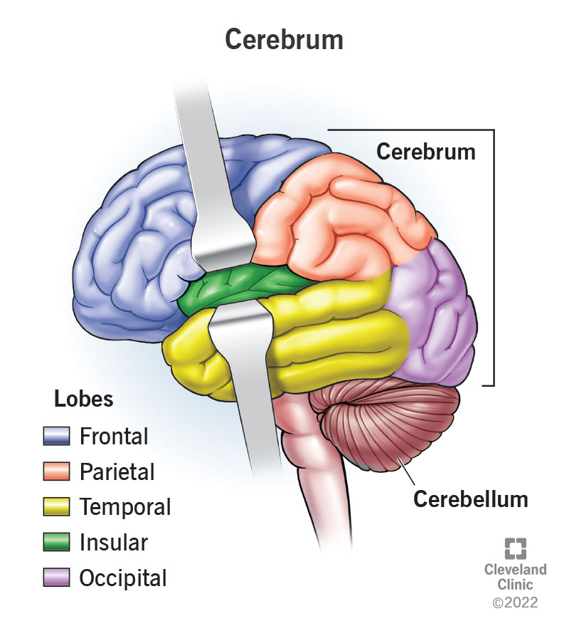

Slide 3
cerebellum
The cerebellum lies within the posterior cranial fossa beneath the tentorium cerebelli.
It is situated posterior to the pons and the medulla oblongata.
It consists of two hemispheres connected by a median portion, the vermis.

Slide 4
Connections to Brain
The cerebellum is connected to the midbrain by the superior cerebellar peduncles,
To the pons by the
middle cerebellar peduncles, and
To the medulla by the inferior cerebellar peduncles.

Slide 5
Surface
The surface layer of each cerebellar hemisphere, called the cortex, is composed of gray matter.
The cerebellar cortex is thrown into folds, or folia, separated by closely set transverse fissures.
Certain masses of gray matter are found in the interior of the cerebellum, embedded in the white matter; the largest of these is known as the dentate nucleus.

Slide 6
Functions
The cerebellum plays an important role in the control of muscle tone and the coordination of muscle movement on the same side of the body.
The medulla oblongata, the pons, and the cerebellum surround a cavity filled with cerebrospinal fluid, called the fourth ventricle.
This is connected superiorly to the third ventricle by the cerebral aqueduct; inferiorly, it is continuous with the central canal of the spinal cord
Notes:
ataxia)AND dysmetria

Slide 7
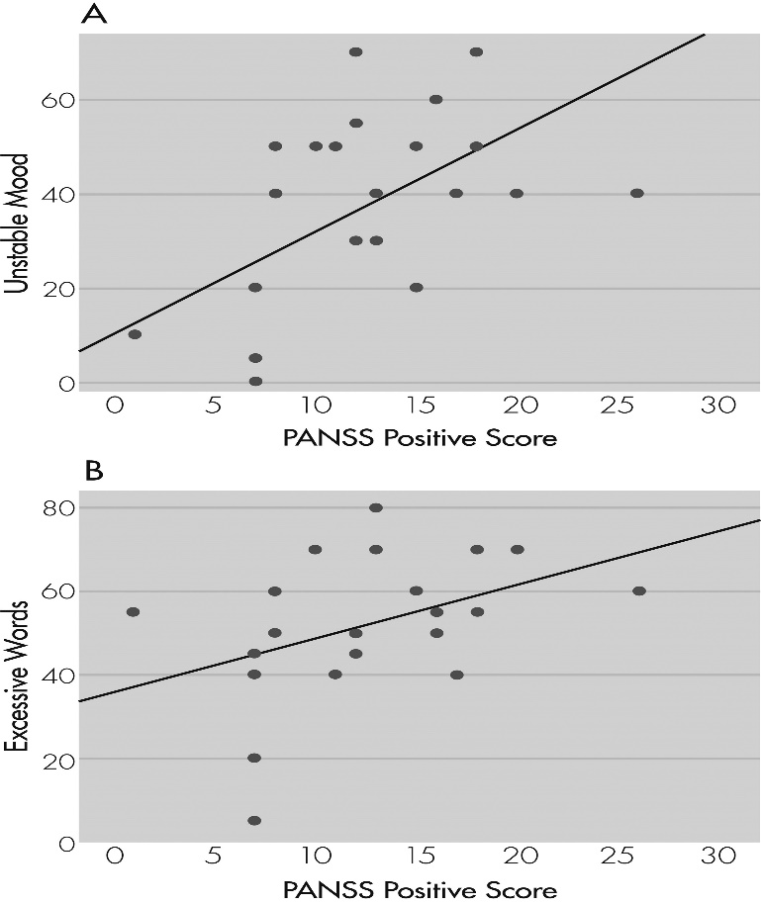
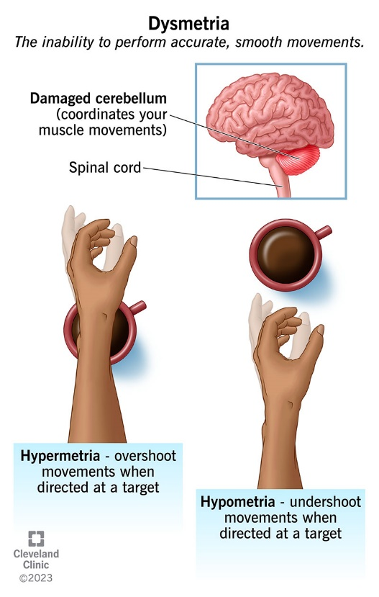

Slide 9
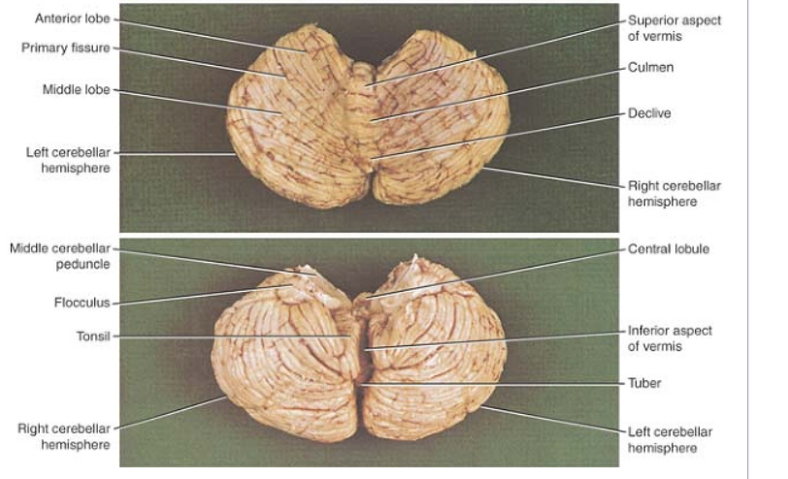
`

Slide 10


