Slide 1

ANATOMY
THE LOWER LIMB
DPT
2ND SEMESTER
DR DANISH
DPT(S.M.C),MPPTA

Slide 2
POPLITEAL FOSSA
The popliteal fossa is a diamond-shaped intermuscular space situated at the back of the knee.
It is the most prominent when the knee joint is flexed.

Slide 3
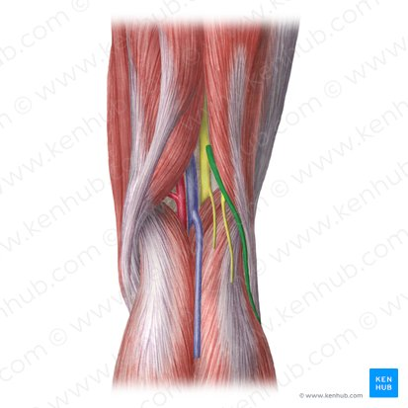

Slide 4
Contents
Popliteal vessels
Small saphenous vein
Common fibular (peroneal) nerve
Tibial nerve
Posterior cutaneous nerve of the thigh
Obturator nerve component
Fat and connective tissue
Branches of the popliteal vessels and nerves

Slide 5
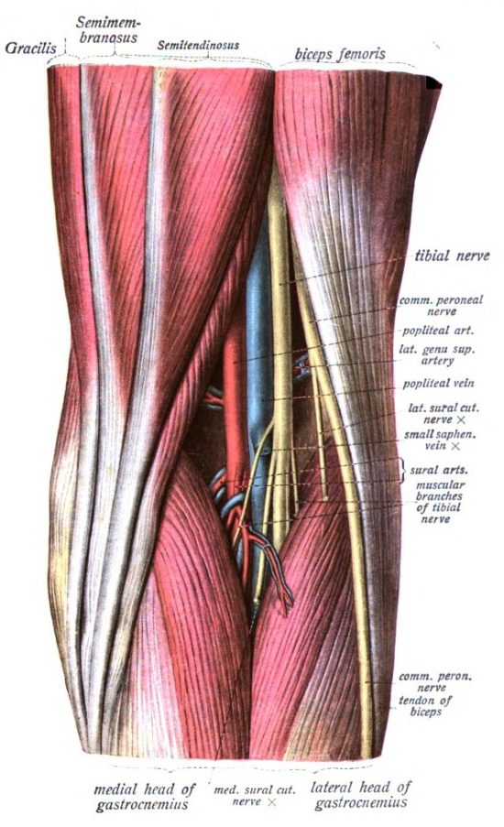

Slide 6
Boundaries of the Popliteal Fossa
Superolateral
Biceps femoris
Superomedial
Semimembranosus
Semitendinosus
Inferolateral
Lateral head of gastrocnemius
Plantaris
Inferomedial
Medial head of gastrocnemius

Slide 7
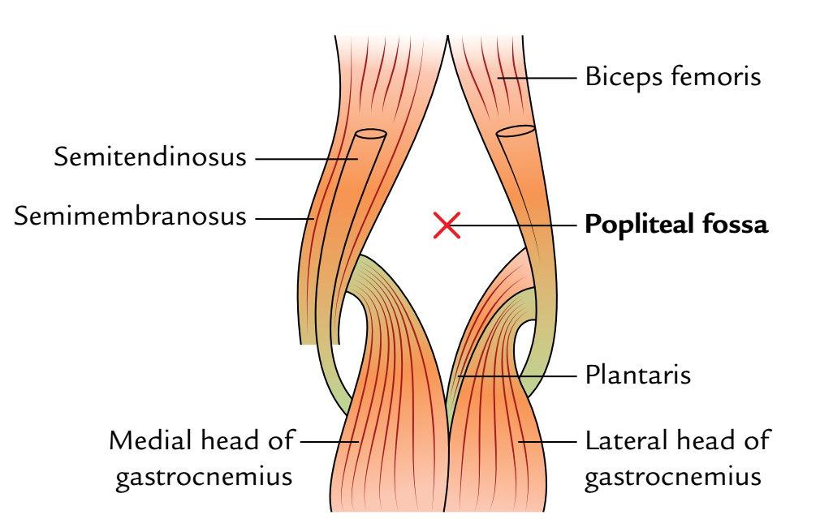

Slide 8
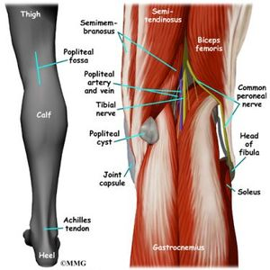

Slide 9
Roof
Skin
Superficial fascia
Deep fascia of the thigh

Slide 10
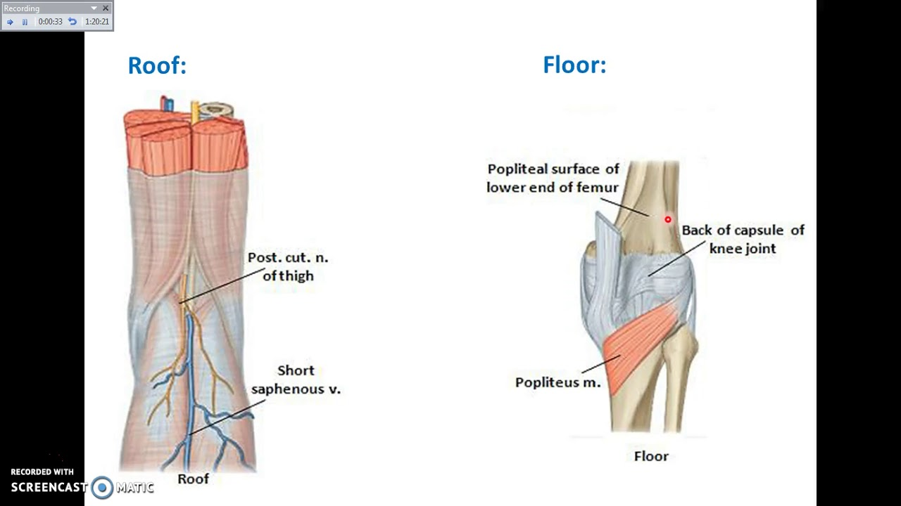

Slide 11
Floor
Popliteal surface of the femur
Capsule of the knee joint
Popliteus muscle

Slide 13
Muscles Associated with the Popliteal Fossa
Hamstring Muscles
Biceps femoris
Semimembranosus
Semitendinosus
Posterior Fascial Compartment Muscles
Gastrocnemius
Plantaris

Slide 15
Popliteus Muscle
Origin
Arises within the fascial compartment of the leg.
Course
Tendon separates the lateral meniscus from the lateral ligament.
Emerges through the lower part of the posterior aspect of the knee joint.
Passes to its insertion.

Slide 16
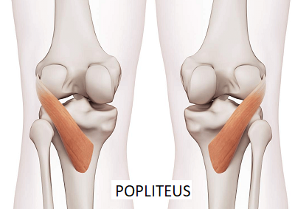

Slide 17
Actions
Produces medial rotation of the tibia on the femur.
Produces lateral rotation of the femur on the tibia.
Lateral rotation occurs at the commencement of knee flexion.
Relaxes ligaments of the knee joint.
Action is referred to as “unlocking the knee joint.”
Pulls the lateral meniscus backward at the commencement of flexion.

Slide 18
Relations of the Popliteal Fossa
Anteriorly
Popliteal surface of femur
Knee joint
Popliteus muscle
Posteriorly
Tibial nerve
Fascia
Skin

Slide 21
Popliteal Artery
Continuation of the femoral artery.
Course
Enters the popliteal fossa through the adductor hiatus.
Lies deeply within the fossa.
Termination
Ends at the lower border of the popliteus muscle.
Divides into:
  Anterior tibial artery
  Posterior tibial artery

Slide 22
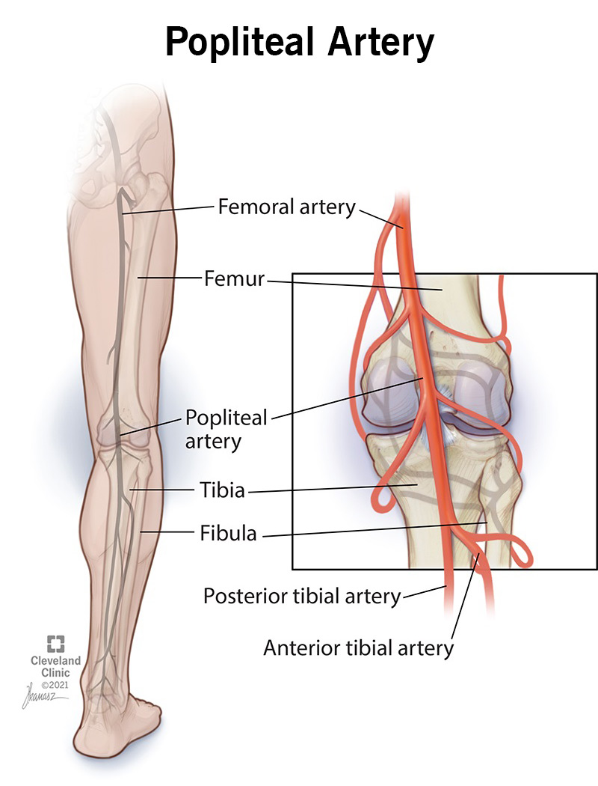

Slide 23
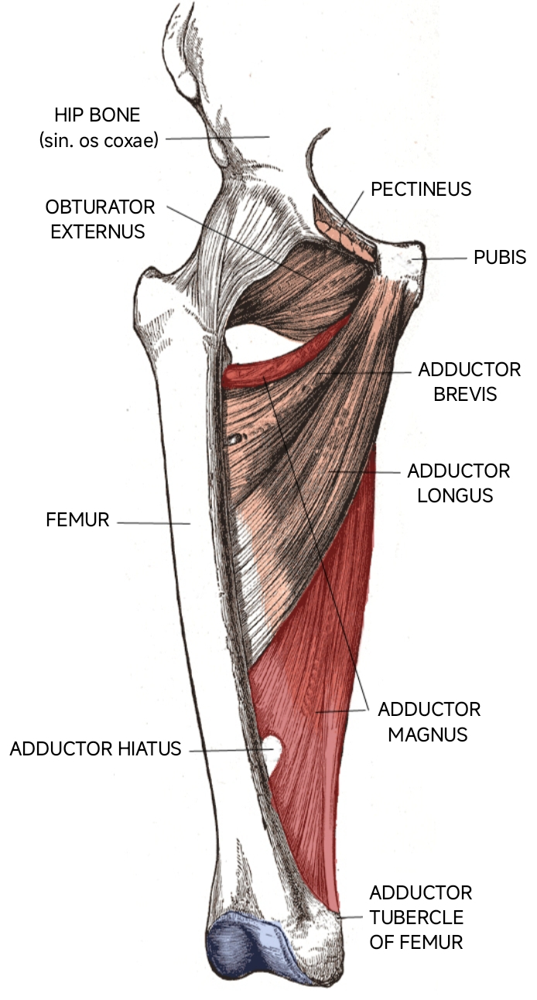

Slide 24
Arterial Anastomosis Around the Knee Joint
Features
Profuse anastomosis of small branches.
Contributions
Muscular and articular branches of:
  Femoral artery
  Popliteal artery
  Anterior tibial artery
  Posterior tibial artery
Function
Compensates for narrowing of the popliteal artery during extreme flexion of the knee

Slide 26
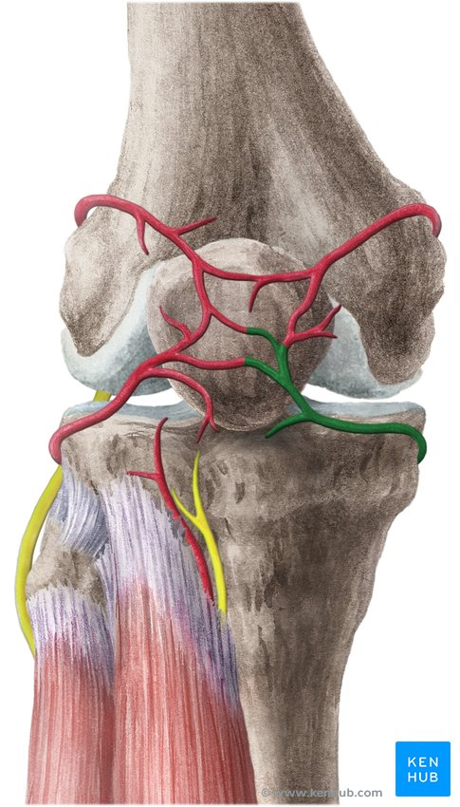

Slide 27
Popliteal Vein
Formation
Formed by union of the venae comitantes of:
  Anterior tibial artery
  Posterior tibial artery

Slide 28
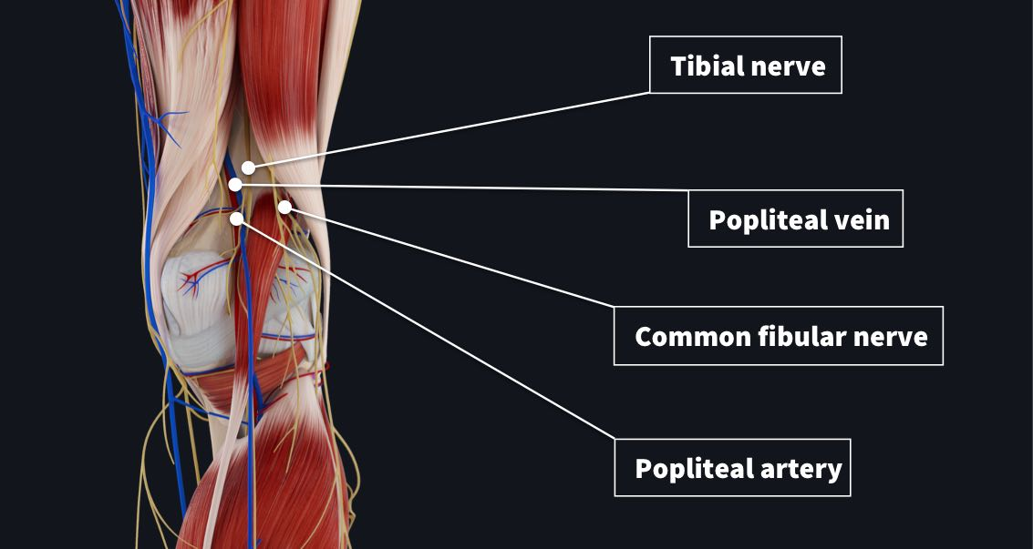

Slide 29
Course
Begins at the lower border of the popliteus muscle.
Lies on the medial side of the popliteal artery.
Ascends through the fossa.
Crosses behind the artery.
Continues on its lateral side.
Passes through the adductor hiatus.
Continuation
Becomes the femoral vein.

Slide 31
Popliteal Lymph Nodes
Number
Approximately six lymph nodes.
Location
Embedded in fat over the popliteal vessels.
Afferent Drainage
Receive superficial lymph vessels from the lateral side of the foot and leg.
Receive lymph from deeper structures accompanying anterior and posterior tibial arteries.

Slide 32
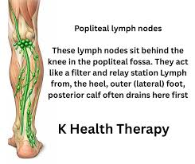

Slide 33


Slide 34


