Slide 1
Applied Science
Fsc Medical Technology
Awais Hamza

Slide 2
What is Convection?
Liquids and gases are poor conductors of heat.Therefore, heat is transferred in fluids mainly by convection.
Definition
Convection is the transfer of heat by the actual movement of molecules from a hot place to a cold place.
Important Points
Occurs only in liquids and gases
Heated fluid becomes less dense
Hot fluid rises upward
Cooler fluid takes its place

Slide 3
How Convection Works
Process of Convection
Fluid near the heat source gets heated
Heated fluid expands and becomes lighter
Hot fluid rises upward
Cooler fluid moves downward
Continuous circulation forms convection currents

Slide 4
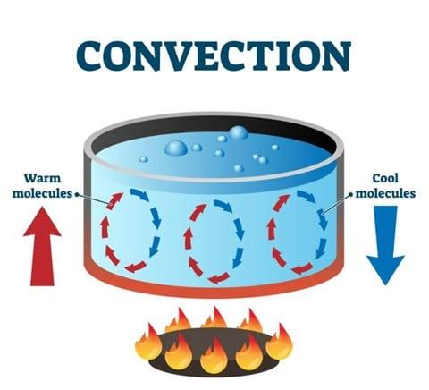
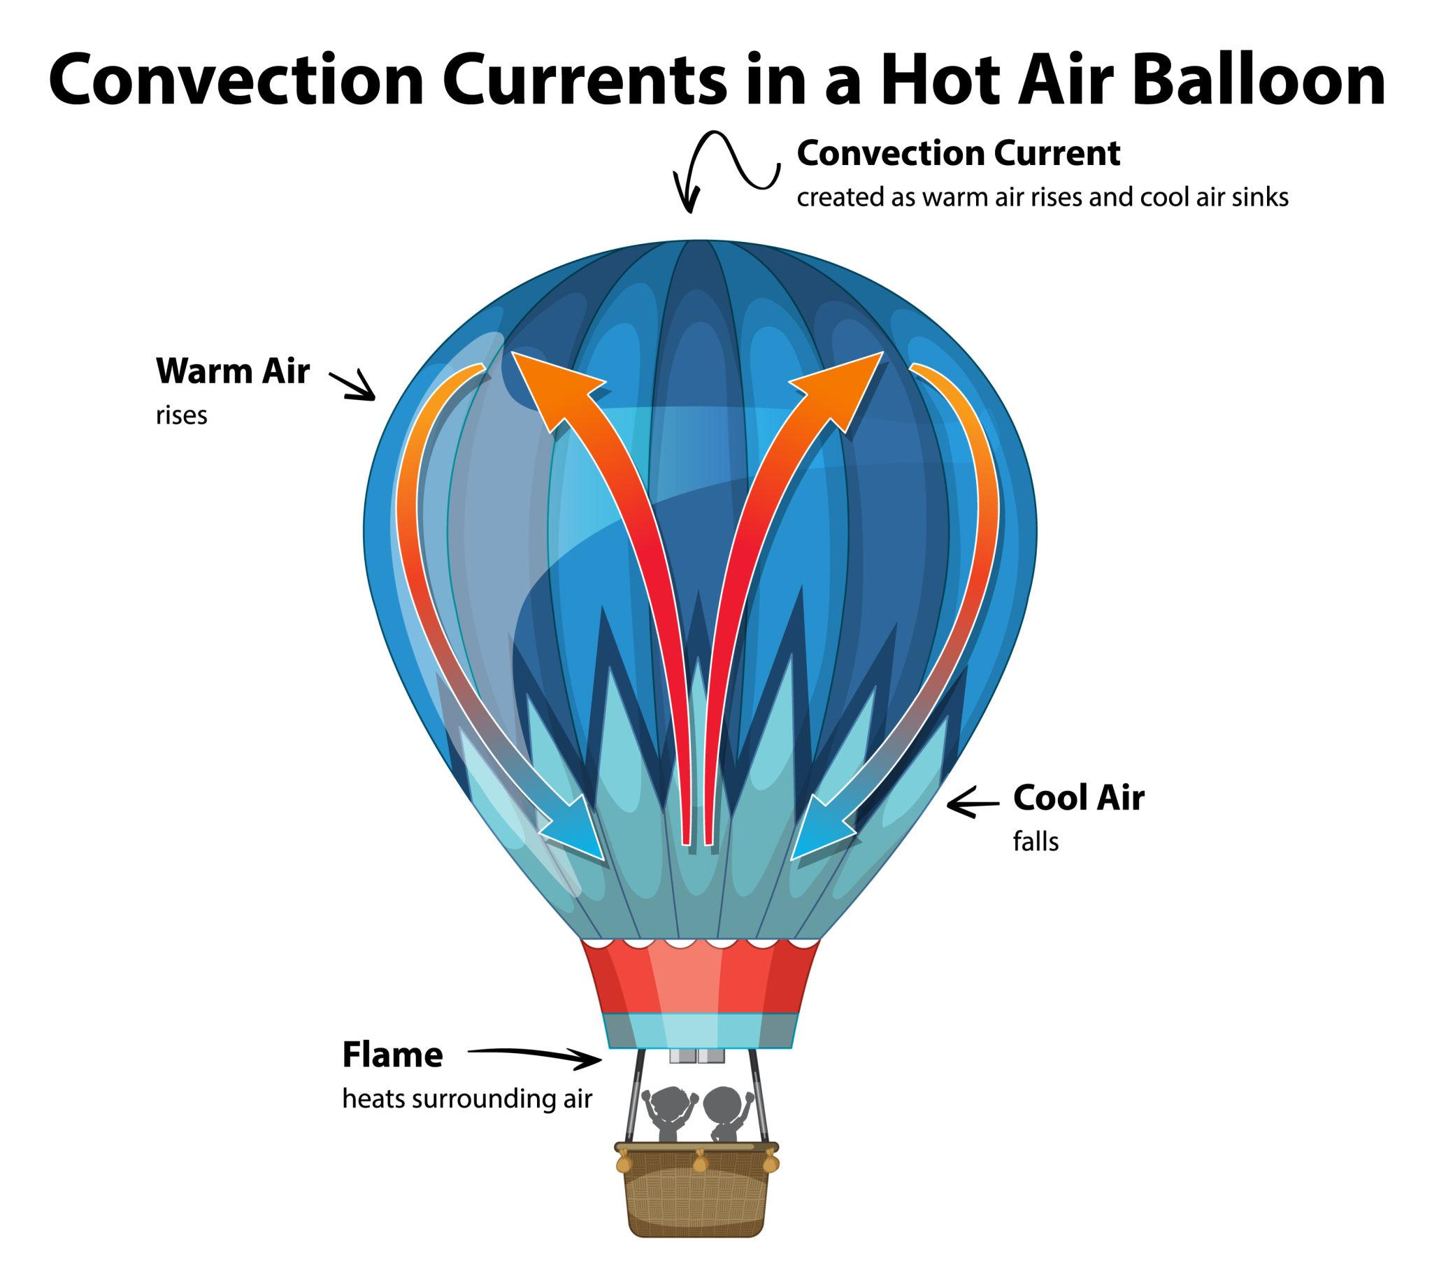

Slide 5
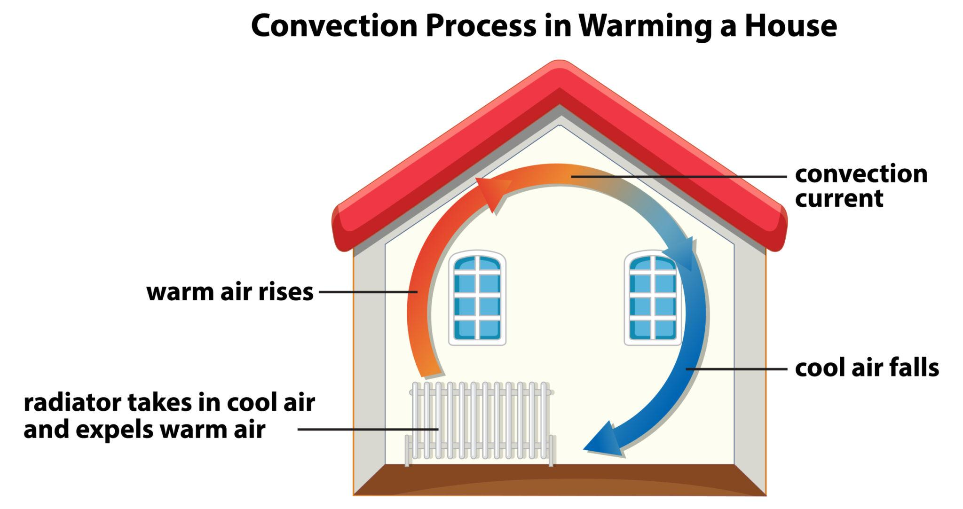
Convection Current in House

Slide 6
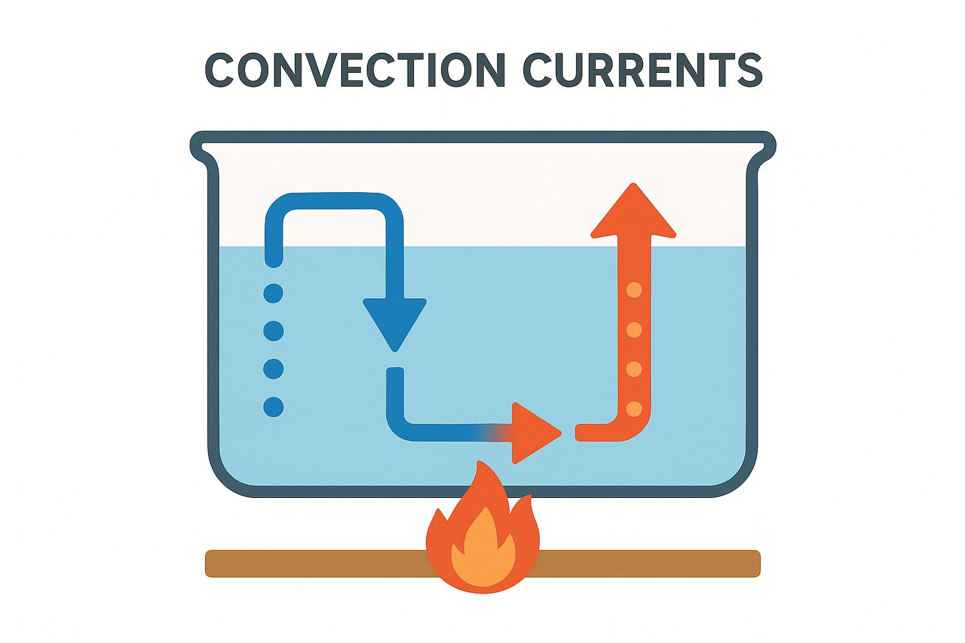

Slide 7
Why Does a Hot Air Balloon Rise?
Hot Air Balloon and Convection
Air inside the balloon is heated
Heated air expands
Density decreases
Balloon becomes lighter than surrounding air
Balloon rises upward

Slide 8
Experiment 9.1 – Convection in Water
Demonstration of Convection
Materials
Beaker
Water
Burner
Potassium permanganate crystals
Observation
Colored streaks move upward from the heated region showing the movement of water currents.
Conclusion: Heat is transferred through water by convection currents.

Slide 9
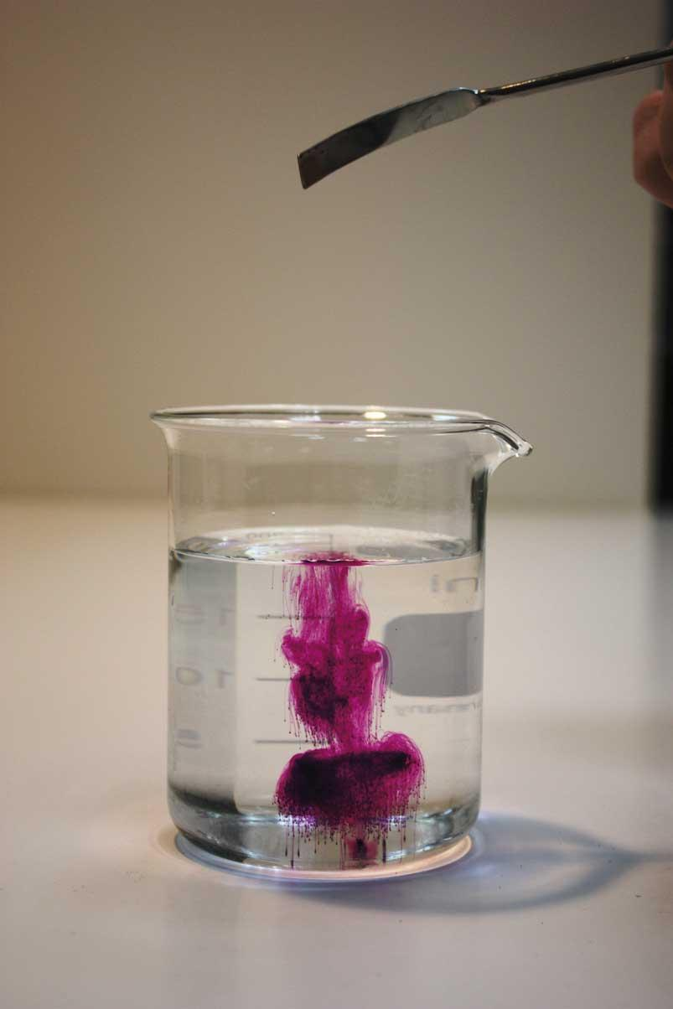
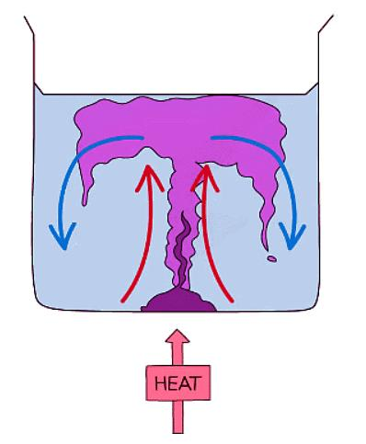

Slide 10
Examples of Convection
In Nature
Sea breeze
Land breeze
Winds in atmosphere
At Home: Boiling water , Room heaters , Chimneys
In Technology
Air conditioners
Refrigerators

Slide 11
What is Radiation?
Radiation
The Sun heats the Earth through radiation because space contains no air.
Definition
Radiation is the transfer of heat from one place to another in the form of electromagnetic waves.
Important Features
Does not require a medium
Travels through vacuum
Travels in straight lines
Speed equals speed of light

Slide 12
Radiation from the Sun
Heat from the Sun
Space between Sun and Earth is almost empty
Conduction and convection cannot occur in vacuum
Heat reaches Earth by radiation

Slide 13
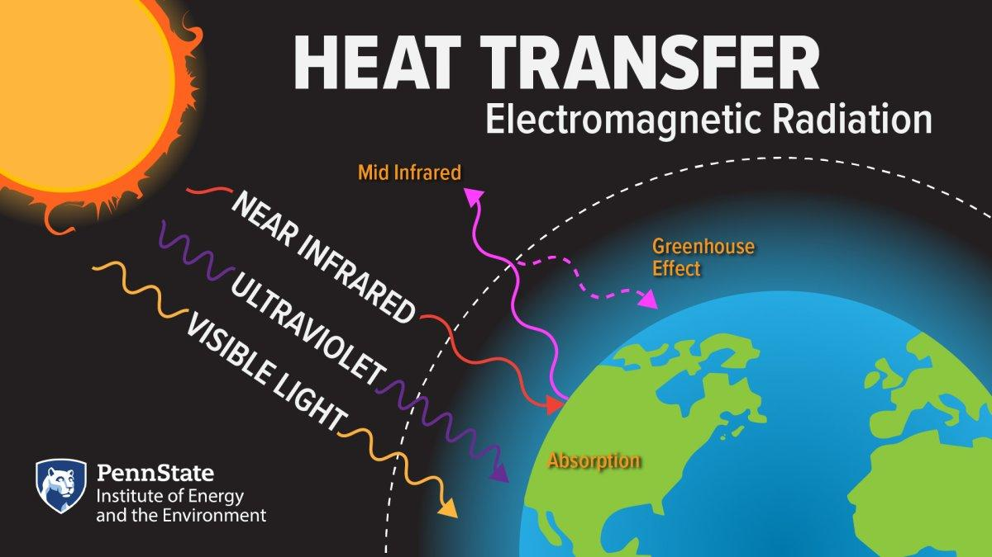

Slide 14
Fireplace Example
Radiation from a Fireplace
Heat reaches us directly from a fireplace
Air is a poor conductor
Hot air rises upward, not sideways
Therefore heat reaches us mainly by radiation
Important Fact
A cardboard sheet placed in the path can block thermal radiation.

Slide 15
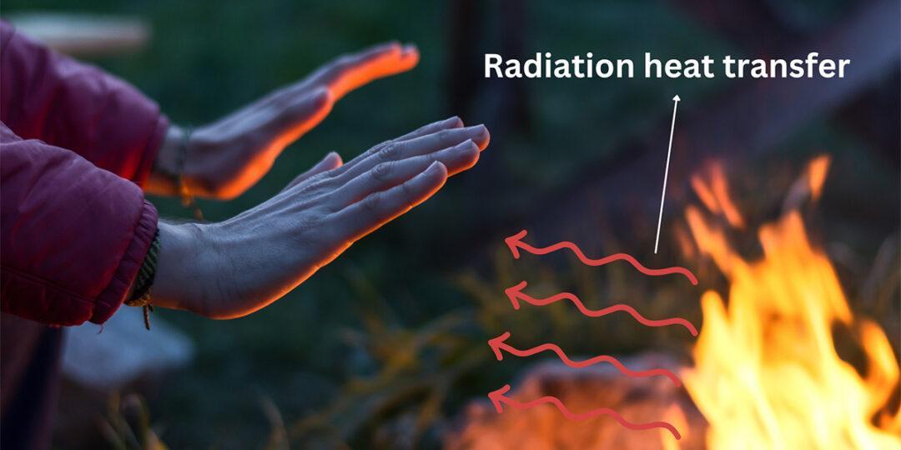
Radiation Heat Transfer

Slide 16
Electromagnetic Waves
Thermal Radiation
Thermal radiation belongs to the electromagnetic spectrum.
Infrared Radiation
Invisible heat waves
Produced by hot bodies
Responsible for feeling warmth

Slide 17
Factors Affecting Radiation
Rate of Radiation Depends On:
Color of surface
Texture of surface
Surface temperature
Surface area
Key Concept
Dark dull surfaces are good emitters
Shiny polished surfaces are poor emitters

Slide 18
Cooling and Heating of Objects
Radiation Around Us
Hot Objects
Emit more heat than they absorb → cool down
Cold Objects
Absorb more heat than they emit → warm up
Example
Hot tea becomes cold
Chilled water becomes warm

Slide 19
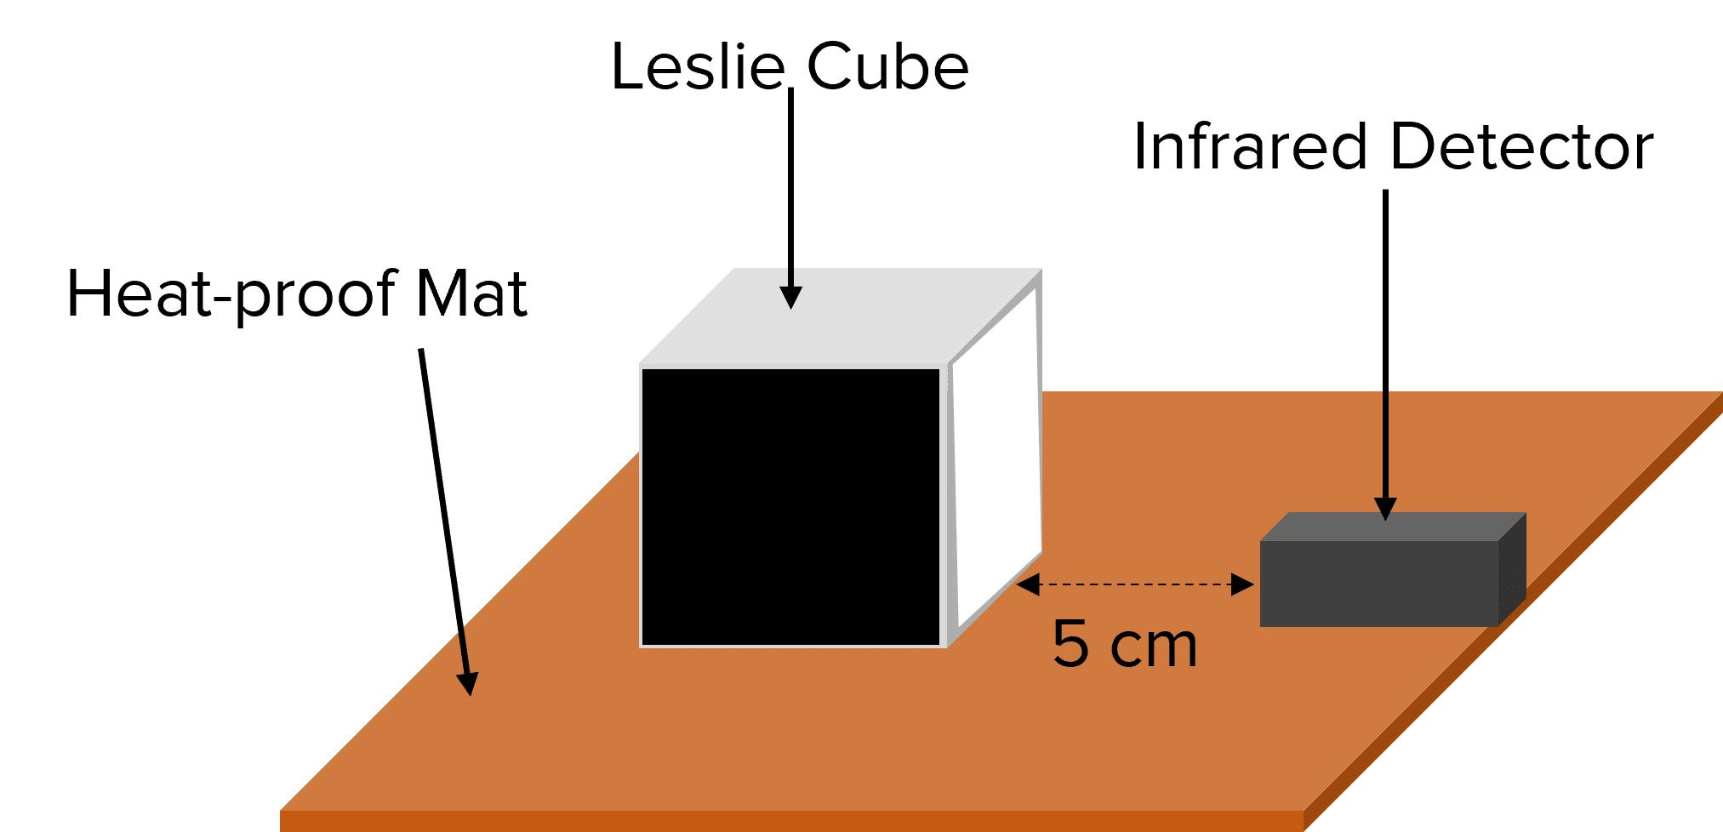
Leslie’s Cube
A Leslie cube is used to compare emission of heat from different surfaces.
Different Surfaces
Shiny silver
Dull black
White
Colored
Observation
Dull black surface emits maximum heat.

Slide 20
Absorption of Radiation
Absorption Experiment
Observation
Black surfaces absorb heat rapidly
Polished shiny surfaces absorb heat slowly
Conclusion
Black dull surfaces are good absorbers
Polished surfaces are poor absorbers

Slide 21
Applications of Radiation
Daily Life
Solar cookers
Greenhouses
Thermos flasks
Clothing
Light-colored clothes in summer
Dark-colored clothes in winter
Technology
Infrared cameras
Remote controls

