Slide 1

Expressionism
DPT(Doctor of Physiotherapy)

Slide 2
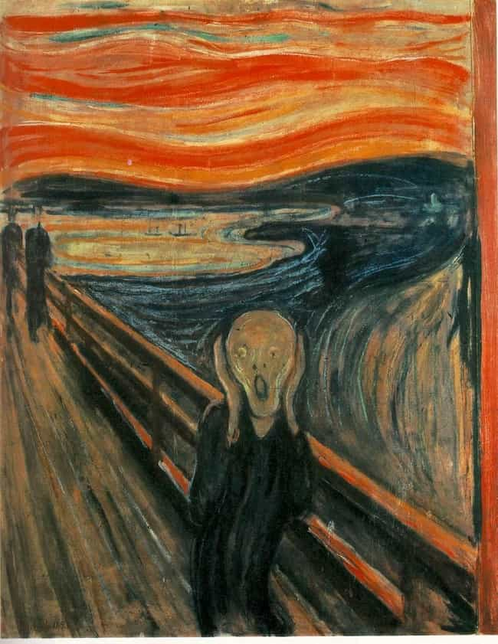
Introduction to Expressionism
• Expressionism emerged in the early 20th century.
• It focused on emotional expression instead of realism.
• Artists used vivid colors and distorted forms.
• Themes included fear, anxiety, and human emotion.

Slide 3
Historical Background
• Originated mainly in Germany around 1905.
• Influenced by industrialization and social change.
• Developed as a reaction against realism and Impressionism.
• Major groups included Die Brücke and Der Blaue Reiter.

Slide 4
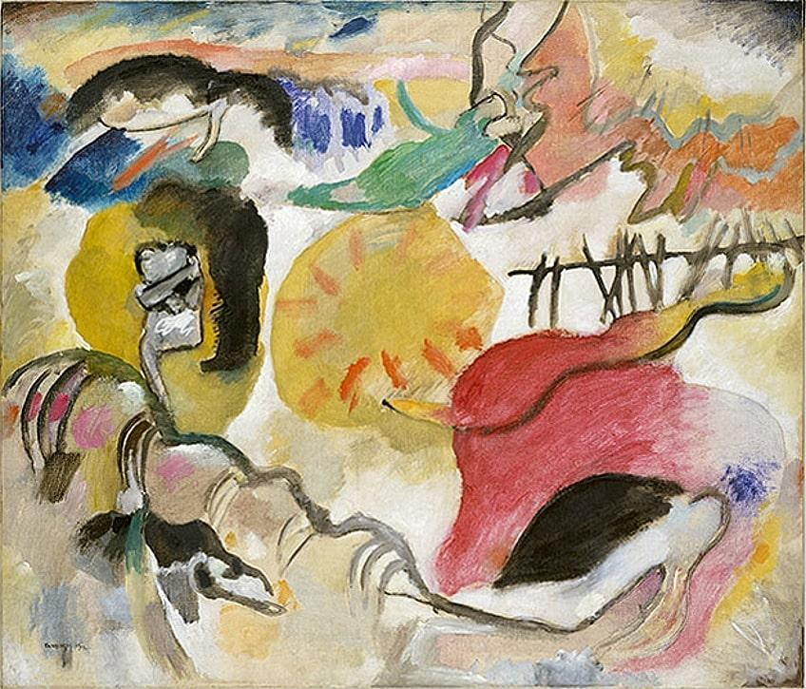
Characteristics of Expressionism
• Bold and unnatural colors
• Distorted shapes and figures
• Emotional intensity
• Dynamic brush strokes
• Subjective interpretation of reality

Slide 5
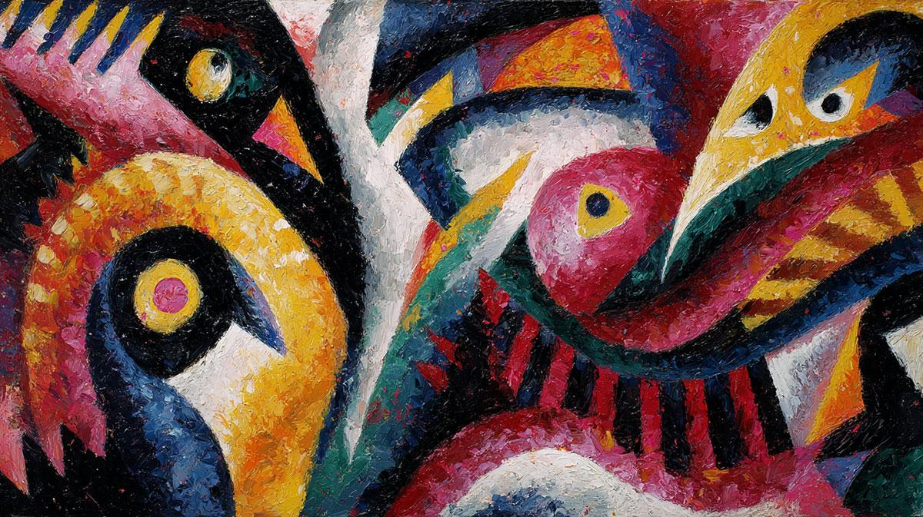
Major Expressionist Artists
• Edvard Munch
• Wassily Kandinsky
• Ernst Ludwig Kirchner
• Franz Marc
• Egon Schiele

Slide 6
The Scream by Edvard Munch
• One of the most famous Expressionist paintings.
• Represents fear, loneliness, and anxiety.
• Uses dramatic lines and intense colors.

Slide 7
Die Brücke Movement
• Founded in Dresden, Germany.
• Focused on emotional and urban themes.
• Artists used sharp lines and exaggerated forms.

Slide 8
Der Blaue Reiter Movement
• Founded by Kandinsky and Franz Marc.
• Interested in spirituality and abstraction.
• Symbolic colors were commonly used.

Slide 9
Impact of Expressionism
• Influenced modern and abstract art.
• Inspired literature, cinema, and theater.
• Expressionist ideas remain important in contemporary art.

Slide 10
Conclusion
• Expressionism transformed visual arts.
• The movement emphasized emotions and individuality.
• It remains one of the most influential modern art movements.

