Slide 1

ANATOMY
THE THORAX
BS RIT,OTT
2ND SEMESTER
DR DANISH
DPT(S.M.C),MPPTA

Slide 2
Arterial Supply of the Heart
The heart is supplied by the coronary arteries.
Coronary arteries arise from the ascending aorta.
Blood flow through coronary arteries occurs mainly during diastole.
Venous blood drains mainly into the coronary sinus.
.

Slide 3
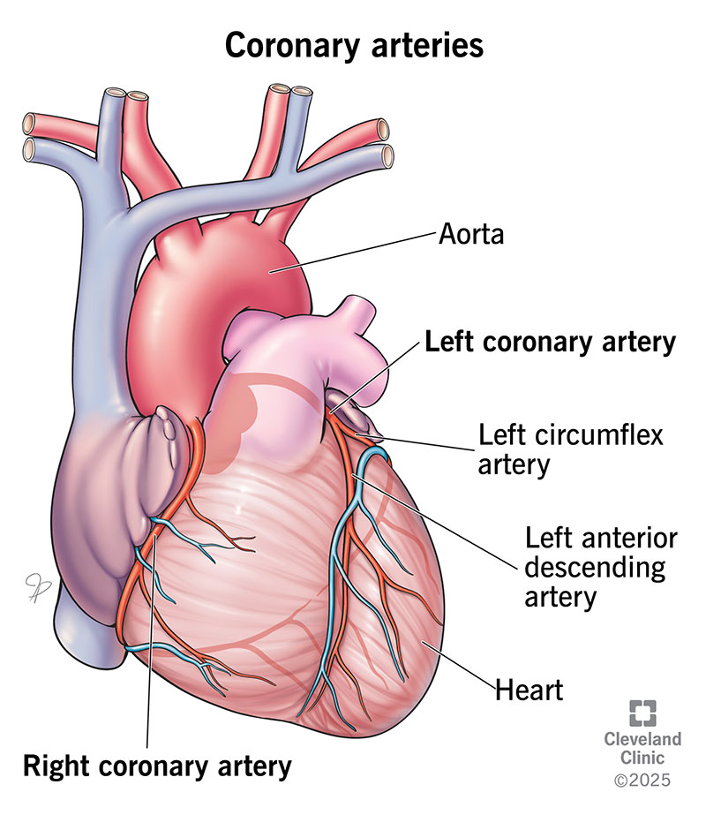

Slide 4
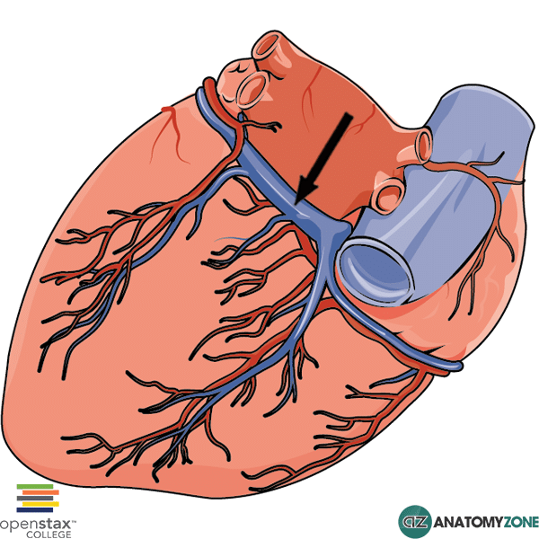

Slide 5
Coronary Arteries
Main Coronary Arteries
Right coronary artery (RCA)
Left coronary artery (LCA)
Origin
Both arise from the ascending aorta.
Originate from the aortic sinuses just above the aortic valve.

Slide 7
Right Coronary Artery (RCA)
Origin and Course
Arises from the anterior aortic sinus.
Passes forward between:
  Pulmonary trunk
  Right auricle
Descends in the right atrioventricular groove.
Winds around the inferior border of the heart.
Continues onto posterior surface.

Slide 8
Branches of RCA
Right marginal artery
Posterior interventricular artery
Atrial branches
Ventricular branches
SA nodal artery
AV nodal artery

Slide 9
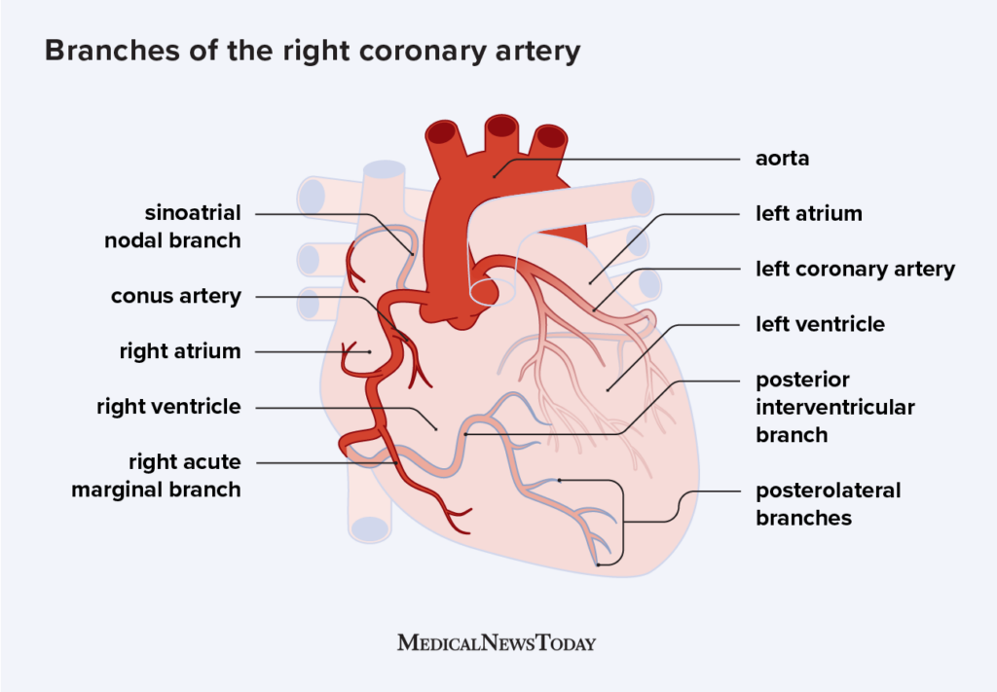

Slide 10
Distribution of RCA
Structures Supplied
Right atrium
Most of right ventricle
Part of left ventricle (diaphragmatic surface)
Posterior one-third of interventricular septum
SA node (≈60% of people)
AV node and AV bundle

Slide 12
Left Coronary Artery (LCA)
Origin and Course
Arises from the left posterior aortic sinus.
Passes between:
  Pulmonary trunk
  Left auricle
Short trunk divides into:
  Anterior interventricular artery (LAD)
  Circumflex artery

Slide 14
Anterior Interventricular Artery (LAD)
Course
Descends in anterior interventricular groove.
Continues toward apex of heart.
Anastomoses with posterior interventricular artery.
Supply
Right and left ventricles
Anterior two-thirds of interventricular septum
AV bundle and bundle branches

Slide 16
Circumflex Artery
Course
Runs in left atrioventricular groove.
Winds around left border of heart.
Anastomoses with RCA.
Supply
Left atrium
Left ventricle
Part of right ventricle
SA node in some individuals

Slide 18
Coronary Artery Dominance
Definition
Dominance determined by artery giving rise to posterior interventricular artery.
Right Dominance
Posterior interventricular artery arises from RCA.
Most common pattern.
Left Dominance
Posterior interventricular artery arises from circumflex branch.
Balanced Circulation
Contributions from both arteries.

Slide 19
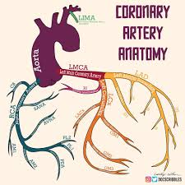

Slide 21
Venous Drainage of Heart
Coronary Sinus
Main venous drainage channel.
Located in posterior atrioventricular groove.
Opens into right atrium.

Slide 23
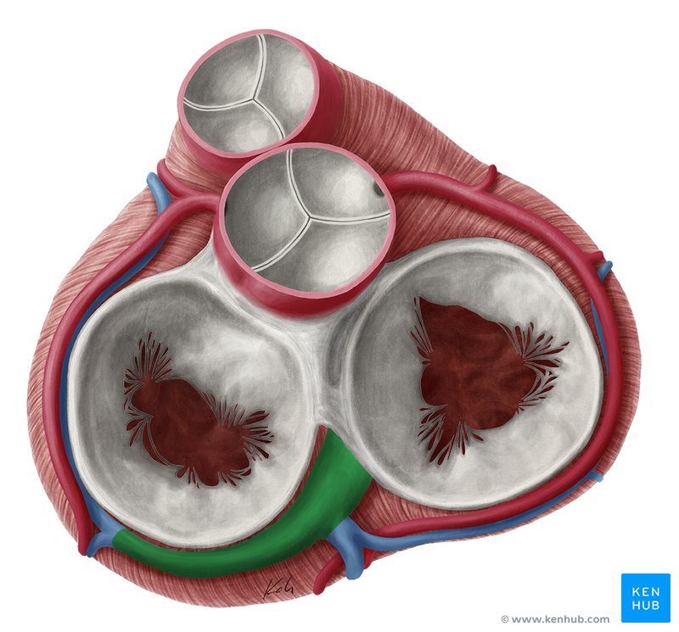

Slide 24
CONTINUED
Tributaries
Great cardiac vein
Middle cardiac vein
Small cardiac vein
Posterior vein of left ventricle
Oblique vein of left atrium

Slide 25
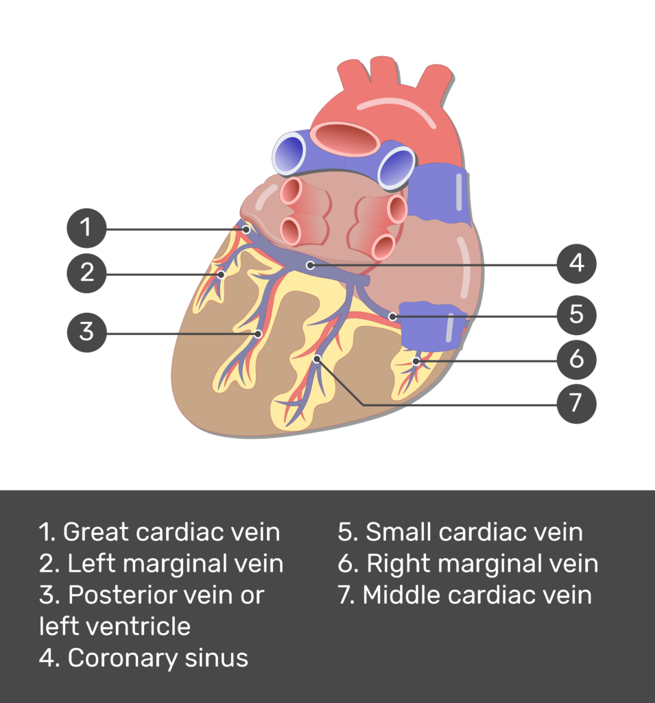

Slide 26
Other Cardiac Veins
Anterior Cardiac Veins
Drain right ventricle.
Open directly into right atrium.
Venae Cordis Minimae
Smallest cardiac veins.
Open directly into heart chambers.
Most numerous in right atrium and right ventricle.

Slide 27
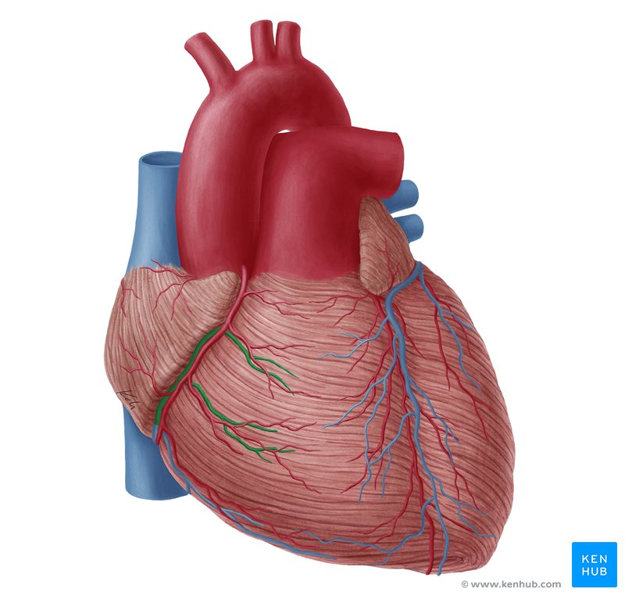

Slide 28
Nerve Supply of Heart
Cardiac Plexus
Heart supplied by autonomic nerve fibers.
Fibers arise from cardiac plexus.
Location of Cardiac Plexus
Below arch of aorta
Anterior to tracheal bifurcation
Components
Sympathetic fibers
Parasympathetic fibers

Slide 29
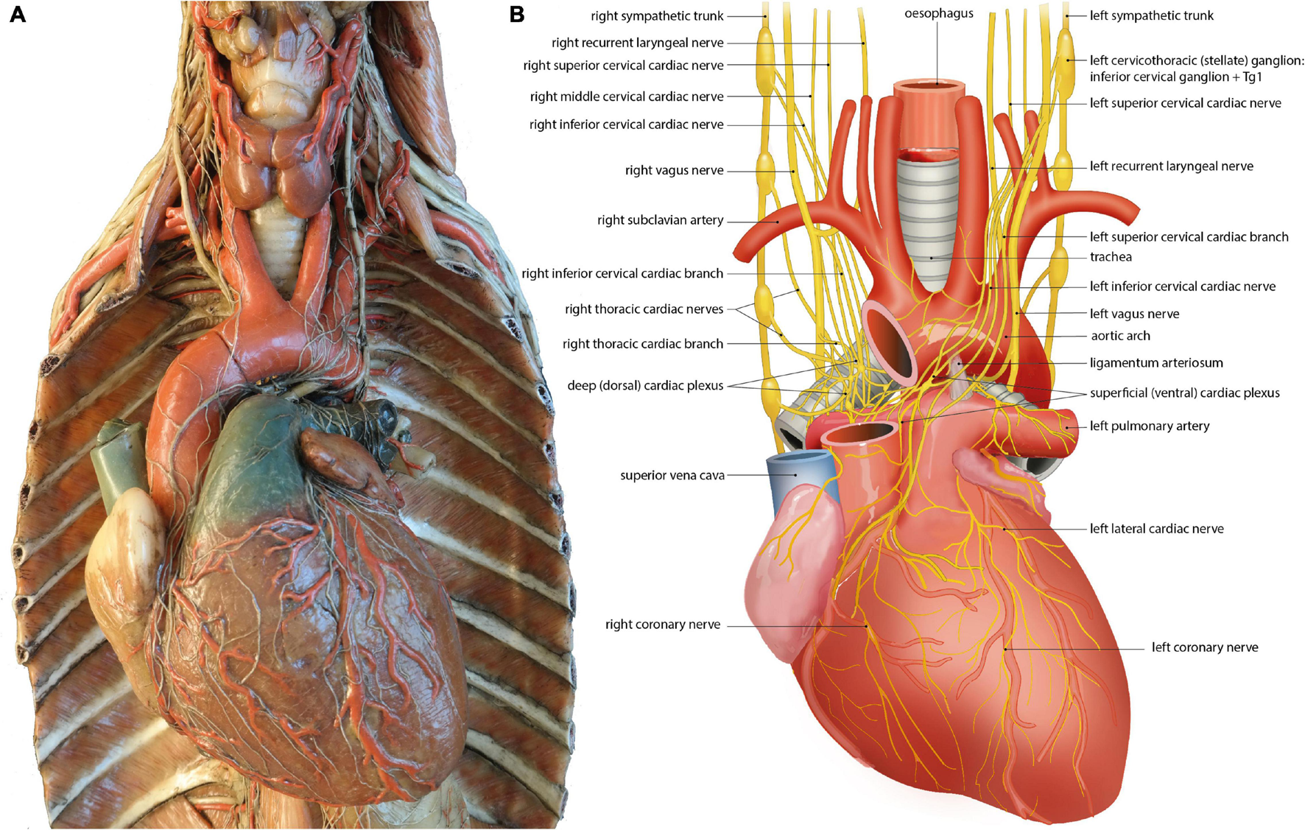

Slide 30
Sympathetic Supply
Origin
Cervical sympathetic ganglia
Upper thoracic sympathetic ganglia
Pathway
Fibers travel through cardiac nerves to cardiac plexus.
Effects
Increase heart rate
Increase force of contraction
Dilate coronary arteries

Slide 32
Parasympathetic Supply
Origin
Vagus nerve
Effects
Decrease heart rate
Decrease force of contraction
Constrict coronary arteries

Slide 33
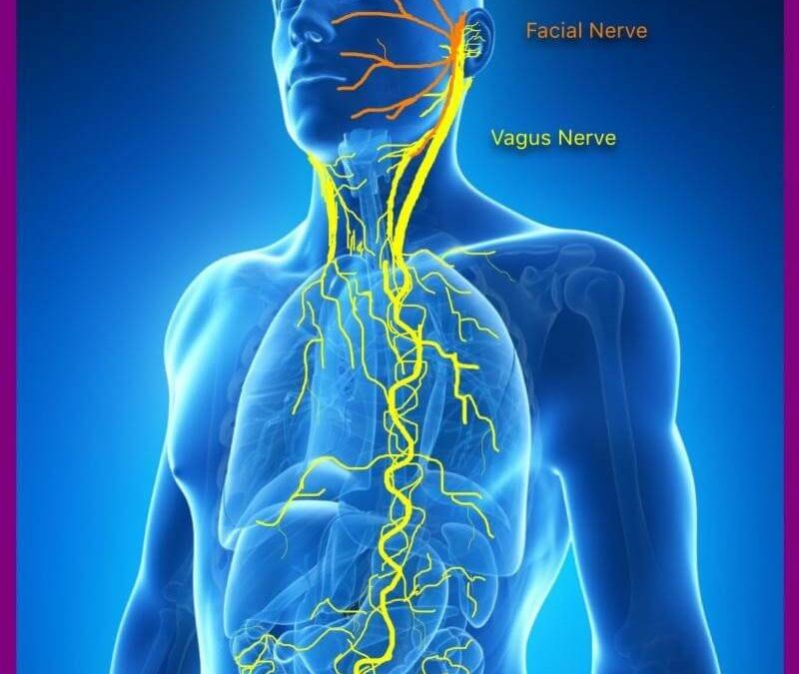

Slide 34
Visceral Afferent Fibers
Pain Fibers
Travel with sympathetic fibers.
Enter spinal cord segments T1–T4.
Reflex Fibers
Travel with parasympathetic fibers in vagus nerve.

Slide 36
Referred Cardiac Pain
Features
Pain due to myocardial ischemia.
Referred to:
  Chest
  Left shoulder
  Medial side of left arm
  Neck
  Jaw
Cause
Shared spinal cord segments (T1–T4).

Slide 37
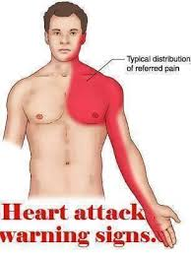

Slide 39
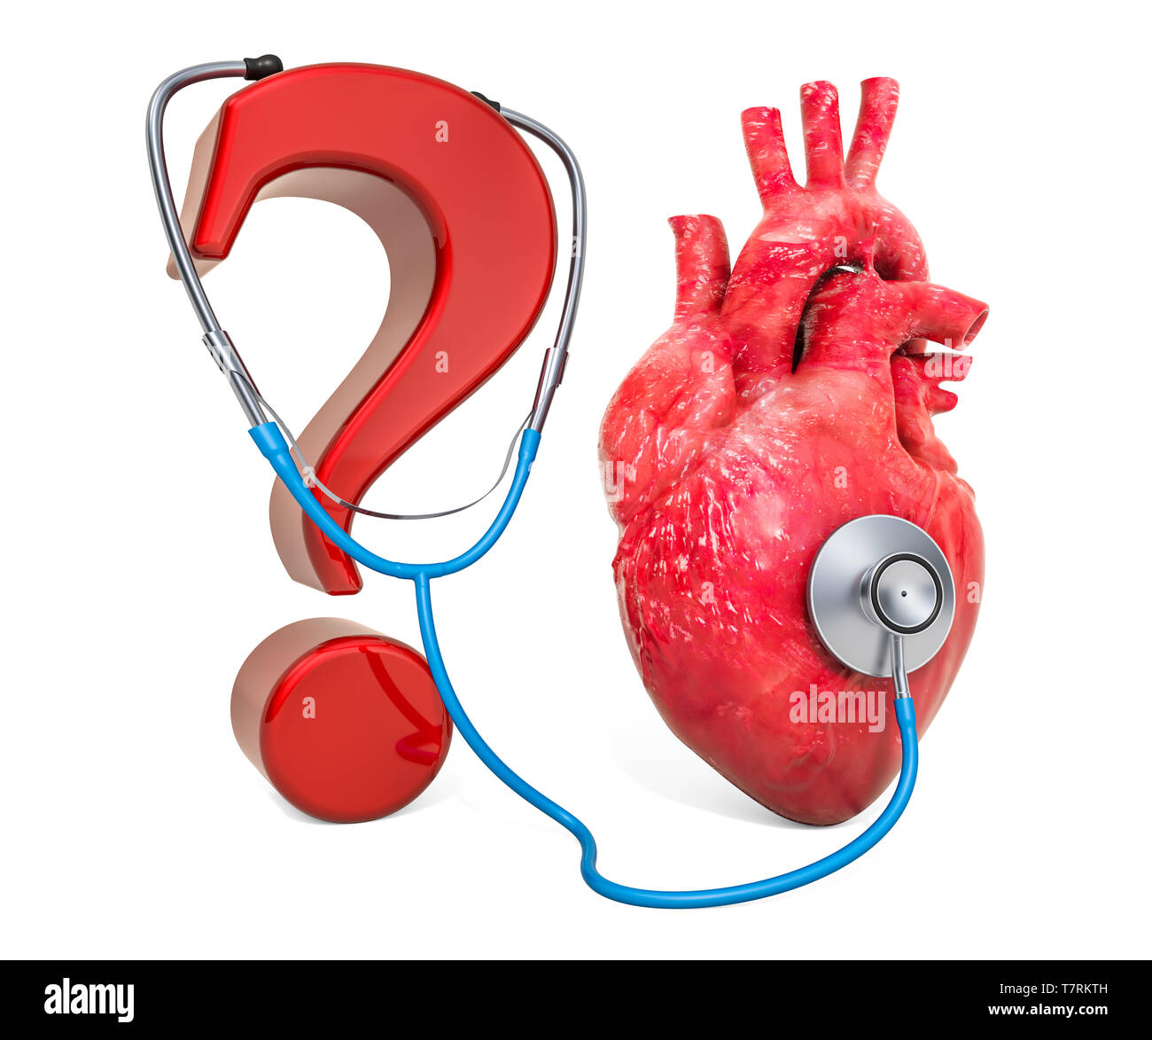

Slide 40


