Slide 1
Expository Writing
BS Psy & DPT
Hafsa Rasheed

Slide 2
What is Essay Structure?
An academic essay is not a random collection of ideas. It is a structured intellectual argument built systematically to communicate, analyze, and persuade.
Introduction & Thesis Statement: The core argument.
Body Paragraphs: Systematic development.
Conclusion: Synthesis and closure.

Slide 3
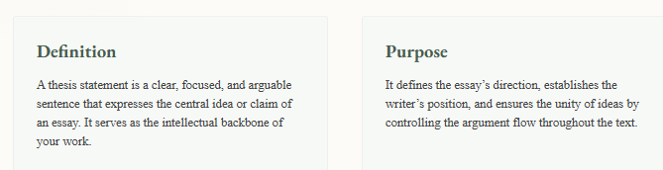
What’s a Thesis Statement?

Slide 4
It acts as:
the intellectual anchor of the essay
the guide for the reader
the framework for all paragraphs

Slide 5
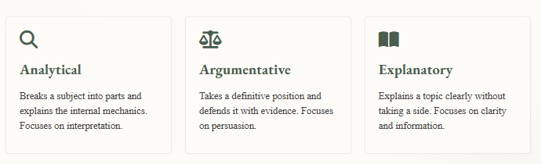
Types of Thesis Statement

Slide 6
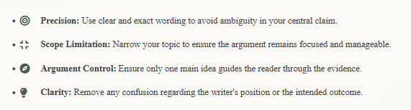
Key Thesis Techniques

Slide 7
Body Paragraghs
Body paragraphs are the core analytical units of an essay where the thesis is developed through structured reasoning and evidence
Each paragraph:
focuses on one idea
supports the thesis
builds the overall argument step by step
👉 Think of body paragraphs as building blocks of logic.

Slide 8
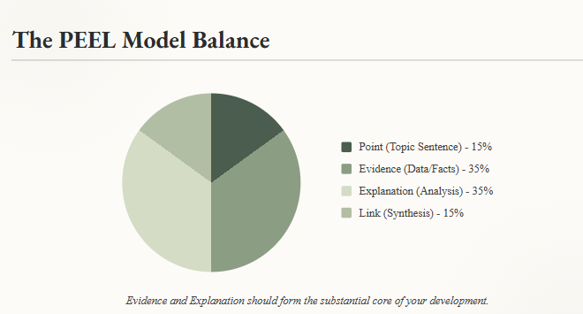
| Also called TEEL Model

Slide 9
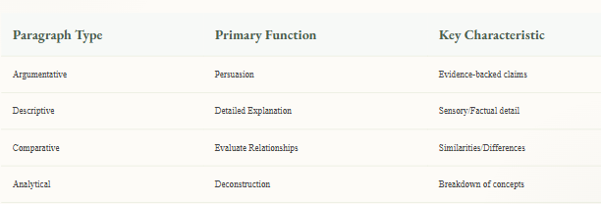
Body Paragraph Development Strategies

Slide 10
Transitions & Flow
Transitions guide the reader logically:
Addition → moreover, furthermore
Contrast → however, although
Cause → therefore, consequently
Example → for instance👉 They create *cohesion between ideas*
Key Insight👉 Strong essays are not about more information — they are about better analysis

Slide 11
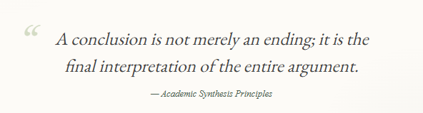

Slide 12
Conclusion
The conclusion is the final interpretive section of an essay where all ideas are brought together into a unified understanding
👉 It answers: “So what does all this mean?”
Functions:
Reinforces the thesis
Summarizes key arguments
Provides final insight
Creates lasting impact

Slide 13
Continued. . .
Advanced Techniques
What to Avoid
Synthesis: combine ideas, don’t list them
Restatement: rewrite thesis in new words
Significance: explain why argument matters
Impact statement: end strongly
Introducing new arguments
Repeating sentences word-for-word
Ending weakly or abruptly

Slide 14
Cohesion & Coherence
Cohesion: surface-level connections (words, grammar)
Coherence: deep logical flow of ideas
👉 Cohesion = how sentences connect
👉 Coherence = how ideas make sense together
Techniques
Transitional words (logical flow)
Pronoun referencing (avoid repetition)
Repetition of key terms (maintain focus)
Logical sequencing (clear structure)

Slide 15
Cohesive Devices
however (contrast)
therefore (result)
moreover (addition)
in contrast (difference)
for example (evidence)
👉 These act as bridges between thoughts
Key Insight👉 Even strong ideas fail if they are not connected properly

Slide 16
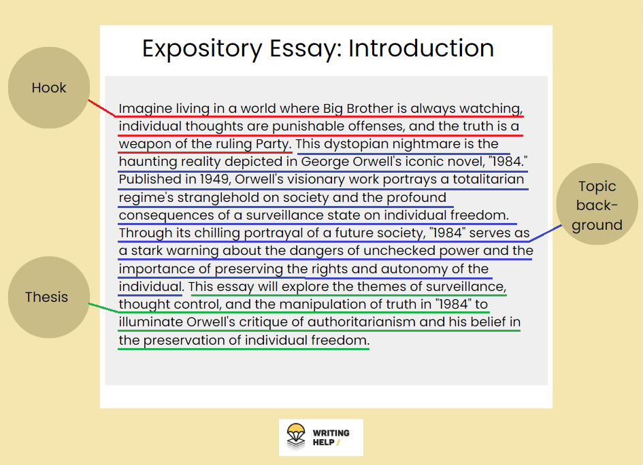

Slide 17


