Slide 1

ANATOMY
THE LOWER LIMB
DPT
2ND SEMESTER
DR DANISH

Slide 2
KNEE JOINT
Knee joint is the largest synovial joint in the body
Structurally complex and mechanically unstable without support
Functions:
  Weight bearing
  Mobility (walking, running)
Classified as:
  Modified hinge joint
  Bicondylar joint

Slide 3
Bones Forming the Joint
Femur:
  Medial condyle
  Lateral condyle
Tibia:
  Medial condyle
  Lateral condyle
Patella:
  Sesamoid bone in quadriceps tendon

Slide 4
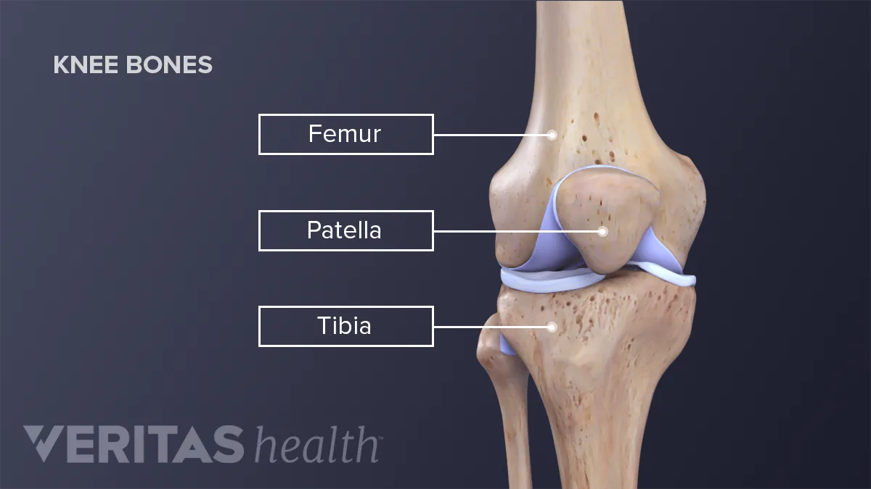

Slide 5
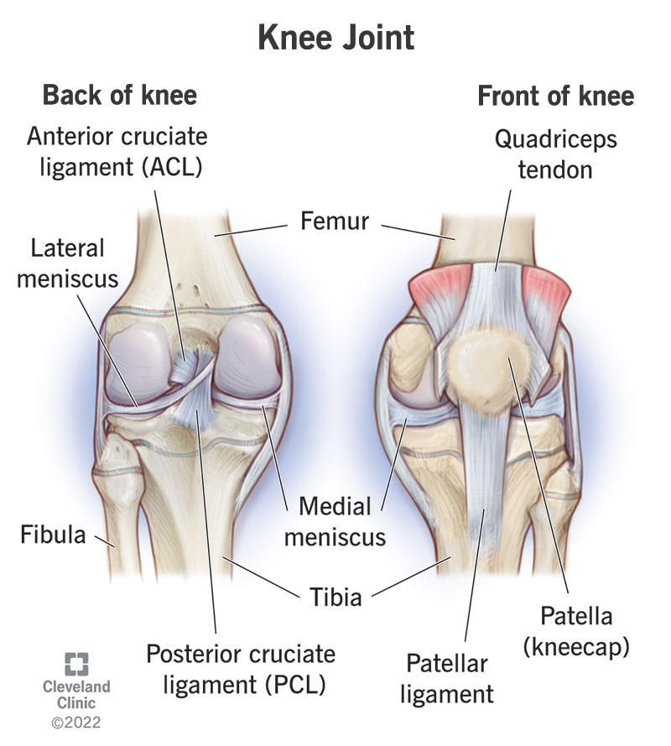

Slide 6
Articulations
Tibiofemoral joint:
  Between femoral condyles and tibial condyles
Patellofemoral joint:
  Between patella and femur
Joint cavity is single but partially divided

Slide 8
Articular Surfaces
Femoral condyles:
  Convex in all directions
Tibial condyles:
  Relatively flat
Patella:
  Posterior surface covered with thick cartilage
All surfaces covered by hyaline cartilage

Slide 9
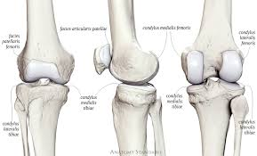

Slide 10
Joint Capsule
Thin and fibrous
Attachments:
  Femur: just proximal to condyles
  Tibia: just distal to articular margins
Anteriorly:
  Deficient
  Replaced by quadriceps tendon, patella, patellar ligament
Strengthened by surrounding ligaments

Slide 11
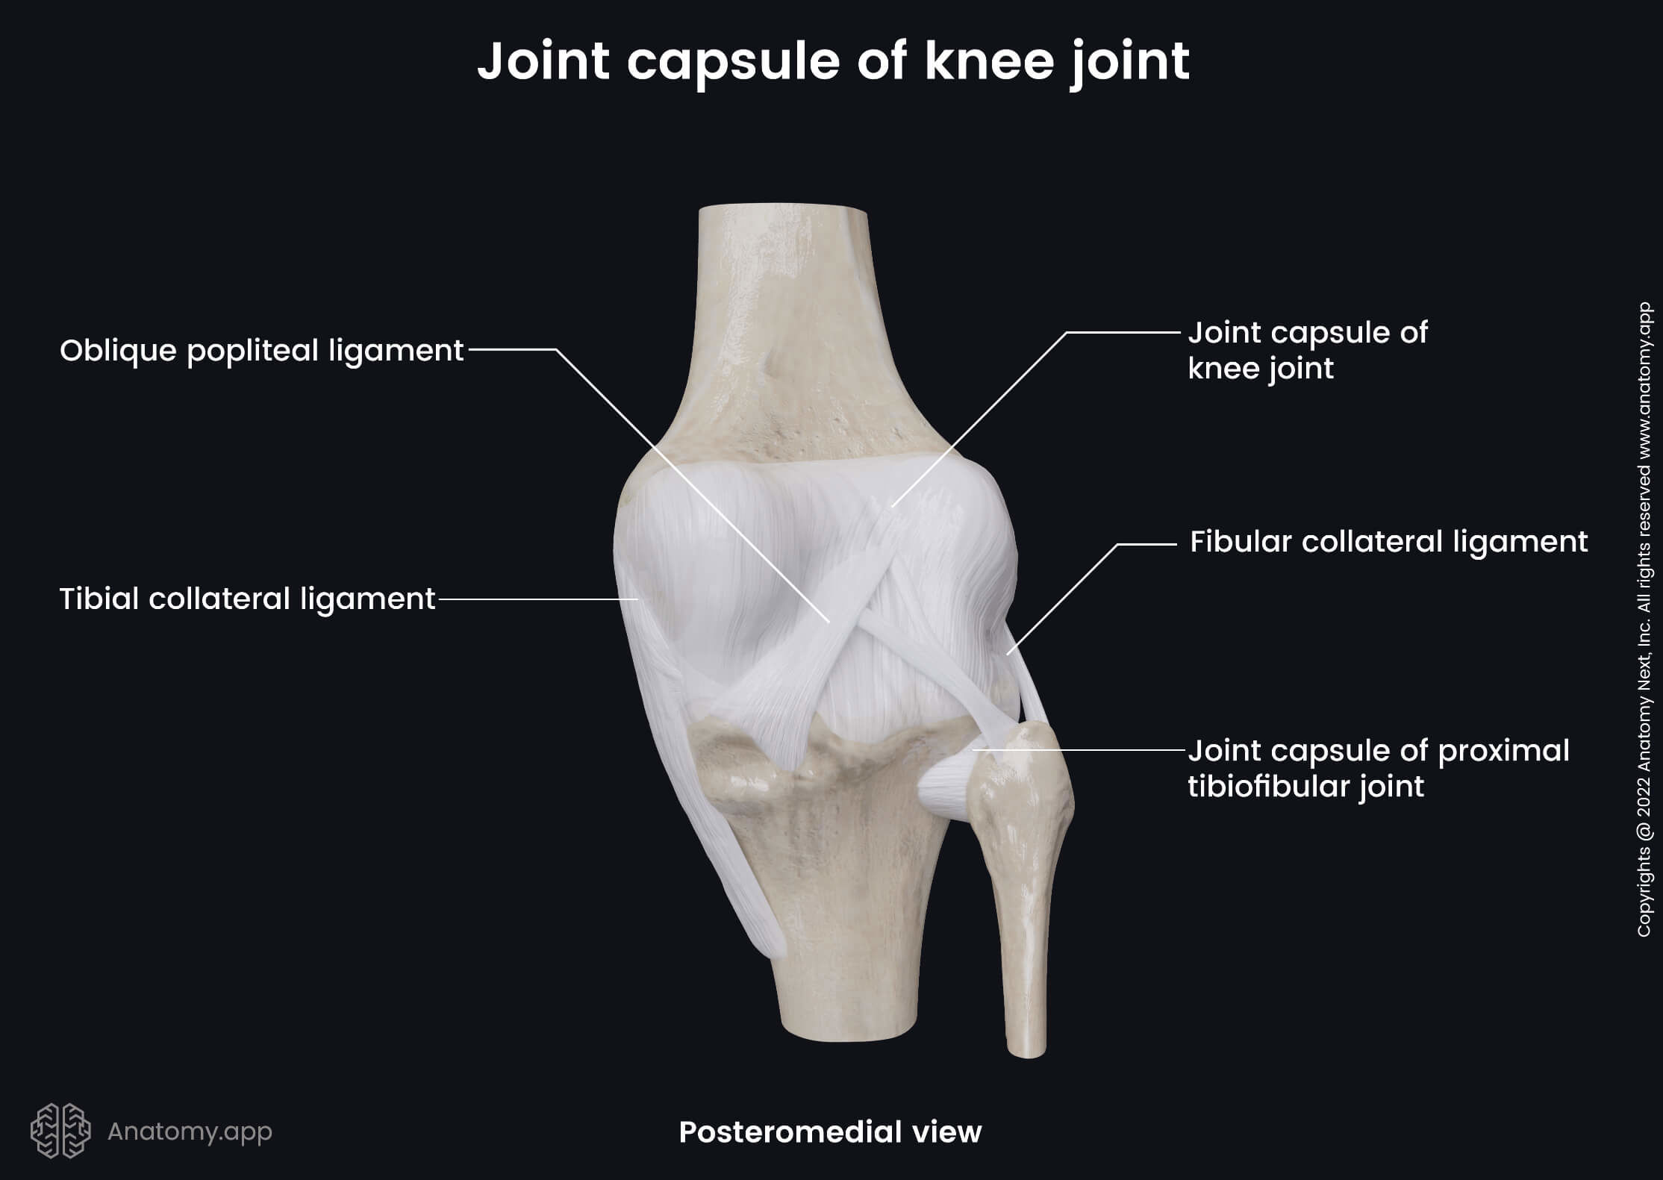

Slide 12
Synovial Membrane
Lines inner surface of fibrous capsule
Does NOT cover:
  Articular cartilage
  Cruciate ligaments (intracapsular but extrasynovial)
Forms:
  Suprapatellar pouch (extends upward)
Covers infrapatellar fat pad

Slide 13
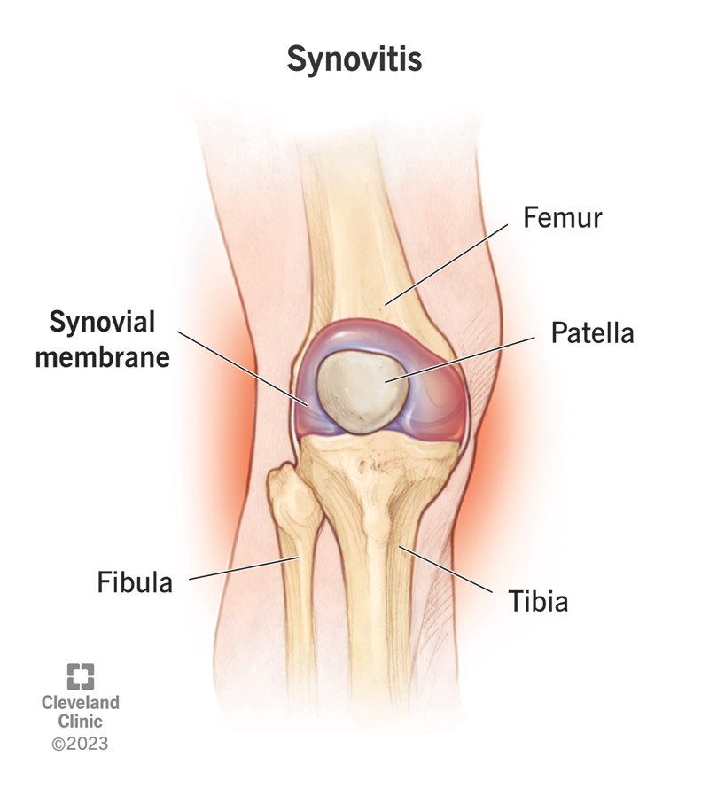

Slide 14
Extracapsular Ligaments
Patellar ligament:
  Continuation of quadriceps tendon
  From patella → tibial tuberosity
Tibial (medial) collateral ligament:
  From medial femoral condyle → medial tibia
Fibular (lateral) collateral ligament:
  From lateral femoral condyle → head of fibula

Slide 16
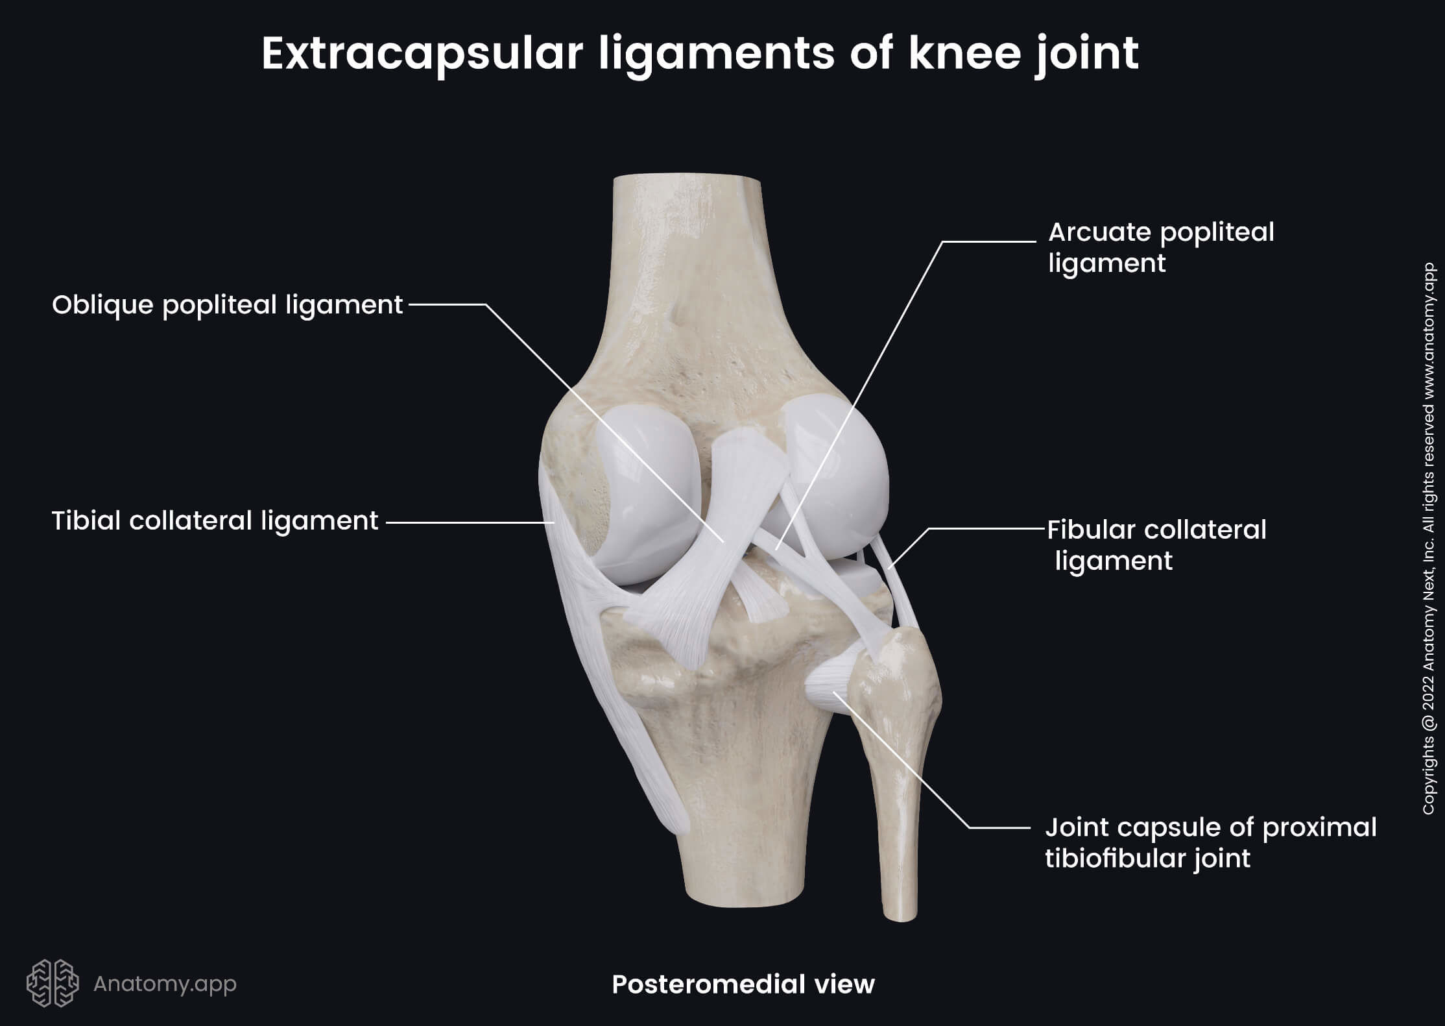

Slide 17
CONTINUED
Oblique popliteal ligament:
  Expansion from semimembranosus tendon
Arcuate popliteal ligament:
  Strengthens posterior capsule

Slide 19
Intracapsular Ligaments
Anterior cruciate ligament (ACL)
Posterior cruciate ligament (PCL)

Slide 20
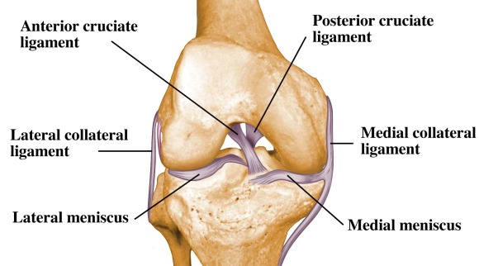

Slide 21
Anterior Cruciate Ligament (ACL)
Attachment:
  Anterior intercondylar area of tibia → posterior part of medial surface of lateral femoral condyle
Function:
  Prevents anterior displacement of tibia on femur
  Prevents hyperextension
Taut in extension

Slide 23
Posterior Cruciate Ligament (PCL)
Attachment:
  Posterior intercondylar area of tibia → lateral surface of medial femoral condyle
Function:
  Prevents posterior displacement of tibia
Stronger than ACL

Slide 25
Menisci
Crescent-shaped fibrocartilage
Deepen tibial articular surfaces
Functions:
  Shock absorption
  Stability
  Lubrication

Slide 26
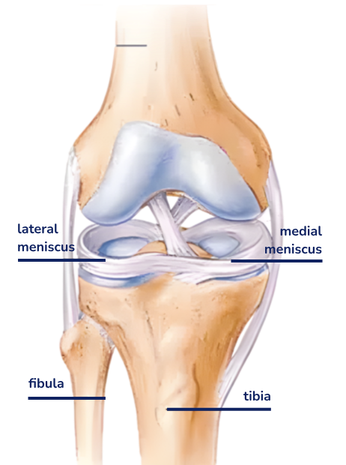

Slide 27
CONTINUED
Medial meniscus:
  C-shaped
  Less mobile
  Commonly injured
Lateral meniscus:
  O-shaped
  More mobile

Slide 28
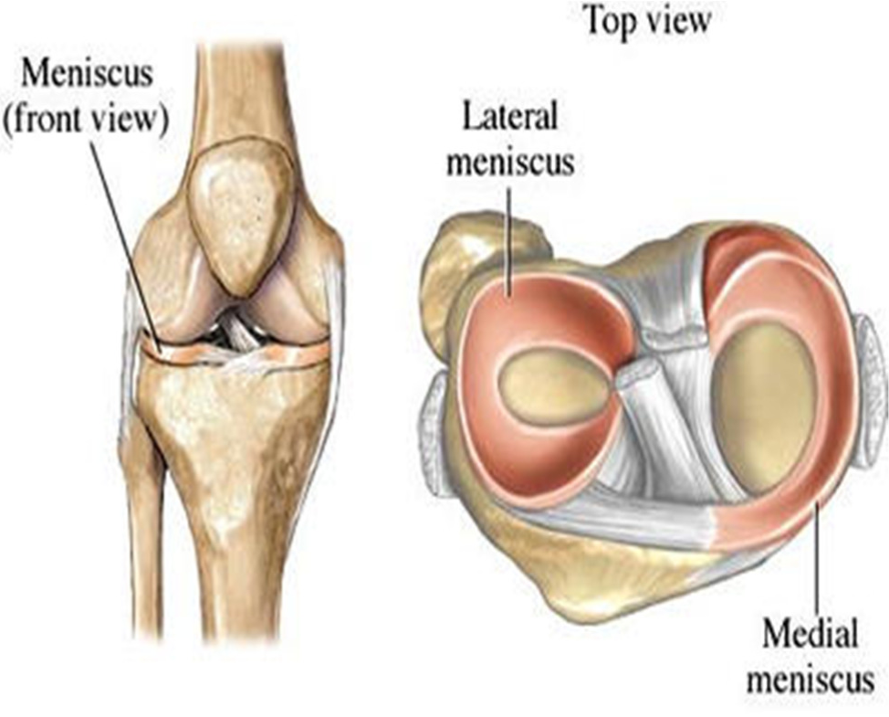

Slide 29
Meniscal Attachments
Meniscal Attachments
Both attached to intercondylar area of tibia
Medial meniscus attached to MCL
Lateral meniscus separated from LCL

Slide 31
Bursae Around Knee
  Suprapatellar
  Prepatellar
  Superficial infrapatellar
  Deep infrapatellar
  Semimembranosus bursa
Some communicate with joint cavity

Slide 32
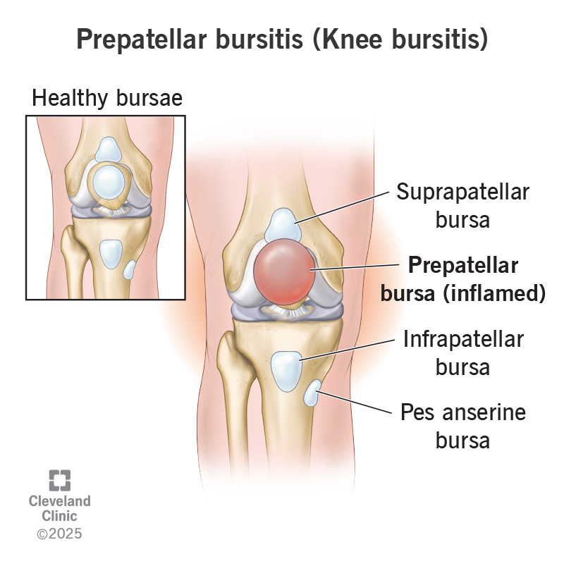

Slide 33
Movements
Flexion:
  By hamstrings
Extension:
  By quadriceps femoris

Slide 34
Locking Mechanism
Occurs during final stage of extension
Femur rotates medially on tibia
Ligaments become taut
Provides stability in standing

Slide 35
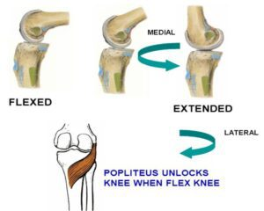

Slide 36
Unlocking Mechanism
Performed by popliteus muscle
Rotates femur laterally on tibia
Initiates flexion

Slide 38
Blood Supply
Branches from:
  Popliteal artery
  Femoral artery
Ensures collateral circulation

Slide 39
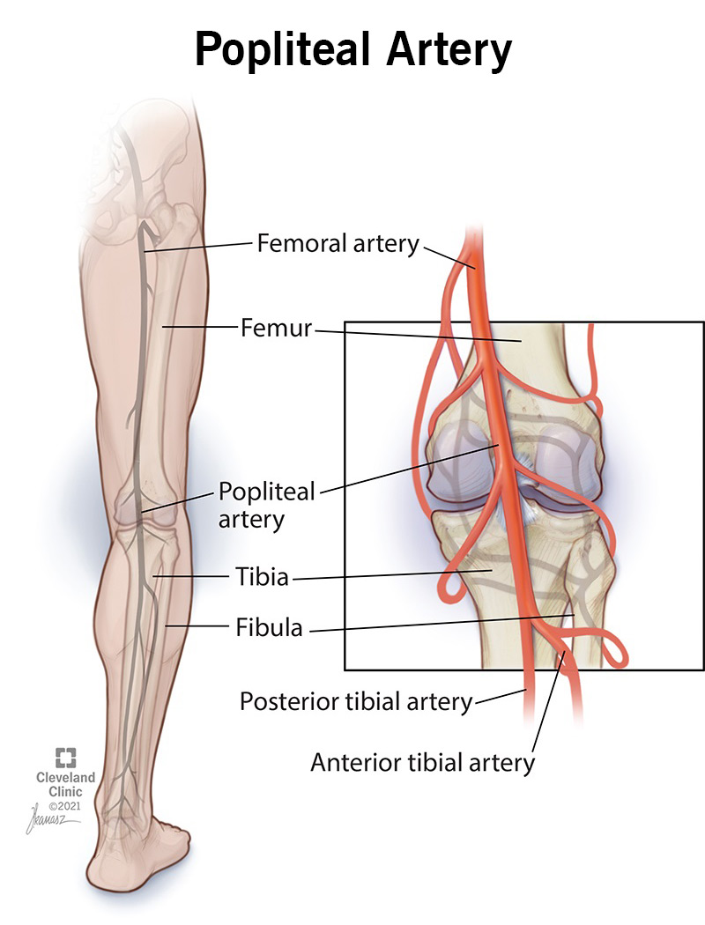

Slide 40
Nerve Supply
  Femoral nerve
  Tibial nerve
  Common fibular nerve
  Obturator nerve

Slide 41
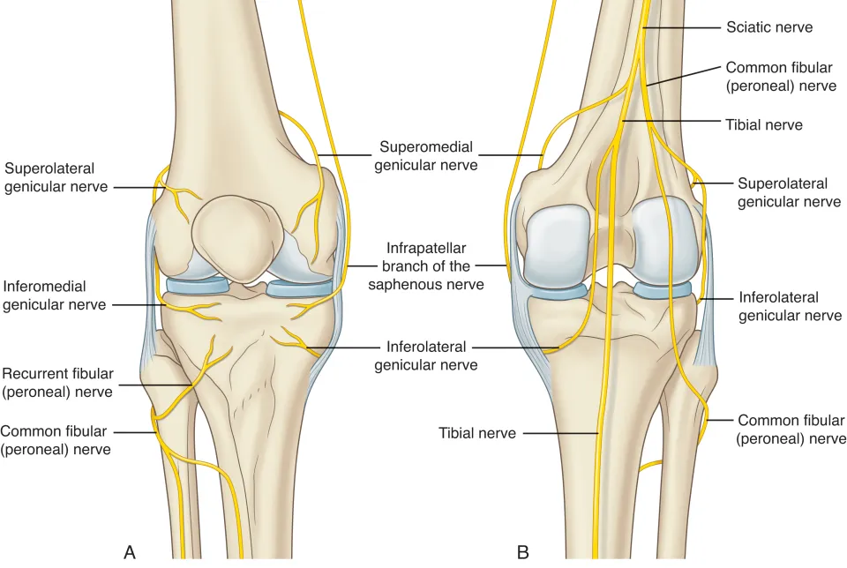

Slide 42


Slide 43


