Slide 1

ANATOMY
THE LOWER LIMB
DPT
2ND SEMESTER
DR DANISH

Slide 2
Hip Joint
Synovial ball-and-socket joint
Articulation between:
  Head of femur
  Acetabulum of hip bone
Designed for:
  Stability (weight-bearing)
  Mobility (wide range of motion)

Slide 3
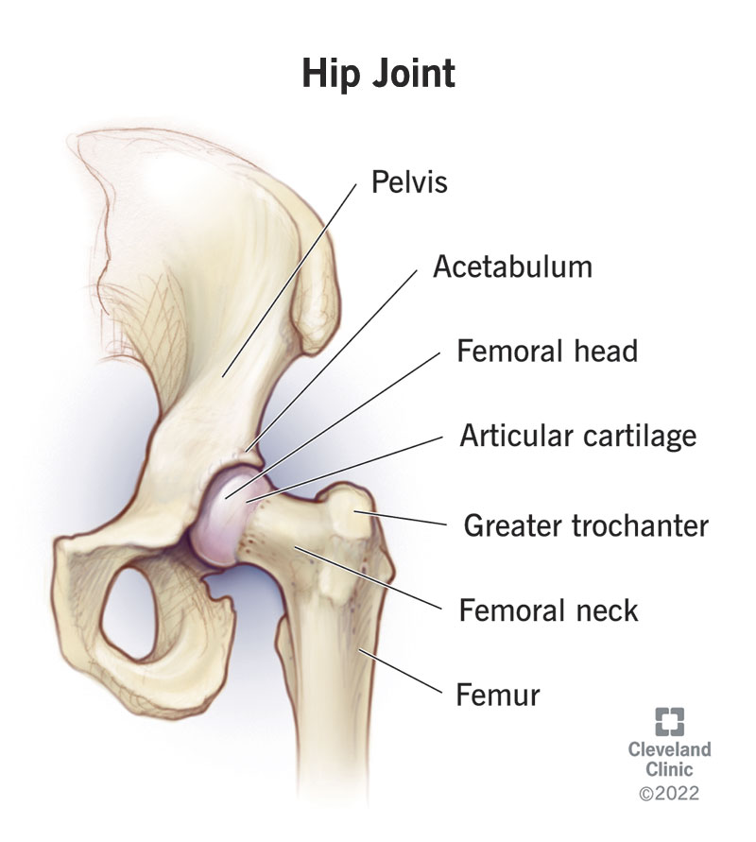

Slide 4
Articular Surfaces
Head of femur
  Covered with hyaline cartilage
  Except at fovea
Acetabulum
  Horseshoe-shaped articular surface
  Deepened by acetabular labrum
Acetabular labrum
  Fibrocartilaginous rim
  Increases depth and stability

Slide 5
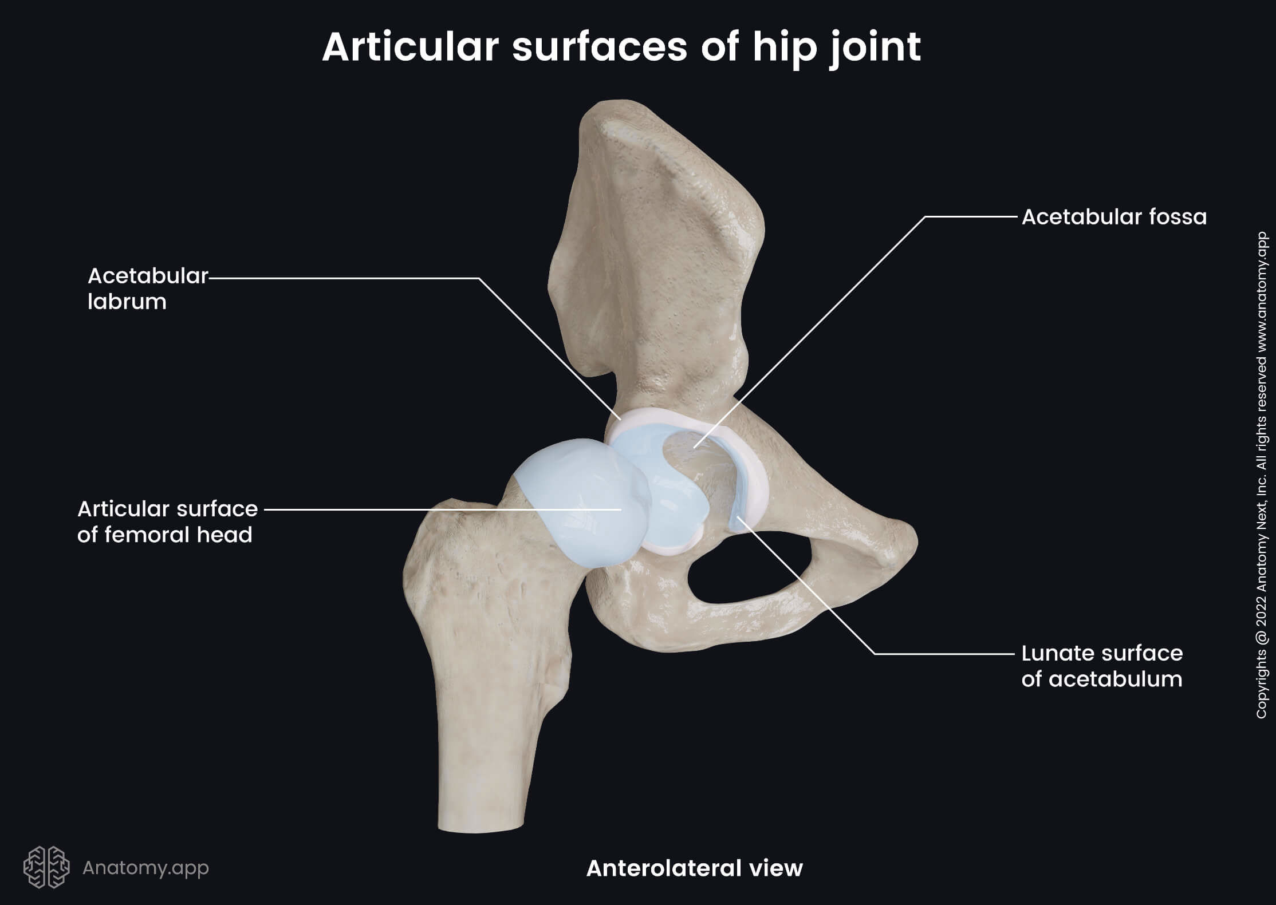

Slide 6
Other Structures
Acetabular notch
  Bridged by transverse acetabular ligament
Ligament of head of femur
  Connects fovea to acetabulum
  Carries blood vessels to femoral head

Slide 7
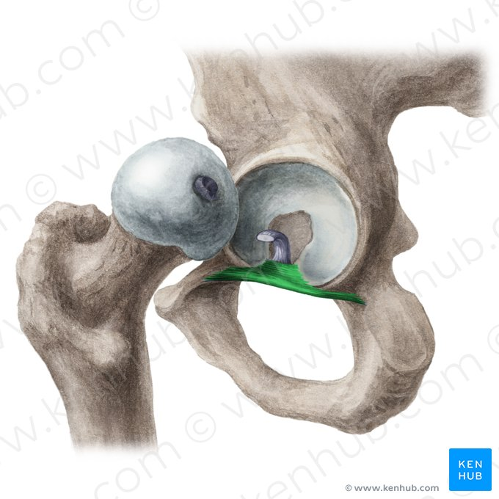

Slide 8
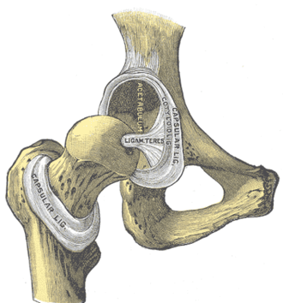

Slide 9
Joint Capsule
Strong fibrous capsule
Attachments:
  Proximally → acetabular margin
  Distally → intertrochanteric line (anteriorly)
  Neck of femur (posteriorly)
Functions:
  Encloses joint
  Provides stability

Slide 10
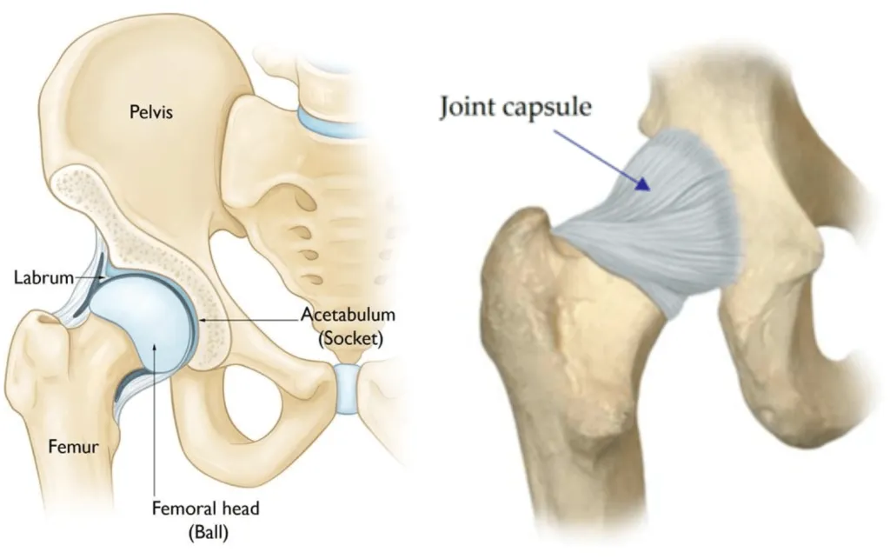

Slide 11
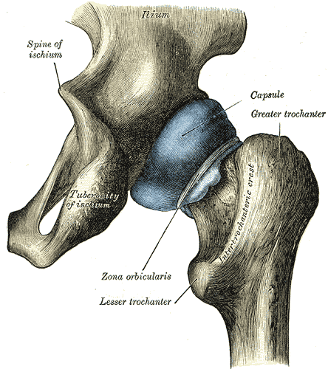

Slide 12
Synovial Membrane
Lines inner surface of capsule
Covers:
  Neck of femur
  Ligament of head of femur
Produces synovial fluid:
  Lubrication
  Nutrition of cartilage

Slide 13
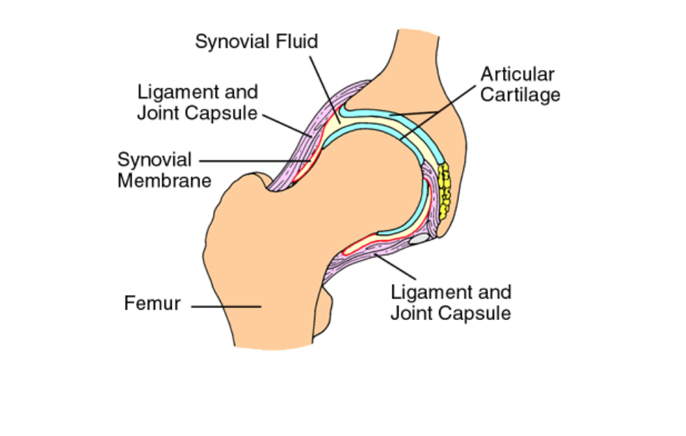

Slide 14
Major Ligaments of Hip Joint
Iliofemoral ligament
Pubofemoral ligament
Ischiofemoral ligament
Ligament of head of femur
Transverse acetabular ligament

Slide 15
Iliofemoral Ligament
Strongest ligament in body
Y-shaped
Prevents hyperextension
Maintains upright posture

Slide 16
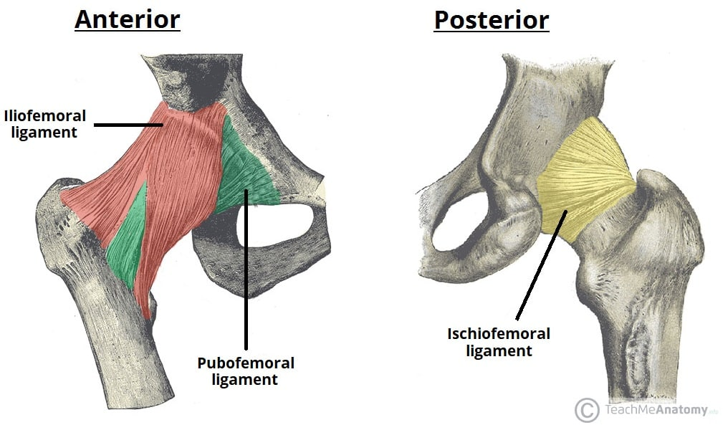

Slide 17
Pubofemoral Ligament
Located anteroinferiorly
Limits:
  Abduction
  Extension

Slide 18
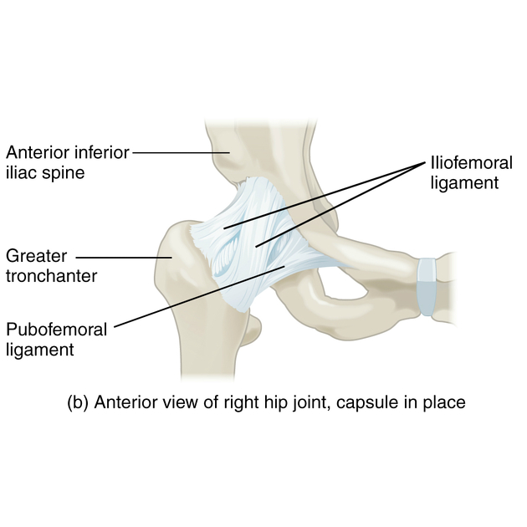

Slide 19
Ischiofemoral Ligament
Located posteriorly
Spiral orientation
Limits:
  Medial rotation
  Extension

Slide 21
Blood Supply
Mainly from:
  Medial circumflex femoral artery
  Lateral circumflex femoral artery
Retinacular arteries supply head and neck
Artery of ligament (minor role)

Slide 22
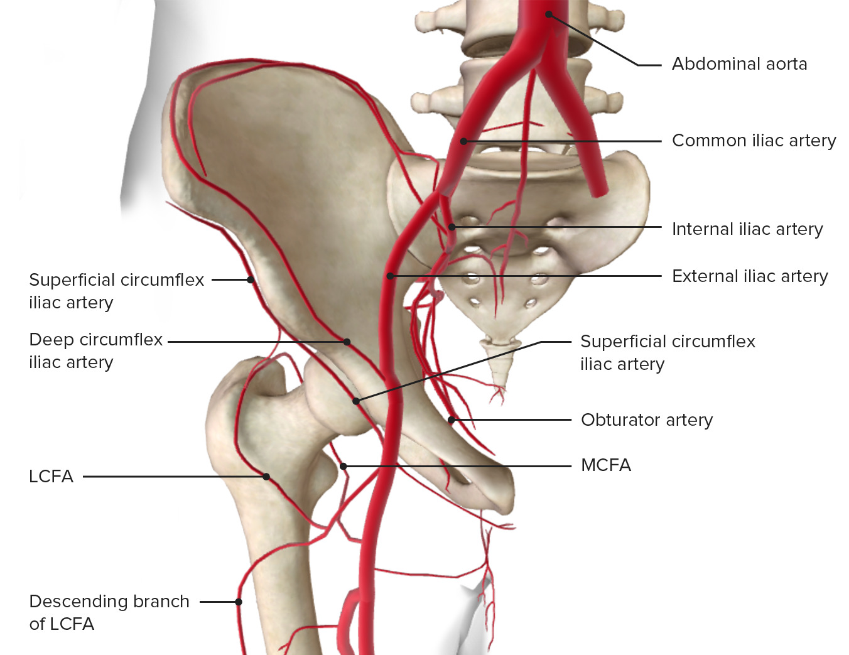

Slide 23
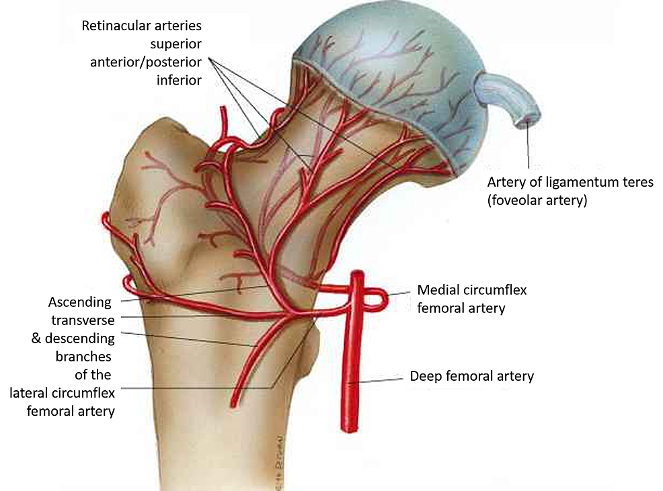

Slide 24
Nerve Supply
Femoral nerve
Obturator nerve
Nerve to quadratus femoris
Superior gluteal nerve

Slide 25
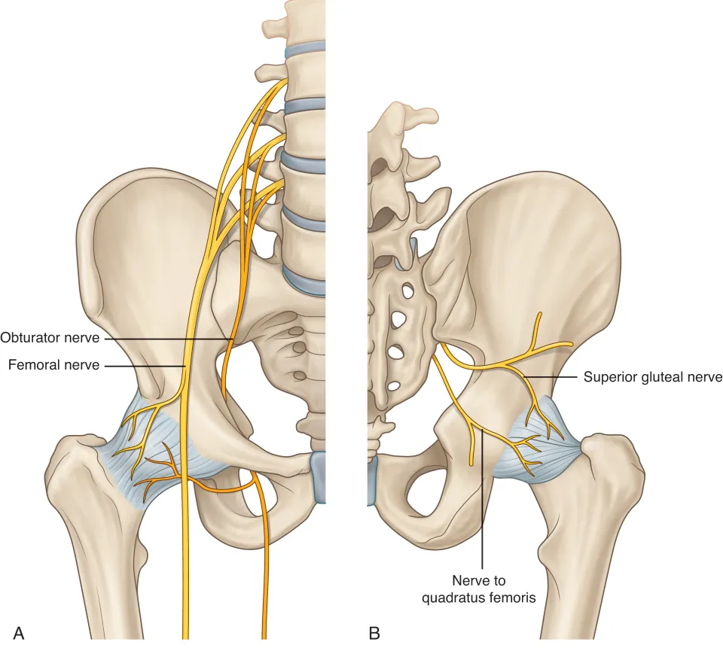

Slide 26
Movements at Hip Joint
Flexion
Extension
Abduction
Adduction
Medial rotation
Lateral rotation
Circumduction

Slide 27
Stability of Hip Joint
Factors contributing:
  Deep acetabulum
  Acetabular labrum
  Strong ligaments
  Surrounding muscles
Stability > mobility compared to shoulder

Slide 28
Clinical – Referred Pain
Pain may be felt in:
  Knee (via obturator nerve)
Important in diagnosis of hip pathology

Slide 29
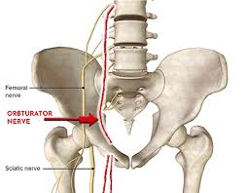

Slide 30
Congenital Hip Dislocation
Developmental abnormality
Shallow acetabulum
Head of femur easily displaced
Requires early treatment

Slide 31
Traumatic Dislocation
Usually posterior
Causes:
  High-force injuries
May damage:
  Sciatic nerve
  Blood supply to femoral head

Slide 32
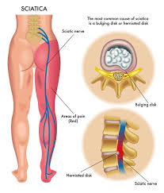

Slide 33
Trendelenburg Sign
Indicates weak hip abductors
Pelvis drops on opposite side
Caused by:
  Gluteus medius/minimus weakness
  Superior gluteal nerve injury

Slide 34
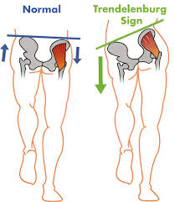

Slide 35
Hip Joint Arthritis
Degeneration of joint
Symptoms:
  Pain
  Stiffness
  Reduced movement
Common in elderly

Slide 36


Slide 37


