Slide 1

ANATOMY
THE THORAX
BS RIT,OTT
2ND SEMESTER
DR DANISH

Slide 2
Diaphragmatic Function
The diaphragm has four main functions:
Muscle of inspiration
Muscle of abdominal straining
Weight-lifting muscle
Thoracoabdominal pump

Slide 3
Muscle of Inspiration
On contraction, the diaphragm:
  Pulls its central tendon downward
  Increases the vertical diameter of the thorax
It is the most important muscle in inspiration

Slide 4
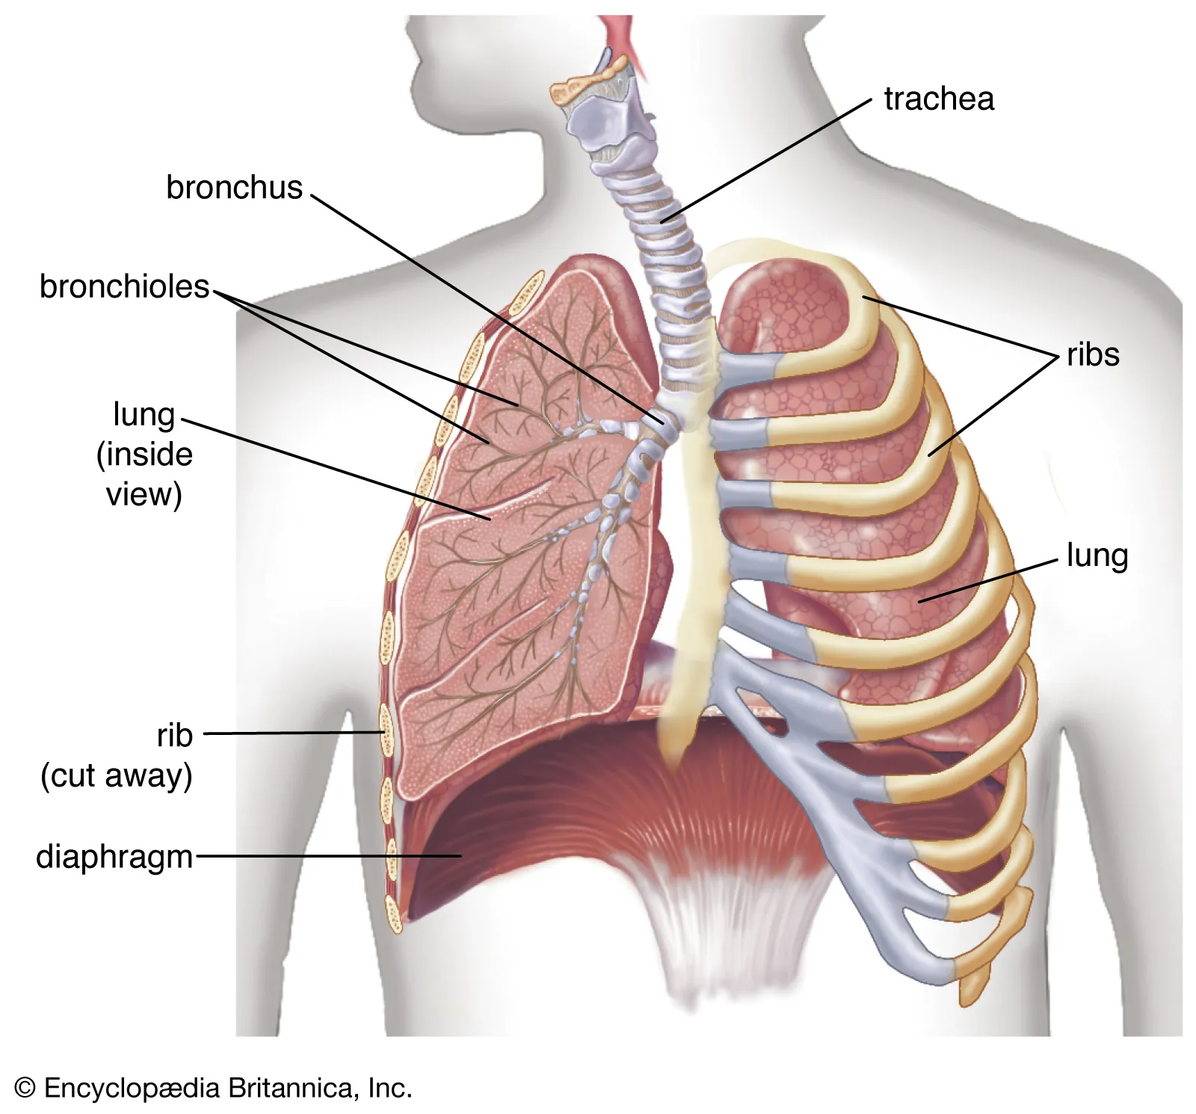

Slide 5
Muscle of Abdominal Straining
Assists contraction of anterolateral abdominal wall muscles
Raises intra-abdominal pressure
Important for:
  Defecation
  Micturition
  Parturition
Closing the glottis helps increase effectiveness
Air trapped → produces a grunting sound

Slide 6
Weight-Lifting Function
During deep breath + breath holding:
  Diaphragm is fixed
  Helps raise intra-abdominal pressure
Supports:
  Vertebral column
  Prevents flexion
Assists in lifting heavy weights
Requires proper sphincter control

Slide 7
Thoracoabdominal Pump
Diaphragm contraction:
  ↓ Intrathoracic pressure
  ↑ Intra-abdominal pressure
Effects:
  Compresses blood in inferior vena cava
  Pushes blood to right atrium
  Helps lymph flow via thoracic duct
  Valves prevent backflow

Slide 8
Diaphragm Openings
Three main openings:
Aortic opening (T12)
Esophageal opening (T10)
Caval opening (T8)

Slide 9
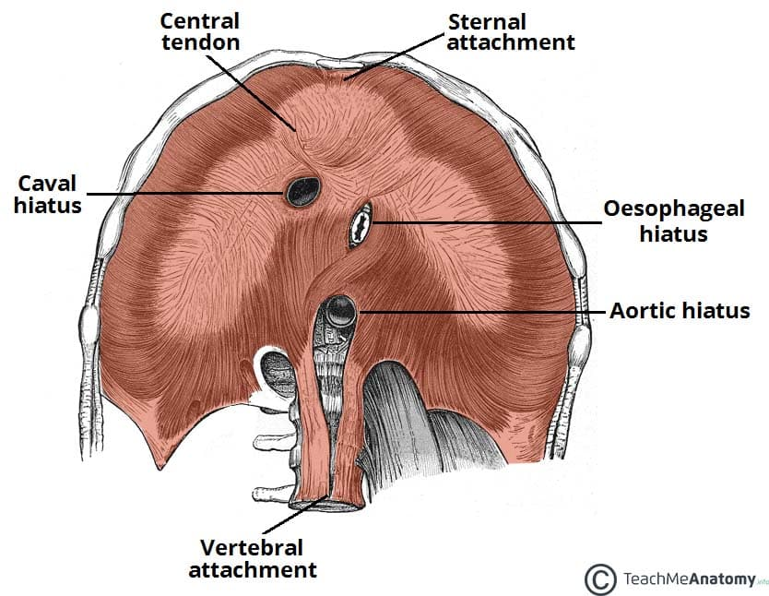

Slide 10
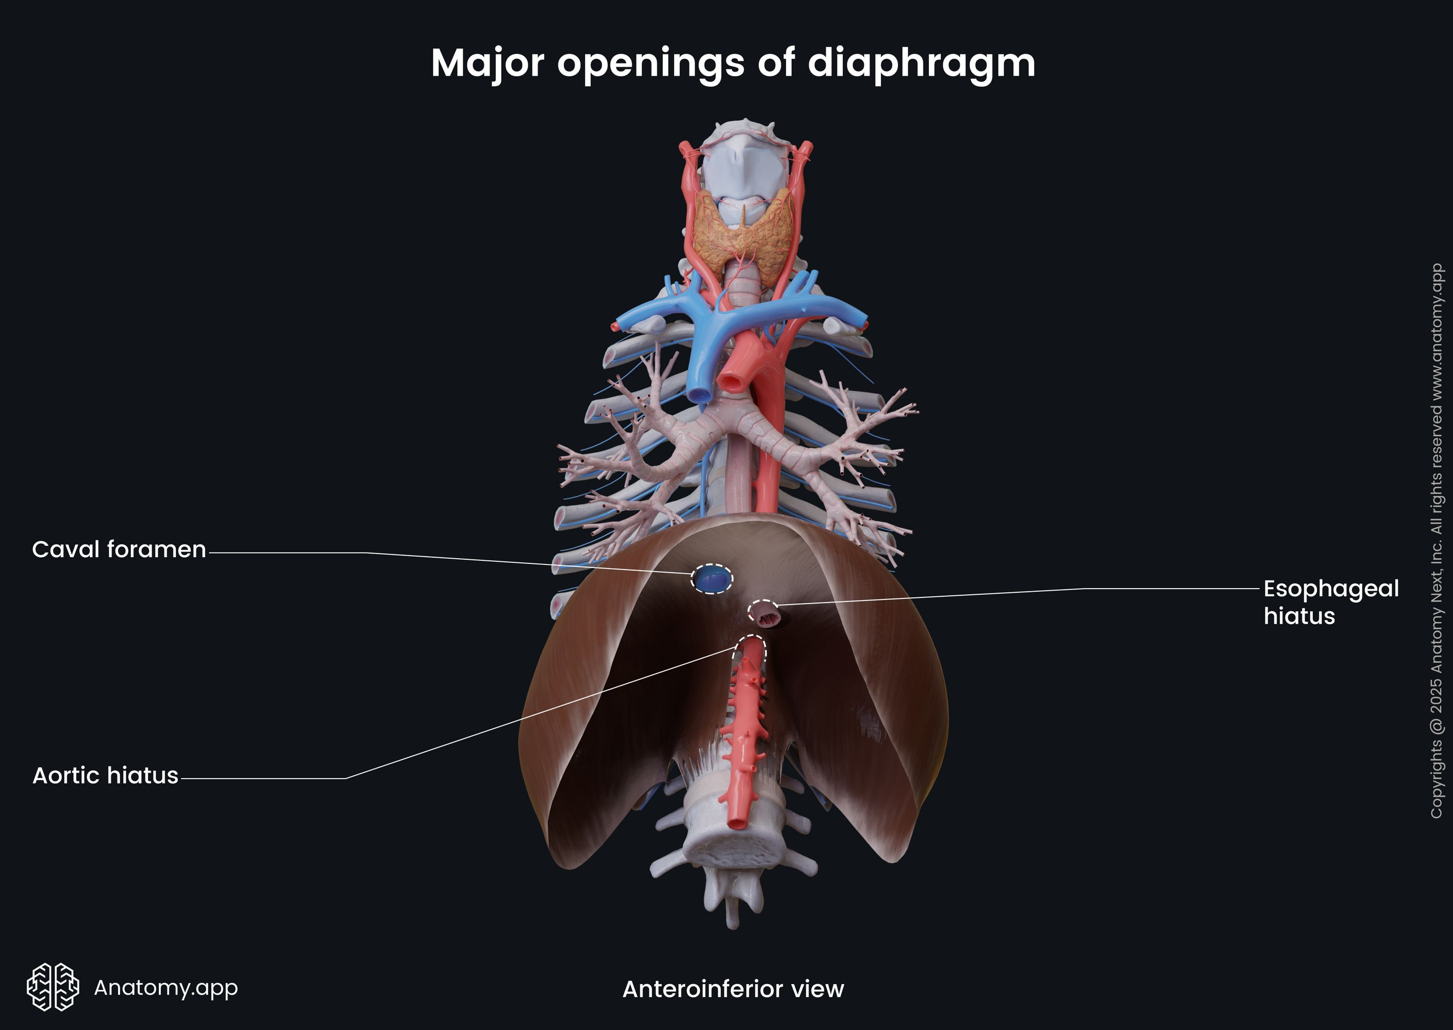

Slide 11
Aortic Opening (T12)
Located:
  Anterior to body of T12 vertebra
  Between the crura
Transmits:
  Aorta
  Thoracic duct
  Azygos vein
Not a true opening → lies behind diaphragm

Slide 13
Esophageal Opening (T10)
Located in:
  Muscle fibers from right crus
Transmits:
  Esophagus
  Right & left vagus nerves
  Esophageal branches of left gastric vessels
  Lymphatics

Slide 16
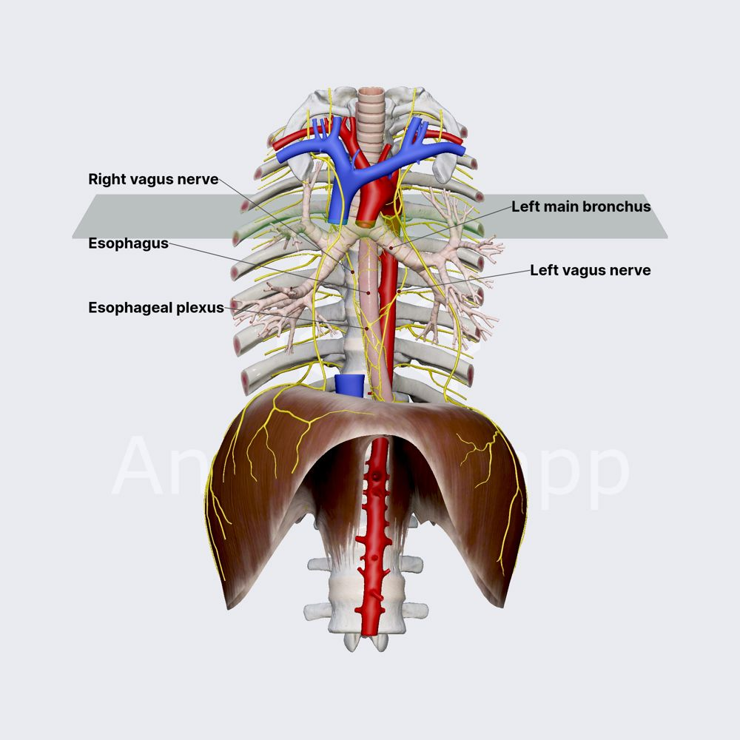

Slide 17
Caval Opening (T8)
Located in central tendon
Transmits:
  Inferior vena cava
  Terminal branches of right phrenic nerve

Slide 19
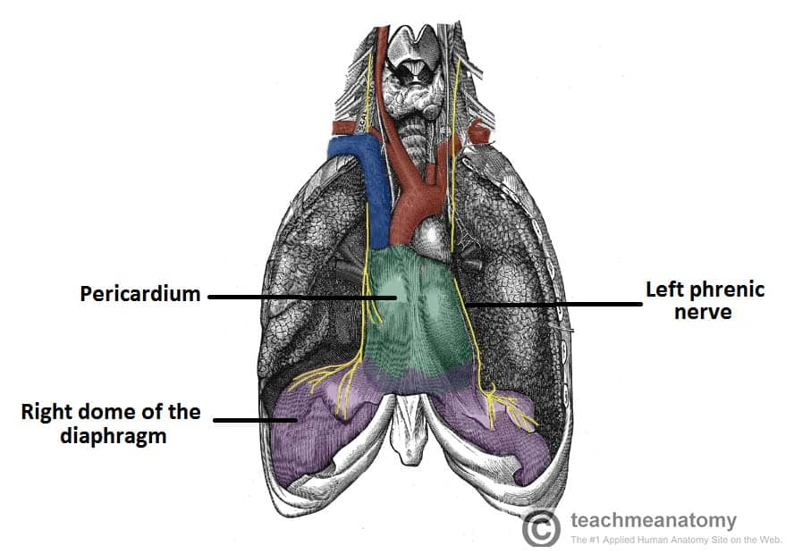

Slide 20
Blood Supply of Diaphragm
Superior (thoracic side):
  Pericardiacophrenic arteries
  Musculophrenic arteries
Inferior (abdominal side):
  Inferior phrenic arteries
Veins follow arteries

Slide 21
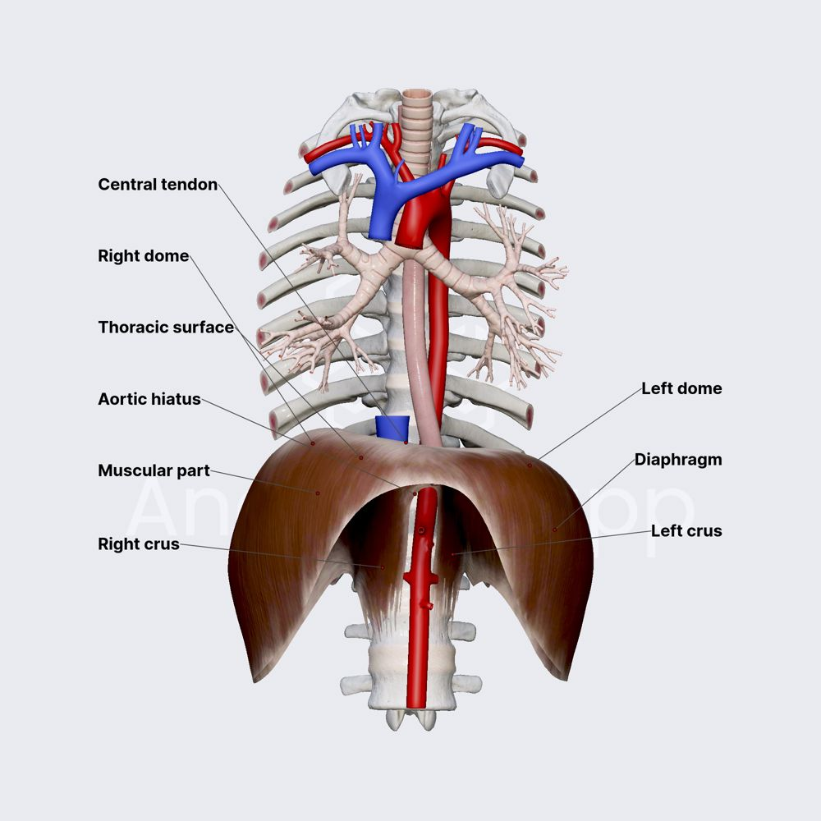

Slide 22
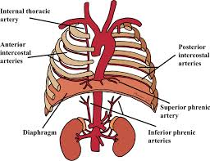

Slide 23
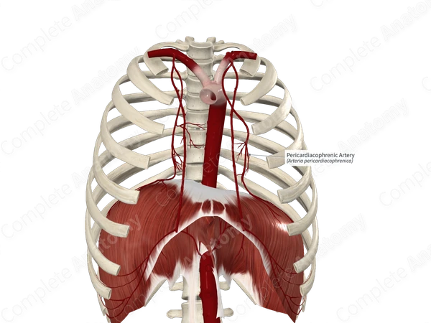

Slide 24
Nerve Supply of Diaphragm
Phrenic nerves (C3–C5):
  Provide motor supply
  Supply ipsilateral half
Sensory:
  Central: phrenic nerve
  Peripheral: intercostal (T6–T11) & subcostal nerves

Slide 26
Diaphragmatic Action
Contraction:
  Pulls down central tendon
  Increases thoracic volume
Results:
  Inspiration → diaphragm flattens
  Expiration → diaphragm elevates

Slide 27
Levatores Costarum
12 pairs of muscles
Each:
  Triangular
  Inserts into rib below
Function:
  Elevate ribs
  Role in respiration is questionable
  May act as proprioceptive devices

Slide 28
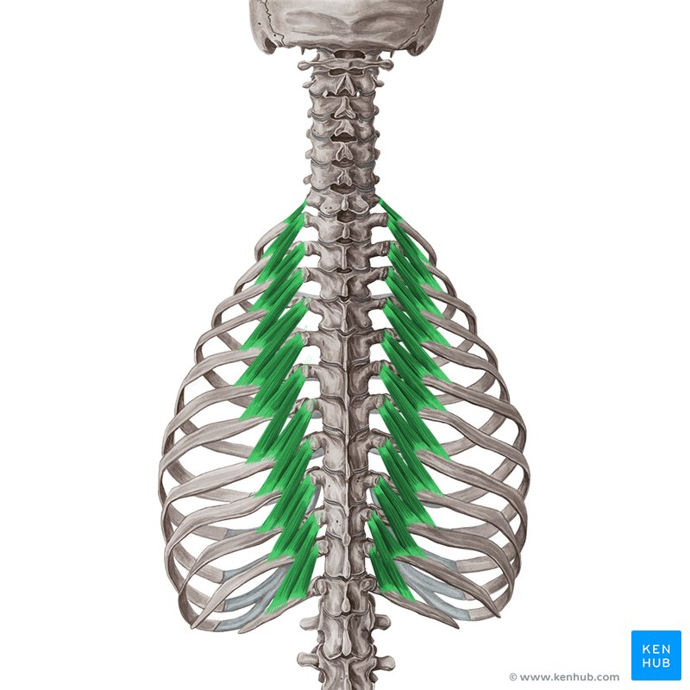

Slide 29
Serratus Posterior Muscles
Includes:
Serratus posterior superior
Serratus posterior inferior
Characteristics:
Thin, flat muscles
Intermediate back layer

Slide 30
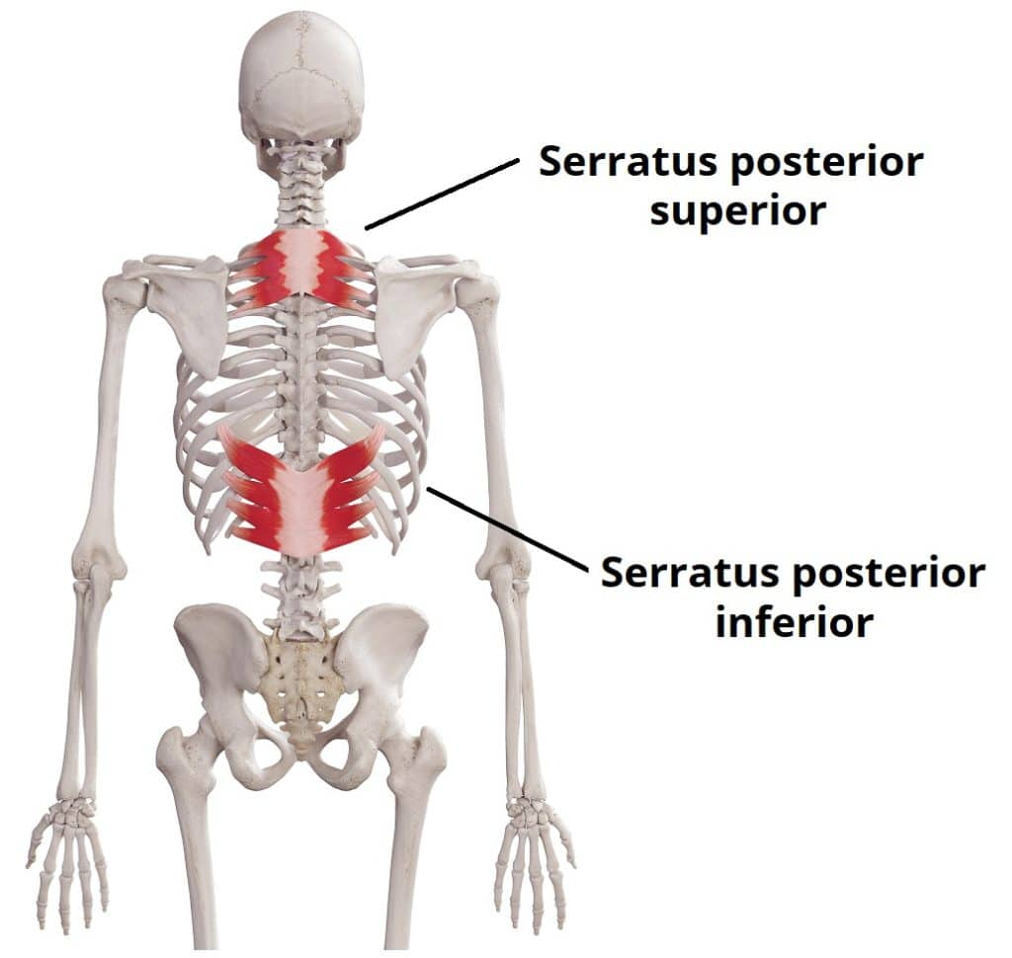

Slide 31
Serratus Posterior Superior
Passes:
  Downward & laterally
Inserts into:
  Upper ribs
Traditionally:
  Assists inspiration (elevates ribs)

Slide 33
Serratus Posterior Inferior
Passes:
  Upward & laterally
Inserts into:
  Lower ribs
Traditionally:
  Assists expiration (depresses ribs)

Slide 35
Thoracic Wall Nerves
Intercostal nerves:
  Supply the entire thoracic wall

Slide 36
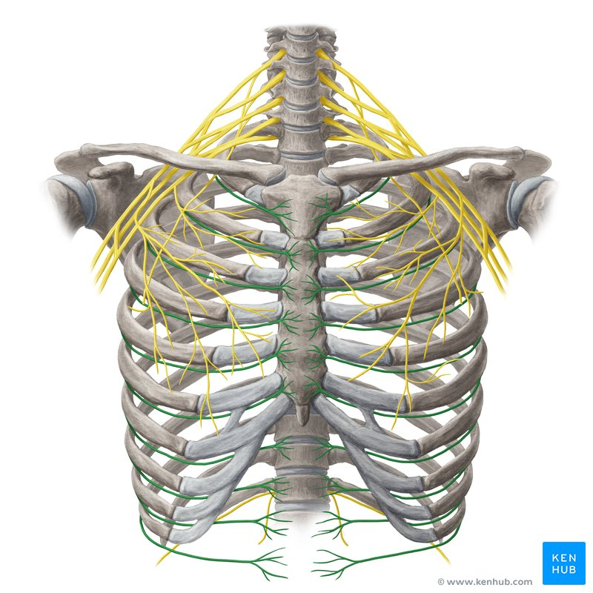

Slide 37


Slide 38


