Slide 1

PHARMACOLOGY
BS RIT,OTT,MLT
2ND SEMESTER
DR DANISH

Slide 2
Drug Clearance Through Metabolism
Drug clearance = removal of drug from the body
Major organs:
  Liver (main site)
  Kidneys
Two main processes:
  Metabolism (biotransformation)
  Excretion

Slide 3
What is Drug Metabolism?
Conversion of lipid-soluble drugs → water-soluble drugs
Makes drugs easier to eliminate
Mostly occurs in:
  Liver (hepatocytes)
Example:
Diazepam (fat-soluble) → metabolized → excreted in urine

Slide 4
Goals of Metabolism
Inactivate drugs
Increase water solubility
Prepare drugs for excretion
Example:
Codeine → converted to morphine (more active)

Slide 5
Phases of Drug Metabolism
Phase I (Functionalization Reactions)
Adds or exposes functional groups (–OH, –NH₂)
Reactions:
  Oxidation
  Reduction
  Hydrolysis
Enzyme system:
  Cytochrome P450 (CYP450)
Example:
Propranolol → oxidized in liver

Slide 6
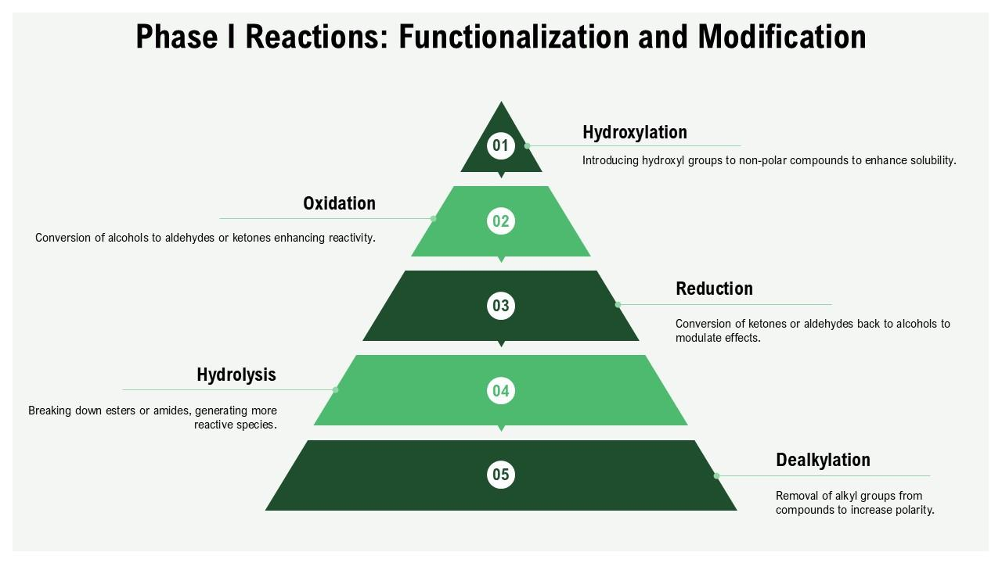

Slide 7
Phase II (Conjugation Reactions)
Drug combines with another substance
Forms highly water-soluble compounds
Common conjugations:
  Glucuronidation
  Sulfation
  Acetylation
Example:
Paracetamol → glucuronide conjugate → excreted

Slide 8
Cytochrome P450 System
Located in:
  Smooth endoplasmic reticulum of liver
Important enzymes:
  CYP3A4 (most important)
Functions:
  Oxidizes many drugs
👉 Example:
Statins metabolized by CYP3A4

Slide 9
Cytochrome P450 System
Located in:
  Smooth endoplasmic reticulum of liver
Important enzymes:
  CYP3A4 (most important)
Functions:
  Oxidizes many drugs
Example:
Statins metabolized by CYP3A4

Slide 10
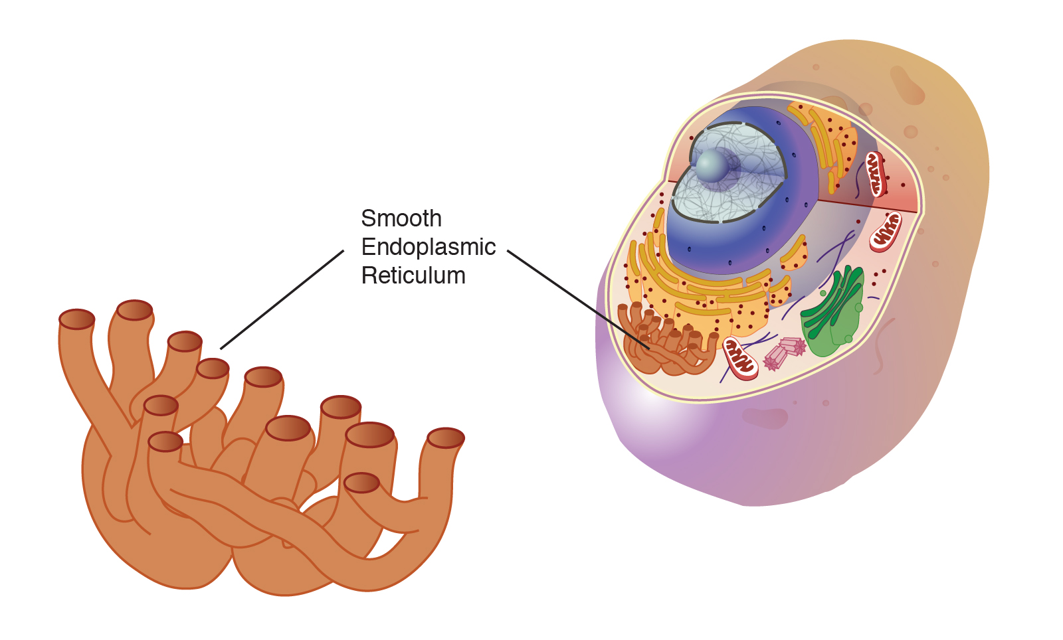

Slide 11
First-Pass Metabolism
Drug metabolized before reaching systemic circulation
Occurs in:
  Liver
  Intestinal wall
Example:
Nitroglycerin (extensive first-pass effect)
  Given sublingually to avoid liver metabolism

Slide 12
Factors Affecting Drug Metabolism
Genetic Factors
Some people metabolize drugs faster/slower

Slide 13
Age
Neonates: low enzyme activity
Elderly: reduced liver function

Slide 14
Liver Disease
Reduced metabolism
Example:
Cirrhosis → drug accumulation

Slide 15
Enzyme Induction
Increased enzyme activity → faster metabolism
↓ drug effect
Example:
Rifampin induces CYP450 → reduces oral contraceptive effect

Slide 16
Enzyme Inhibition
Decreased metabolism → drug accumulation
↑ toxicity risk
Example:
Cimetidine inhibits CYP450

Slide 17
Conclusion
Metabolism mainly in liver
Two phases:
  Phase I (modification)
  Phase II (conjugation)
CYP450 system plays key role
Affects drug efficacy & safety

Slide 18
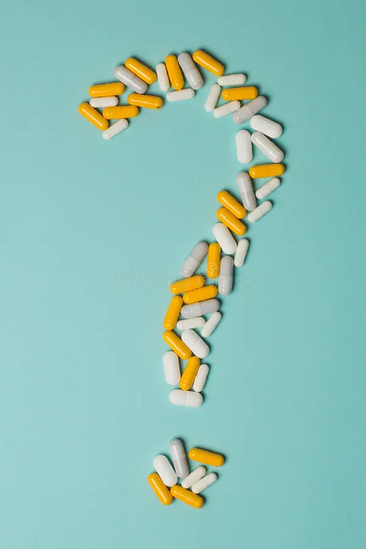

Slide 19


