Slide 1
Pre-Writing
Writing Process | Expository Writing
BS Psy & DPT
Hafsa Rasheed

Slide 2
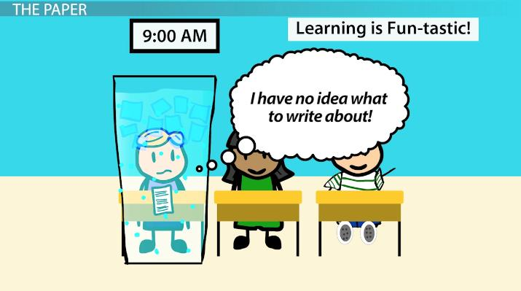

Slide 3
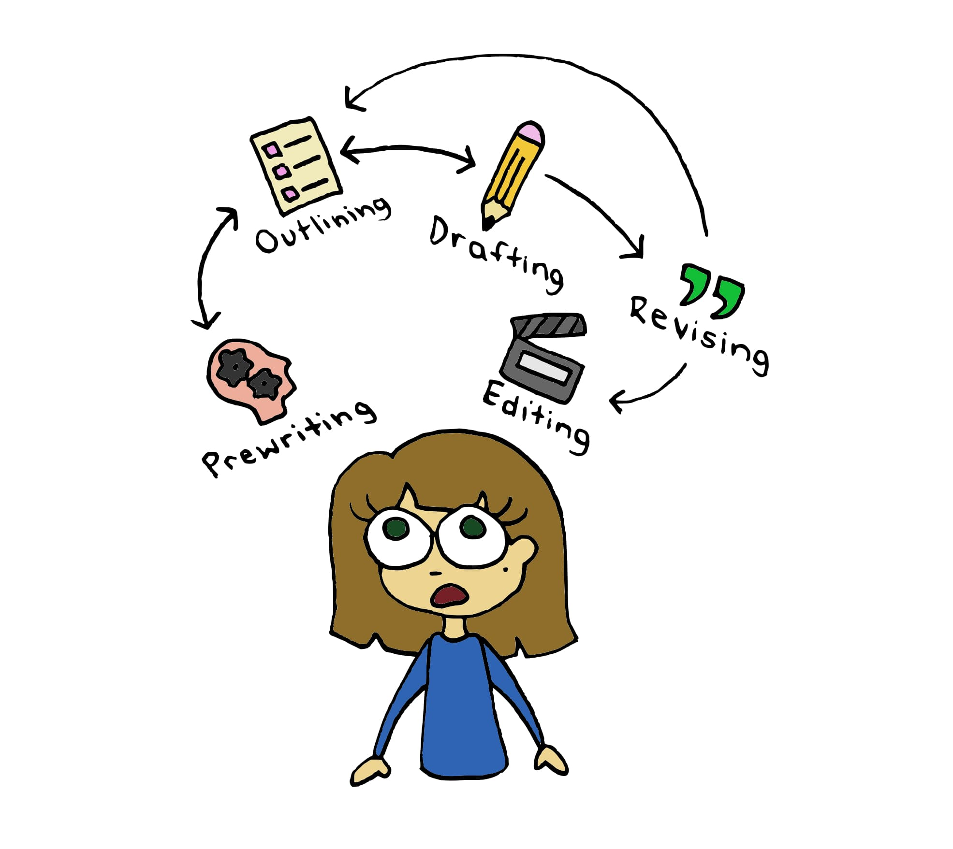

Slide 4
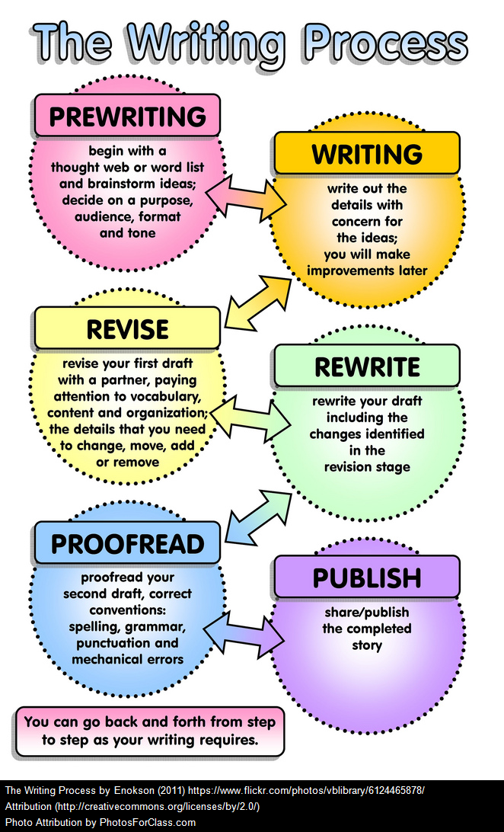

Slide 5
What is Pre-Writing?
Pre-writing is the first stage of the writing process, where writers:
-- Generate ideas
-- Explore topics
-- Plan structure
-- Clarify purpose and audience
👉 It is the thinking stage before actual writing begins
🎯 Key Purpose:
To transform: ❌ vague thoughts → ✅ clear, organized ideas

Slide 6
Theoretical Background of Pre-Writing
1. Donald M. Murray (1960s–1970s)
Book: “A Writer Teaches Writing” (1968)
Contribution:
Introduced writing as a process
Emphasized pre-writing as discovery
👉 His famous idea: “Writing is not a product, but a process.”

Slide 7
Continued. . .
2. Janet Emig (1971)
Work: “The Composing Processes of Twelfth Graders”
Contribution:
- Studied how students actually write
- Highlighted recursive nature of writing
👉 Pre-writing is not linear—it can repeat and evolve

Slide 8
To Describe
3. Linda Flower & John R. Hayes (1981)
Model: Cognitive Process Theory of Writing
Contribution: Defined writing as:
- Planning
- Translating
- Reviewing
👉 Pre-writing = Planning Stage

Slide 9
4. Peter Elbow (1973)
Book: “Writing Without Teachers”
Contribution:
- Introduced Freewriting
👉 Focus: - Remove fear
- Encourage idea flow
5. Tony Buzan (1970s)
Concept: Mind Mapping
Contribution:
Visual thinking technique

Slide 10
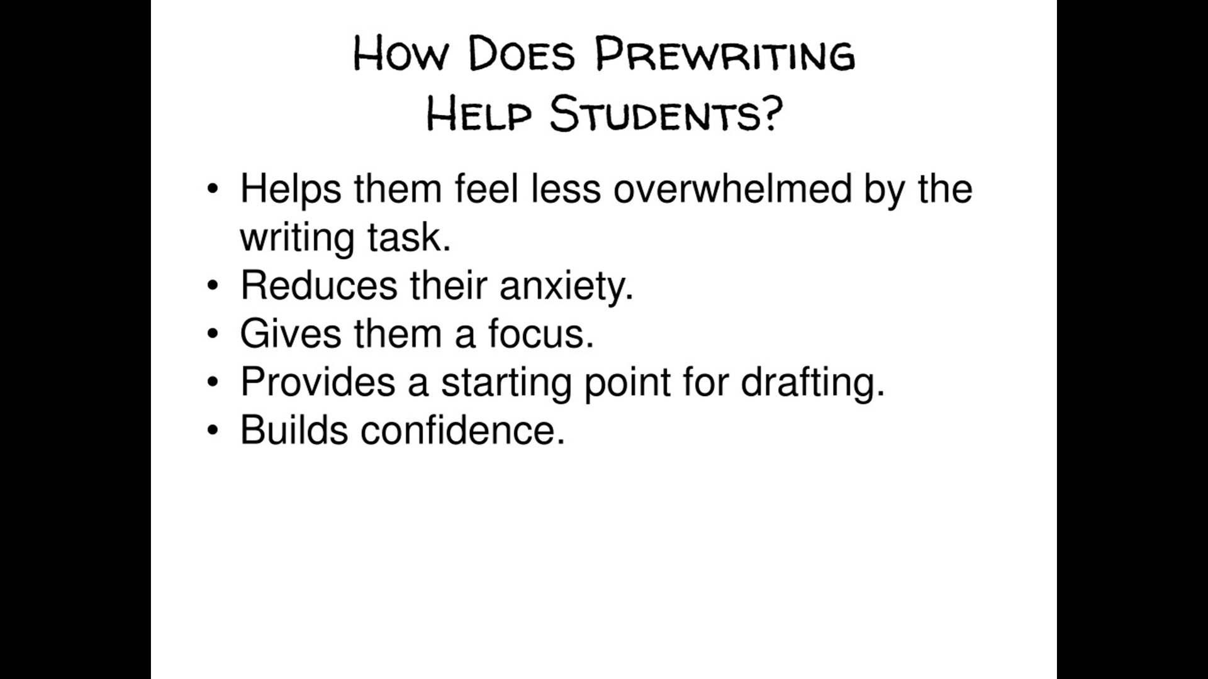
Importance of Pre-Writing
Pre-writing helps to:
✔ Generate ideas
✔ Organize thoughts
✔ Avoid writer’s block
✔ Improve clarity
✔ Strengthen thesis
👉 Without pre-writing
= weak structure + poor development

Slide 11
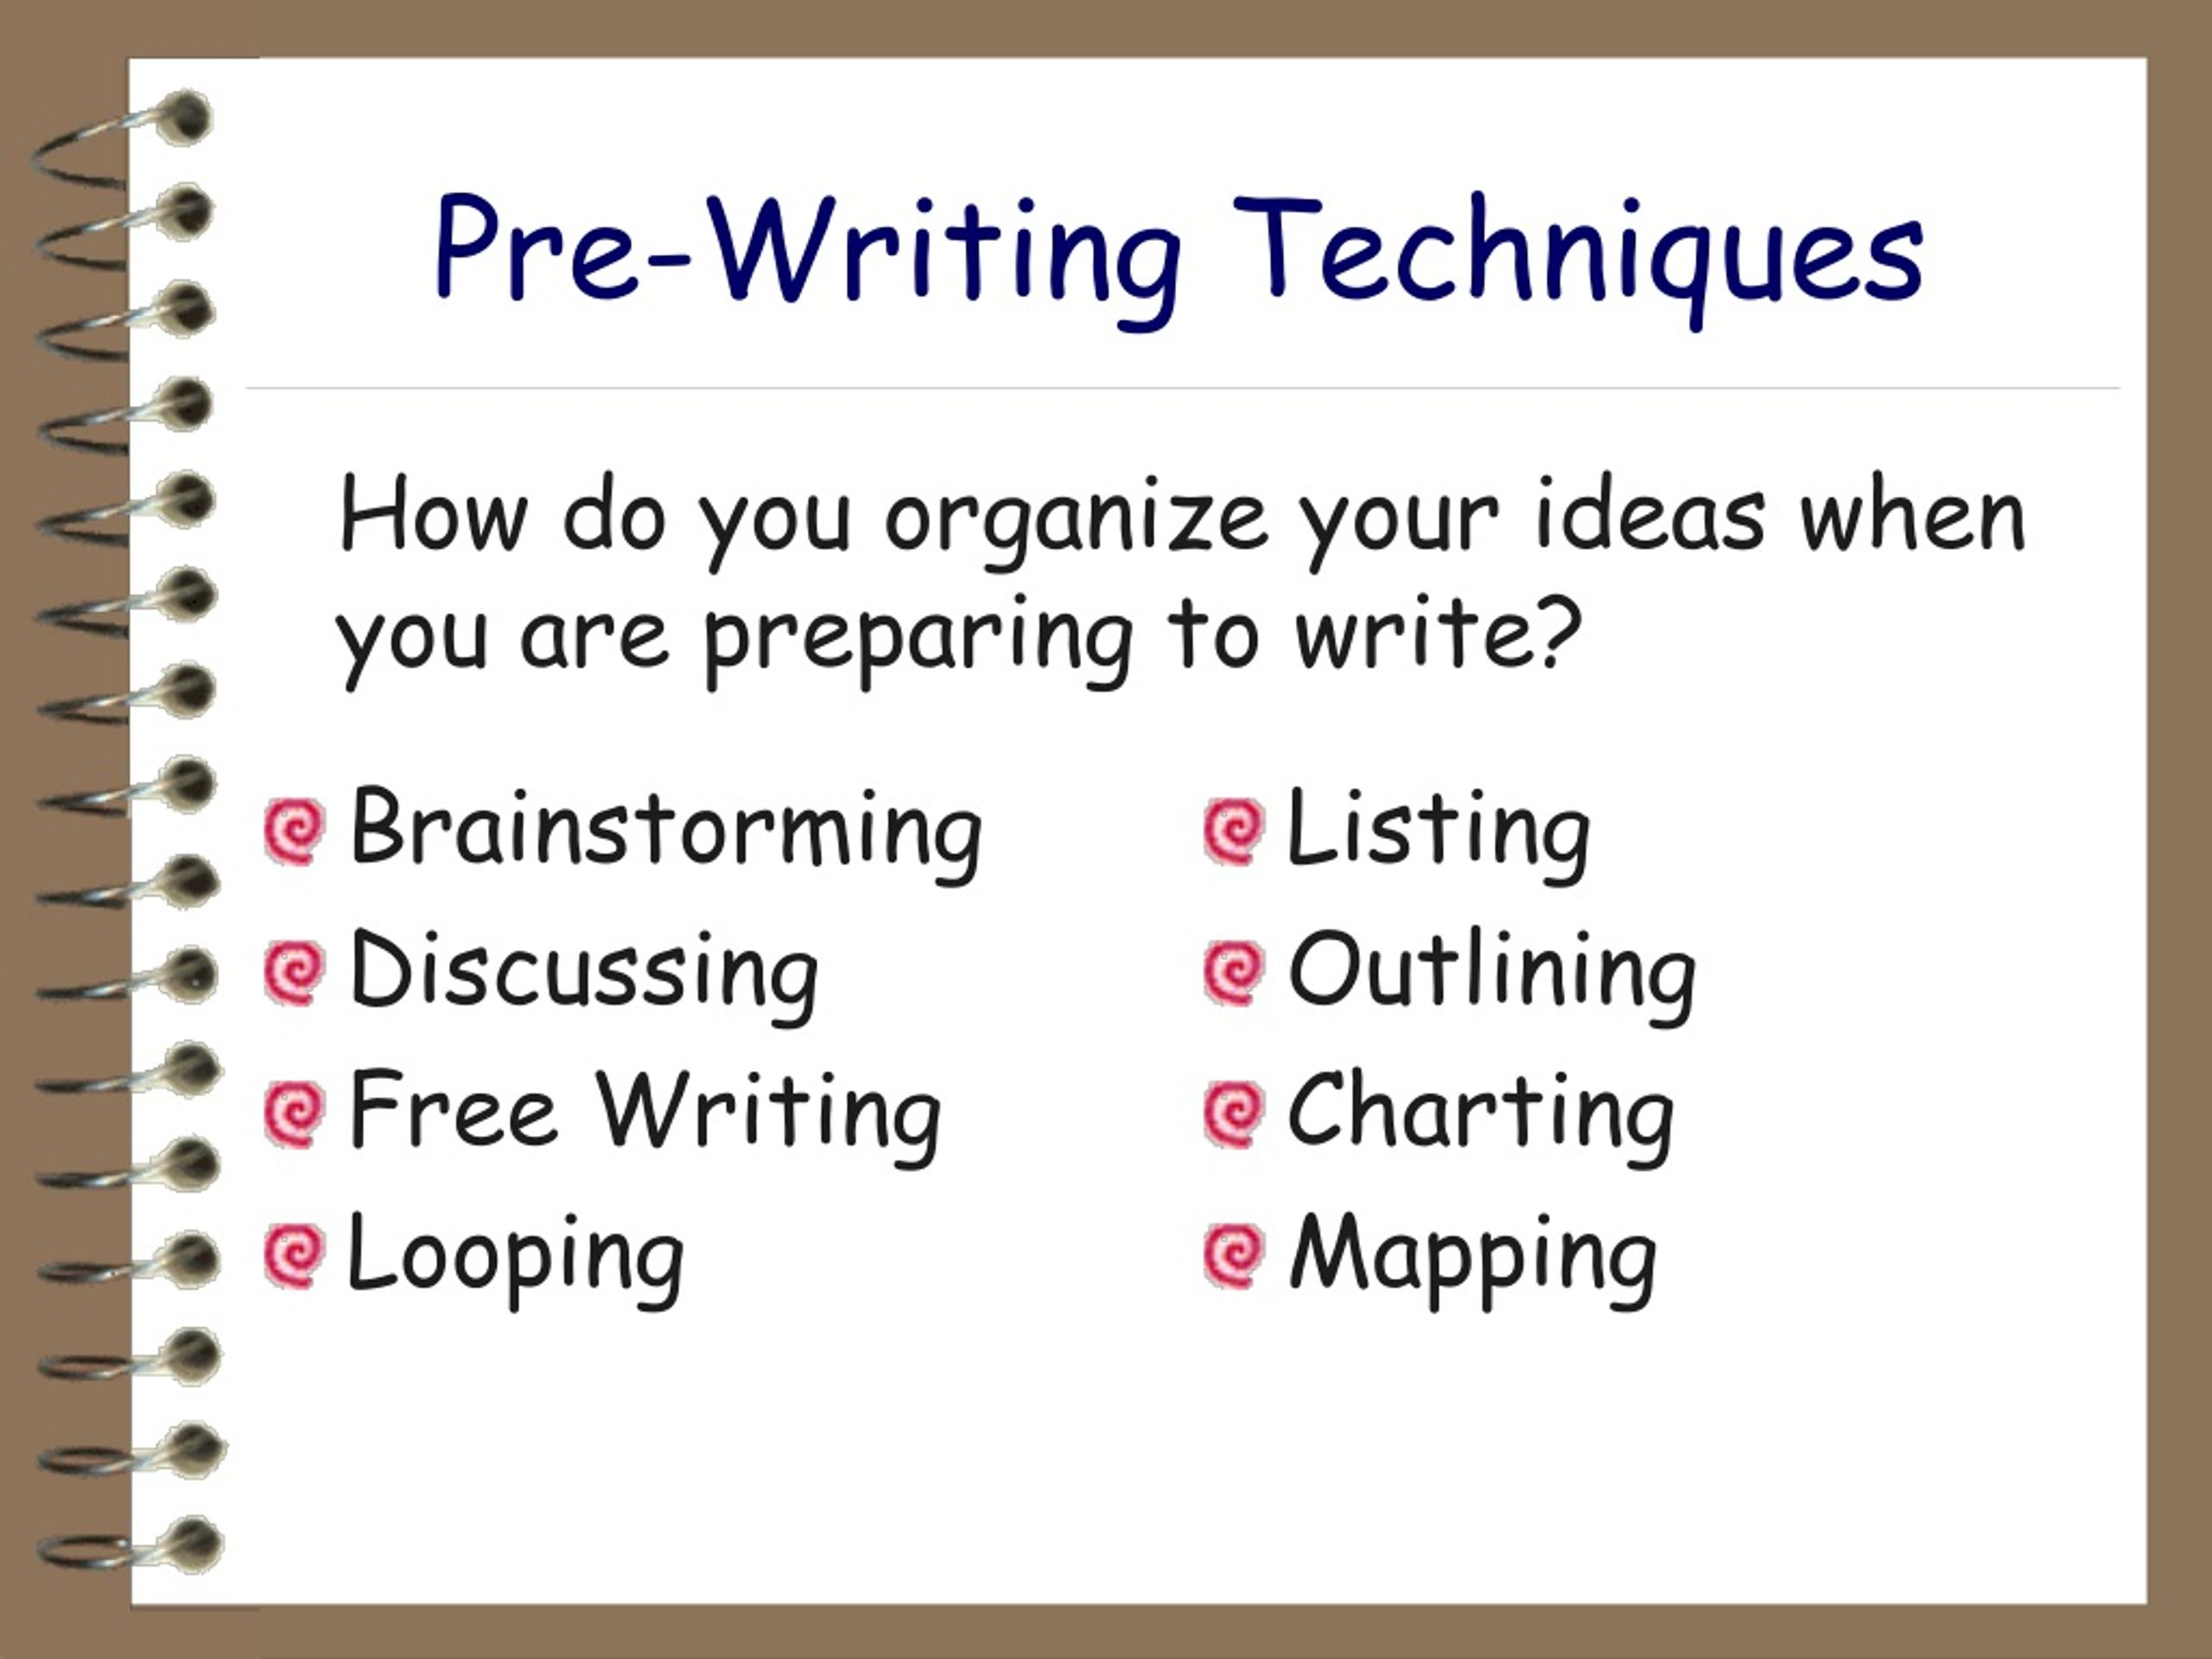
Pre-Writing Techniques

Slide 12
Brainstorming
Throw out as many ideas as possible—no judging.
Vibe:
“Just dump ideas 🧠💥”
Example (Topic: Social Media):
- Addiction
- Communication
- Fake news
- Business promotion
👉 Don’t filter. Even weird ideas can help later.
✔ Types:
- Individual brainstorming
- Group brainstorming

Slide 13
Freewriting (Peter Elbow)
Write non-stop without caring about grammar or structure.
Vibe:
“Write first, fix later ✍️”
Example:
“Social media is everywhere people use it daily it affects life maybe good maybe bad…”
👉 Looks messy—but ideas come out 🔥
Rules:
- Write non-stop (5–10 minutes)
- No editing
- No thinking too much
🎯 Purpose:
- Unlock ideas
- Reduce fear

Slide 14
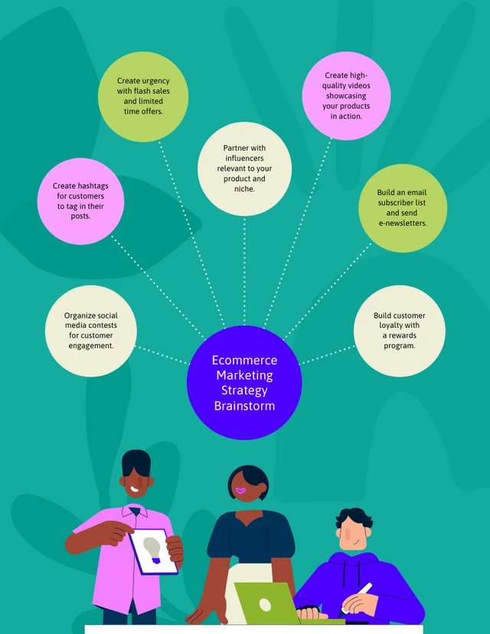

Slide 15
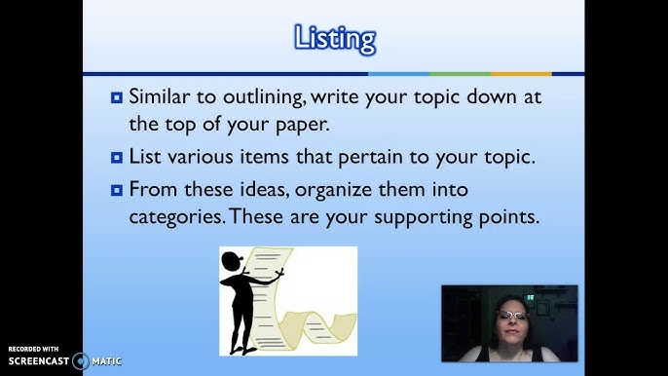
Listing
Make a simple list of ideas
Vibe:
“Bullet points = clarity”
Example:
- Topic: Pollution
- Causes→ factories, cars
- Effects→ disease, climate change
- Solutions→ recycling, laws
Benefit: Organizes raw ideas quickly

Slide 16
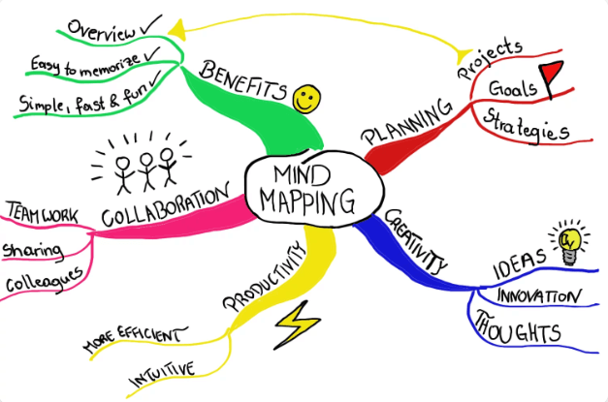
Mind Mapping (Tony Buzan)
Visual diagram connecting ideas: Draw ideas like a tree/diagram.
Vibe:
“Visual thinking 🌳”
Example:
Central: Education
→ Benefits
→ Problems
→ Solutions
👉 Helps you see connections and enhances memory
✔ Structure: - Central idea - Branches - Sub-ideas

Slide 17
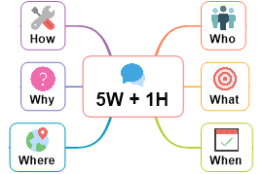
Questioning (Journalistic Method)
Ask questions to explore topic.
Vibe:
“Be curious like a journalist 🕵️”
Example (Topic: Unemployment):
Why is unemployment increasing?
Who is affected most?
How can it be reduced?
👉 Turns basic topic → deep ideas
Based on:

Slide 18

Clustering / Webbing
Ideas grouped visually: Group ideas in bubbles (similar but less neat than mind mapping)
Vibe:
“Messy but creative 🌀”
Example:
Center: Health
→ Diet → Junk food
→ Exercise → Gym
👉 Great when ideas feel random

Slide 19
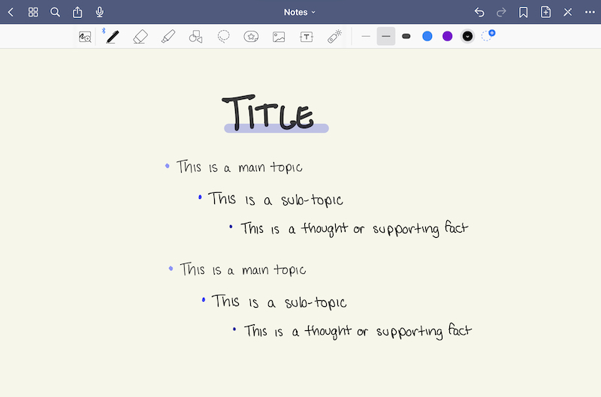
Outlining
Arrange ideas into proper structure.
Vibe:
“Make a roadmap 🗺️”
Example:
I. Introduction
II. Causes of Pollution
III. Effects
IV. Solutions
V. Conclusion
👉 This is your essay skeleton : it creates clear direction
Types:
- Formal outline- Informal outline

Slide 20
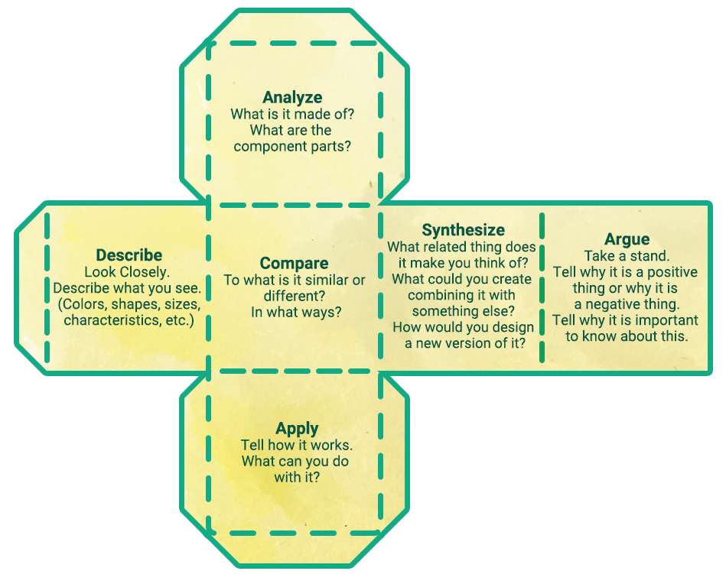
Cubing
Look at topic from 6 angles.
Example (Topic: Technology):
1. Describe → What is it
2. Compare → Old vs new tech
3. Associate → Daily life
4. Analyze → Pros/cons
5. Apply → Uses
6. Argue → Good or bad?
👉 Makes your writing next level as it is advanced academic technique

Slide 21
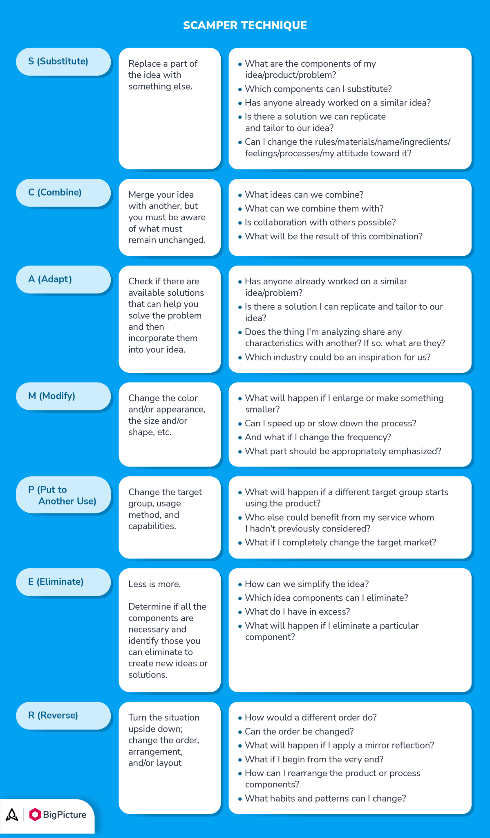
SCAMPER
refines idea generation with seven targeted steps
designed to evolve and enhance concepts.

Slide 23
Looping
Write → pick best idea → rewrite
Vibe:
“Refine again and again 🔁”
Example:
First write: “Social media affects people”
Then focus: “It affects mental health”
Then refine: “It increases anxiety in teens”
👉 Helps find your main point

Slide 24
Research-Based Prewriting
Collect info before writing.
Vibe:
“Don’t guess—know 📚”
Example:
Topic: Climate Change
→ Find stats
→ Read articles
→ Note key facts
👉 Important for academic and expository writing
Includes: - Reading sources - Taking notes -Gathering data

Slide 25
Graphic Organizers
Use diagrams to organize ideas.
Types + Examples:
✔ Venn Diagram → Compare online vs offline learning
✔ Flowchart → Steps of essay writing
✔ Concept Map → Topic connections
👉 Best for visual learners 👀

Slide 26
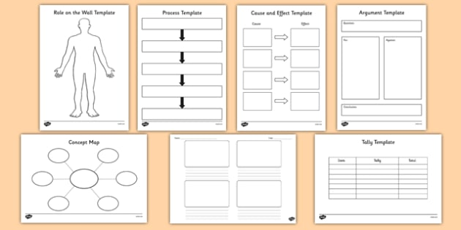

Slide 27

Journaling
Write your thoughts freely.
Vibe:
“Talk to your notebook 📓”
Example:
“I think education is important because it changes lives…”
👉 Good for personal + reflective topics

Slide 28
Role-Playing
Write from different perspectives.
Vibe:
“Think like someone else 🎭”
Example (Topic: Pollution):
As a doctor → health issues
As a citizen → daily problems
As a government → policies
👉 Boosts critical thinking

Slide 29
SWOT Analysis
Analyze topic in 4 parts.
Example (Topic: Online Learning):
- Strength → flexible
- Weakness → distraction
- Opportunity → global access
- Threat → less interaction
👉 Perfect for analytical answers

Slide 30
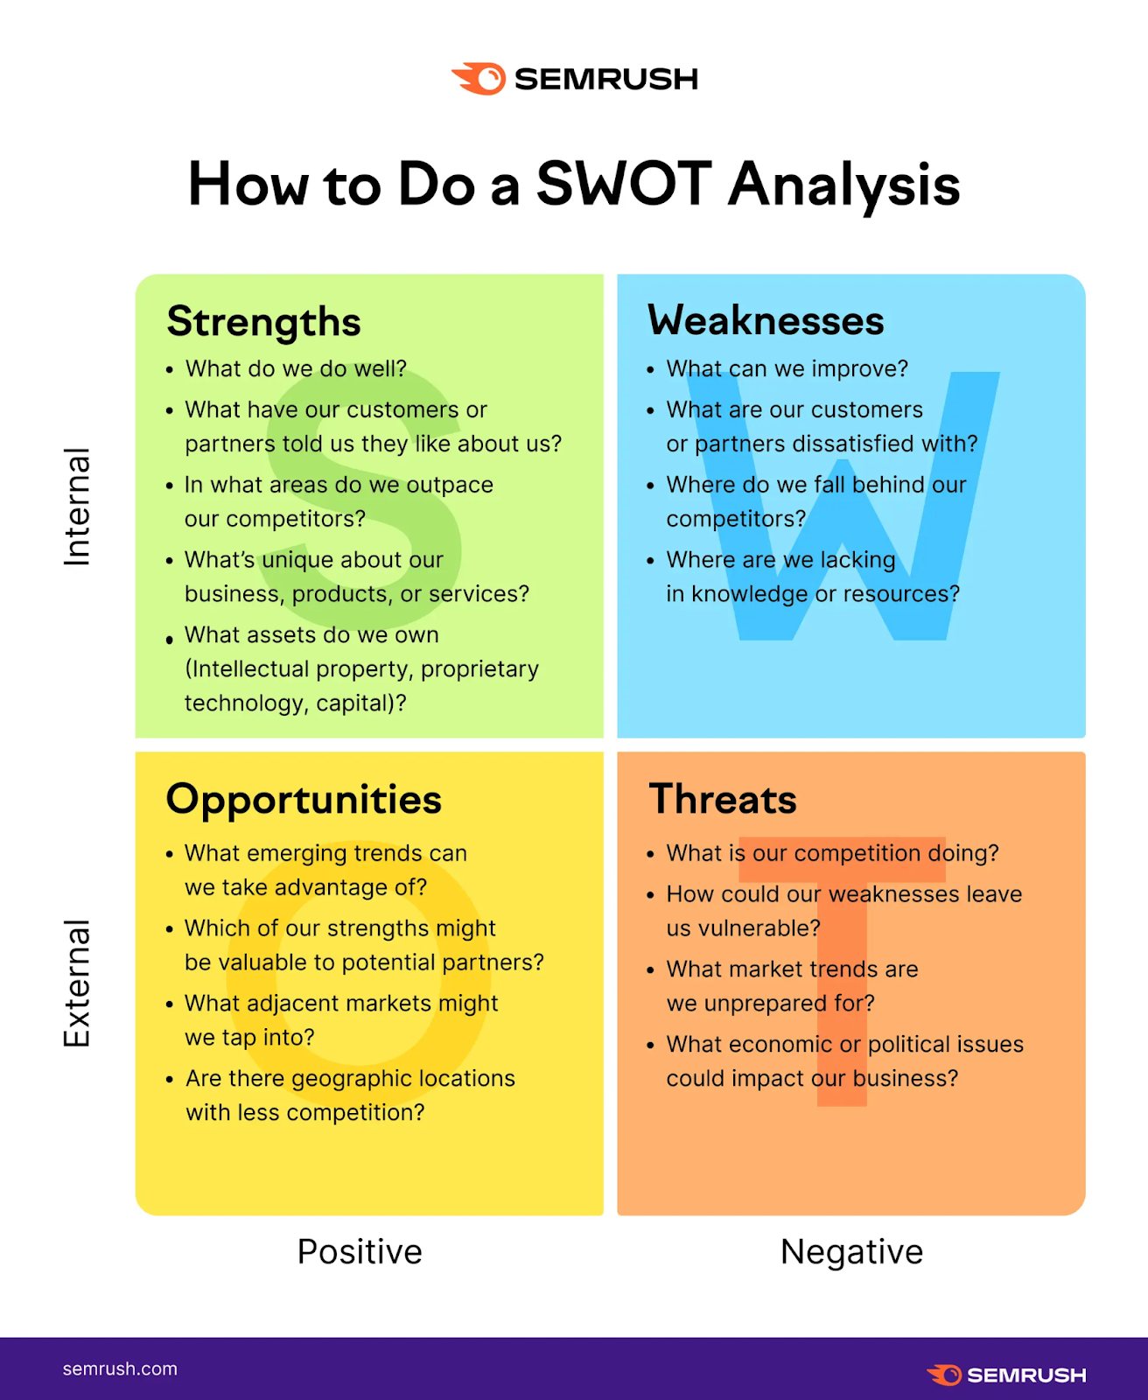

Slide 31
Keyword Mapping
Pick key words and expand them.
Example:
Topic: Education
Keywords → skills, jobs, society
👉 Each keyword = paragraph idea

Slide 32


