Slide 1
بسم اللہ الرحمٰن الرحیم

Slide 2
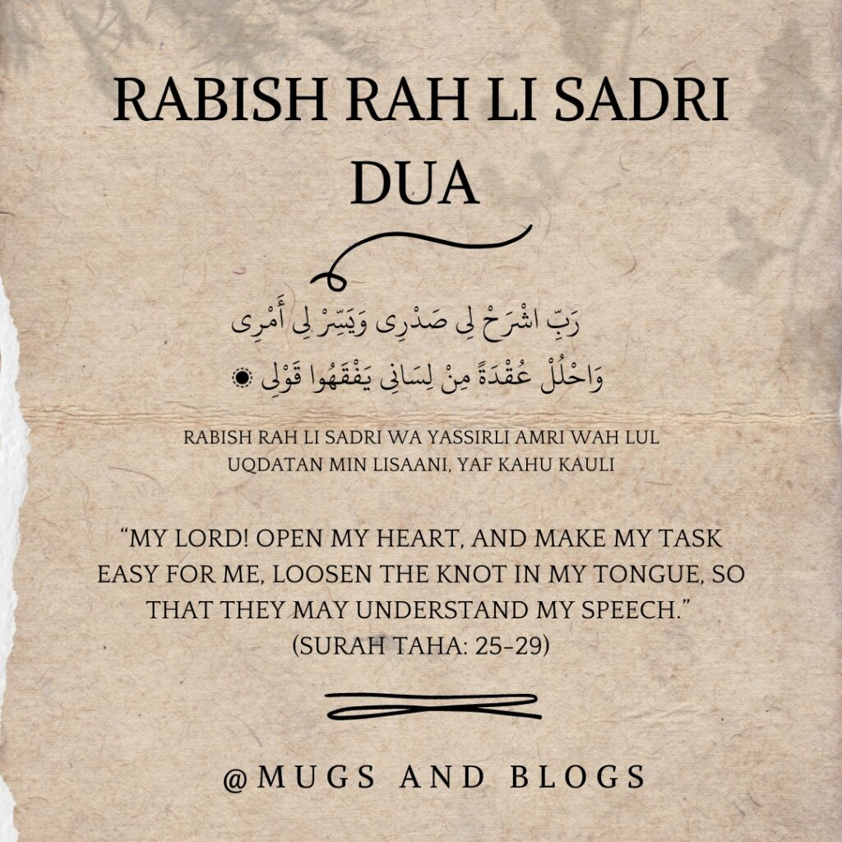

Slide 3
PAKISTAN STUDIES
Instructor: Khalid Makhdoom
Ideology and Constitution of Pakistan
Course code : ICP-321
Program: BS Applied Psychology
Credit hours : 2

Slide 4
INTRODUCTION TO THE IDEOLOGY OF PAKISTAN

Slide 5
Contributions of women and students in the freedom movement for separate homeland for Muslims of British India

Slide 6
Contribution of Women in the Pakistan Movement
1. Political Mobilization and Public Engagement
Fatima Jinnah played a central role—supporting Quaid-e-Azam, organizing women politically, and becoming a symbol of female leadership.
Women attended public meetings and rallies at a time when it was socially discouraged. Their presence strengthened Muslim League’s grassroots support.
2. Organization & Mobilization
Women formed committees under the All-India Muslim League, especially during the 1937–1947 period.
Leaders like Begum Shaista Ikramullah, Begum Rana Liaquat Ali Khan, Begum Jahanara Shahnawaz mobilized women in urban centers (Lahore, Delhi, Lucknow).

Slide 7
3. Awareness & Propaganda
Women spread political awareness inside households and neighborhoods through:
Door-to-door campaigns
Distributing pamphlets
Educating other women on why Muslims needed separate political safeguards
This created a wider mass base for the demand of Pakistan.
4. Social Welfare & Relief Work
Women organized welfare groups such as APWA (All Pakistan Women’s Association—later formalized after independence).
Their involvement in relief activities during riots and migration strengthened communal solidarity and trust in the Muslim League.

Slide 8
Contribution of Students in the Pakistan Movement
1. Backbone of Street-Level Political Activism
Students were often the most energetic and visible supporters of Pakistan.
They held demonstrations, organized Pakistan Day events, and countered anti-Pakistan propaganda from Congress and left-wing student groups.
2. Formation of Student Organizations
The All-India Muslim Students Federation (AIMSF) became a powerful mobilizing force after 1937.
Students visited towns and villages, expanding political outreach where Muslim League presence was weak.

Slide 9
3. Intellectual Contribution
Students in Aligarh Muslim University (AMU) played a critical ideological role:
Debates, writings, and pamphlets from AMU helped shape the narrative that Muslims were a distinct political “nation.”
AMU became known as the arsenal of the Pakistan Movement due to student activism and scholarly support.
4. Support During Key Elections
During the 1945–46 elections, students acted as:
canvassers
volunteers
polling agents
Their work significantly helped the Muslim League win the Muslim vote, which strengthened the demand for a separate homeland.

Slide 10
5. Defense and Safety During Communal Riots
Student groups protected Muslim neighborhoods, organized relief camps, and helped migrants.
Their efforts built unity and confidence among ordinary Muslims.

Slide 11
THANK YOU

