Slide 1

BASIC MEDICAL SCIENCE
FSC MEDICAL TECHNOLOGIES I
DR DANISH

Slide 2
EPIDERMIS
The epidermis is the outermost layer of the skin
Acts as a protective barrier against:
  Microorganisms
  UV radiation
  Water loss
Composed mainly of keratinized stratified squamous epithelium

Slide 3
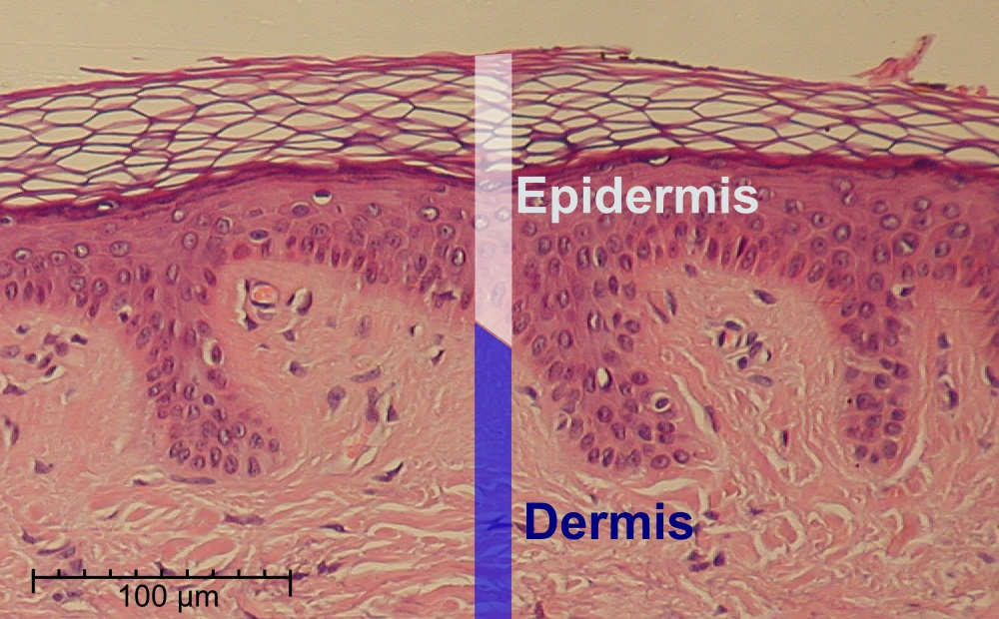

Slide 4
General Characteristics
Avascular (no blood vessels)
Receives nutrients via diffusion from dermis
Continuously undergoes cell renewal
Thickness varies by body location:
  Thick skin (palms, soles)
  Thin skin (rest of body)

Slide 5
Main Cell Types
Keratinocytes
  Most abundant cells
  Produce keratin (protective protein)
Melanocytes
  Produce melanin (skin pigment)
  Protect against UV radiation

Slide 6
CONTINUED
Langerhans cells
  Immune defense
  Detect pathogens
Merkel cells
  Sensory receptors
  Associated with touch

Slide 7
Layers of the Epidermis
(From deep to superficial)
Stratum basale
Stratum spinosum
Stratum granulosum
Stratum lucidum (only in thick skin)
Stratum corneum

Slide 8
Stratum Basale
Deepest layer (single row of cells)
Contains stem cells → active mitosis
Produces new keratinocytes
Contains melanocytes and Merkel cells
Attached to basement membrane

Slide 9
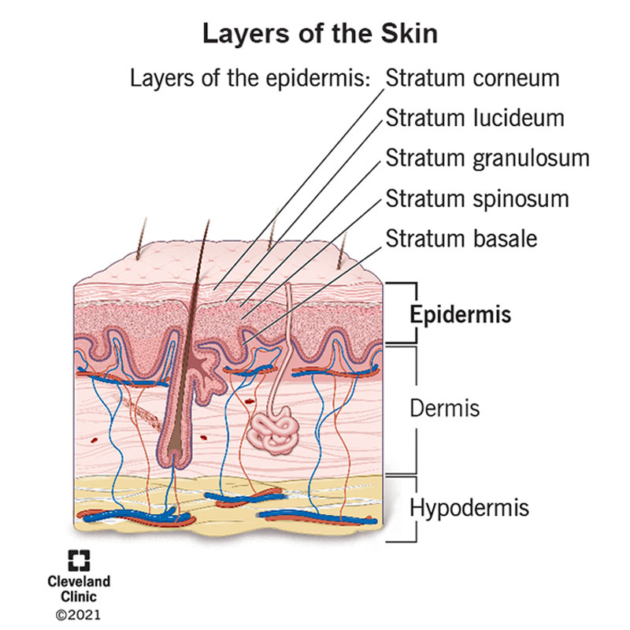

Slide 10
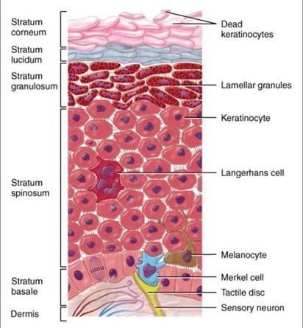

Slide 11
Stratum Spinosum
Several layers of cells
Cells appear spiny due to desmosomes
Provides strength and flexibility
Contains Langerhans cells

Slide 13
Stratum Granulosum
3–5 layers of flattened cells
Contains keratohyalin granules
Cells begin to die
Formation of waterproof barrier

Slide 15
Stratum Lucidum
Found only in thick skin (palms & soles)
Thin, clear layer
Provides extra protection

Slide 17
Stratum Corneum
Outermost layer
Composed of dead, keratinized cells
Cells are flattened and scale-like
Provides:
  Barrier against environment
  Prevents water loss
Continuously shed (desquamation)

Slide 19
Functions of the Epidermis
Protection (physical, chemical, biological)
Prevents dehydration
UV protection (melanin)
Sensory role (touch receptors)
Immune defense

Slide 20


