Slide 1

ANATOMY
THE THORAX
BS RIT,OTT
2ND SEMESTER
DR DANISH

Slide 2
Thoracic Vertebrae
General Features of Vertebrae
Typical vertebra consists of:
  Body
  Pedicle
  Lamina
  Spinous process
  Transverse processes
  Superior and inferior articular processes

Slide 3
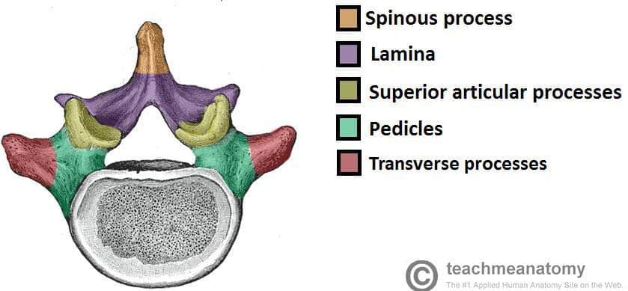

Slide 4
Characteristic Features
Heart-shaped body
Costal facets for rib articulation
Long, downward-sloping spinous process

Slide 5
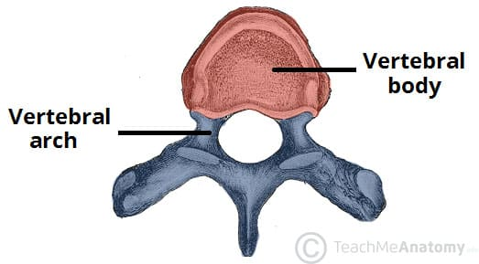

Slide 6
Costal Facets
1. Demifacets (on vertebral body)
Also called superior and inferior costal facets
Located on the sides of vertebral bodies
Sites where heads of ribs articulate
Each typical thoracic vertebra has:
  Superior costal facet (demifacet)
  Inferior costal facet (demifacet)

Slide 7
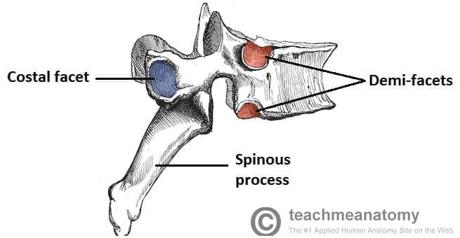

Slide 8
Continued
Each facet carries half of the rib articulation
Therefore, the head of a typical rib articulates with:
  The superior costal facet of its corresponding vertebra
  The inferior costal facet of the vertebra above

Slide 9
Continued
2. Transverse Costal Facets
Small articular surfaces on transverse processes
Site where the tubercle of the rib articulates
Usually present on T1–T10
Ribs 11 and 12 do NOT articulate with transverse processes

Slide 11


Slide 12


