Slide 1

ANATOMY
THE LOWER LIMB
DPT
2ND SEMESTER
DR DANISH

Slide 2
Lower Limb Osteology
Overview:
The lower limb functions:
  Support body weight
  Provide locomotion (walking, running)
Structurally adapted for:
  Stability
  Strength
  Weight-bearing

Slide 3
Bones of the Lower Limb
  Hip bone (os coxae)
  Femur
  Tibia
  Fibula
  Tarsal bones
  Metatarsals
  Phalanges
Arrangement is similar to the upper limb but modified for weight-bearing

Slide 4
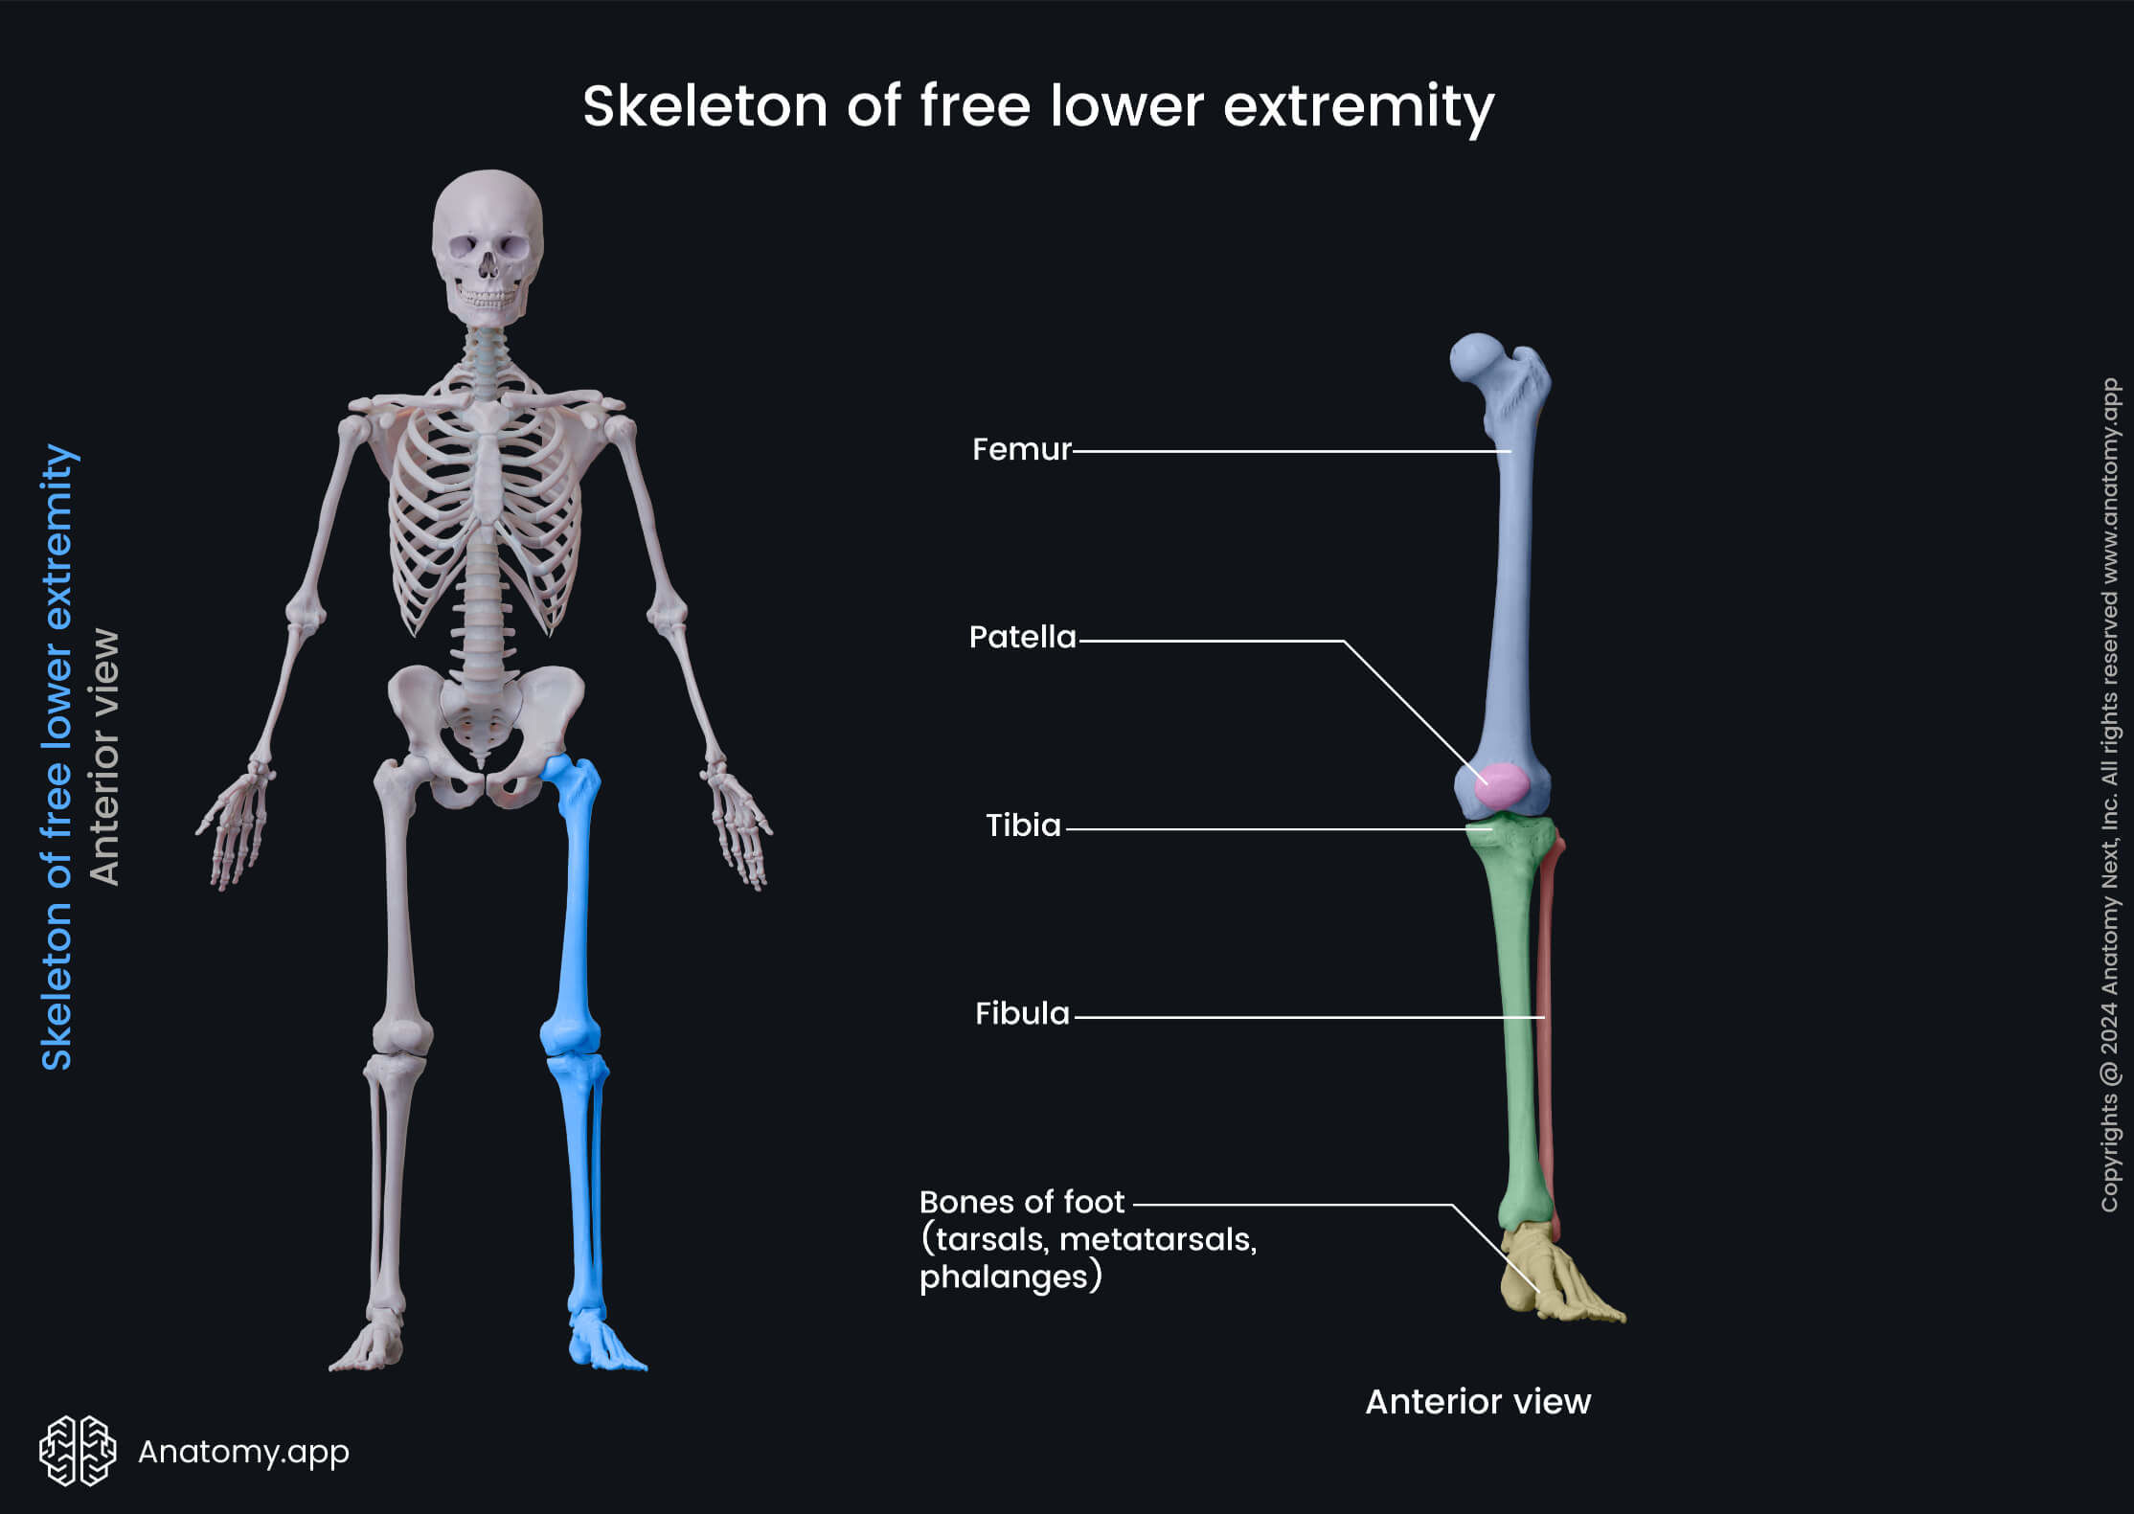

Slide 5
Os Coxae (Hip Bone)
Forms the pelvic girdle with:
  Sacrum
  Opposite hip bone
Composed of three bones:
  Ilium
  Ischium
  Pubis
These meet at the acetabulum

Slide 6
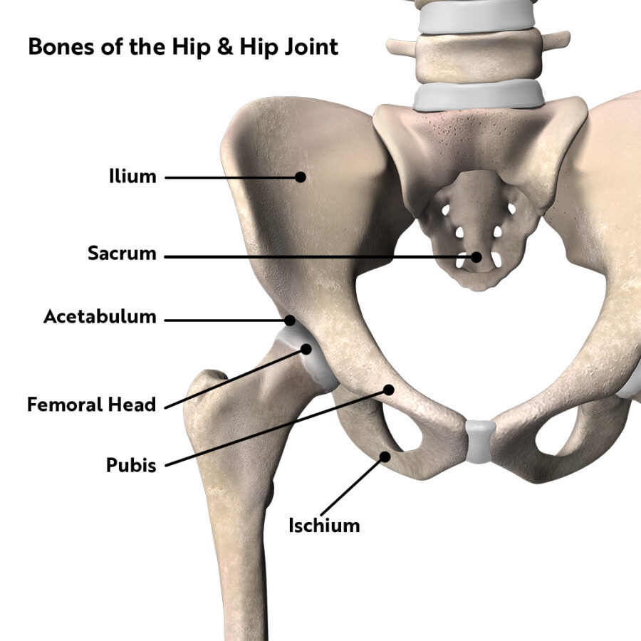

Slide 7
Acetabulum
Deep depression on lateral surface of hip bone
Functions:
  Articulates with head of femur → forms hip joint
Features:
  Articular surface: covered with hyaline cartilage
  Non articular central area: acetabular fossa
  Inferior margin: acetabular notch

Slide 9
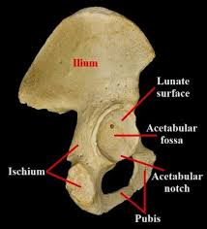

Slide 10
Ilium
Upper flattened part of hip bone
Key features:
  Iliac crest: superior border
  Ends anteriorly at:
    Anterior superior iliac spine (ASIS)
    Anterior inferior iliac spine (AIIS)
  Ends posteriorly at:
    Posterior superior iliac spine (PSIS)
    Posterior inferior iliac spine (PIIS)

Slide 11
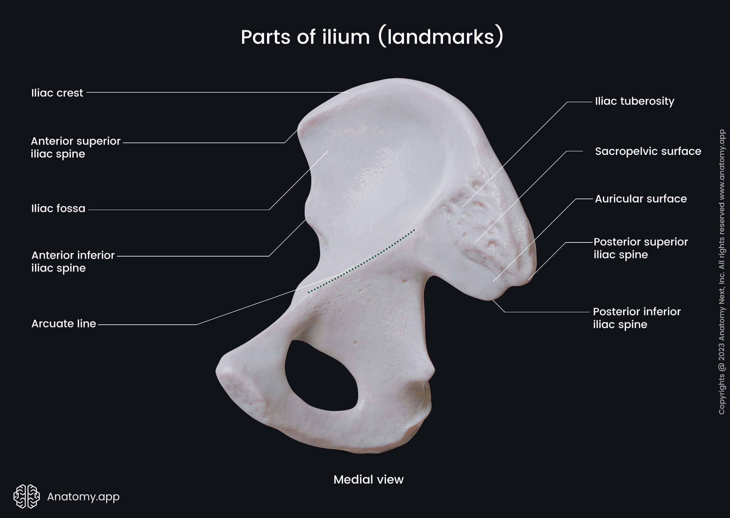

Slide 12
Continued
Other features:
  Iliac tubercle
  Greater sciatic notch
Inner surface contributes to pelvic cavity

Slide 13
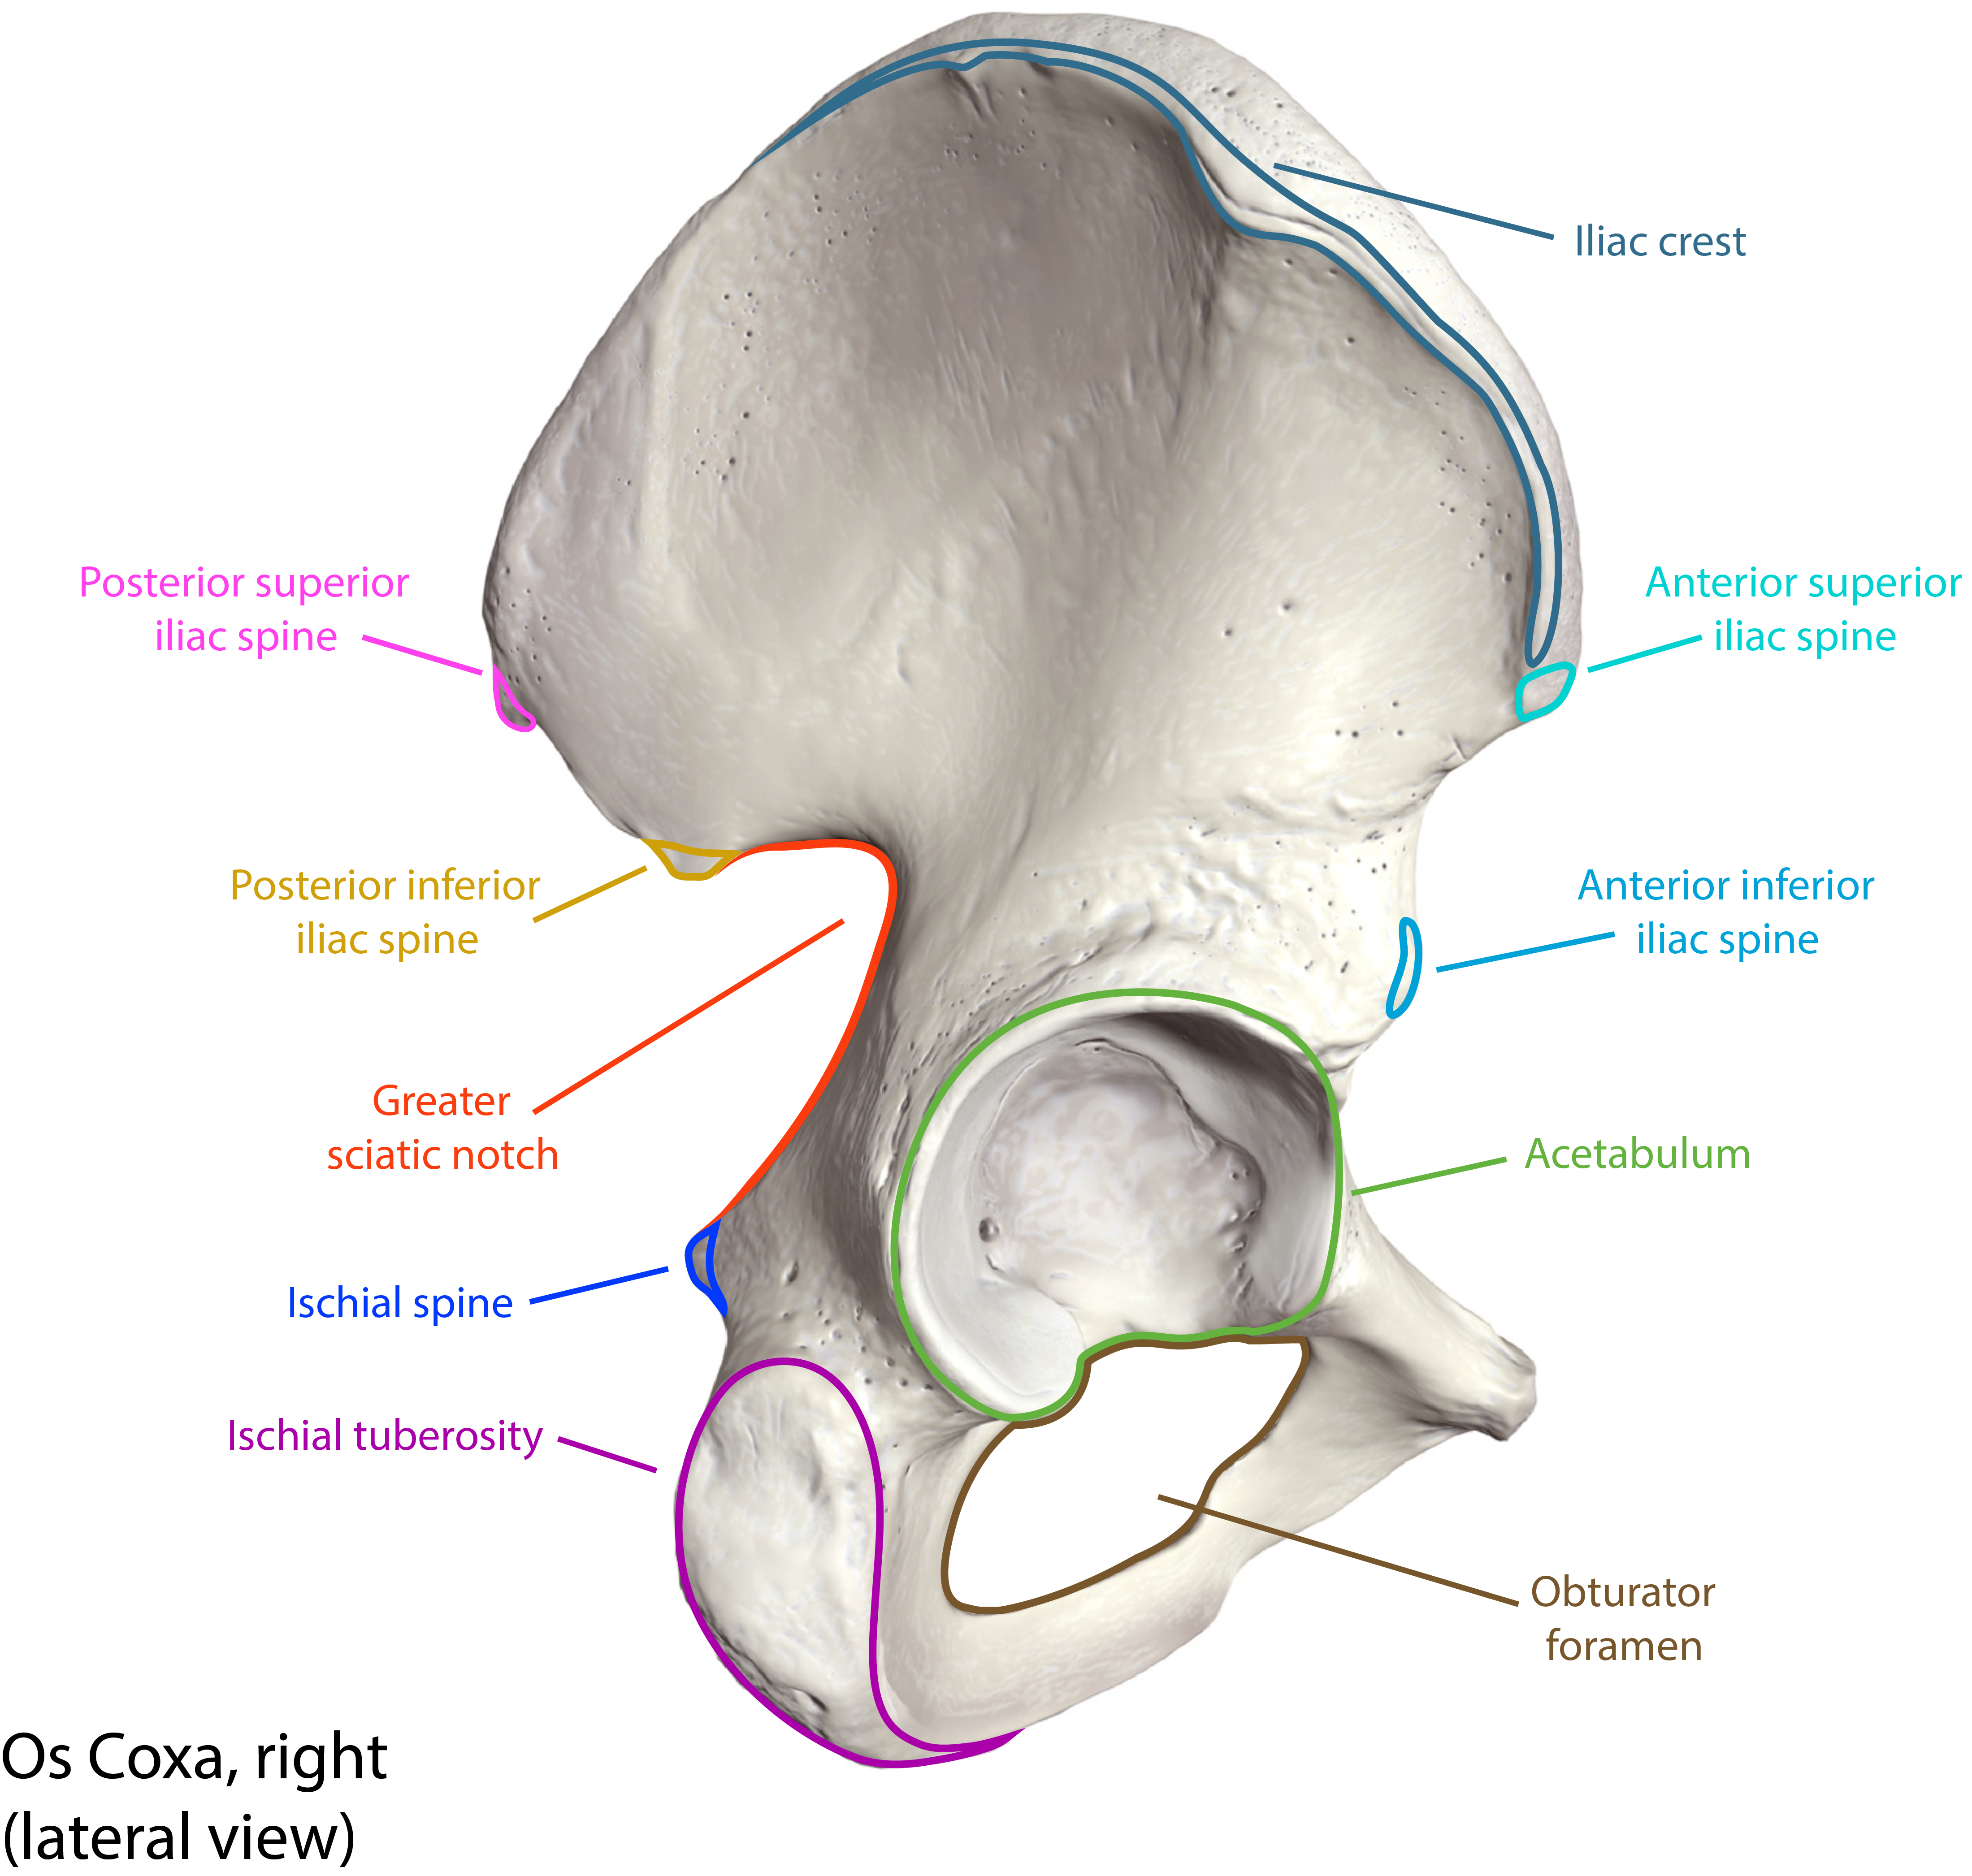

Slide 14
Ischium
Forms postero inferior part of hip bone
Features:
  Body and ramus
  Ischial spine:
    Located between greater and lesser sciatic notches
  Ischial tuberosity:
    Roughened area for weight-bearing (sitting)
  Greater and lesser sciatic notches
    Converted to foramina by ligaments

Slide 15
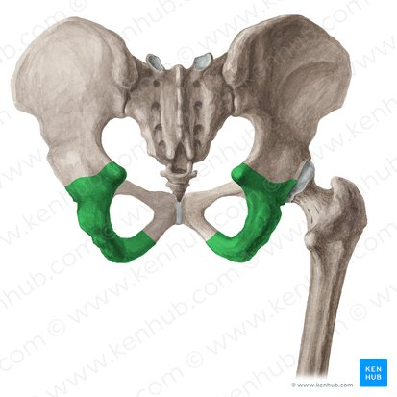

Slide 16
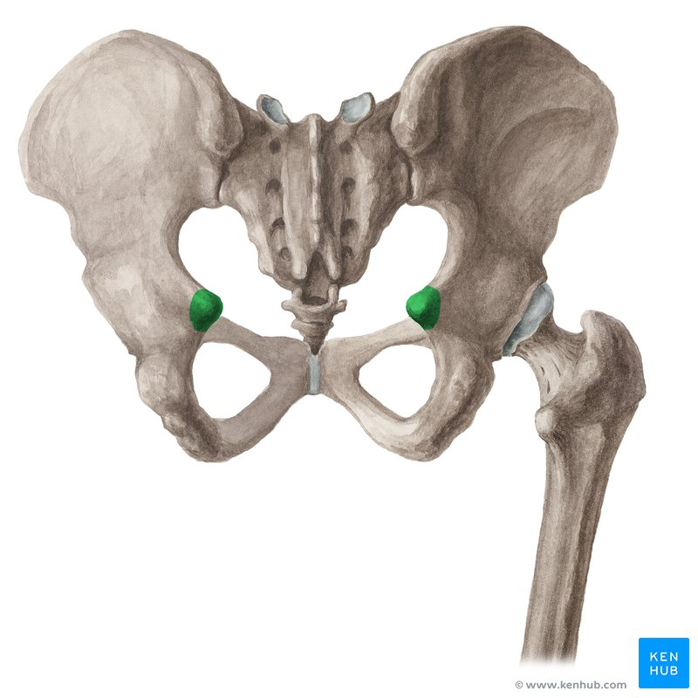

Slide 17
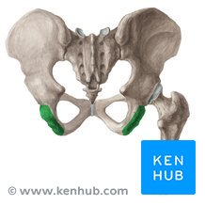

Slide 18
Pubis
Divided into:
  Body
  Superior ramus
  Inferior ramus
Features:
  Bodies meet at pubic symphysis
  Pubic crest forms upper border
  Contributes to obturator foramen

Slide 19
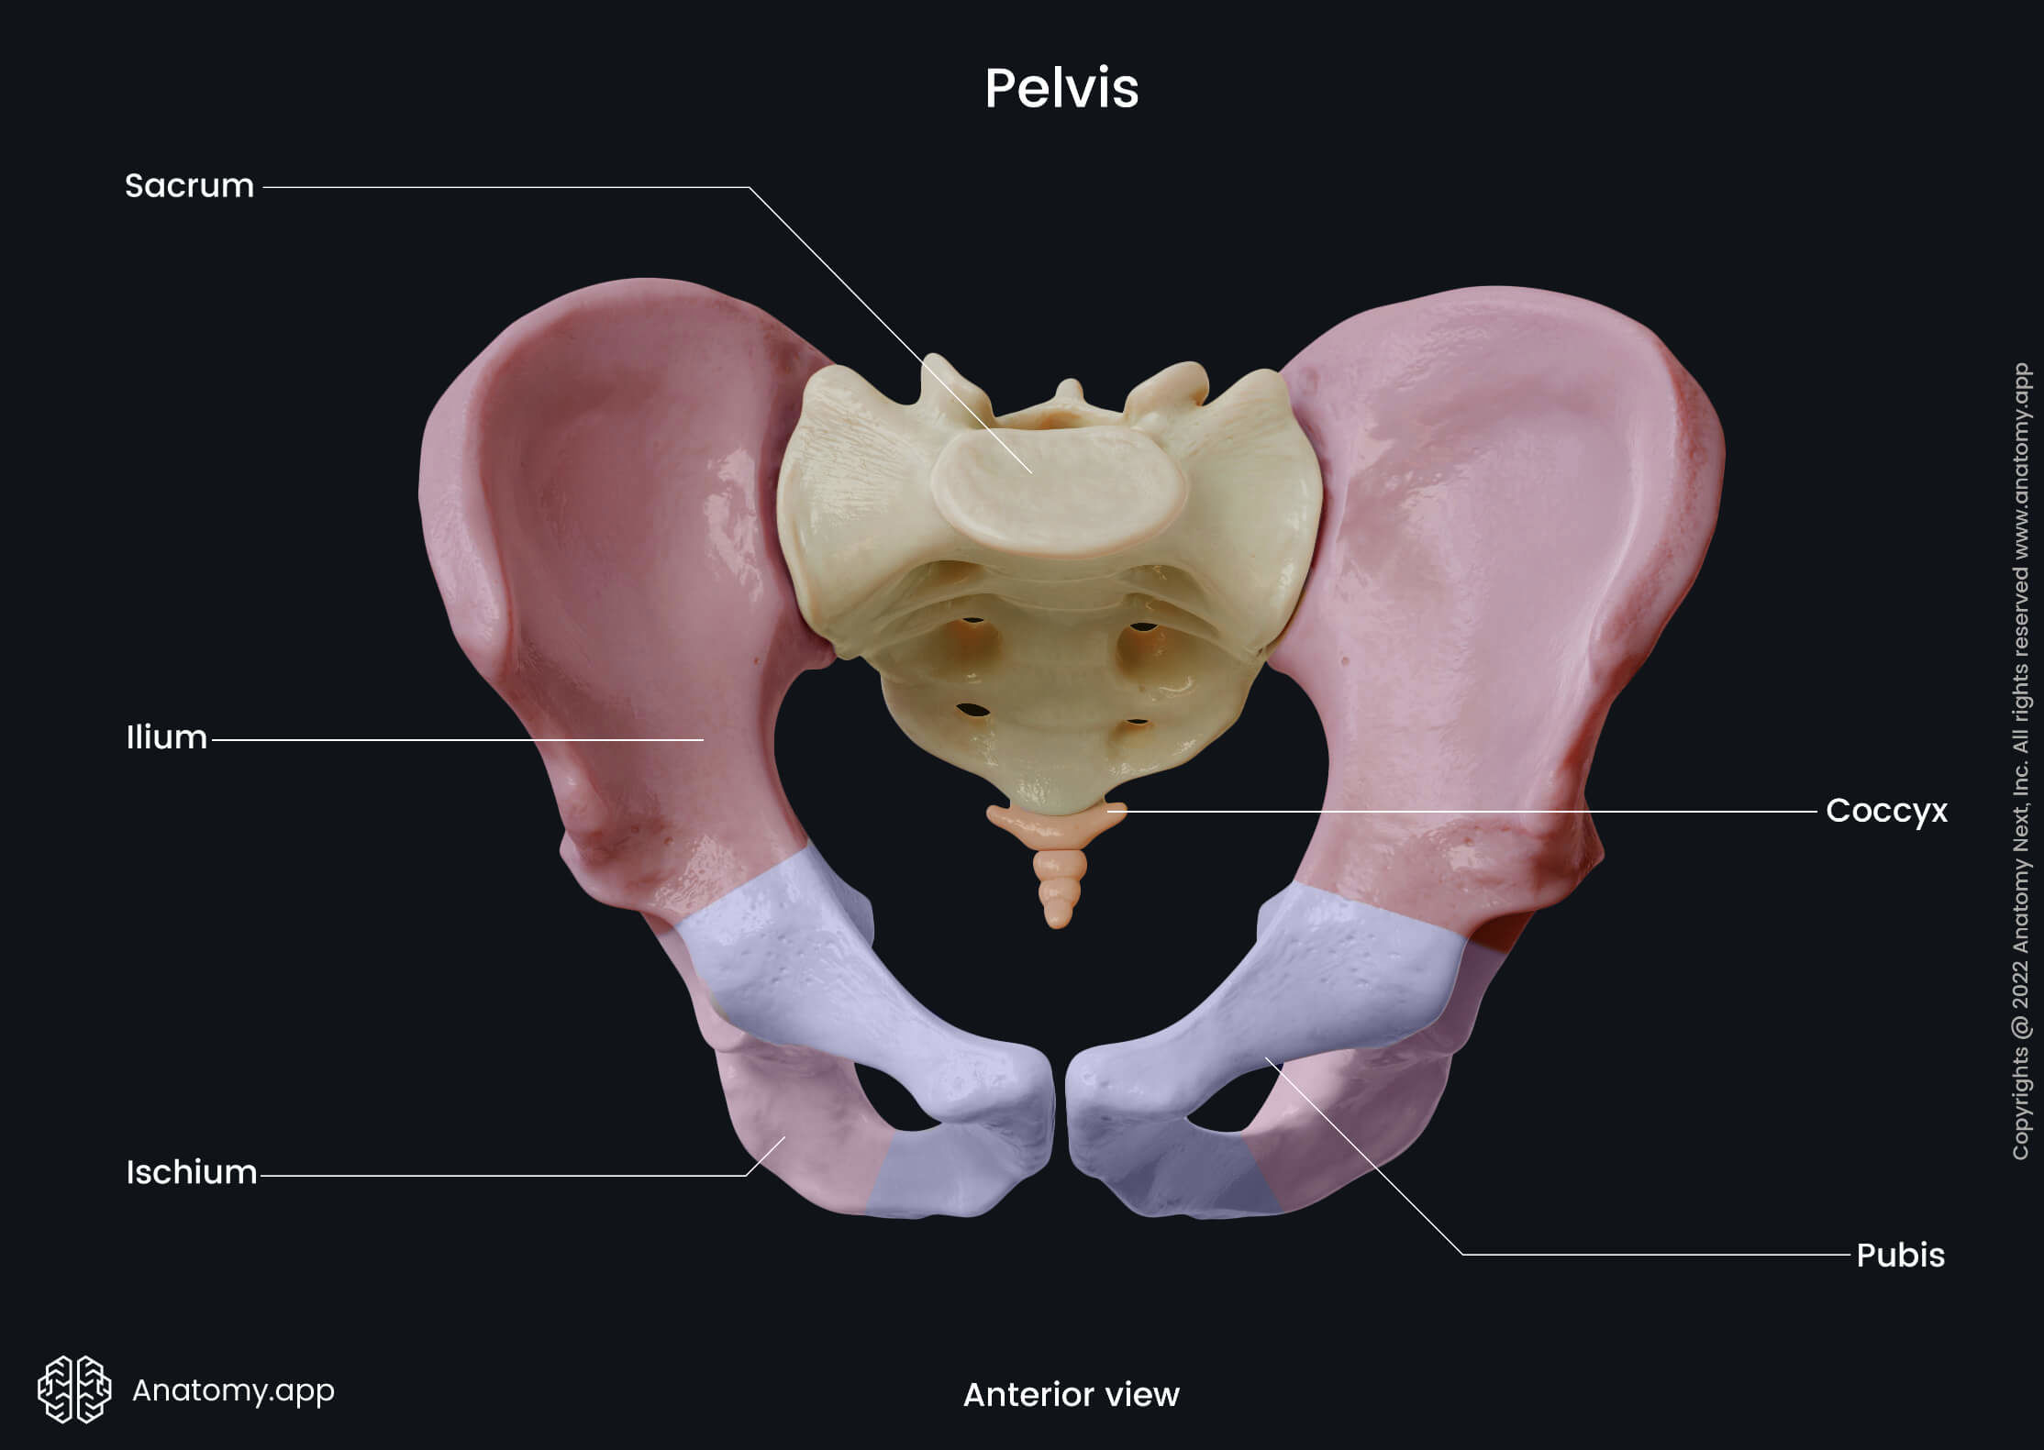

Slide 20
Obturator Foramen
Large opening formed by:
  Pubis and ischium
Mostly closed by obturator membrane

Slide 22
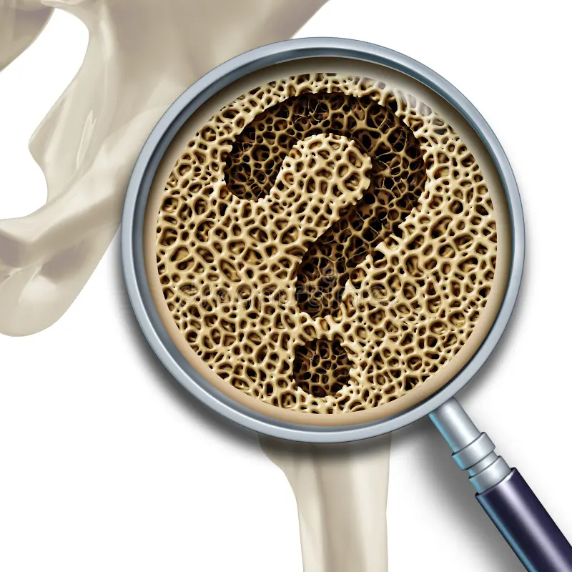

Slide 23
