Slide 1

REGIONAL ANATOMY
BS RIT
2ND SEMESTER
DR DANISH

Slide 2
THORAX
The upper part of the human trunk located between the neck and the diaphragm

Slide 3
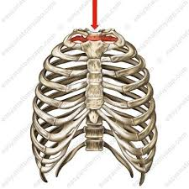

Slide 4
Sternum
Overview:
The sternum forms the anterior part of the thoracic skeleton.
It consists of three parts:
  Manubrium
  Body
  Xiphoid process
Articulates with:
  Clavicles
  Ribs (via costal cartilages)

Slide 5
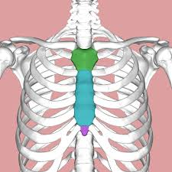

Slide 6
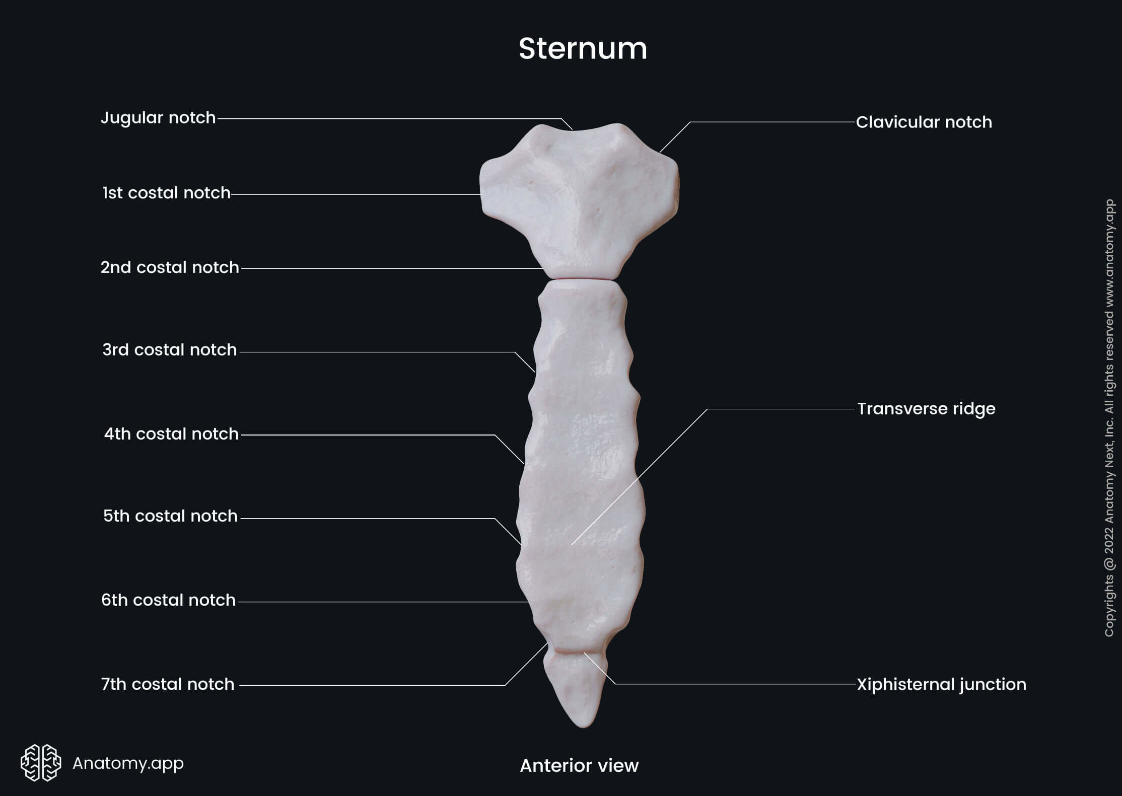

Slide 7
Manubrium
Superior part of the sternum.
Jugular (suprasternal) notch
  Easily palpable
  Concave notch on superior border.
Clavicular notches
  Located at superolateral corners.
  Articulate with the clavicles.
Articulates inferiorly with the body at the manubriosternal joint.

Slide 10
Sternal Angle (Angle of Louis)
Located at the manubriosternal joint.
Palpable landmark on anterior chest wall.
Level of:
  Attachment of the second costal cartilages.
Important thoracic landmark.

Slide 12
Body of Sternum
Long, middle portion.
Articulates:
  Superiorly with manubrium.
  Inferiorly with xiphoid process at xiphisternal joint.
Has costal notches for:
  2nd to 7th costal cartilages (on each side).

Slide 15
Xiphoid Process
Inferior part of sternum.
Thin plate of cartilage in youth.
May ossify in adulthood.
No ribs or costal cartilages attach directly to it.
Lies at the level of the 9th thoracic vertebra.
Serves as an attachment for:
  Linea alba of abdominal wall.

Slide 18


Slide 19


