Slide 1

ANATOMY
THE UPPER LIMB
DPT
1ST SEMESTER
DR DANISH

Slide 2
Basilic Vein
Large superficial vein
Drains medial side of upper limb
Important link between superficial and deep venous systems

Slide 3
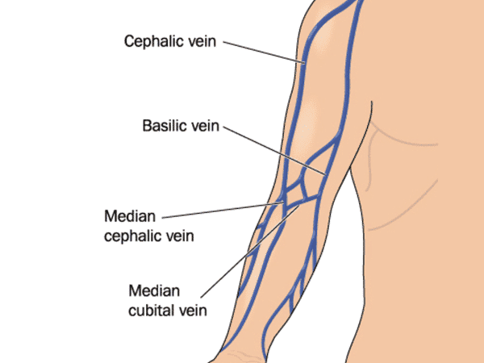

Slide 4
Origin & Course
Origin
Arises from medial end of dorsal venous network of hand
Course
Ascends along medial side of forearm
Passes anterior to medial epicondyle at elbow
Continues up medial side of arm
Pierces deep fascia about midway up arm
Joins brachial veins

Slide 5
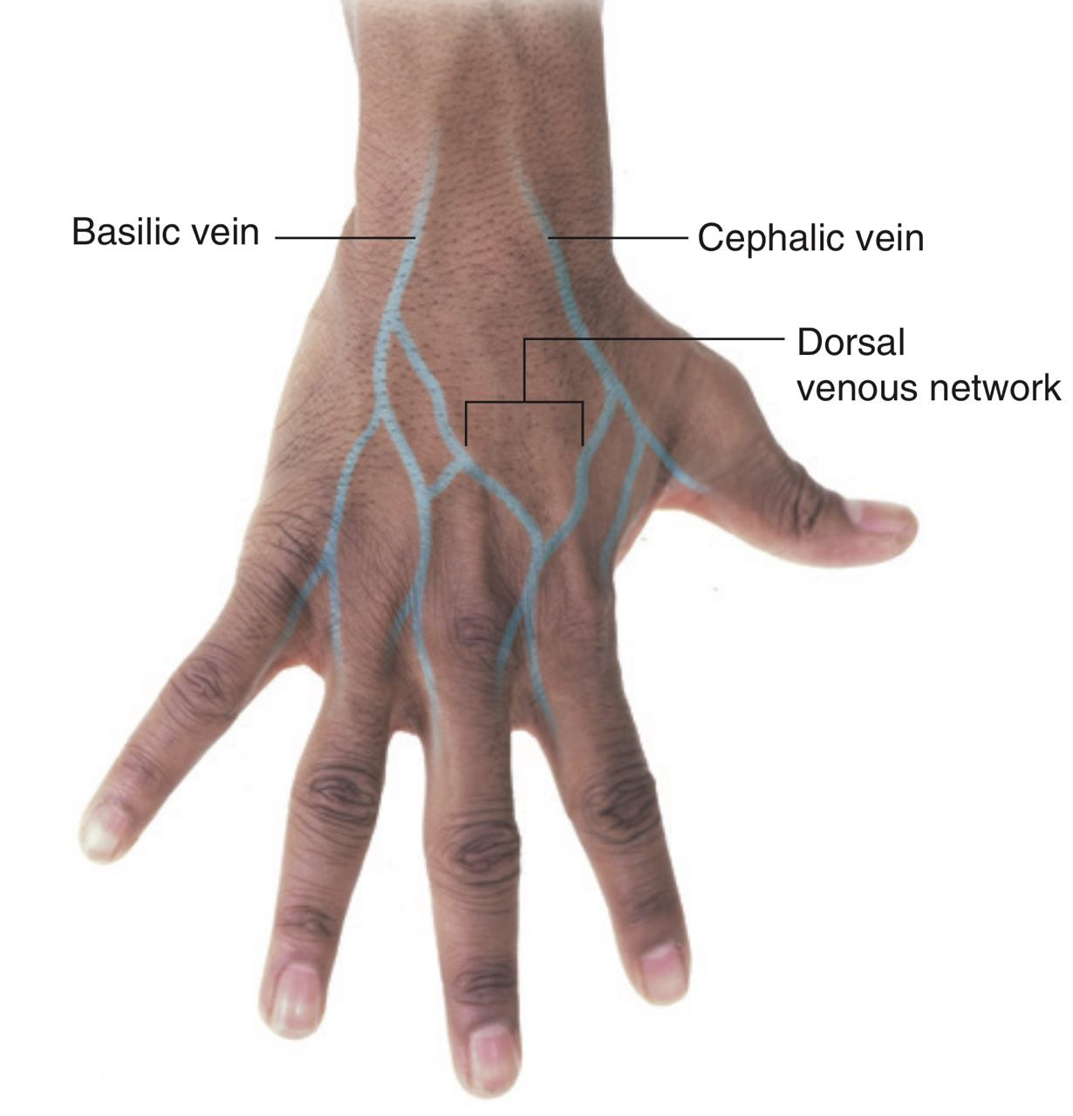

Slide 7
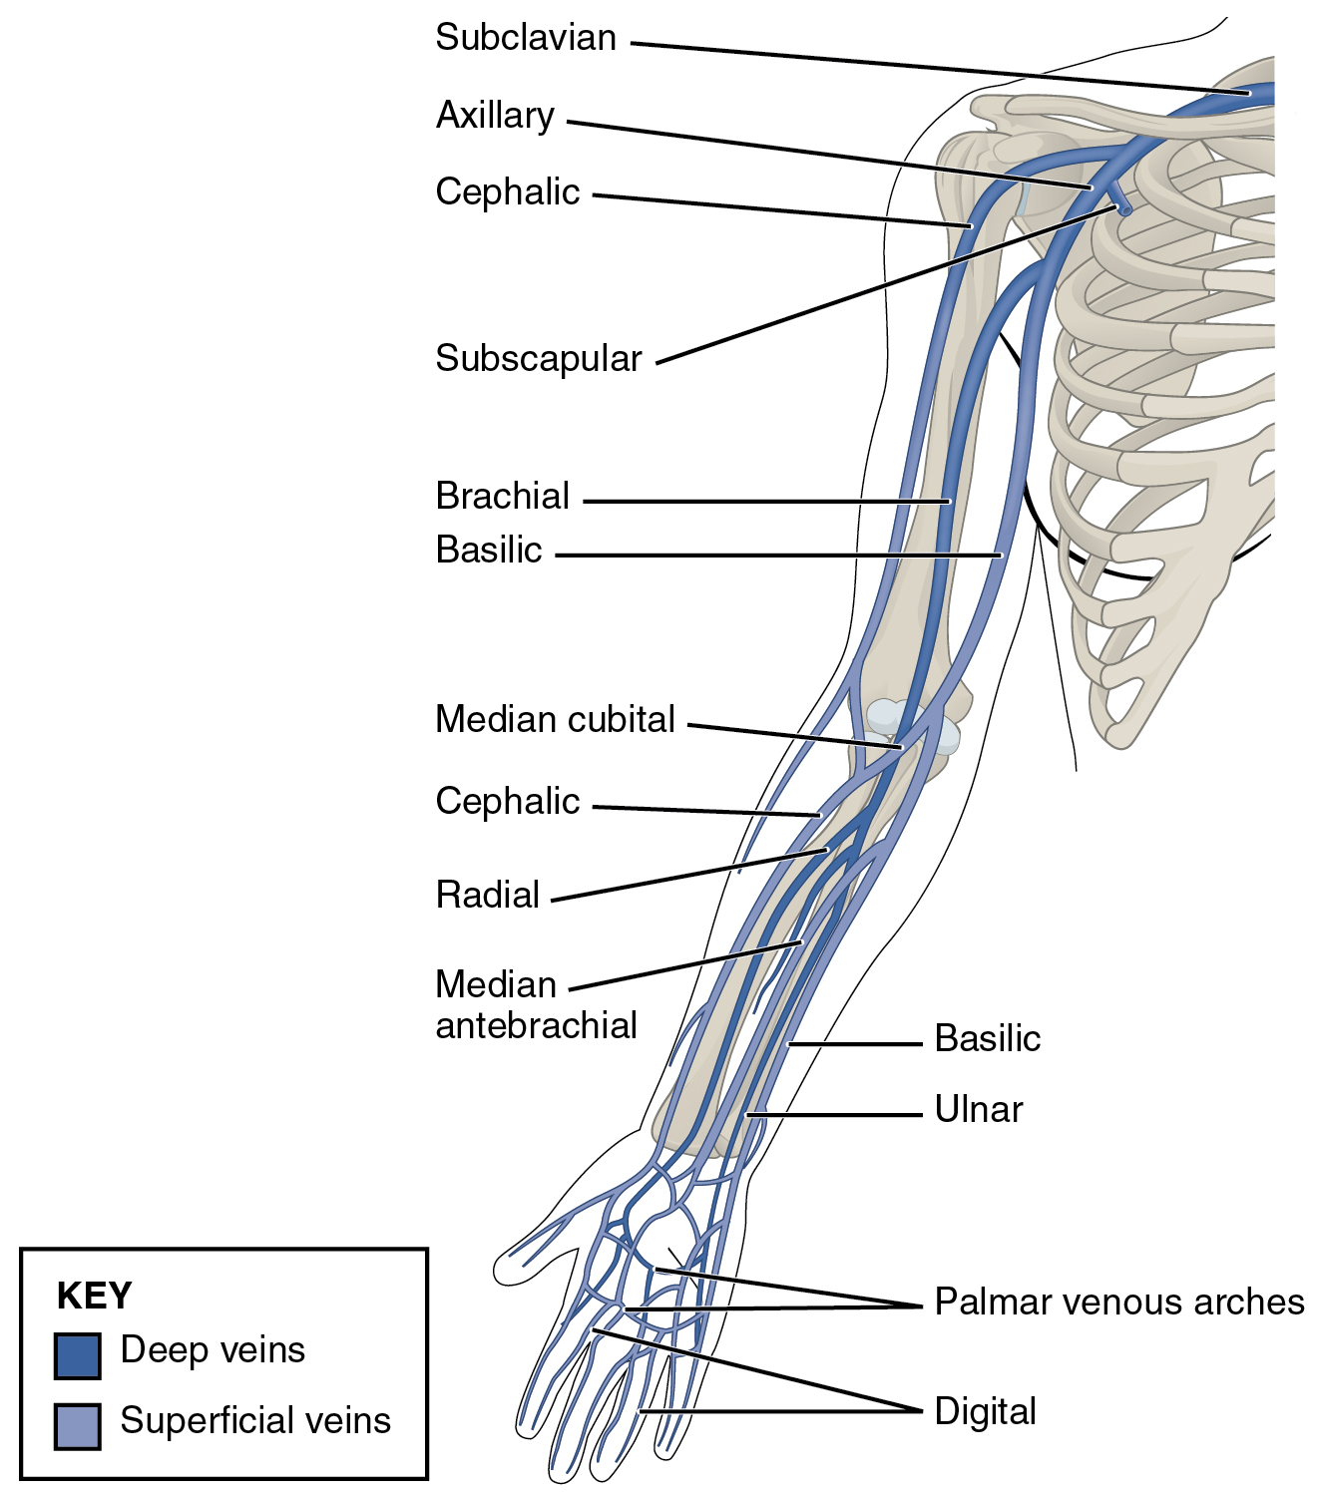

Slide 8
Termination
Forms axillary vein at lower border of teres major

Slide 10
Relations
Closely related to medial cutaneous nerve of forearm
Becomes deep in middle of arm

Slide 11
Cephalic Vein
Large superficial vein
Drains lateral side of upper limb
Origin
Arises from lateral part of dorsal venous network

Slide 13
Course
Ascends along lateral forearm
Passes anterior to elbow
Ascends along lateral border of biceps brachii
Lies in deltopectoral groove
Pierces clavipectoral fascia

Slide 15
Termination & Relations
Termination
Drains into axillary vein
Relations
Accompanied by lateral cutaneous nerve of forearm (in forearm)
Located between deltoid and pectoralis major near termination

Slide 17
Axillary Vein
Large deep vein of upper limb
Continuation of basilic vein
Formation
Formed at lower border of teres major by:
  Basilic vein
  Brachial veins

Slide 19
Course
Ascends through axilla
Lies medial to axillary artery

Slide 20
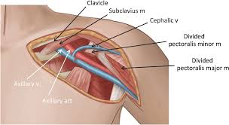

Slide 21
Termination
Becomes subclavian vein at lateral border of first rib

Slide 23
Relations
Medial and anterior to axillary artery
Closely related to cords of brachial plexus

Slide 24


Slide 25


