Slide 1

The Three Questions
Presented by: Anila Khalid

Slide 2
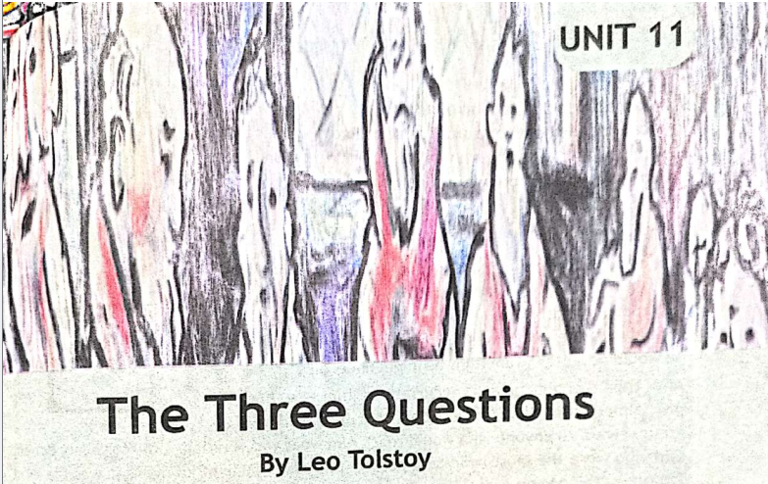

Slide 3
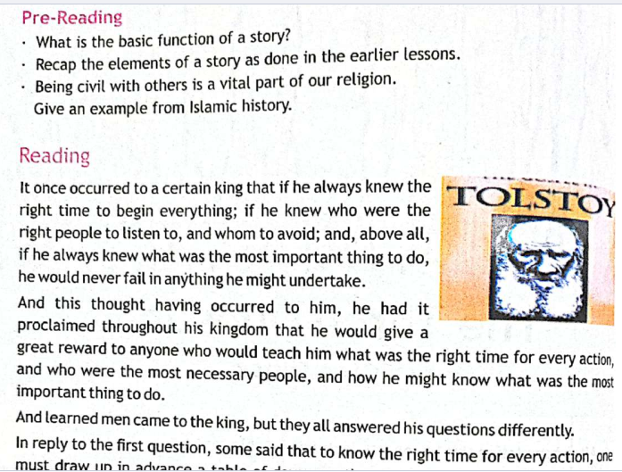

Slide 4
Vocabulary

Slide 5
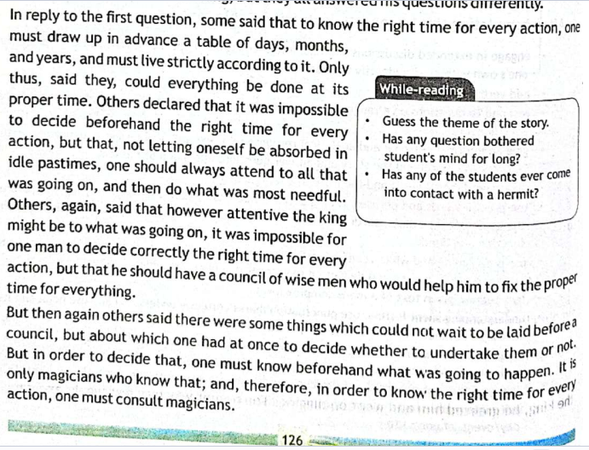

Slide 6
Vocabulary

Slide 7
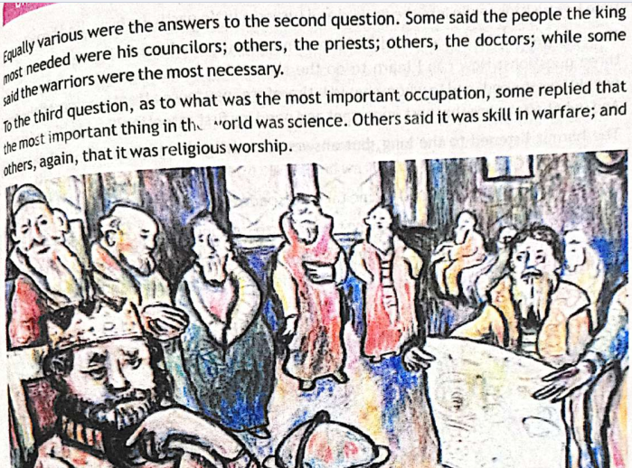

Slide 8
Vocabulary

Slide 9
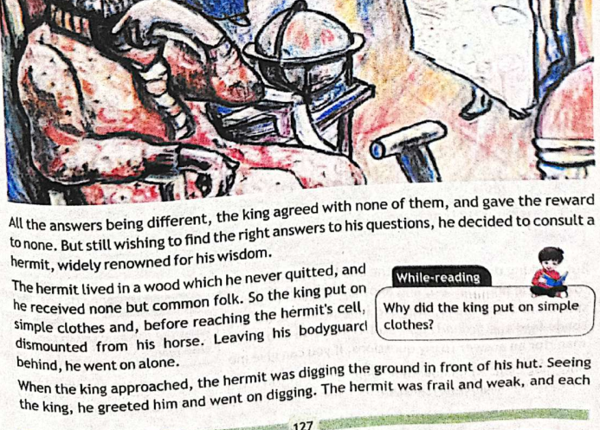

Slide 10
Vocabulary

Slide 11
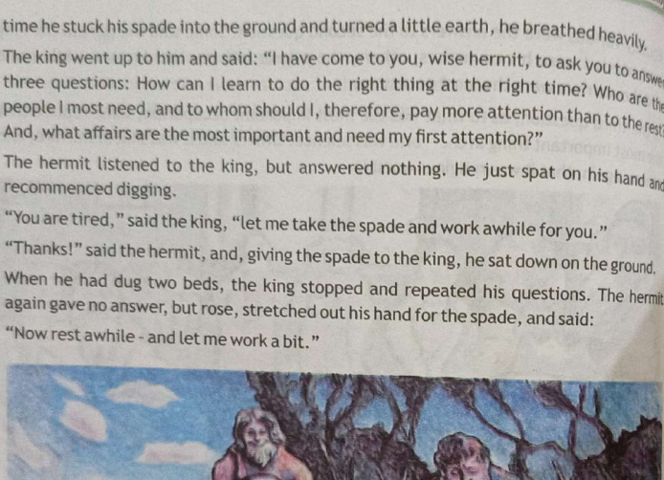

Slide 12
Vocabulary

Slide 13
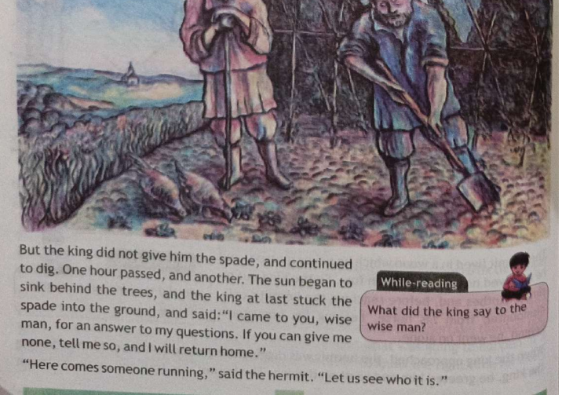

Slide 14
Vocabulary

Slide 15
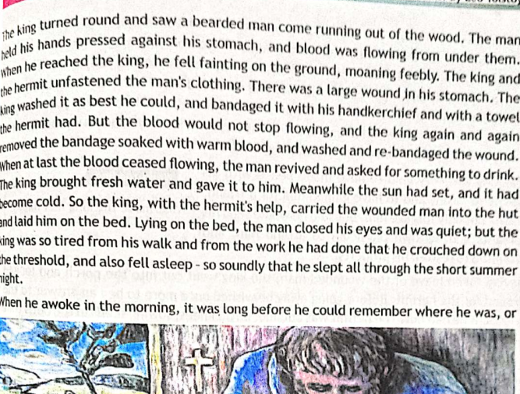

Slide 16
Vocabulary

Slide 17
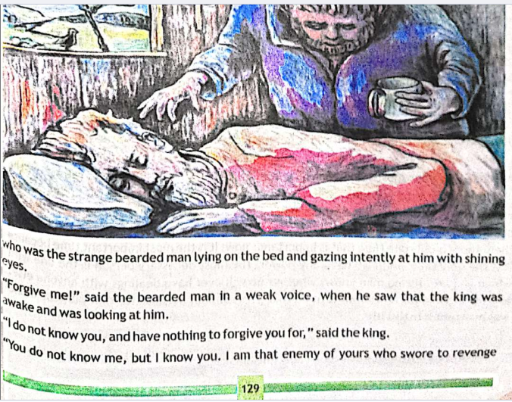

Slide 18
Vocabulary

Slide 19
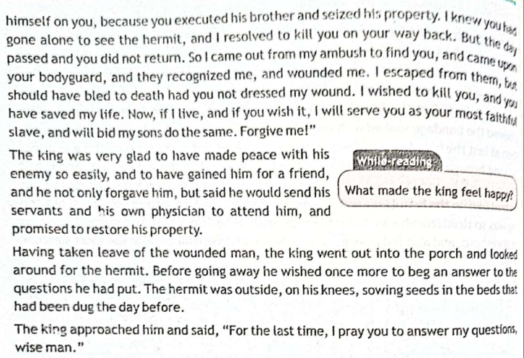

Slide 20
Vocabulary

Slide 21
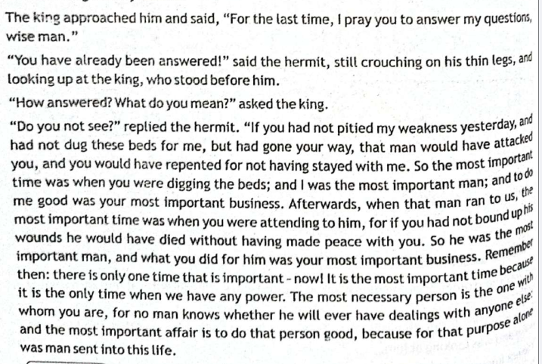

Slide 22
Vocabulary

Slide 23


