Slide 1

ANATOMY
THE UPPER LIMB
DPT
1ST SEMESTER
DR DANISH

Slide 2
VASCULATURE
The vascular system of any part of the body and its arrangement.

Slide 3
Axillary Artery
The axillary artery is the main arterial supply of the upper limb
It is the continuation of the subclavian artery
Begins at the outer border of the first rib
Ends at the lower border of teres major
Continues as the brachial artery

Slide 4
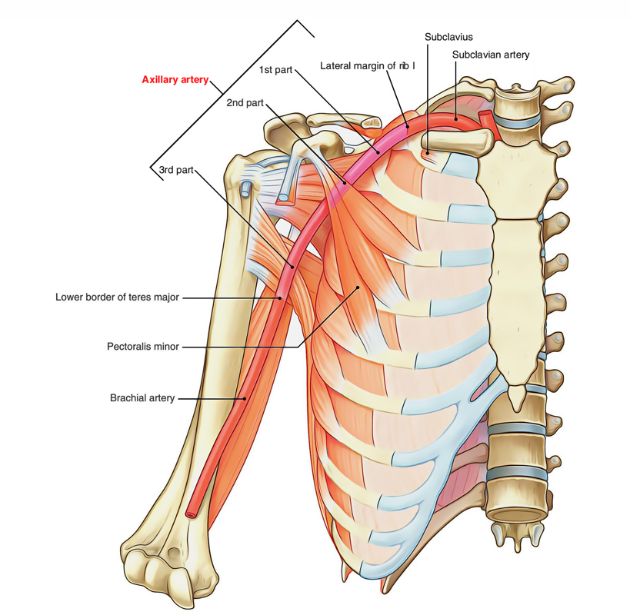

Slide 5
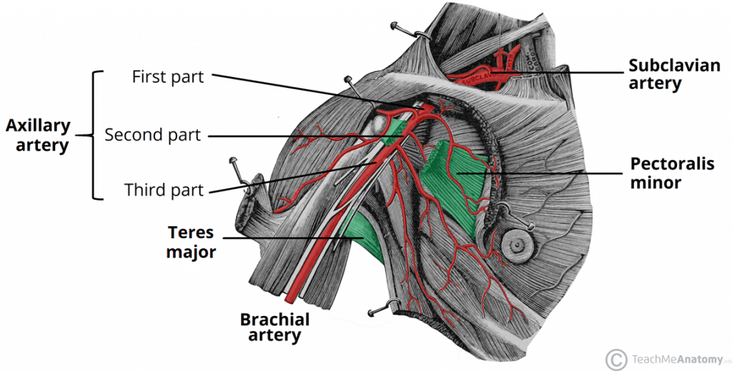

Slide 6
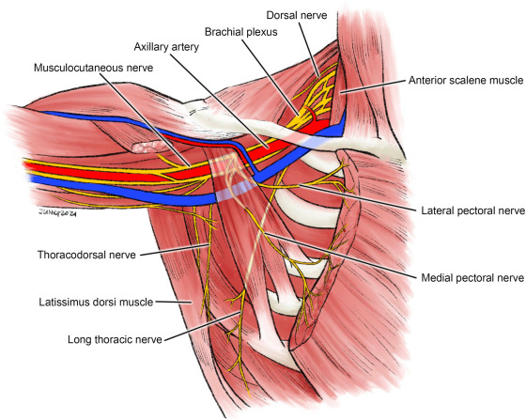

Slide 7
Extent & Course
Passes through the axilla
Runs downward and laterally
Surrounded by:
  Muscles
  Axillary vein
  Cords of the brachial plexus
Enclosed within the axillary sheath

Slide 9
Relations of Axillary Artery
Anterior Relations
Skin
Superficial fascia
Pectoralis major
Pectoralis minor (important landmark)

Slide 11
Continued
Posterior Relations
Subscapularis
Latissimus dorsi
Teres major

Slide 12
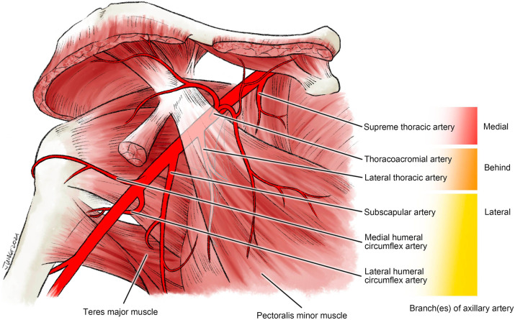

Slide 13
Medial Relations
Axillary vein
Medial cord of brachial plexus

Slide 15
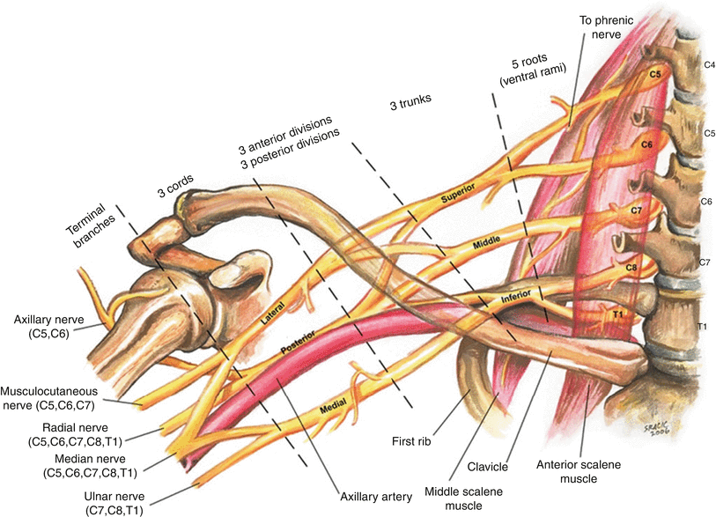

Slide 16
Continued
Lateral Relations
Coracobrachialis
Biceps brachii
Lateral cord of brachial plexus

Slide 19
Division into Three Parts
First Part:
Lies medial to pectoralis minor
Short part
Gives 1 branch

Slide 21
Continued
Second Part
Lies posterior (deep) to pectoralis minor
Gives 2 branches

Slide 23
Continued
Third Part
Lies lateral to pectoralis minor
Longest part
Gives 3 branches

Slide 25
Branches
Superior Thoracic Artery
Small artery
Supplies:
  Upper intercostal spaces
  Upper chest wall
  Pectoral muscles

Slide 26
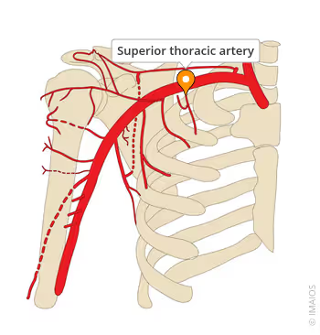

Slide 27
Continued
Thoracoacromial Artery
Short trunk
Pierces clavipectoral fascia
Divides into four branches:
  Clavicular
  Acromial
  Deltoid
  Pectoral
Supplies:
  Shoulder region
  Pectoral muscles

Slide 28
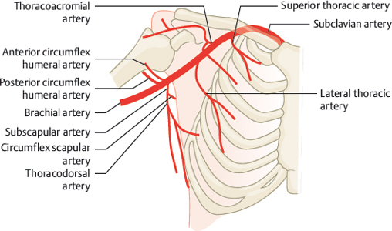

Slide 29
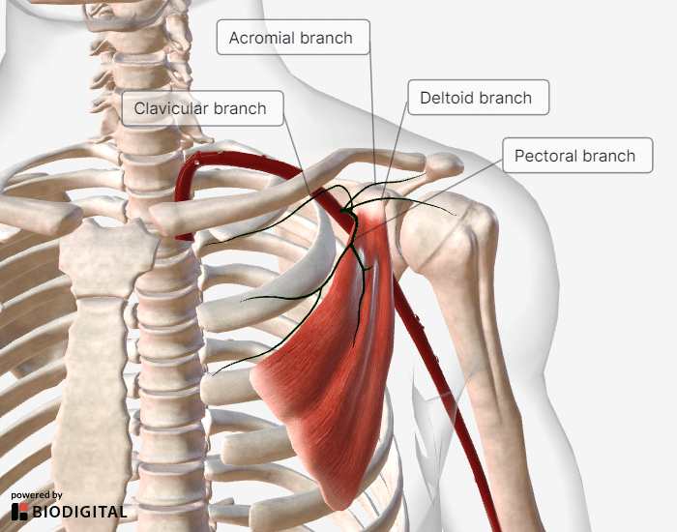

Slide 30
Lateral Thoracic Artery
Runs along lateral border of pectoralis minor
Supplies:
  Serratus anterior
  Pectoral muscles
  Breast (important in females)

Slide 32
Continued
Subscapular Artery
Largest branch of axillary artery
Divides into:
  Thoracodorsal artery
    Supplies latissimus dorsi
  Circumflex scapular artery
    Takes part in scapular anastomosis

Slide 34
Continued
Anterior Circumflex Humeral Artery
Small artery
Winds around surgical neck of humerus
Supplies shoulder joint and surrounding muscles

Slide 36
Continued
Posterior Circumflex Humeral Artery
Larger than anterior
Passes through quadrangular space
Accompanied by axillary nerve
Supplies:
  Deltoid
  Shoulder joint

Slide 38
Scapular Anastomosis
Network of arteries around scapula
Provides collateral circulation
Important when axillary artery is blocked
Involves:
  Circumflex scapular artery
  Suprascapular artery
  Dorsal scapular artery

Slide 39
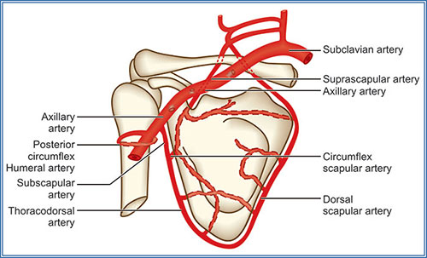

Slide 40
Clinical Importance
Injury
Commonly injured in:
  Shoulder dislocation
  Fracture of surgical neck of humerus
Can cause:
  Severe bleeding
  Nerve damage (brachial plexus)

Slide 41
Continued
Aneurysm
Can compress brachial plexus
Leads to pain, numbness, or muscle weakness
Compression
Axillary artery can be compressed against humerus to control bleeding

Slide 42
Surface Anatomy
Pulse felt deep in axilla
Best palpated by pressing against humerus

Slide 43
Important Mnemonic
“Screw The Lawyers Save A Patient”
Superior thoracic
Thoracoacromial
Lateral thoracic
Subscapular
Anterior circumflex humeral
Posterior circumflex humeral

Slide 44


Slide 45


