Slide 1

BASIC MEDICAL SCIENCE
FSC MEDICAL TECHNOLOGIES I
DR DANISH

Slide 2
Pharynx
Muscular tube located behind the nasal cavity, mouth, and larynx
Common passage for air and food

Slide 3
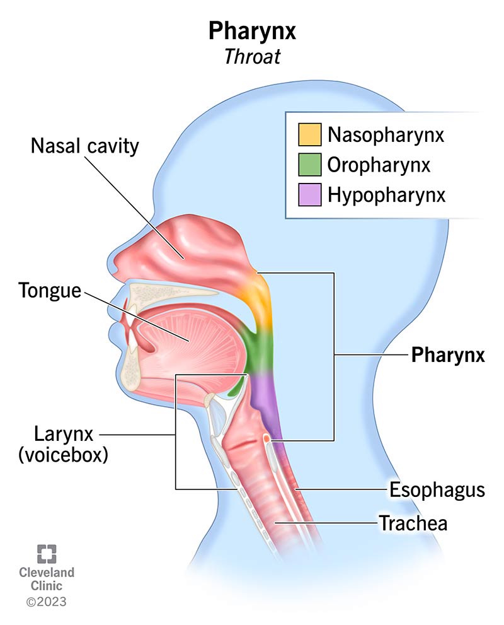

Slide 4
Parts of the Pharynx
1. Nasopharynx
2. Oropharynx
3. Laryngopharynx

Slide 5
1. Nasopharynx
Located behind the nasal cavity
Connects nasal passages to the pharynx
Passageway for air only
Involved in breathing

Slide 7
2. Oropharynx
Middle part of the pharynx
Located behind the oral cavity
Common passage for air and food
Contains tonsils (lymphoid tissue)

Slide 9
3. Laryngopharynx
Lowest part of the pharynx
Located behind the larynx
Connects to the esophagus
Directs food into the esophagus
Epiglottis prevents food from entering the trachea during swallowing

Slide 11
Esophagus
Muscular tube connecting pharynx to stomach
Transports food and liquids
Movement occurs by peristalsis

Slide 12
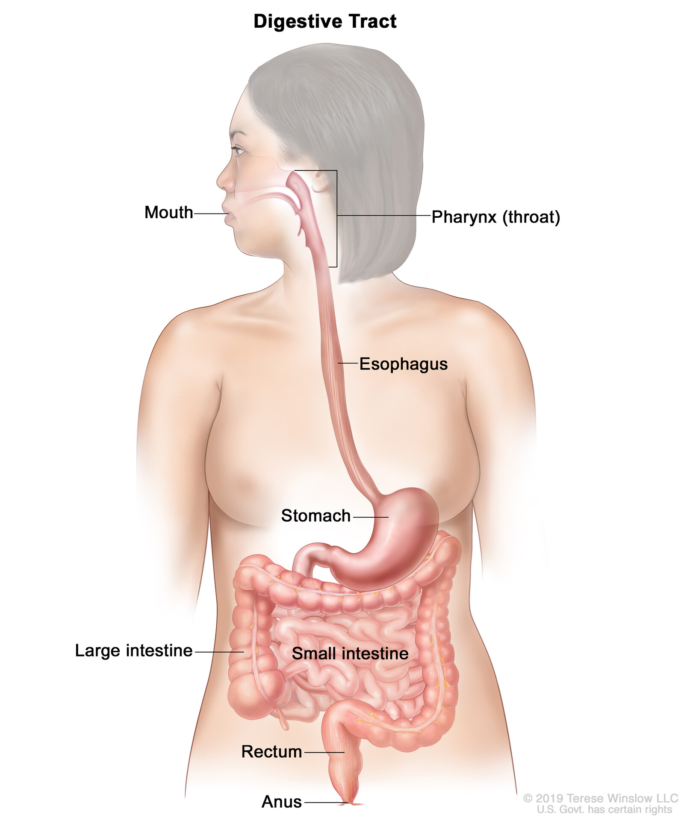

Slide 13
Muscular Layers
Inner circular muscle layer
Outer longitudinal muscle layer
Work together to push food downward

Slide 14
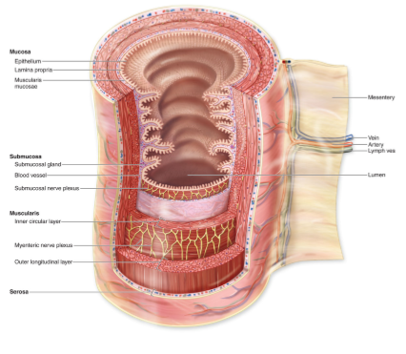

Slide 15
Esophageal Sphincters
Upper Esophageal Sphincter (UES)
Located at upper end of esophagus
Opens during swallowing
Prevents air from entering the esophagus

Slide 16
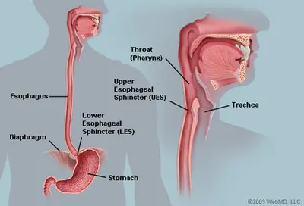

Slide 17
Continued
Lower Esophageal Sphincter (LES)
Located at lower end of esophagus
Allows food to enter the stomach
Prevents backflow of gastric contents (acid reflux)

Slide 19
Functions of the Pharynx and Esophagus
Swallowing (Deglutition): coordinated movement of muscles
Protection of Airways: epiglottis prevents aspiration
Peristalsis: propels food toward the stomach

Slide 20
Stomach
Location:
Upper left part of the abdominal cavity
Beneath the diaphragm
Between esophagus and small intestine

Slide 21
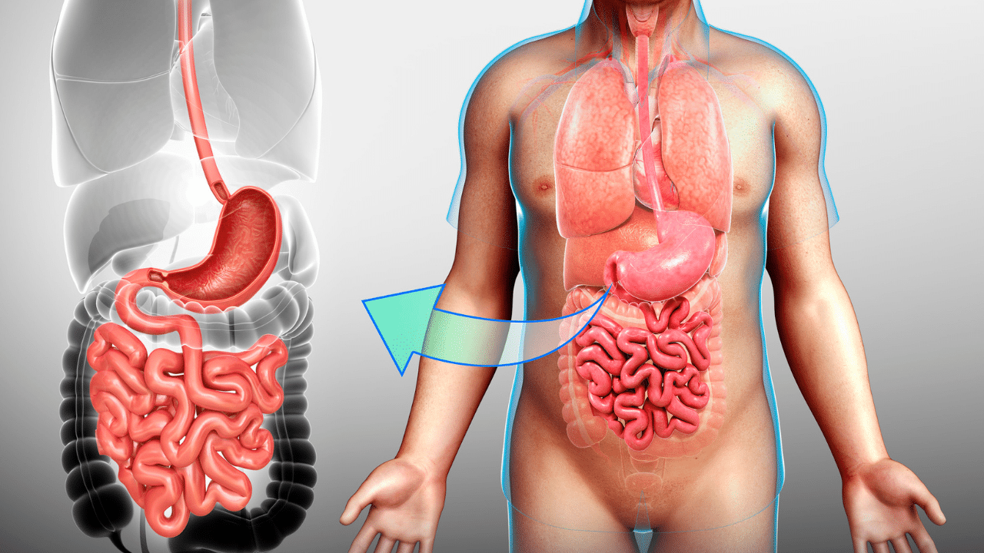

Slide 22
Shape and Size
J-shaped organ
Capacity: ~1–1.5 liters (can expand more)
Highly distensible

Slide 24
Anatomical Regions
Cardia: opening from esophagus
Fundus: dome-shaped upper portion
Body (Corpus): main central region
Pylorus: lower portion connecting to duodenum

Slide 25
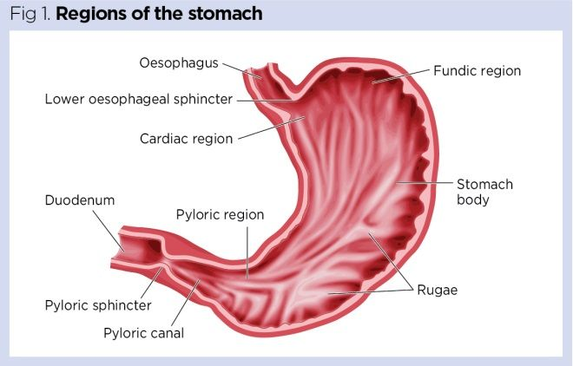

Slide 26
Muscular Layers of Stomach
Outer longitudinal layer
Middle circular layer
Inner oblique layer
Help in churning and mixing food

Slide 27
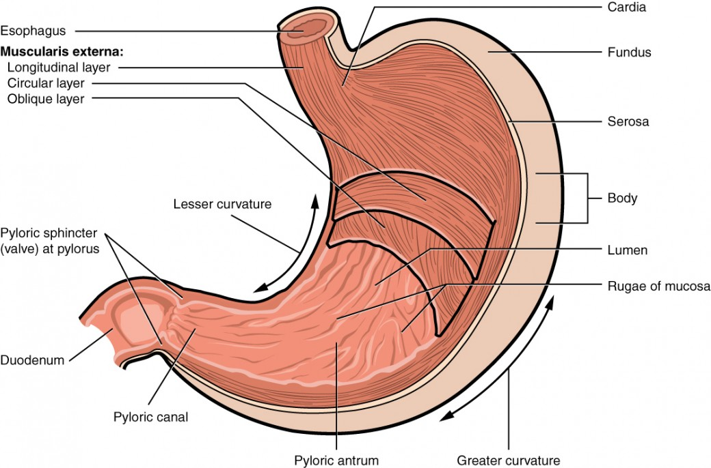

Slide 28
Gastric Mucosa and Rugae
Inner lining contains gastric glands
Secretes:
  Hydrochloric acid (HCl)
  Digestive enzymes
  Mucus (protective)
Rugae (folds) allow expansion of the stomach

Slide 29
Gastric Sphincters
Cardiac (Esophageal) Sphincter: prevents reflux
Pyloric Sphincter: controls release of chyme into duodenum

Slide 31
Functions of the Stomach
Storage: temporary storage of food
Mechanical Digestion: churning and mixing
Chemical Digestion:
  HCl kills bacteria
  Enzymes begin protein digestion
Formation of Chyme
Protection: mucus protects stomach lining
Limited Absorption: alcohol, water, some drugs

Slide 32


Slide 33


