Slide 1

ANATOMY
THE UPPER LIMB
DPT
1ST SEMESTER
DR DANISH

Slide 2
MUSCULOCUTANEOUS NERVE
Root Value
C5, C6, C7
Origin
From lateral cord of brachial plexus

Slide 3
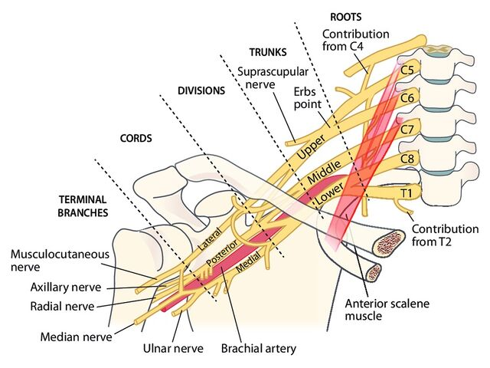

Slide 4
Course
Leaves lateral cord in the axilla
Pierces coracobrachialis muscle
Runs obliquely between:
  Biceps brachii
  Brachialis
Supplies muscles of anterior compartment of arm
Continues beyond elbow as lateral cutaneous nerve of forearm

Slide 5
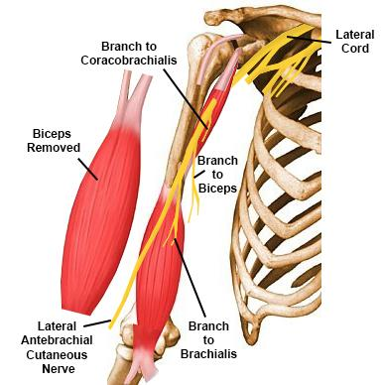

Slide 6
Branches
Muscular branches
Coracobrachialis
Biceps brachii
Brachialis
Terminal branch
Lateral cutaneous nerve of forearm

Slide 8
Motor Supply
Flexors of the arm:
  Coracobrachialis (flexion & adduction of arm)
  Biceps brachii (flexion & supination)
  Brachialis (main elbow flexor)
Sensory Supply
Skin of lateral side of forearm (anterior and posterior)

Slide 9
Applied Anatomy
Injury causes:
  Weak elbow flexion
  Loss of forearm supination
  Sensory loss on lateral forearm
Rarely injured due to deep location

Slide 10
MEDIAN NERVE
Root Value
C5, C6, C7, C8, T1
Origin
Formed by union of:
  Lateral root (lateral cord)
  Medial root (medial cord)

Slide 12
Course
In Arm
Lies lateral to brachial artery initially
Crosses anterior to artery to lie medially
Gives no motor branches in arm

Slide 13
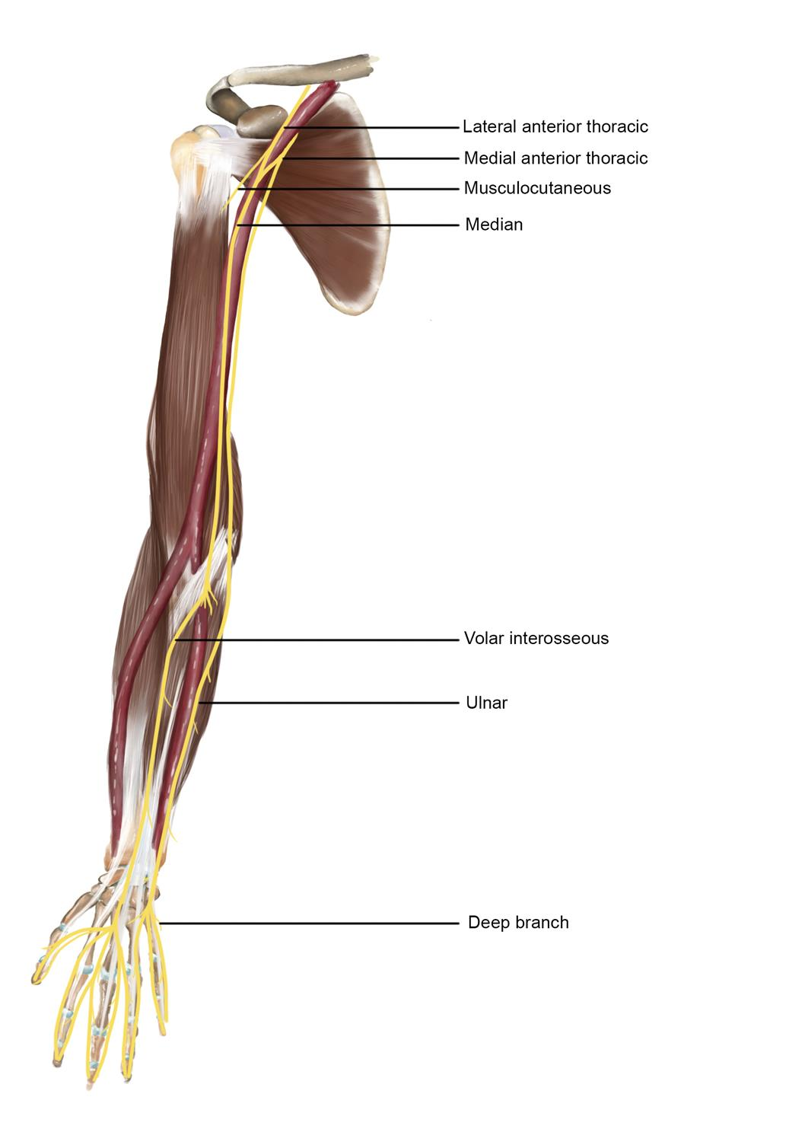

Slide 14
Continued
In Forearm
Enters forearm between two heads of pronator teres
Passes deep to flexor digitorum superficialis
Gives anterior interosseous nerve

Slide 15
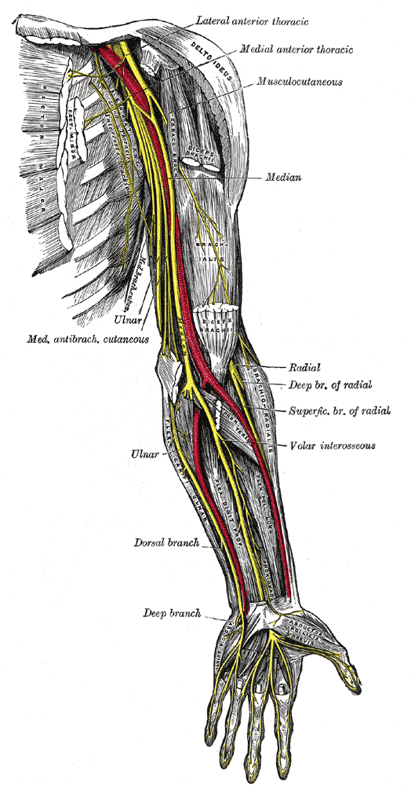

Slide 16
Continued
At Wrist
Passes through carpal tunnel
Lies deep to flexor retinaculum

Slide 17
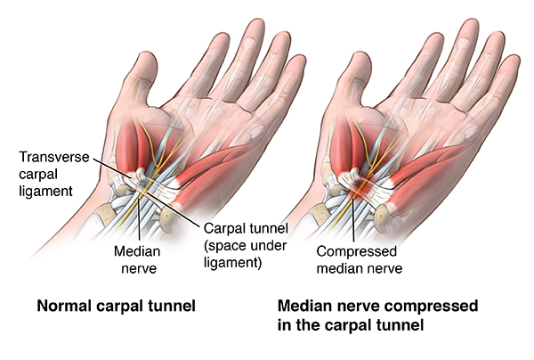

Slide 18
Continued
In Hand
Divides into:
  Recurrent branch
  Digital branches

Slide 20
Branches
In Forearm
Muscular branches
Anterior interosseous nerve
Palmar cutaneous branch
In Hand
Recurrent (thenar) branch
Digital nerves

Slide 21
Motor Supply
Forearm
Pronator teres
Flexor carpi radialis
Palmaris longus
Flexor digitorum superficialis
Lateral half of flexor digitorum profundus
Flexor pollicis longus
Pronator quadratus

Slide 22
Continued
Hand
Thenar muscles:
  Abductor pollicis brevis
  Opponens pollicis
  Flexor pollicis brevis (superficial head)
1st and 2nd lumbricals

Slide 24
Continued
Sensory Supply
Palmar surface of lateral 3½ digits
Nail beds of same digits
Lateral part of palm

Slide 26
Applied Anatomy
Carpal tunnel syndrome
Ape hand deformity
Loss of opposition of thumb
Injury above elbow → loss of pronation, weak wrist flexion
Pointing index finger on making fist

Slide 27
ULNAR NERVE
Root Value
C8, T1
Origin
From medial cord of brachial plexus

Slide 29
Course
In Arm
Runs medial to brachial artery
Passes behind medial epicondyle
In Forearm
Enters forearm between heads of flexor carpi ulnaris
Runs with ulnar artery
Supplies forearm muscles
In Hand
Passes superficial to flexor retinaculum
Enters via Guyon’s canal
Divides into superficial and deep branches

Slide 31
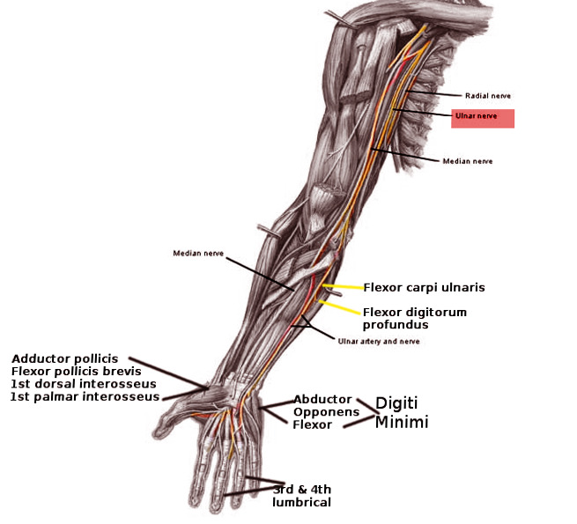

Slide 32
Branches
In Forearm
Muscular branches
Palmar cutaneous branch
Dorsal cutaneous branch
In Hand
Superficial branch
Deep branch

Slide 33
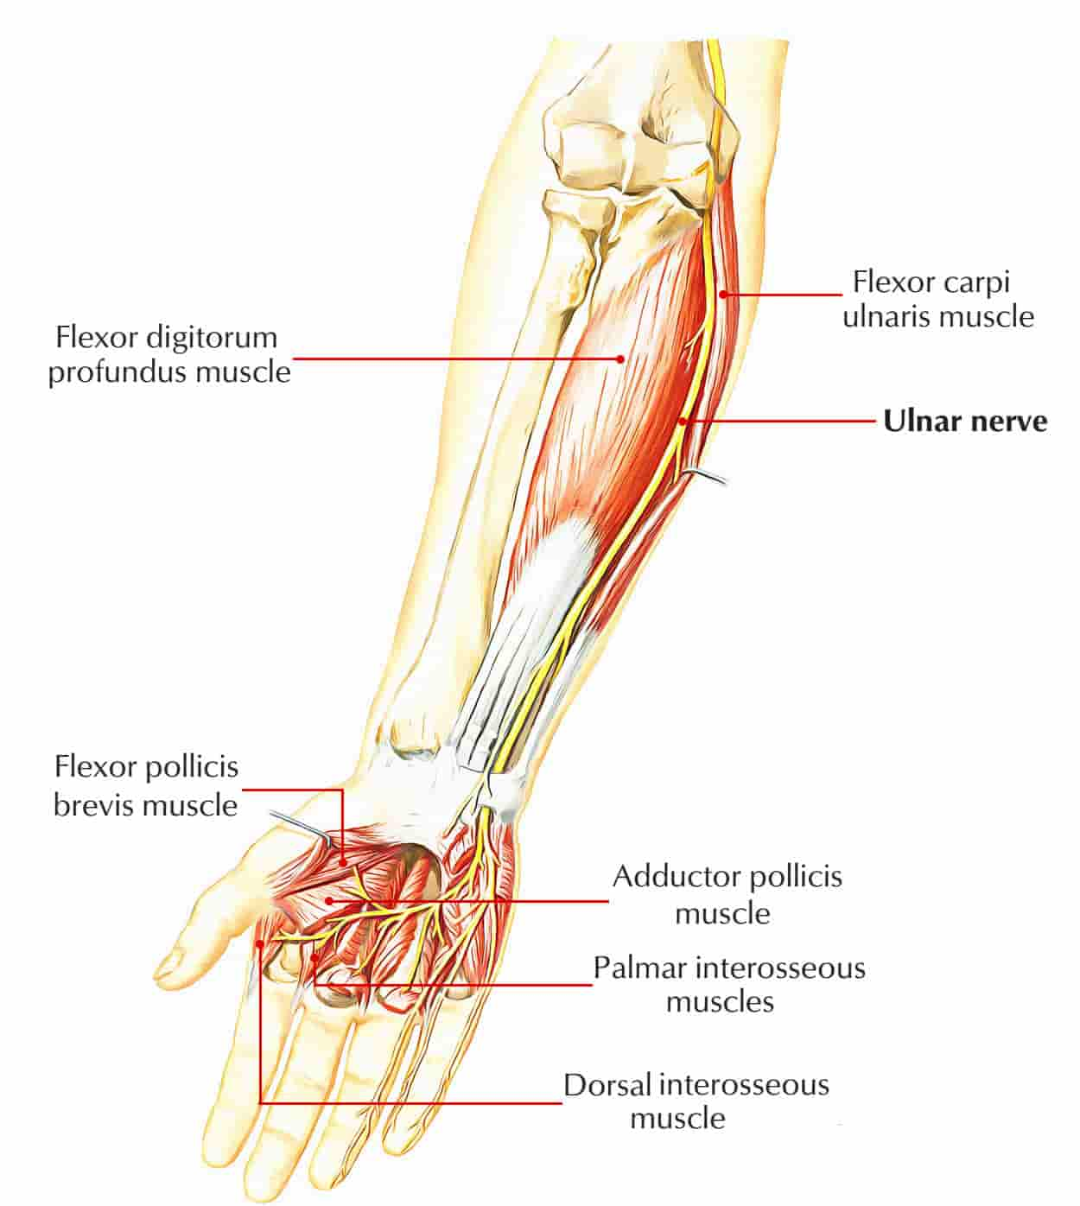

Slide 34
Motor Supply
Forearm
Flexor carpi ulnaris
Medial half of flexor digitorum profundus
Hand
Interossei (palmar & dorsal)
Medial two lumbricals
Adductor pollicis
Deep head of flexor pollicis brevis

Slide 35
Sensory Supply
Sensory Supply
Medial 1½ digits
Medial palm and dorsum of hand

Slide 37
Applied Anatomy
Injury at elbow → ulnar claw hand
Froment’s sign positive
Loss of finger abduction/adduction
Sensory loss over medial hand

Slide 38
AXILLARY NERVE
Root Value
C5, C6
Origin
From posterior cord of brachial plexus

Slide 40
Course
Passes through quadrangular space
Winds around surgical neck of humerus
Accompanied by posterior circumflex humeral artery

Slide 41
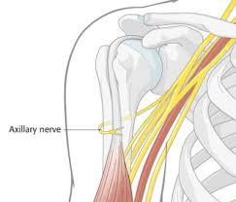

Slide 42
Branches
Anterior branch
Posterior branch
Cutaneous branch (upper lateral cutaneous nerve of arm)

Slide 43
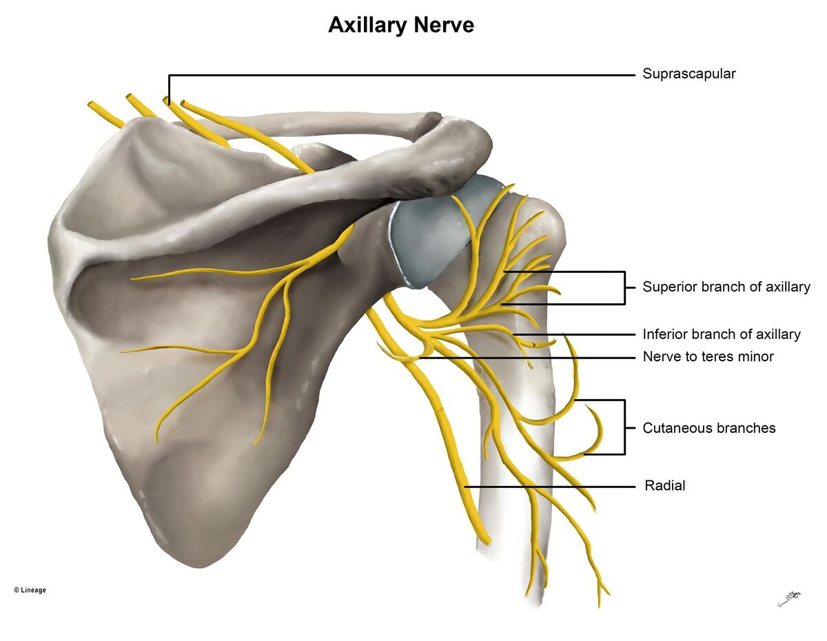

Slide 44
Motor & Sensory Supply
Motor Supply
Deltoid
Teres minor
Sensory Supply
Skin over lower half of deltoid
Regimental badge area

Slide 46
Applied Anatomy
Injury in:
  Surgical neck fracture
  Shoulder dislocation
Flattened shoulder
Loss of abduction from 15°–90°

Slide 47
RADIAL NERVE
Root Value
C5, C6, C7, C8, T1
Origin
From posterior cord

Slide 49
Course
In Axilla
Lies posterior to axillary artery
In Arm
Passes through radial groove
Supplies triceps
Pierces lateral intermuscular septum

Slide 50
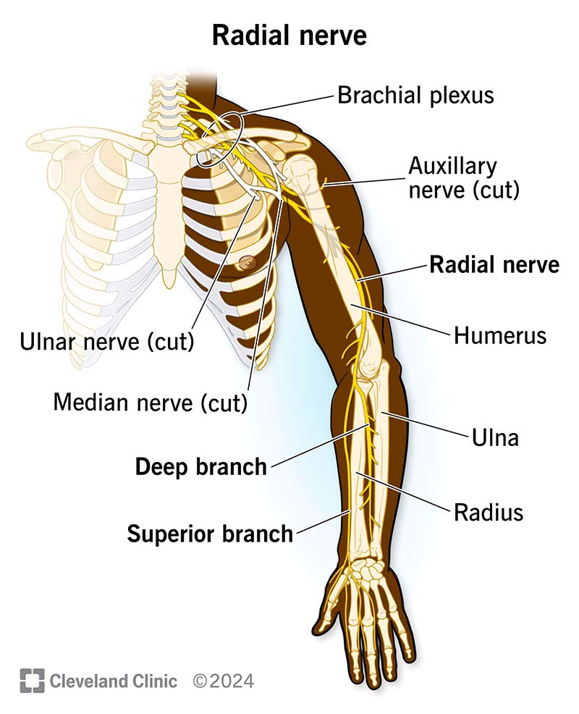

Slide 51
Continued
At Elbow
Divides into:
  Superficial branch (sensory)
  Deep branch (posterior interosseous nerve)
In Forearm
Deep branch supplies extensor muscles
Superficial branch supplies skin

Slide 53
Motor & Sensory Supply
Motor Supply
Triceps brachii
Anconeus
All extensor muscles of forearm
Sensory Supply
Posterior arm and forearm
Dorsum of lateral hand
Proximal parts of lateral digits

Slide 55
Applied Anatomy
Wrist drop
Injury in:
  Crutch palsy
  Mid-shaft humerus fracture
Loss of extension at wrist and fingers

Slide 56


Slide 57


