Slide 1

HUMAN ANATOMY
BS RIT,OTT,MLT
1ST SEMESTER
DR DANISH

Slide 2
Female Reproductive System
Female reproductive system is concerned with:
  Production of female gametes (ova)
  Secretion of female sex hormones
  Fertilization and nourishment of fetus
Consists of:
  Primary sex organs
  Secondary sex organs
  External genitalia

Slide 3
Primary Sex Organ – Ovary
Paired, almond-shaped organs
Located in ovarian fossa
Functions:
  Production of ova
  Secretion of estrogen and progesterone

Slide 4
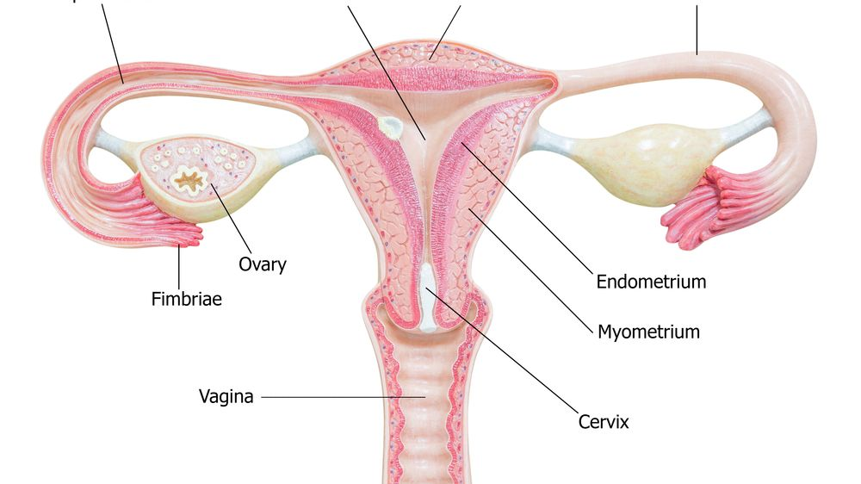

Slide 5
Structure of Ovary
Size: 3 × 2 × 1 cm
Two surfaces: medial and lateral
Two borders: anterior (mesovarian) and posterior
Two ends: tubal and uterine

Slide 6
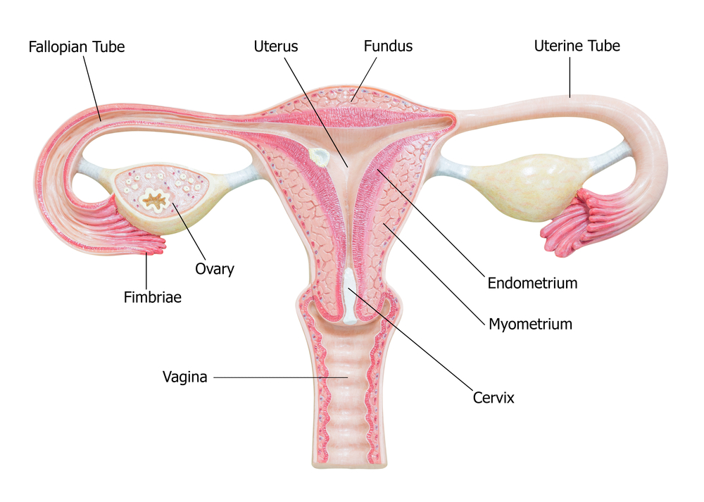

Slide 7
Internal Structure
Cortex
  Contains ovarian follicles
Medulla
  Contains blood vessels and nerves

Slide 8
Secondary Sex Organs
Include:
Uterine tubes
Uterus
Vagina

Slide 10
Uterine (Fallopian) Tubes
Paired muscular tubes, about 10 cm long
Convey ova from ovary to uterus
Site of fertilization

Slide 12
Parts of Uterine Tube
Infundibulum
  Funnel-shaped
  Contains fimbriae
Ampulla
  Widest part
  Fertilization occurs here
Isthmus
  Narrow part
Intramural part
  Passes through uterine wall

Slide 13
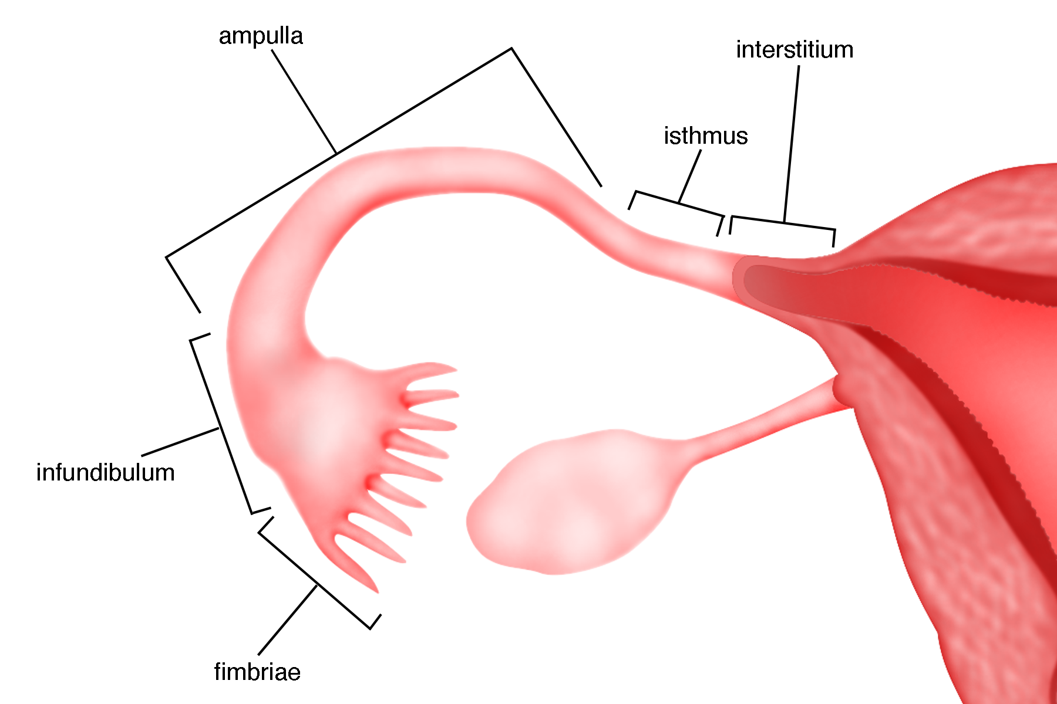

Slide 14
Uterus
Hollow, muscular, pear-shaped organ
Located in pelvic cavity
Functions:
  Implantation of fertilized ovum
  Development of fetus

Slide 16
Parts of Uterus
Fundus
Body
Cervix

Slide 18
Layers of Uterine Wall
Perimetrium (outer)
Myometrium (muscle layer)
Endometrium (inner lining)

Slide 20
Vagina
Fibromuscular canal
Extends from cervix to vestibule
Functions:
  Copulation
  Birth canal
  Passage of menstrual blood

Slide 22
External Genitalia (Vulva)
Includes:
Mons pubis
Labia majora
Labia minora
Clitoris
Vestibule
Functions
Protection of internal organs
Sexual stimulation

Slide 23
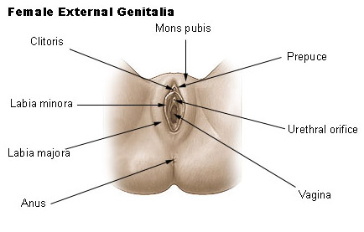

Slide 24
Mammary Glands (Accessory Organs)
Modified sweat glands
Function: lactation
Develop under hormonal influence

Slide 25
Blood Supply & Nerve Supply
Blood Supply
Ovarian artery
Uterine artery
Vaginal artery
Nerve Supply
Autonomic nervous system
Sympathetic and parasympathetic nerves

Slide 26


