Slide 1

BASIC MEDICAL SCIENCE
FSC MEDICAL TECHNOLOGIES I
DR DANISH

Slide 2
Main Vessels of Upper and Lower Limbs
Overview
The main vessels of the limbs include arteries (supply blood) and veins (return blood).
They ensure proper circulation to and from the upper and lower extremities.

Slide 3
Upper Limb Vessels
Arteries
1. Subclavian Artery
Originates:
  Left side: from the aortic arch
  Right side: from the brachiocephalic trunk
Becomes the axillary artery after passing under the clavicle

Slide 4
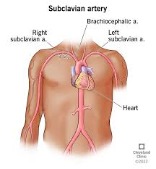

Slide 5
2. Axillary Artery
Continuation of the subclavian artery
Begins at the lateral border of the first rib
Extends to the lower border of the teres major muscle
Continues as the brachial artery

Slide 6
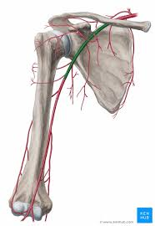

Slide 7
3. Brachial Artery
Continuation of the axillary artery
Supplies blood to the arm
Divides into radial and ulnar arteries in the cubital fossa

Slide 9
4. Radial Artery
Runs along the lateral side of the forearm
Supplies blood to the lateral structures of the forearm and hand

Slide 10
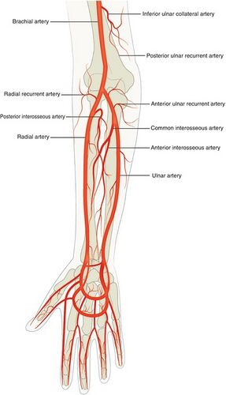

Slide 11
5. Ulnar Artery
Runs along the medial side of the forearm
Supplies blood to the medial structures of the forearm and hand

Slide 13
Veins (Upper Limb)
1. Subclavian Vein
Drains blood from the upper limb
Empties into the brachiocephalic vein

Slide 14
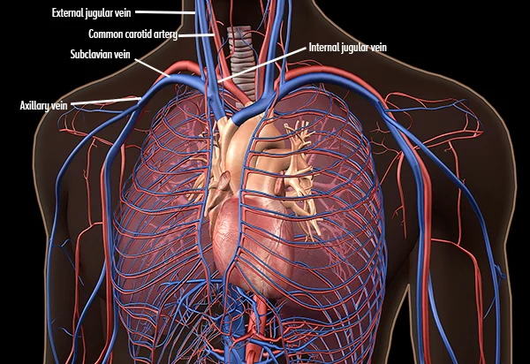

Slide 15
2. Axillary Vein
Drains blood from the axillary region
Continuation of veins from the upper limb
Becomes the subclavian vein

Slide 17
3. Brachial, Radial, and Ulnar Veins
Accompany their corresponding arteries
Drain blood from the arm and forearm

Slide 18
Basilic Vein & Cephalic Vein
4. Basilic Vein
Superficial vein
Runs along the medial aspect of the forearm and arm
Joins with brachial veins to form the axillary vein
5. Cephalic Vein
Superficial vein
Runs along the lateral aspect of the forearm and arm
Drains into the axillary vein

Slide 19
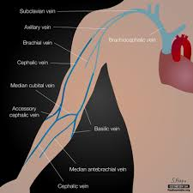

Slide 20
Lower Limb Vessels
Arteries
1. Common Iliac Artery
Divides into internal and external iliac arteries
2. External Iliac Artery
Continues as the femoral artery after passing under the inguinal ligament

Slide 21
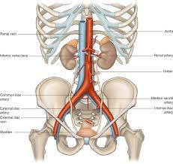

Slide 22
3. Femoral Artery
Major artery of the thigh
Divides into:
  Deep femoral artery
  Superficial femoral artery

Slide 23
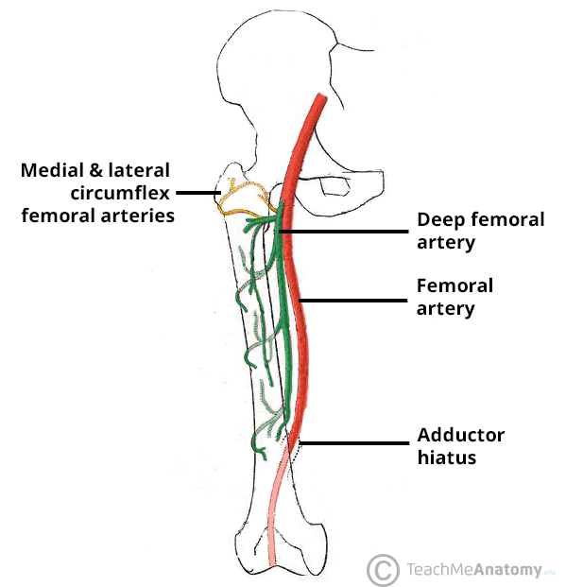

Slide 24
4. Popliteal Artery
Continuation of the femoral artery behind the knee
Divides into anterior and posterior tibial arteries

Slide 25
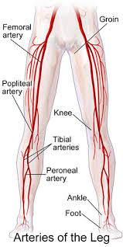

Slide 26
5. Anterior Tibial Artery
Supplies blood to the anterior compartment of the leg

Slide 27
6. Posterior Tibial Artery
Supplies blood to the posterior compartment of the leg
Branches into the fibular (peroneal) artery

Slide 28
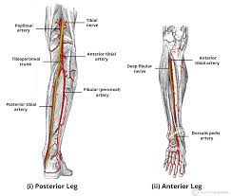

Slide 29
Veins (Lower Limb)
1. Common Iliac Vein
Drains blood from the lower limb
Empties into the inferior vena cava
2. External Iliac Vein
Continuation of the femoral vein
Joins to form the common iliac vein
3. Great Saphenous Vein
Longest superficial vein in the body
Runs along the medial side of the leg and thigh
Drains into the femoral vein
4. Small Saphenous Vein
Runs along the lateral aspect of the leg
Drains into the popliteal vein

Slide 30
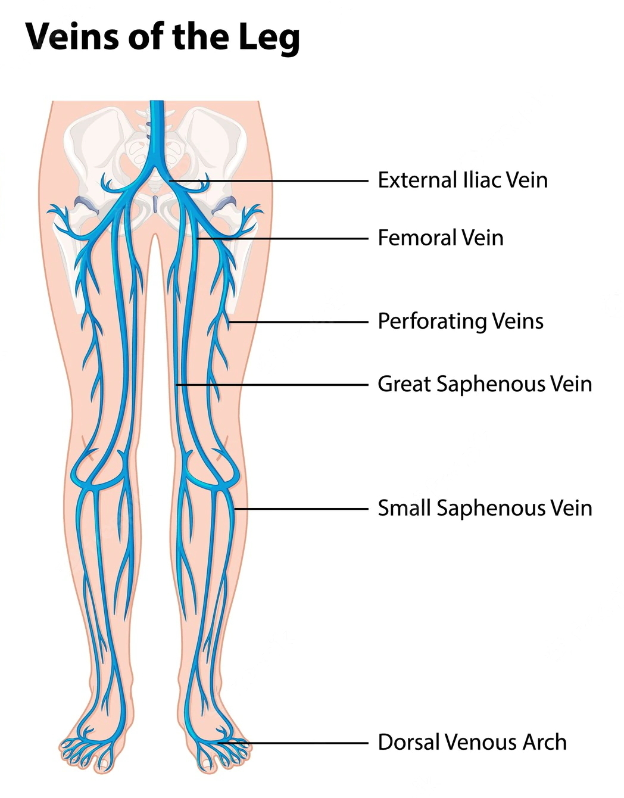

Slide 31


Slide 32


