Slide 1

ANATOMY
THE UPPER LIMB
DPT
1ST SEMESTER
DR DANISH

Slide 2
Muscles of the Posterior Aspect of Forearm
Overview:
Posterior forearm muscles are extensors & supinators
Located in the extensor compartment
Mainly supplied by Radial nerve
Divided into:
  Superficial group
  Deep group

Slide 3
Superficial Muscles
Brachioradialis
Extensor carpi radialis longus
Extensor carpi radialis brevis
Extensor digitorum
Extensor digiti minimi
Extensor carpi ulnaris
Anconeus

Slide 4
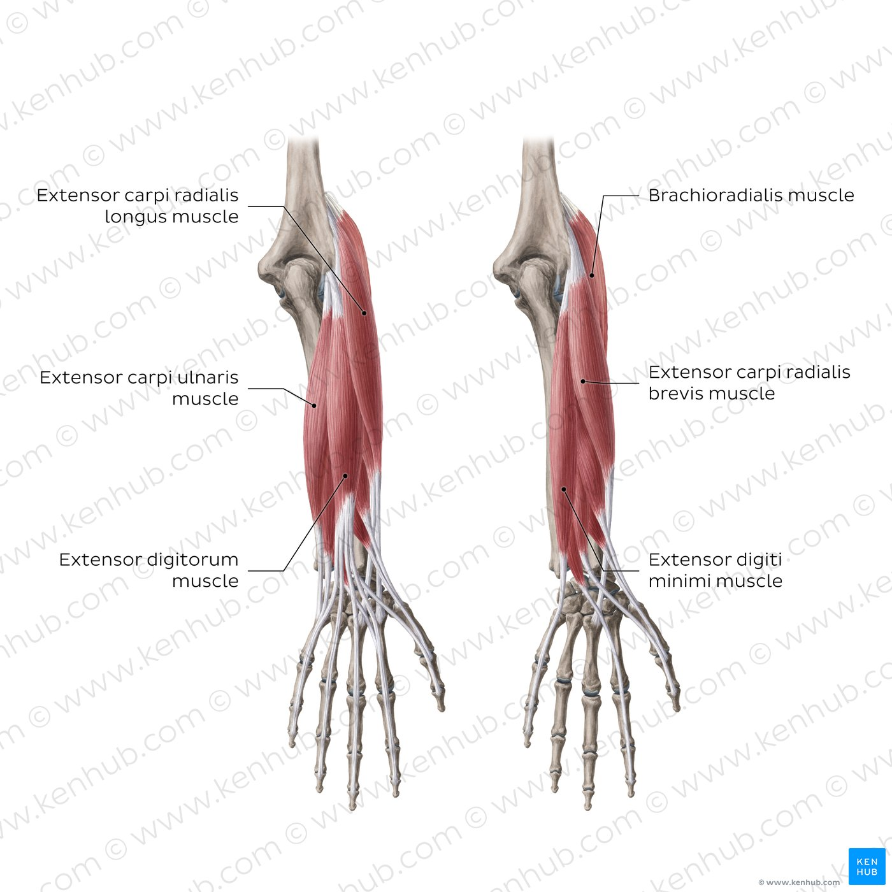

Slide 5
Brachioradialis
Origin: Lateral supracondylar ridge of humerus
Insertion: Styloid process of radius
Nerve supply: Radial nerve
Nerve root: C5–C6
Function: Flexion of elbow (max in mid-prone position)

Slide 6
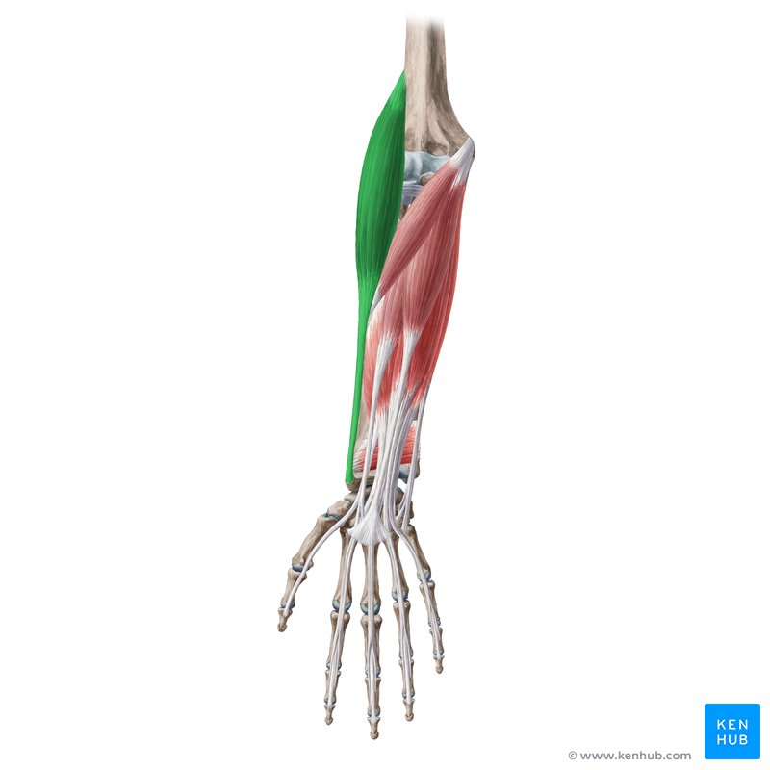

Slide 7
Extensor Carpi Radialis Longus
Origin: Lateral supracondylar ridge of humerus
Insertion: Base of 2nd metacarpal
Nerve supply: Radial nerve
Nerve root: C6–C7
Function: Wrist extension & abduction

Slide 8
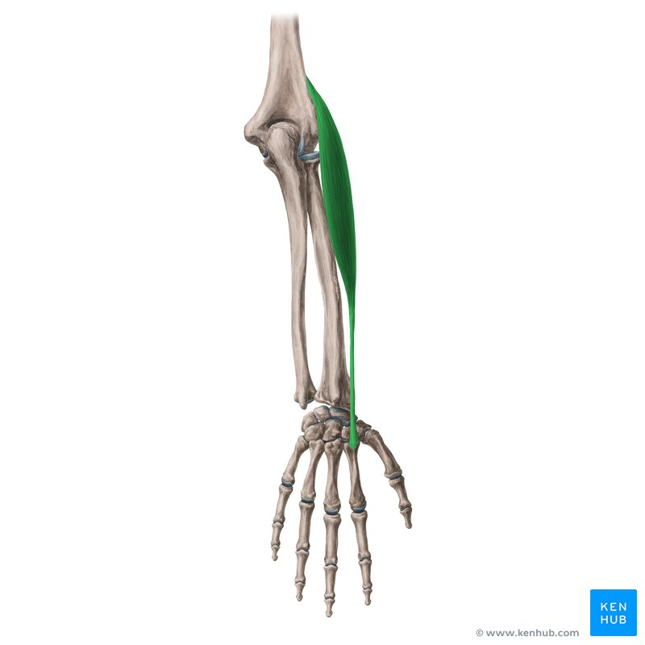

Slide 9
Extensor Carpi Radialis Brevis
Origin: Lateral epicondyle of humerus
Insertion: Base of 3rd metacarpal
Nerve supply: Deep branch of radial nerve
Nerve root: C7–C8
Function: Wrist extension

Slide 10
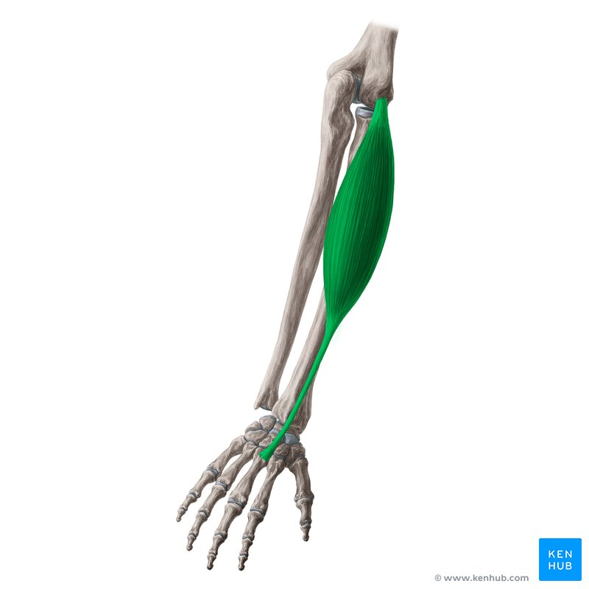

Slide 11
Extensor Digitorum
Origin: Lateral epicondyle of humerus
Insertion: Extensor expansion of digits 2–5
Nerve supply: Posterior interosseous nerve
Nerve root: C7–C8
Function: Extension of fingers & wrist

Slide 12
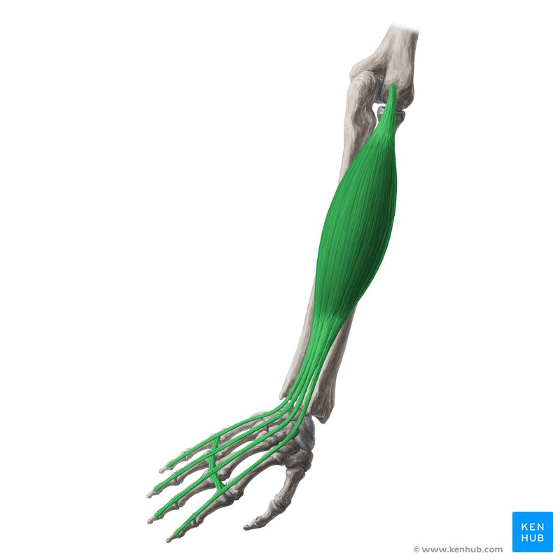

Slide 13
Extensor Digiti Minimi
Origin: Lateral epicondyle of humerus
Insertion: Extensor expansion of little finger
Nerve supply: Posterior interosseous nerve
Nerve root: C7–C8
Function: Extension of little finger

Slide 14
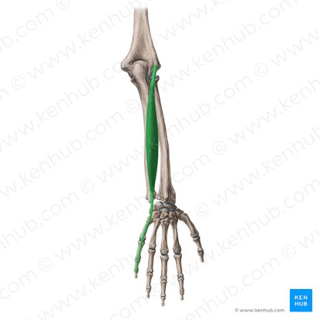

Slide 15
Extensor Carpi Ulnaris
Origin: Lateral epicondyle of humerus & posterior ulna
Insertion: Base of 5th metacarpal
Nerve supply: Posterior interosseous nerve
Nerve root: C7–C8
Function: Wrist extension & adduction

Slide 16
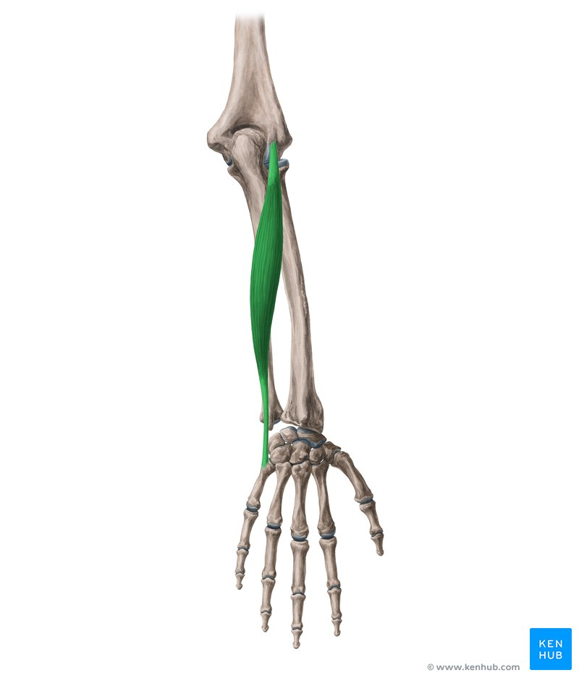

Slide 17
Anconeus
Origin: Lateral epicondyle of humerus
Insertion: Olecranon & posterior ulna
Nerve supply: Radial nerve
Nerve root: C7–C8
Function: Assists elbow extension, stabilizes elbow

Slide 18
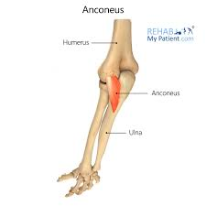

Slide 19
Deep Muscles
Supinator
Abductor pollicis longus
Extensor pollicis brevis
Extensor pollicis longus
Extensor indicis

Slide 20
Supinator
Origin: Lateral epicondyle, radial collateral ligament, ulna
Insertion: Lateral surface of proximal radius
Nerve supply: Deep branch of radial nerve
Nerve root: C6–C7
Function: Supination of forearm

Slide 21
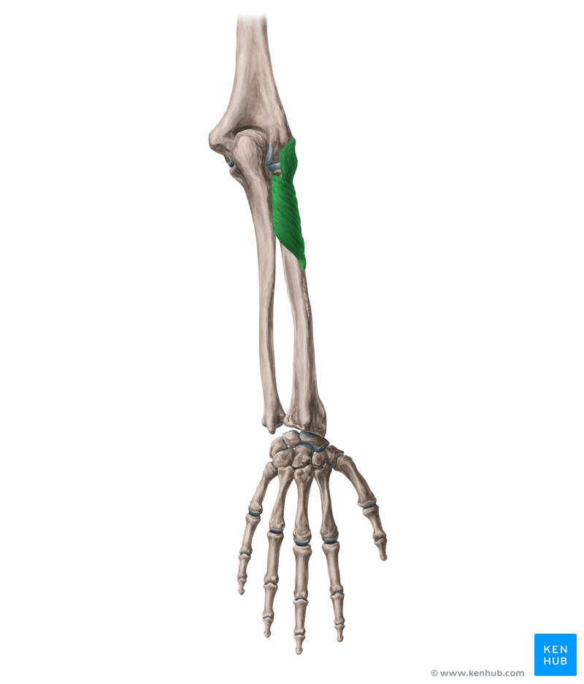

Slide 22
Abductor Pollicis Longus
Origin: Posterior radius, ulna & interosseous membrane
Insertion: Base of 1st metacarpal
Nerve supply: Posterior interosseous nerve
Nerve root: C7–C8
Function: Abduction & extension of thumb

Slide 23
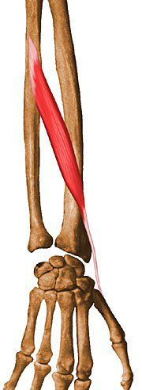

Slide 24
Extensor Pollicis Brevis
Origin: Posterior radius & interosseous membrane
Insertion: Base of proximal phalanx of thumb
Nerve supply: Posterior interosseous nerve
Nerve root: C7–C8
Function: Extension of thumb (MCP joint)

Slide 25
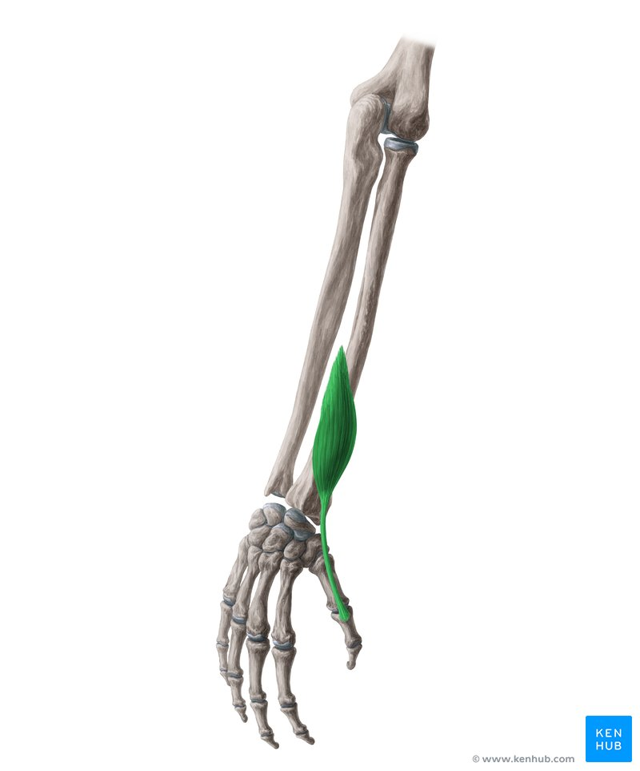

Slide 26
Extensor Pollicis Longus
Origin: Posterior ulna & interosseous membrane
Insertion: Base of distal phalanx of thumb
Nerve supply: Posterior interosseous nerve
Nerve root: C7–C8
Function: Extension of thumb (IP joint)

Slide 27
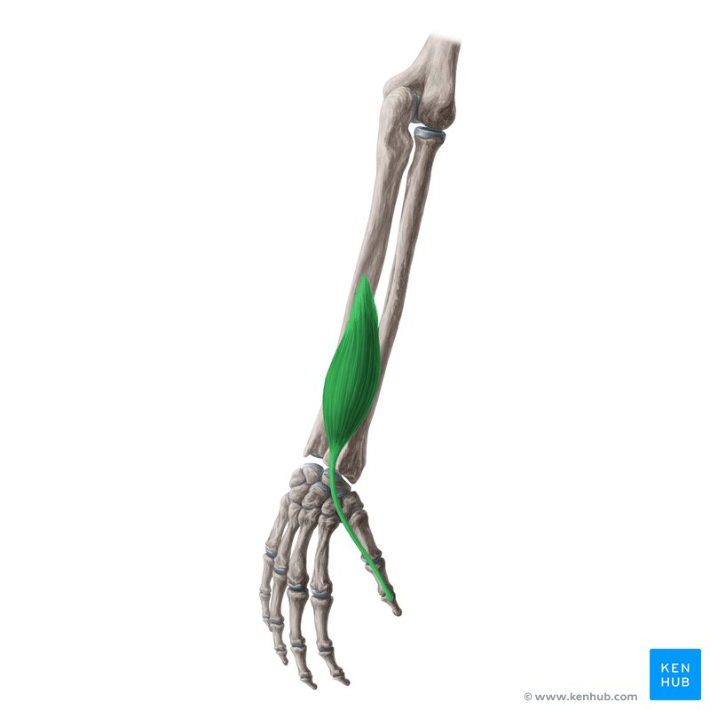

Slide 28
Extensor Indicis
Origin: Posterior ulna & interosseous membrane
Insertion: Extensor expansion of index finger
Nerve supply: Posterior interosseous nerve
Nerve root: C7–C8
Function: Extension of index finger

Slide 29
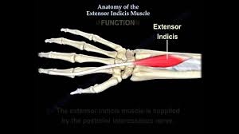

Slide 30


Slide 31


