Slide 1

PHYSIOTHERAPY TECHNIQUES
FSC PT I
DR DANISH

Slide 2
Volkmann’s Contracture
Definition:
A deformity of the hand, fingers, and wrist
Caused by injury to forearm muscles due to lack of blood supply (ischemia)
Commonly follows compartment syndrome

Slide 3
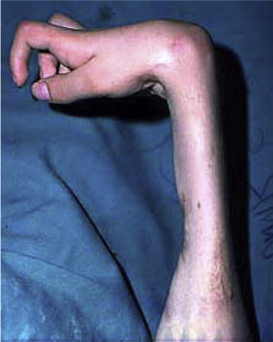

Slide 4
Cause
Increased pressure in forearm compartments due to:
  Swelling
  Crush injury
  Fracture
Pressure reduces blood flow → muscle & nerve damage
Muscles become scarred, shortened, and stiff
Leads to permanent flexion deformity

Slide 5
Levels of Severity
Mild
  Contracture of 2–3 fingers only
  Little or no loss of wrist movement or sensation
Moderate
  All fingers flexed
  Thumb stuck in the palm
  Wrist may be bent
  Some loss of hand sensation

Slide 6
Continued
Severe
  All forearm muscles involved
  Both flexors and extensors affected
  Severe disability

Slide 7
Symptoms (Compartment Syndrome / Volkmann’s)
Severe pain not relieved by rest or medication
Pain increases over time
Decreased sensation
Pale skin
Muscle weakness

Slide 8
Treatment of Volkmann’s Contracture
Immobilize with sling or splint
Elevate arm above heart level
Early surgery to relieve pressure is best
Surgery to lengthen muscles may help regain function
Early diagnosis improves outcome

Slide 9
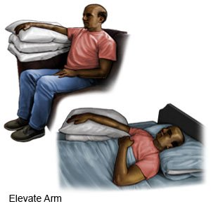

Slide 10
Dislocation
Definition:
Complete displacement of bone ends from a joint
Joint slips out of its normal position
Causes damage to muscles, ligaments, and tendons

Slide 11
Classification
Congenital
Traumatic
  Acute
  Old unreduced
  Recurrent
Pathological
Paralytic

Slide 12
Symptoms
Swelling
Intense pain
Immobility of the affected joint

Slide 13
Treatment
Reduction (manual repositioning of bones)
  May require local or general anesthesia
Immobilization
  Splint or sling for several weeks
Surgery
  If reduction fails
  If nerves, vessels, or ligaments are damaged
  Common in recurrent shoulder dislocations
Rehabilitation
  Restore range of motion and strength

Slide 14
Subluxation
Definition:
Partial dislocation of a joint
Often due to traumatic or acute injury

Slide 15
Causes
Sports injuries
Falls
Car accidents
Twisting movements
Joint laxity (loose joints)

Slide 16
Common Symptoms
Pain around the joint
Sensation of joint “giving way”
Swelling
Limited mobility

Slide 17
Treatment of Joint Subluxation
Ensure proper joint alignment
Reduce inflammation using:
  Rest (splint, sling, or crutches if needed)
  Ice application
  Elevation above heart level
  Anti-inflammatory medications (NSAIDs)
  Braces / splints to stabilize the joint

Slide 18


Slide 19


