Slide 1

BASIC MEDICAL SCIENCE
FSC MEDICAL TECHNOLOGIES I
DR DANISH

Slide 2
ABDOMINAL AORTA
The abdominal aorta is a major segment of the aorta
The largest artery in the human body
Responsible for supplying oxygenated blood to the abdominal organs, pelvis, and lower extremities.

Slide 3
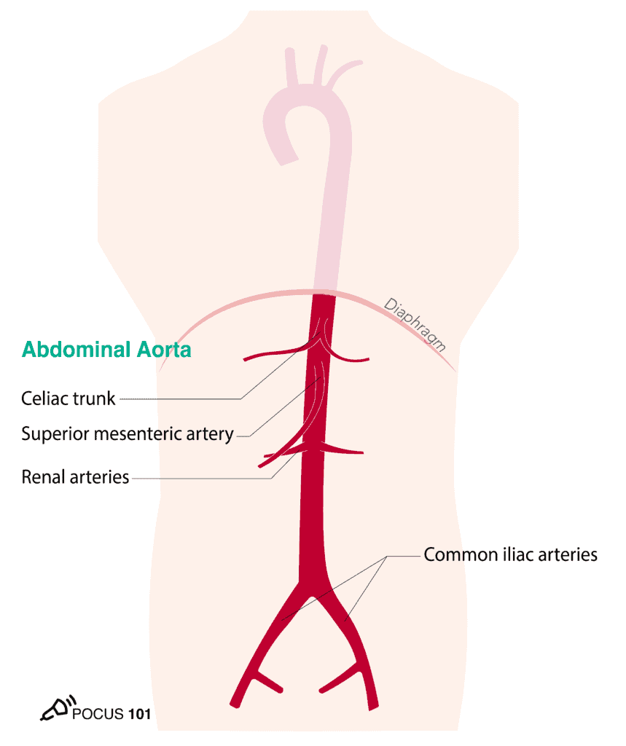

Slide 4
1. Location
The abdominal aorta is the continuation of the thoracic aorta.
It begins at the diaphragm, where the thoracic aorta transitions into the abdominal aorta.
It extends to the level of the fourth lumbar vertebra, where it bifurcates into the left and right common iliac arteries.

Slide 5
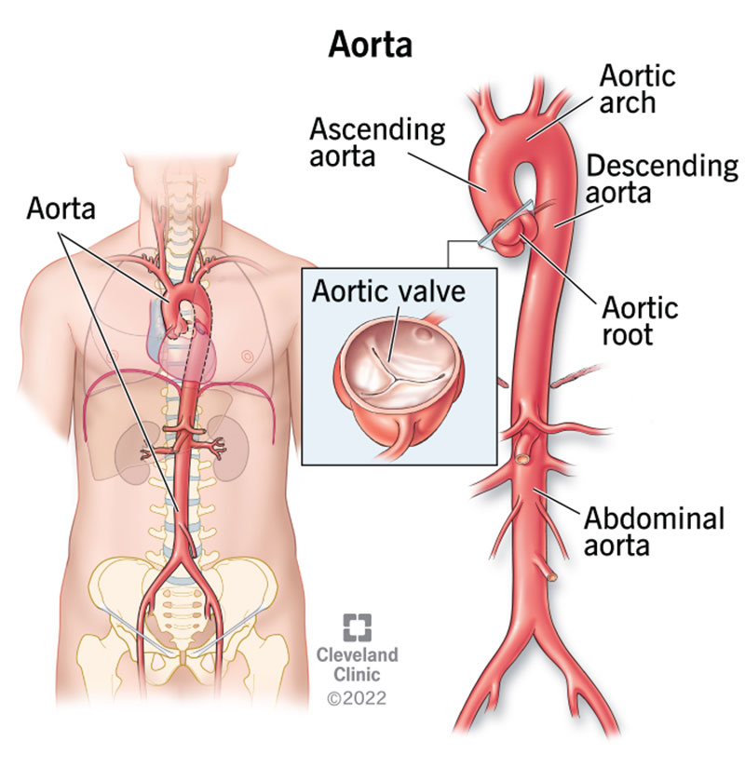

Slide 6
2. Segments
Suprarenal Aorta:
  This segment is located superior to the renal arteries.
Renal Aorta:
  This segment gives off the renal arteries, which supply blood to the kidneys.
Mesenteric Aorta:
  This segment gives rise to the superior and inferior mesenteric arteries, which supply blood to the intestines and associated organs.

Slide 7
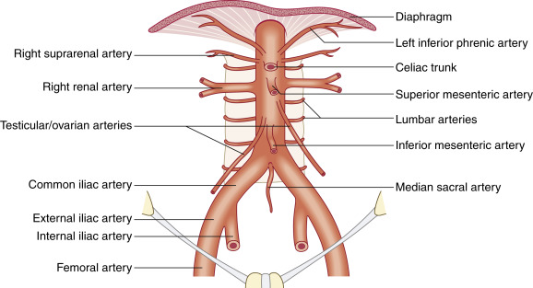

Slide 8
Continued
Lumbar Aorta:
  This segment gives off the lumbar arteries, which supply blood to the muscles and vertebrae of the lower back.
Terminal Aorta:
  This segment bifurcates into the left and right common iliac arteries, which further branch into the internal and external iliac arteries supplying the pelvis and lower extremities.

Slide 10
3. Branches
Celiac Trunk (Artery):
  Arises from the abdominal aorta and branches into the left gastric artery, splenic artery, and common hepatic artery, supplying blood to the stomach, spleen, liver, and pancreas.
Superior Mesenteric Artery:
  Arises from the abdominal aorta and supplies blood to the small intestine, cecum, appendix, and part of the large intestine.
Inferior Mesenteric Artery:
  Arises from the abdominal aorta and supplies blood to the distal part of the large intestine (descending colon, sigmoid colon, and rectum).

Slide 11
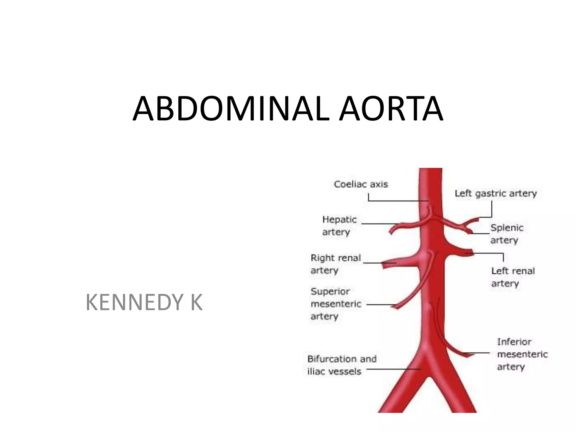

Slide 12
4. Pathologies
Diseases of the abdominal aorta
Such as abdominal aortic aneurysms, atherosclerosis, and dissections, can lead to serious complications and require medical intervention.
Abdominal aortic aneurysms, in particular, can be life-threatening if they rupture.

Slide 13


Slide 14


