Slide 1

Anesthesia Workstations
BS ( PSYCHOLOGY)
ADNAN RAMZAN

Slide 2
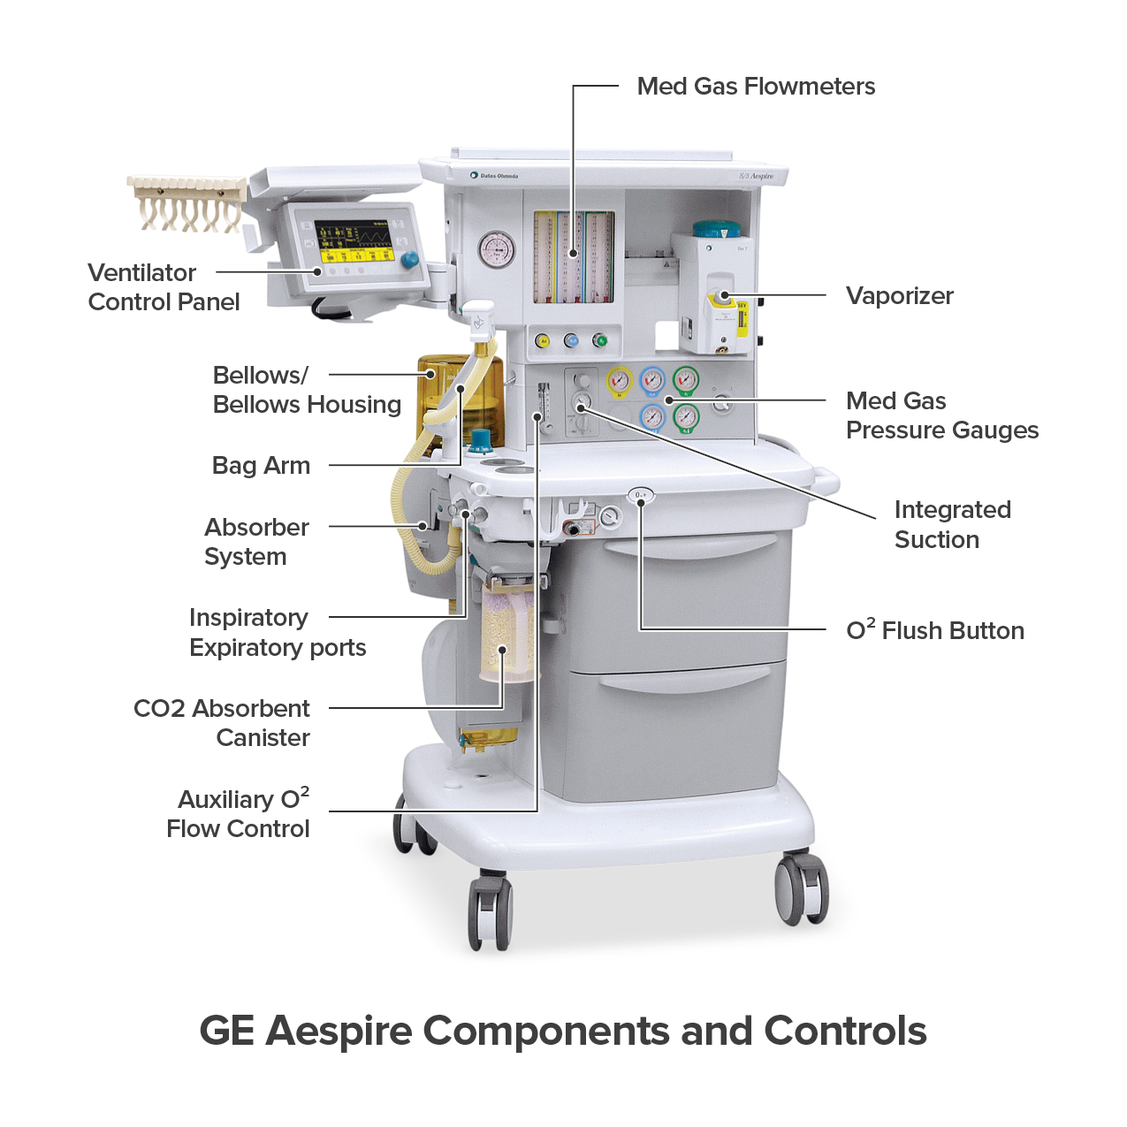
Anesthesia Workstations

Slide 3
Modern Anesthesia Workstations – Introduction
Modern anesthesia workstations are used in operation theatres.
They combine anesthesia delivery and patient monitoring.
They improve safety during surgery.
They reduce manual work for anesthetists.
They are computer-controlled systems.
They give accurate and continuous data.
They are used for simple and complex surgeries.

Slide 4
Integrated Monitoring Systems
Monitoring systems are built into anesthesia workstations.
They continuously monitor patient vital signs.
ECG monitoring shows heart activity.
SpO2 monitoring measures oxygen saturation.
Blood pressure can be invasive or non-invasive.
Alarms alert doctors during emergencies.
Helps in early detection of complications.

Slide 5
Display and Data Recording
Modern monitors have large color screens.
Displays can be customized by the user.
Waveforms and numbers are shown clearly.
Trends of past vital signs are available.
Data is recorded automatically.
Improves accuracy of records.
Saves time for anesthesia staff.

Slide 6
Networking and EMR Connection
Machines can connect to hospital networks.
They integrate with Electronic Medical Records.
Patient data is saved automatically.
Helps in documentation and reporting.
Reduces chances of human error.
Data can be reviewed later.
Useful for audits and research.
Supports hospital information systems.
Notes:
integrating an Electronic Medical Record (EMR)

Slide 7
Ventilation Modes
Modern machines support different ventilation modes.
Pressure Support Ventilation helps spontaneous breathing.
Volume-controlled ventilation is commonly used.
SIMV mode supports both spontaneous and controlled breaths.
Provides better patient comfort.
Helps in complicated patient cases.
Notes:
Synchronized(to occur at the same time) Intermittent Mandatory Ventilation

Slide 8
Accurate Ventilation Delivery
Modern ventilators deliver very low tidal volumes.
Piston ventilators are more accurate than bellows.
Self-test systems detect leaks.
Improves patient safety.

Slide 9
Respiratory Monitoring
Flow sensors measure respiratory flow.
Sensors are placed near Y-piece.
Flow-time waveforms are displayed.
Volume-time waveforms are shown.
Pressure-time waveforms are monitored.
Helps assess lung condition.
Detects disconnections early.
Improves ventilation management.

Slide 10
Power Backup System
Modern machines depend on electricity.
Battery backup is provided.
Backup usually lasts around 30 minutes.
Important during power failure.
Manual backup should be ready.
Older machines needed less electricity.
Modern machines are fully electronic.
Power safety is very important.

Slide 11
Target Controlled Anesthesia
Target Controlled Anesthesia is an automatic system.
Doctor sets target oxygen and agent levels.
System continuously monitors values.
Gas delivery adjusts automatically.
Prevents over-delivery of anesthetic agents.
Prevents hypoxia.
Reduces wastage of gases.
Cost-effective anesthesia.

Slide 12
Total Intravenous Anesthesia
TIVA uses intravenous drugs.
It avoids inhalational anesthetics.
Modern systems automate TIVA.
Software calculates drug doses.
Syringe pumps deliver drugs accurately.
Reduces calculation errors.
Provides smooth anesthesia.
Example: Drager Zeus system.

Slide 13
Additional Advantages
Improves patient safety.
Reduces workload of anesthetists.
Useful in long surgeries.
Provides detailed records.
Useful for legal documentation.
Supports modern anesthesia practice.
Represents future anesthesia care.

Slide 14


