Slide 1

ANATOMY
THE UPPER LIMB
DPT
1ST SEMESTER
DR DANISH

Slide 2
Joints of the Hand
Radiocarpal joint
Intercarpal joints
Carpometacarpal joints
Metacarpophalangeal joints
Interphalangeal joints

Slide 3
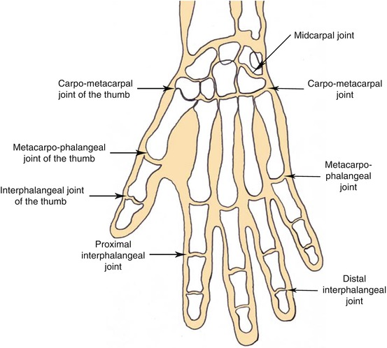

Slide 4
Carpometacarpal Joints
Digits 2–5
  Plane synovial joints
  Limited movement
Thumb (1st CMC joint)
  Saddle-type synovial joint
  Allows opposition
Ligaments:
  Palmar ligaments
  Dorsal ligaments
  Interosseous ligaments

Slide 6
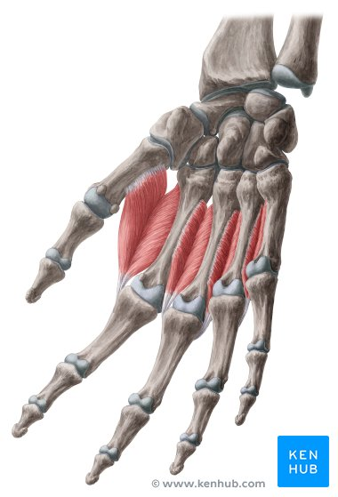

Slide 7
Metacarpophalangeal (MCP) Joints
Synovial condyloid joints
Present between:
  Metacarpal heads
  Bases of proximal phalanges
Allow:
  Flexion
  Extension
  Abduction
  Adduction
  Circumduction (limited)

Slide 8
Ligaments of MCP Joints
Capsule
  Loose anteriorly
Collateral ligaments
  Strong cord-like bands
  Taut in flexion
  Lax in extension
Palmar ligaments
  Fibrocartilaginous plates
Deep transverse metacarpal ligament
  Connects heads of 2nd–5th metacarpals

Slide 9
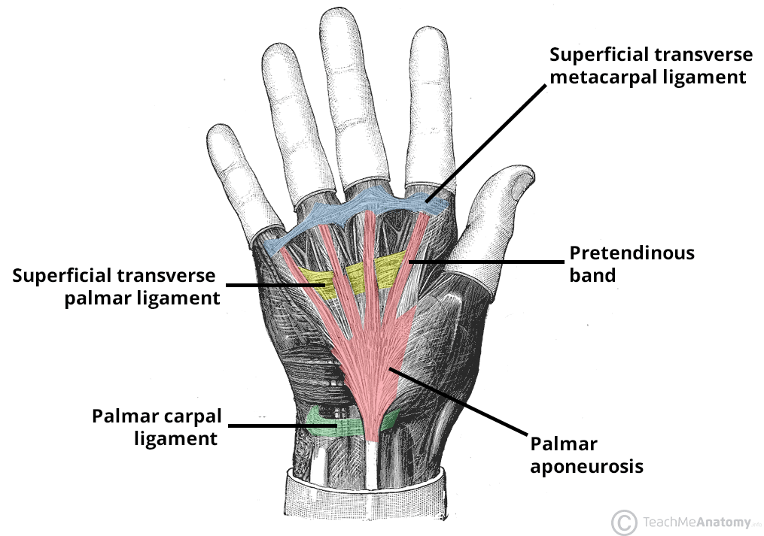

Slide 10
Movements at MCP Joints
Flexion
  Lumbricals
  Interossei
  Flexor digitorum superficialis
  Flexor digitorum profundus
Extension
  Extensor digitorum
  Extensor indicis
  Extensor digiti minimi

Slide 11
Continued
Abduction
  Dorsal interossei
Adduction
  Palmar interossei

Slide 12
Thumb MCP Joint
Limited compared to fingers
Flexion:
  Flexor pollicis longus
  Flexor pollicis brevis
Extension:
  Extensor pollicis longus
  Extensor pollicis brevis
Abduction and adduction occur mainly at CMC joint

Slide 13
Interphalangeal (IP) Joints
Types
  Proximal interphalangeal (PIP)
  Distal interphalangeal (DIP)
Thumb has a single IP joint
Synovial hinge joints

Slide 14
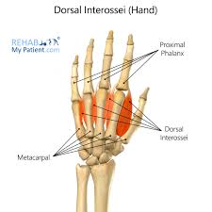

Slide 15
Ligaments of IP Joints
Strong collateral ligaments
Thick palmar ligaments
Provide stability during flexion

Slide 16
Movements at IP Joints
Flexion
Extension
No abduction or adduction

Slide 17
Clinical Anatomy
.Ulnar nerve injury
  Claw hand deformity
Median nerve injury
  Ape thumb deformity
Rheumatoid arthritis
  Commonly affects MCP and PIP joints
Osteoarthritis
  Common at DIP joints

Slide 18
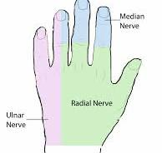

Slide 19
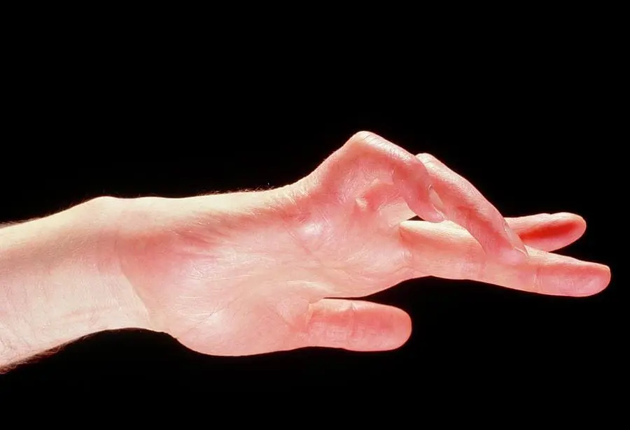

Slide 20
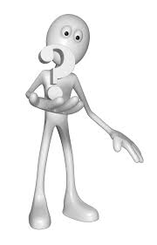

Slide 21


