Slide 1

Acculturation and Diffusion
BS PSYCHOLOGY
1ST SEMESTER
Ms. Shehwar Saeed

Slide 2
Acculturation
Refers to the process by which individuals or groups adopt the cultural traits or social patterns of another group.
Often occurs when different cultures come into contact, such as through migration, colonization, or globalization.
Can involve changes in language, customs, values, and social practices.
Typically affects minority groups more than dominant cultures.

Slide 3
Acculturation
Key Features
Involves two or more cultures
Occurs through direct contact
Change is usually gradual
Original culture is not completely lost
Can be voluntary or forced

Slide 4
Examples
Tribal communities adopting modern education but keeping traditional customs
Immigrants learning a new language while following their native traditions
Indian society adopting Western dress styles alongside traditional clothing

Slide 5
Types
Assimilation – Minority culture is absorbed into dominant culture
Integration – Both cultures coexist and influence each other
Separation – Group rejects dominant culture
Marginalization – Loss of both original and dominant cultures

Slide 6
Diffusion
Involves the spread of cultural elements, such as ideas, technologies, or practices, from one society to another.
Can occur through various means, including trade, communication, and social interaction.
Diffusion can be direct (between cultures in close proximity) or indirect (through intermediaries).
It plays a significant role in cultural change and innovation.

Slide 7
Diffusion
Key Features
Cultural elements spread across societies
May occur with or without direct contact
Can be slow or rapid
Leads to cultural similarity

Slide 8
Diffusion
Examples
Spread of yoga from India to other countries
Use of smartphones worldwide
Fast food culture spreading globally

Slide 9
Types of Diffusion
1. Direct Diffusion – Through direct contact
Example: Trade between countries
2. Indirect Diffusion – Through intermediaries
Example: Cultural traits spread via media
3. Forced Diffusion – One culture imposes traits on another
Example: Colonial rule

Slide 10
Key Differences
Acculturation focuses on individual or group adaptation, while diffusion emphasizes the broader spread of cultural elements.
Acculturation may lead to a change in identity, whereas diffusion does not necessarily alter the identity of the originating culture.
Both processes are essential for understanding cultural dynamics and the evolution of societies.

Slide 11
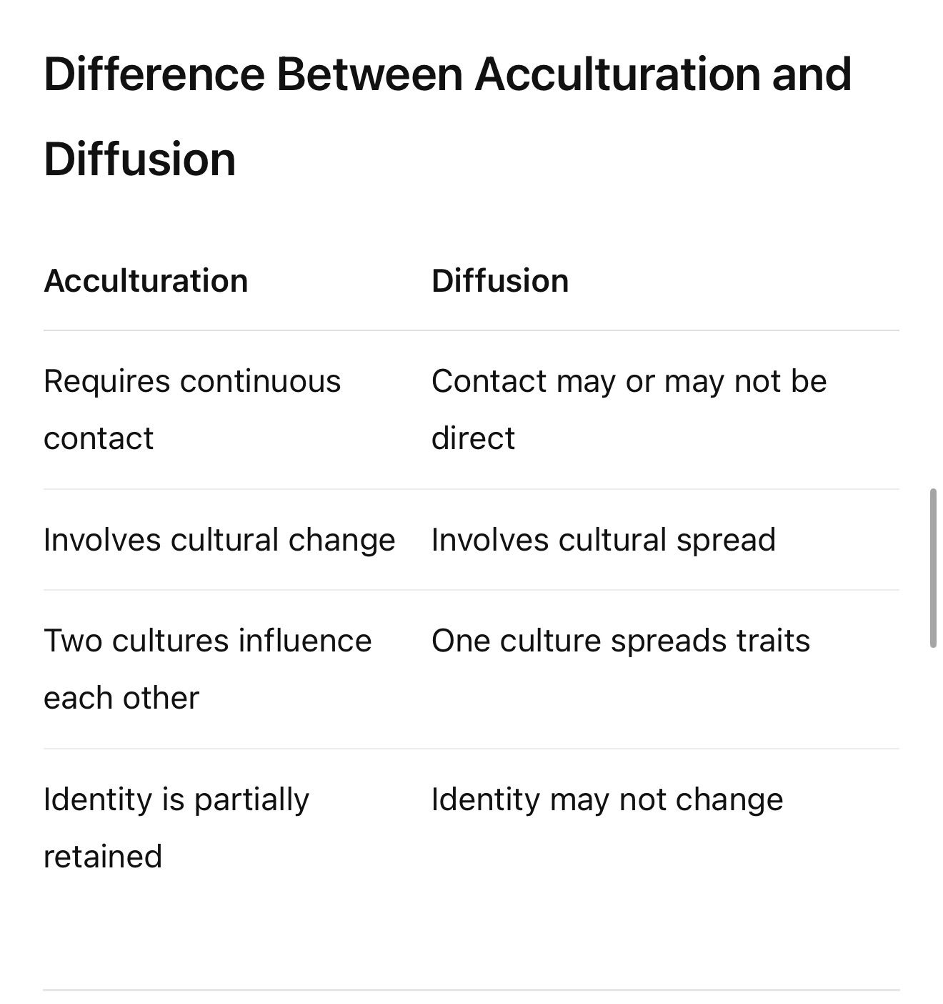

Slide 12

Any Question?

Slide 13


