Slide 1

Introduction to Fake Science
BS(PSYCHOLOGY)
By ADNAN RAMZN

Slide 2


Slide 3
Introduction to Fake Science
Science helps us understand the natural world
Not everything called science is genuine
Fake science copies the appearance of real science
It often spreads misinformation
People easily trust scientific-sounding claims
Media and internet increase its spread
Goal is to build critical thinking skills

Slide 4
What Is Real Science?
Based on observation and experimentation
Uses the scientific method
Experiments are repeatable
Results are reviewed
Methods are transparent
Claims are testable
Continuously improves with evidence
Notes:
ANALYSIS ARE CLEAR

Slide 5
What Is Fake Science?
Lacks proper scientific method
Avoids testing
Uses selective evidence
Relies on anecdotes
Not peer reviewed
Rejects negative results
Also called pseudoscience
Notes:
Anecdotes(unpublished)

Slide 6
Why Fake Science Is Dangerous
Can harm health decisions
Misleads the public
Wastes money and time
Reduces trust in real science
Influences bad policies
Spreads fear and false hope
Targets vulnerable people
Hard to correct once believed
Notes:
Palmistery
Lucky charm

Slide 7
Science vs Pseudoscience
Science is testable
Pseudoscience is not testable
Science changes with evidence
Pseudoscience remains fixed
Science accepts criticism
Pseudoscience avoids criticism
Science uses data properly
Pseudoscience misuses data
Notes:
Achi or buri dono cheezo ka jaiza laina

Slide 8
Red Flag: Extraordinary Claims
Promise miraculous results
No strong supporting evidence
Use dramatic language
Appeal to mystery
Avoid clear explanations
Say science is hiding truth
Extraordinary claims need strong proof
Notes:
Red flag ( suggested claim that can not be base on evedence

Slide 9
Red Flag: No Peer Review
Not published in journals
Only found on websites
Self-published research
Avoids expert evaluation
No independent verification
Rejects scientific community
Peer review ensures quality

Slide 10
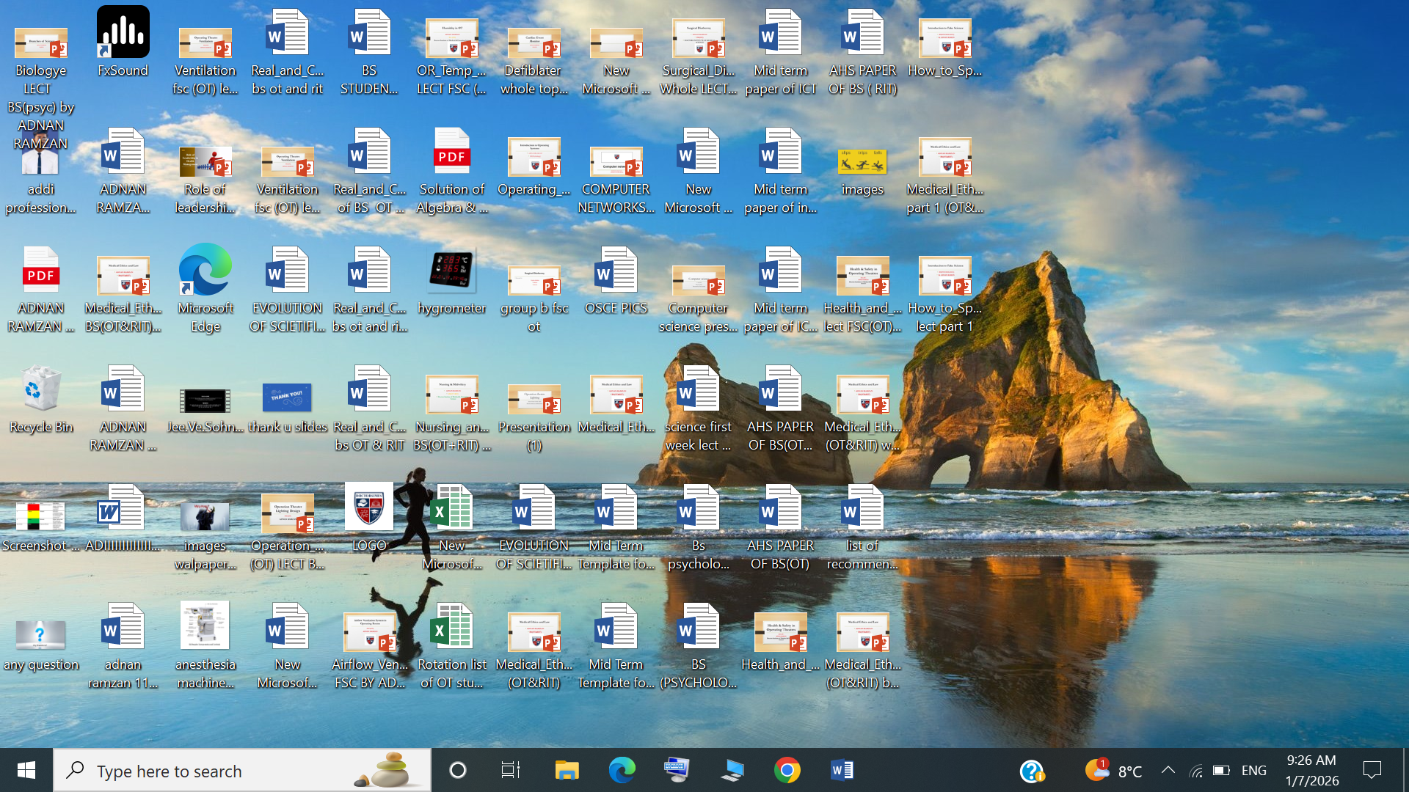
Red Flag: Anecdotal Evidence
Personal stories used as proof
Testimonials replace data
No controlled experiments
Placebo effect ignored
Emotional appeal used
Failures not reported
Stories not verified
Notes:
placebo effect is a real, beneficial outcome from a fake treatment (like a sugar pill or saline injection) where a patient's belief and expectation of healing trigger real psychological and physiological changes, improving symptoms like pain or nausea, but not curing the underlying disease
"Placebo effect ignored in anecdotal evidence" means that personal stories of improvement (anecdotal evidence) often fail to account for the very real physiological and psychological benefits that can result from a person's belief or expectation of treatment, rather than the treatment's active properties.

Slide 11
Red Flag: Unfalsifiable Claims
Cannot be tested
Cannot be proven wrong
Every result supports claim
Uses vague explanations
Avoids predictions
Violates scientific method
Science must be falsifiable

Slide 12
Red Flag: Misuse of Terms
Uses scientific jargon incorrectly
Energy used vaguely
Confusing language
No real definitions
Impresses instead of explains
Hides lack of evidence
Notes:
A quantitative, measurable property of an object or system that can be used to do work or produce heat.
Fake Science Misuse: The term is used qualitatively in pseudoscientific practices like "energy healing" or the concept of "good/bad vibes"

Slide 13
Poor Experimental Design
No control groups
Small sample size
Biased participants
No randomization
Confounding variables ignored
Notes:
A lack of control groups in an experiment means that there is no baseline or standard for comparison against the results of the experimental group
Confounding (الجھانے والا)

Slide 14
Confirmation Bias
Only supporting data accepted
Opposing data ignored
Cherry-picking results
Selective reporting
Beliefs influence conclusions
Common in fake science
Must be avoided
Notes:
Cherry-picking results" means only choosing the best, most favorable, or most convenient facts/data to support a specific argument while deliberately ignoring evidence that contradicts it.

Slide 15
Case Study: Cold Fusion
Claimed nuclear reactions at room temperature
Announced without peer review
Media hype increased belief
Other scientists failed to replicate
Violated known physics
Results were inconsistent
Credibility collapsed
Example of premature claims

Slide 16
Lesson from Cold Fusion
Replication is essential
Peer review is important
Media can mislead
Extraordinary claims need proof
Transparency matters
Reputation is not enough
Science self-corrects
Evidence decides truth

Slide 17
Case Study: Telepathy
Claim of mind-to-mind communication
Studied for many years
No consistent evidence
Results not reproducible
Often anecdotal
Fails under strict controls
Explanations change
Rejected by mainstream science

Slide 18
Why Telepathy Persists
Popular in media
Human desire for connection
Confirmation bias
Misunderstanding probability
Selective success reporting
Cultural beliefs
Poor experimental control
Lack of skepticism

Slide 19
Case Study: N-Rays
Claimed new radiation
Discovered in early 1900s
Based on visual observation
Other scientists failed to detect
Blind tests disproved claims
Observer bias involved
Psychological influence
Eventually rejected

Slide 20
Lessons from N-Rays
Human senses are unreliable
Need objective measurement
Blind testing is important
Replication matters
Bias affects observations
Authority can be wrong
Consensus is important
Science corrects mistakes

Slide 21
Role of Media
Sensational headlines
Oversimplified science
False balance
Lack of expertise
Social media spread
Viral misinformation
Corrections ignored
Critical reading needed

Slide 22
How Students Can Evaluate Claims
Check information source
Look for peer review
Examine methods
Ask about replication
Identify bias
Be cautious of certainty
Compare with consensus
Ask critical questions

Slide 23
Scientific Consensus
Based on many studies
Independent verification
Expert agreement
Not a single experiment
Can change with evidence
Often misunderstood
Indicates reliability
Ignoring it is risky

Slide 24
Statistics in Fake Science
Misleading graphs
Correlation vs causation confusion
Small samples exaggerated
No uncertainty shown
Selective data
P-values misused
No statistical significance
Statistics mislead audience

Slide 25
Ethical Issues in Research
Data fabrication
Data falsification
Plagiarism
No informed consent
Selective reporting
Hidden conflicts
Ignoring ethics boards
Ethics protect science

Slide 26
What to Avoid in Research
Fixed conclusions
Ignoring evidence
Poor documentation
Data manipulation
Overgeneralization
Avoiding peer review
Lack of transparency
Unethical practices

Slide 27
Developing Scientific Skepticism
Question claims
Demand evidence
Be open to change
Avoid cynicism
Think logically
Understand limitations
Seek multiple sources
Practice critical thinking

Slide 28
Education’s Role
Teach scientific method
Encourage questioning
Promote media literacy
Teach uncertainty
Learn from history
Hands-on experiments
Critical discussions
Build informed citizens

Slide 29
Summary of Warning Signs
Extraordinary claims
No peer review
Anecdotal evidence
Unfalsifiable claims
Misused terminology
Financial motives
Resistance to criticism
Poor methodology

Slide 30
Conclusion
Fake science looks convincing
Critical thinking is essential
Evidence over authority
Science is self-correcting
Students must question claims
Methods matter
Awareness reduces harm
Informed society benefits

