Slide 1

HUMAN ANATOMY
BS RIT,OTT,MLT
1ST SEMESTER
DR DANISH

Slide 2
Specialized cells of CNS
Neuroglial Cells:
Supporting cells of CNS
More numerous than neurons
Can divide throughout life
Provide:
  Support
  Protection
  Nutrition
  Insulation

Slide 3
Types
Astrocytes
Oligodendrocytes
Microglial Cells
Ependymal Cells

Slide 4
Astrocytes
Star-shaped cells
Most abundant neuroglial cells
Functions:
  Support neurons
  Maintain blood-brain barrier
  Regulate chemical environment
Types:
  Protoplasmic (gray matter)
  Fibrous (white matter)

Slide 5
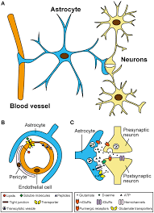

Slide 6
Oligodendrocytes
Form myelin sheath in CNS
One cell myelinates multiple axons
Function:
  Increase speed of nerve impulse conduction
Present mainly in white matter

Slide 7
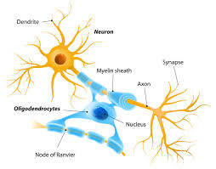

Slide 8
Microglial Cells
Small, mobile cells
Act as phagocytes
Functions:
  Defense mechanism of CNS
  Remove dead neurons and debris
Derived from mesoderm

Slide 9
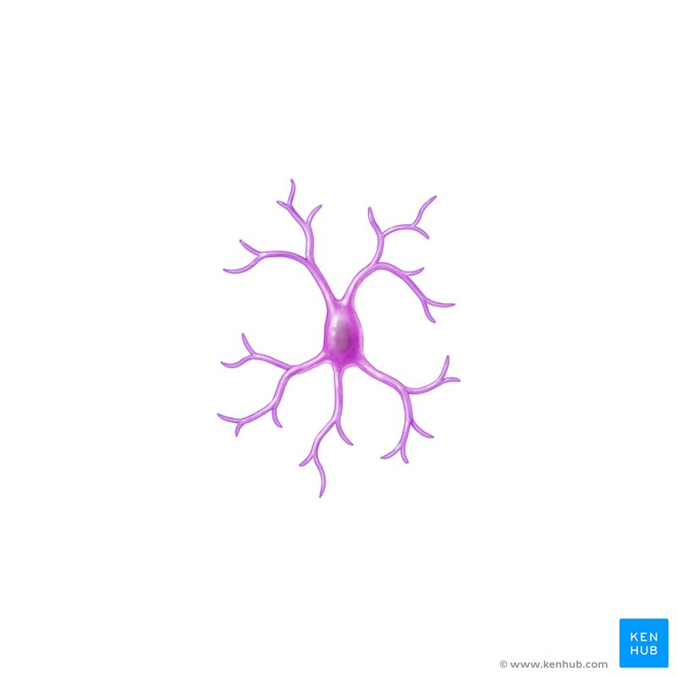

Slide 10
Ependymal Cells
Line ventricles of brain and central canal of spinal cord
Ciliated columnar or cuboidal cells
Functions:
  Produce cerebrospinal fluid (CSF)
  Circulate CSF

Slide 11
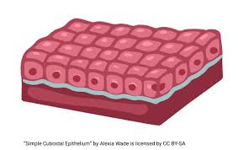

Slide 12
Peripheral Nervous System
Definition
Peripheral Nervous System includes:
  All nerves outside the brain and spinal cord
Connects:
  Central Nervous System (CNS)
  With different parts of the body

Slide 13
Components of PNS
Cranial nerves
Spinal nerves
Peripheral ganglia
Nerve endings (receptors and effectors)

Slide 14
Cranial Nerves
Total 12 pairs
Arise from the brain
Mainly supply:
  Head and neck
Vagus nerve supplies thoracic and abdominal organs

Slide 15
Names of cranial Nerves
I. Olfactory (smell)
II. Optic (vision)
III. Oculomotor (movement of eyeball, constriction of pupil)
IV. Trochlear (downward and inward movement of eye)
V. Trigeminal (facial sensation and chewing)
VI. Abducent (abduction of eyeball)

Slide 16
Continued
VII. Facial (facial expression, taste from anterior 2/3 of tongue)
VIII. Vestibulocochlear (hearing and balance)
IX. Glossopharyngeal (taste from posterior 1/3 of tongue, swallowing)
X. Vagus (parasympathetic supply to heart, lungs, digestion)
XI. Accessory (movement of head and shoulders)
XII. Hypoglossal (movement of tongue)

Slide 17
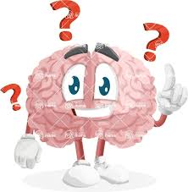

Slide 18
