Slide 1

ANATOMY
THE UPPER LIMB
DPT
1ST SEMESTER
DR DANISH

Slide 2
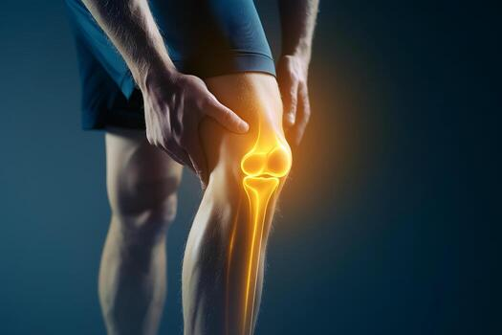
The Arthrology
Study of joints is called Arthrology.

Slide 3
Sternoclavicular Joint (SC Joint)
Articulation:
Formed between:
  Sternal end of the clavicle
  Manubrium of sternum
  First costal cartilage
It is the only bony articulation between the upper limb and the axial skeleton

Slide 4
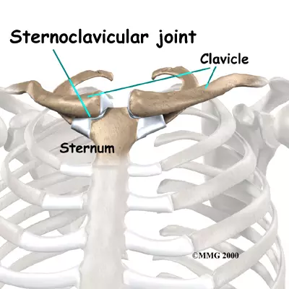

Slide 5
Type of Joint
Synovial double-plane joint
Allows movements in multiple directions

Slide 6
Joint Capsule
Surrounds the joint completely
Attached to the margins of the articular surfaces
Provides stability while allowing mobility

Slide 8
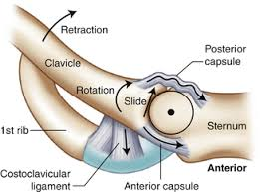

Slide 9
Ligaments
Capsule reinforced:
  Anteriorly
  Posteriorly
Strengthened by sternoclavicular ligaments
These ligaments prevent excessive movement of the clavicle

Slide 10
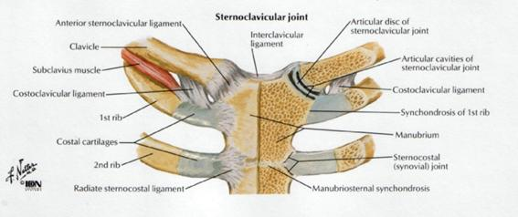

Slide 11
Articular Disc
Flat fibrocartilaginous disc
Lies inside the joint cavity
Divides the joint into:
  Medial compartment
  Lateral compartment

Slide 12
Continued
Attachments:
To joint capsule circumferentially
Superiorly → clavicle
Inferiorly → first costal cartilage
Functions:
Increases stability
Acts as a shock absorber

Slide 13
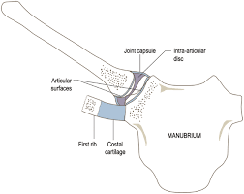

Slide 14
Accessory Ligament
Costoclavicular ligament
Strong ligament connecting:
  First rib and its cartilage
  Inferior surface of the clavicle
Limits excessive elevation of clavicle

Slide 15
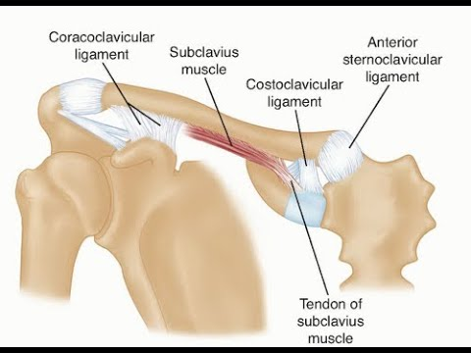

Slide 16
Synovial Membrane
Lines the inner surface of the capsule
Attached to margins of articular cartilage
Secretes synovial fluid for lubrication

Slide 18
Nerve Supply
Supraclavicular nerve
Nerve to subclavius muscle

Slide 19
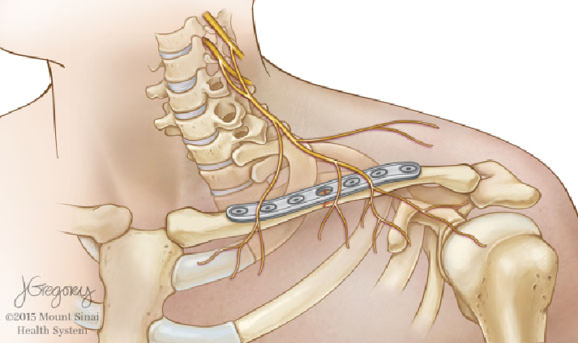

Slide 20
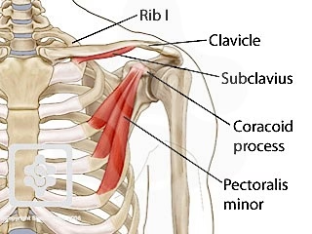

Slide 21
Movements at Sternoclavicular Joint
Movements at Sternoclavicular Joint
Elevation
Depression
Protraction
Retraction
Rotation of clavicle during arm elevation

Slide 22
Clinical Notes – Sternoclavicular Joint Injuries
Joint is strong but can be injured by:
  Direct force on shoulder
Posterior dislocation is dangerous because it may compress:
  Trachea
  Esophagus
  Major blood vessels

Slide 23
Acromioclavicular Joint (AC Joint)
Articulation:
Between:
  Acromion process of scapula
  Lateral end of clavicle

Slide 24
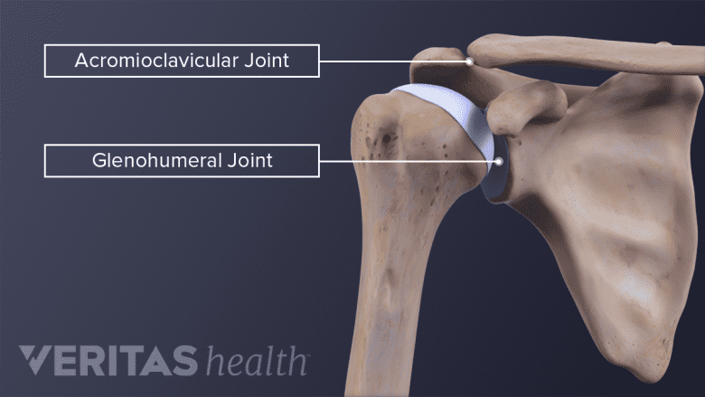

Slide 25
Type of Joint
Synovial plane joint.

Slide 26
Joint Capsule
Thin and loose
Attached to margins of articular surfaces

Slide 27
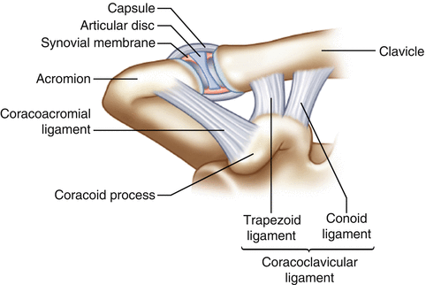

Slide 28
Ligaments
Acromioclavicular ligament
  Reinforces capsule
Coracoclavicular ligament (very important)
  Conoid ligament
  Trapezoid ligament
These provide major stability to the joint

Slide 29
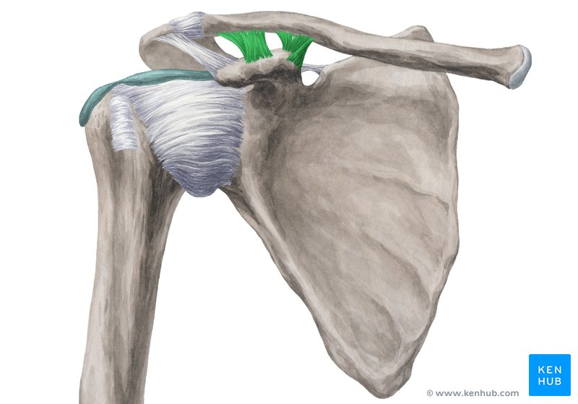

Slide 31
Articular Disc
Fibrocartilaginous disc may be present
Often incomplete
Helps absorb stress

Slide 32
Movements
Gliding movements
Allows scapular rotation during arm elevation

Slide 33
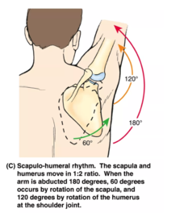

Slide 34
Nerve supply
Articular branches of the suprascapular nerve
lateral pectoral nerve

Slide 35
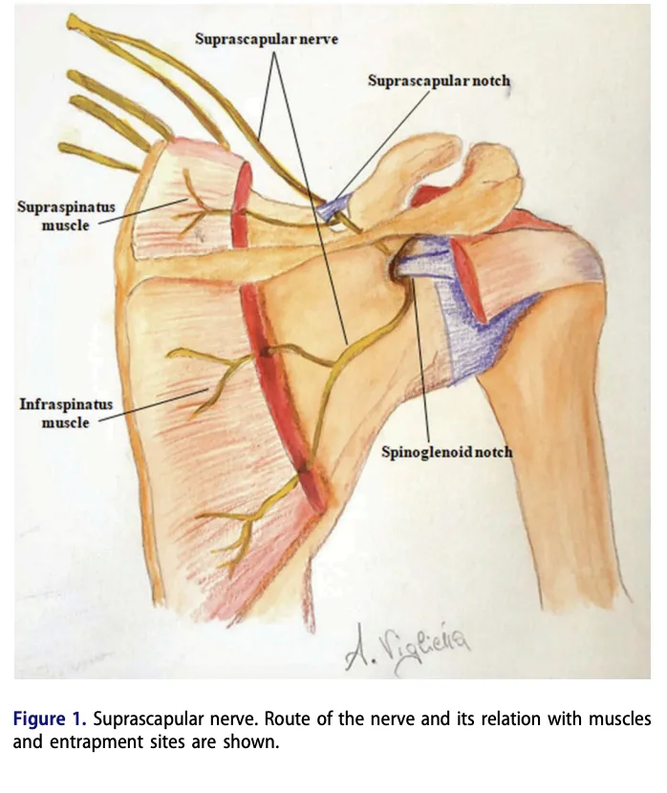

Slide 36


Slide 37
