Slide 1

Fourteen
Presented by: Anila Khalid

Slide 2
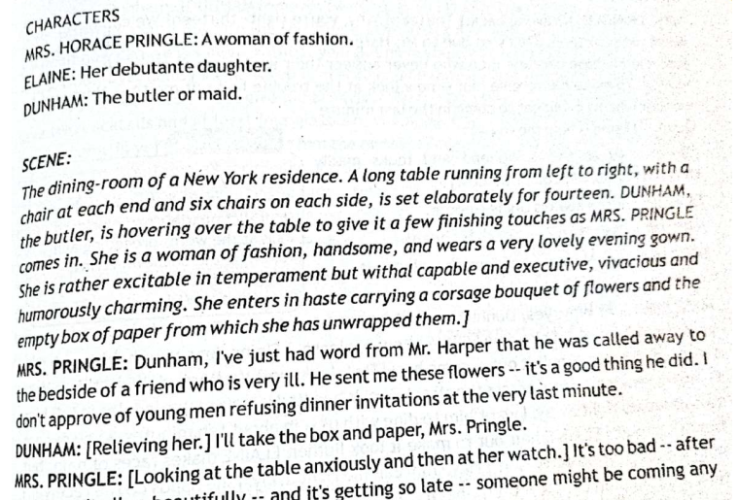

Slide 3
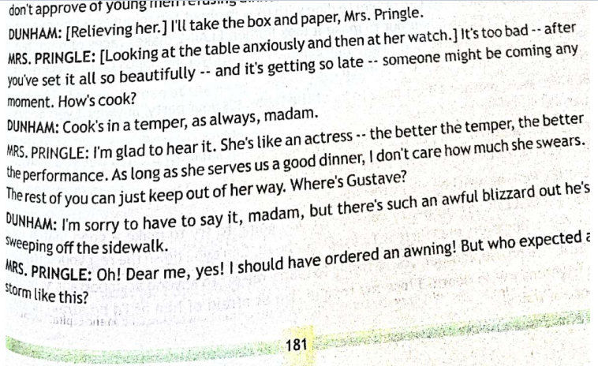

Slide 4
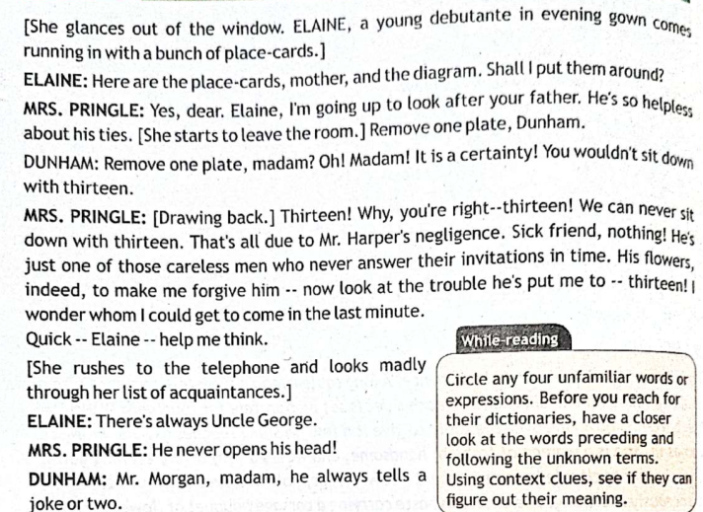

Slide 5
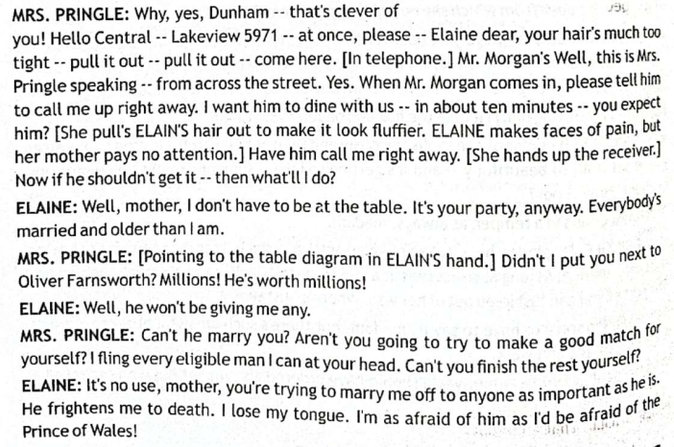

Slide 6
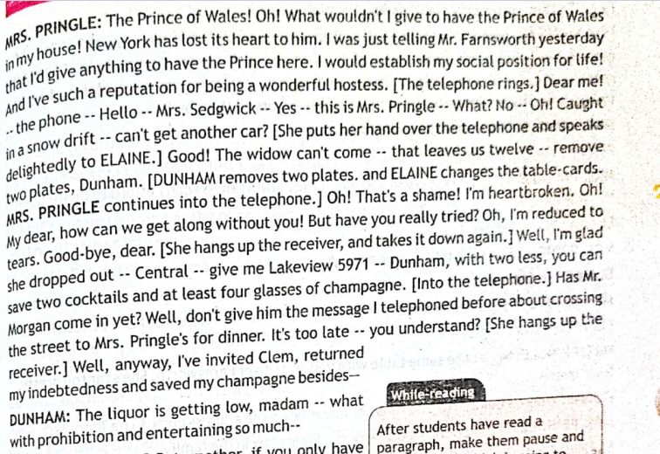

Slide 7
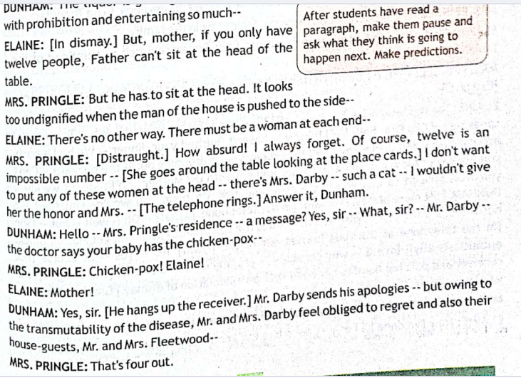

Slide 8
QUESTION
How is conflict the most important element to make a work of fiction interesting for the reader?

Slide 9


