Slide 1

BASIC MEDICAL SCIENCE
FSC MEDICAL TECHNOLOGIES I
DR DANISH

Slide 2
Atrial supply of the heart
Right coronary artery(RCA).
Left coronary artery(LCA).

Slide 3
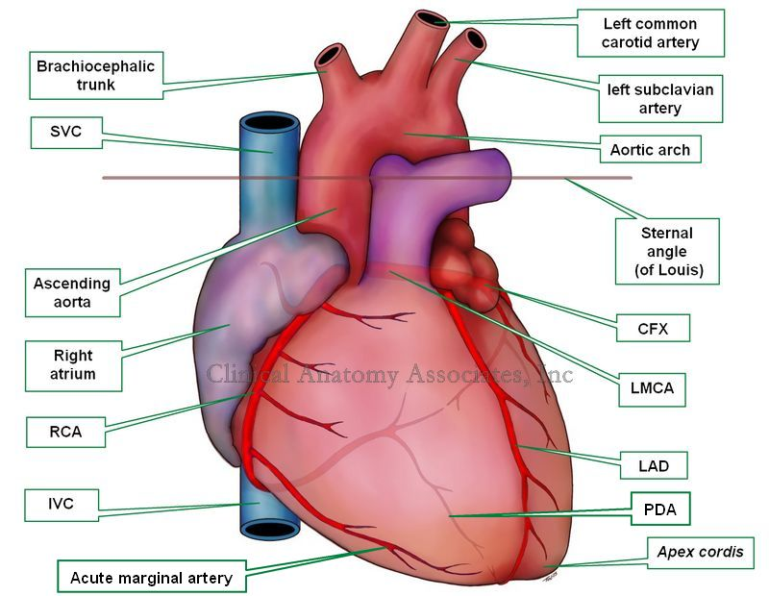

Slide 4
Right Coronary Artery (RCA)
Originates from the right aortic sinus (of Valsalva) of the ascending aorta
Runs in the right atrioventricular (coronary) sulcus
Blood supply of the heart is usually right-side dominant

Slide 6
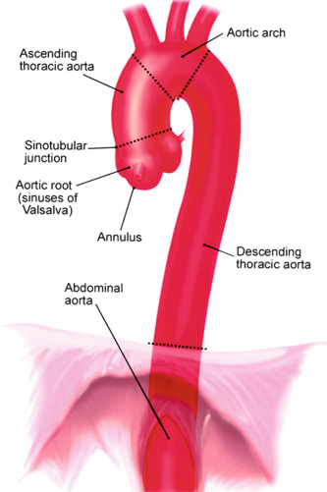

Slide 7
Branches:
Conus artery
SA nodal artery
Atrial branches
Right ventricular branches
Posterior interventricular artery
AV nodal artery
Septal branches

Slide 8
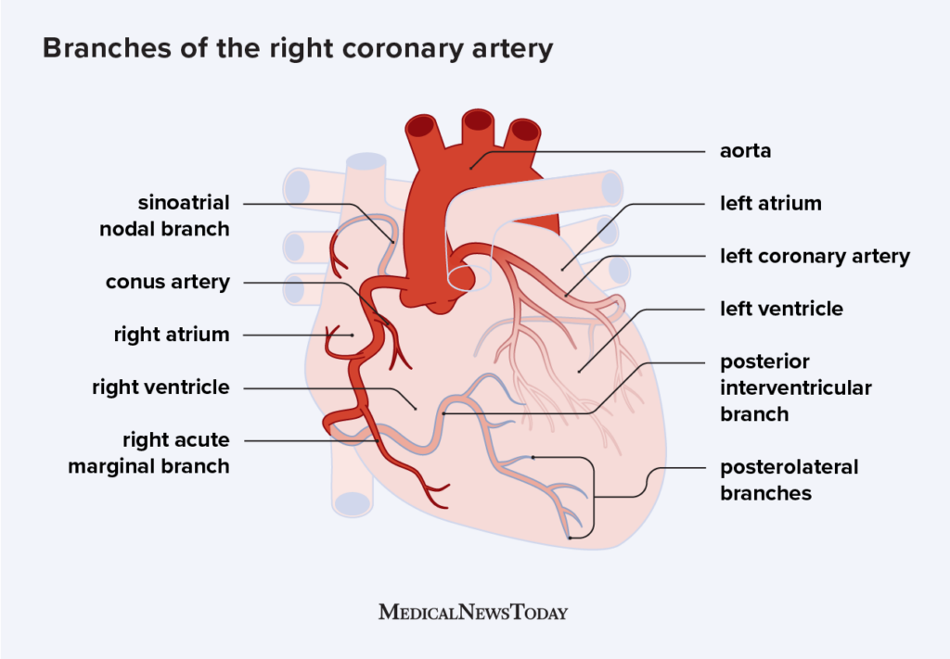

Slide 9
Left Main Coronary Artery (LMCA)
Originates from the left aortic sinus (of Valsalva) of the ascending aorta
Supplies the major portion of the heart
Divides into two main branches:
1. Left Circumflex Artery (LCX)
2. Anterior Interventricular Artery (LAD)

Slide 11
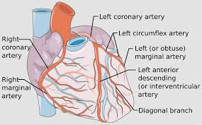

Slide 12
1. Left Circumflex Artery (LCX)
Runs in the left atrioventricular sulcus
Branches:
  Atrial branches
  Obtuse marginal artery
  Posterior marginal artery

Slide 14
2. Anterior Interventricular Artery (LAD)
Also called Left Anterior Descending artery
Branches:
  Anterior diagonal artery
  Septal branches

Slide 16
Venous Drainage of the Heart
A. Coronary Sinus
Largest vein of the heart
Drains directly into the right atrium
B. Great Cardiac Vein
Follows the anterior interventricular artery
Drains into the coronary sinus
C. Middle Cardiac Vein
Follows the posterior interventricular artery
Drains into the coronary sinus

Slide 17
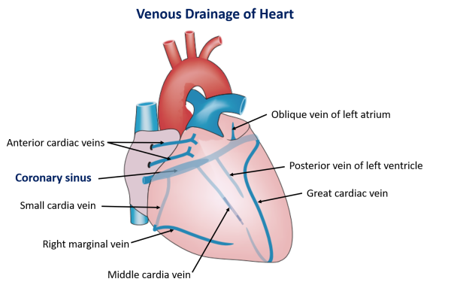

Slide 18
Other Cardiac Veins
Oblique vein of left atrium → coronary sinus
Left posterior ventricular vein → coronary sinus
Left marginal vein → coronary sinus
Anterior cardiac veins → drain directly into right atrium

Slide 20


Slide 21


