Slide 1

ANATOMY
THE UPPER LIMB
DPT
1ST SEMESTER
DR DANISH

Slide 2
Bones of the Hand – Overview
The hand skeleton is divided into three main groups:
  Carpal bones (wrist)
  Metacarpal bones (palm)
  Phalanges (digits/fingers)
These bones together provide:
  Stability
  Mobility
  Precision grip and fine movements

Slide 3
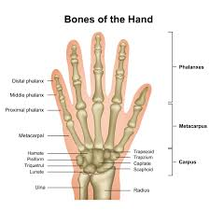

Slide 4
Carpal Bones – General Features
Total 8 carpal bones
Arranged in two rows:
  Proximal row (lateral → medial)
  Distal row (lateral → medial)
Function:
  Form the wrist joint
  Create the carpal arch, contributing to the carpal tunnel

Slide 5
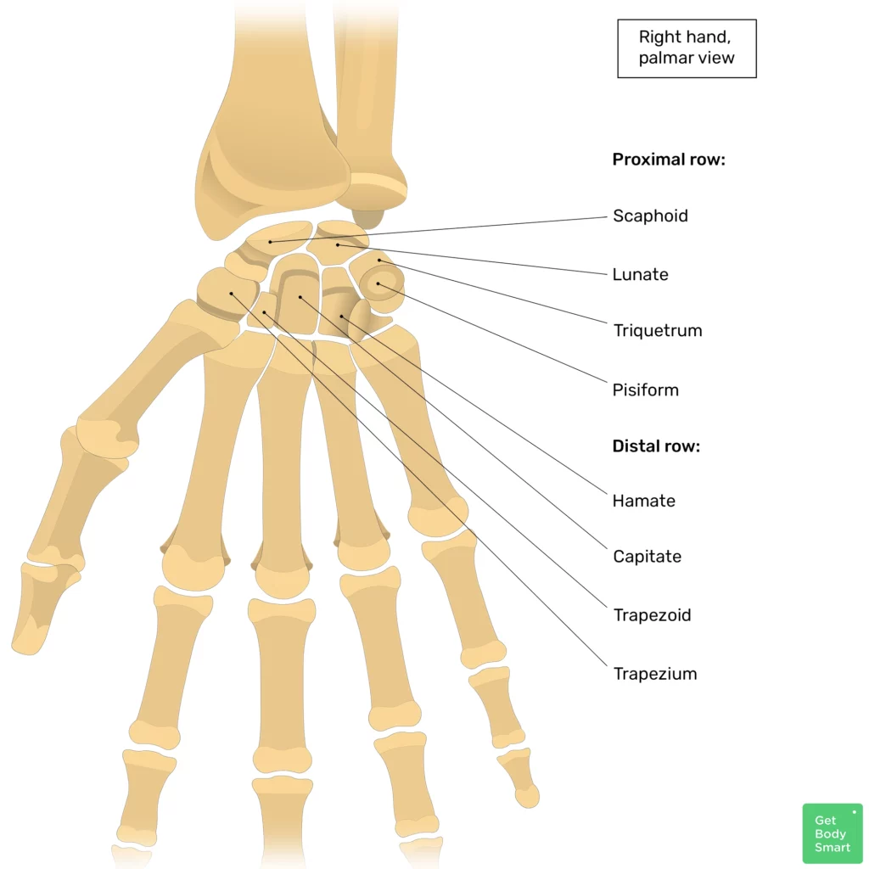

Slide 6
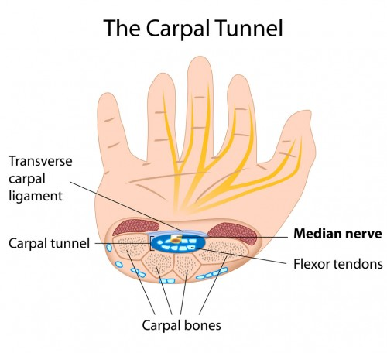

Slide 7
Proximal Row of Carpal Bones
(Lateral → Medial)
Scaphoid
Lunate
Triquetrum
Pisiform
These bones articulate with the radius and articular disc of ulna
More mobile and commonly involved in injuries

Slide 8
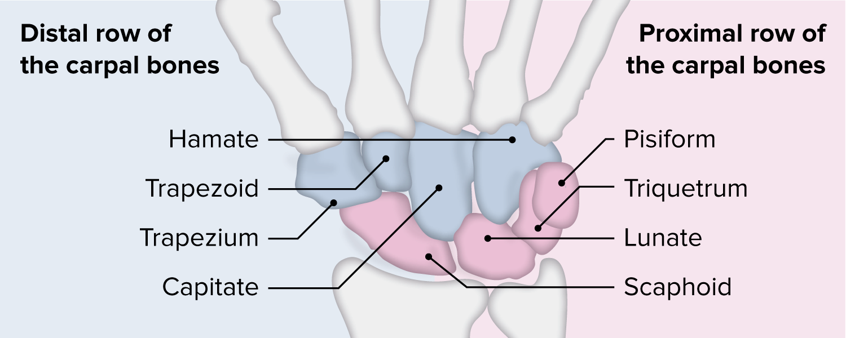

Slide 9
Distal Row of Carpal Bones
(Lateral → Medial)
Trapezium
Trapezoid
Capitate
Hamate
Articulate with the metacarpal bones
More stable than proximal row
Capitate is the largest carpal bone

Slide 11
Important Individual Carpal Bones
Scaphoid
Boat-shaped
Most commonly fractured carpal bone
Blood supply is retrograde, so fractures may cause avascular necrosis
Pisiform
Pea-shaped
Sesamoid bone in flexor carpi ulnaris tendon

Slide 13
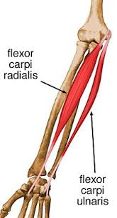

Slide 14
Clinical Note – Scaphoid Bone Injury
Common in young adults
Usually caused by fall on outstretched hand
Fracture may:
  Be missed on X-ray
  Lead to avascular necrosis
Symptoms:
  Pain in anatomical snuffbox
Clinical importance:
  Early diagnosis is crucial

Slide 15
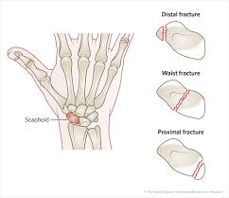

Slide 16
Metacarpal Bones – Introduction
Five metacarpal bones
Located between:
  Carpal bones (proximal)
  Phalanges (distal)
Numbered 1 to 5:
  Metacarpal I → thumb
  Metacarpal V → little finger

Slide 17
Structure of a Metacarpal Bone
Each metacarpal has:
Base (proximal)
  Articulates with carpal bones
Body (shaft)
  Elongated
  Slightly concave anteriorly
Head (distal)
  Rounded
  Forms the knuckle

Slide 18
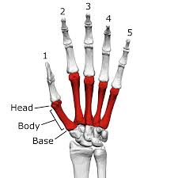

Slide 19
Special Features of First Metacarpal (Thumb)
Shortest and most mobile
Lies in a different plane than other metacarpals
Rotated medially at right angle
Allows:
  Opposition
  Grip strength
Articulates with trapezium (saddle joint)

Slide 21
Phalanges – Introduction
Phalanges are bones of the digits
Total 14 phalanges in each hand
Distribution:
Thumb → 2 phalanges
  Proximal
  Distal
Other fingers → 3 phalanges each
  Proximal
  Middle
  Distal

Slide 22
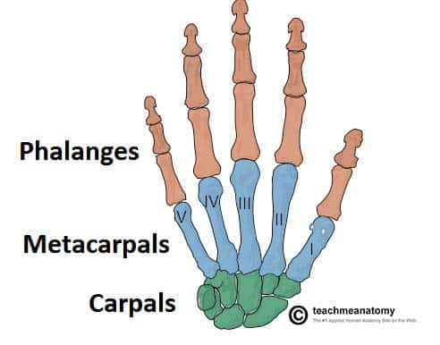

Slide 23
Structure of Phalanges
Each phalanx has:
Base
  Proximal articular surface
Body (shaft)
  Narrow and flattened
Head
  Distal articular surface

Slide 25
Articulations of Phalanges
Base of proximal phalanx articulates with:
  Head of corresponding metacarpal
Base of middle phalanx articulates with:
  Head of proximal phalanx
Base of distal phalanx articulates with:
  Head of middle phalanx

Slide 26
Clinical Importance of Hand Bones
Hand fractures affect:
  Grip
  Dexterity
Common injuries:
  Scaphoid fracture
  Metacarpal fractures (e.g., boxer’s fracture)
  Distal phalanx crush injuries
Proper alignment is critical for hand function

Slide 27
Summary
Hand bones are specialized for precision and strength
Carpal bones form wrist stability
Metacarpals form palm framework
Phalanges enable fine movements
Clinical relevance is high due to frequent injuries

Slide 28


Slide 29


