Slide 1

Medical Ethics and Law
ADNAN RAMZAN
BS(OT&RIT)

Slide 2
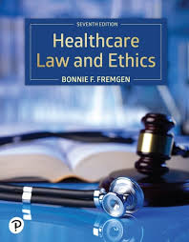

Slide 3
Medical Ethics and Law
Medical ethics explains what is right and wrong in healthcare
Medical law provides legal rules for healthcare practice
Both guide doctors, nurses, and health professionals
They help in providing safe and fair patient care

Slide 4
Meaning of Medical Ethics
Medical ethics is the study of moral values
It guides health professionals in daily work
It helps in making correct decisions for patients
It focuses mainly on patient welfare

Slide 5
Need for Medical Ethics
Helps protect patient life and dignity
Builds trust between patient and doctor
Improves quality of healthcare services
Prevents misuse of medical power

Slide 6
History of Medical Ethics
Medical ethics started with Hippocratic Oath
Doctors promised to serve patients honestly
Modern ethics include laws and guidelines
International codes guide ethical practice today
Notes:
ETHICAL CODE--- Set of rules which are related to the ethics of patient in health care

Slide 7
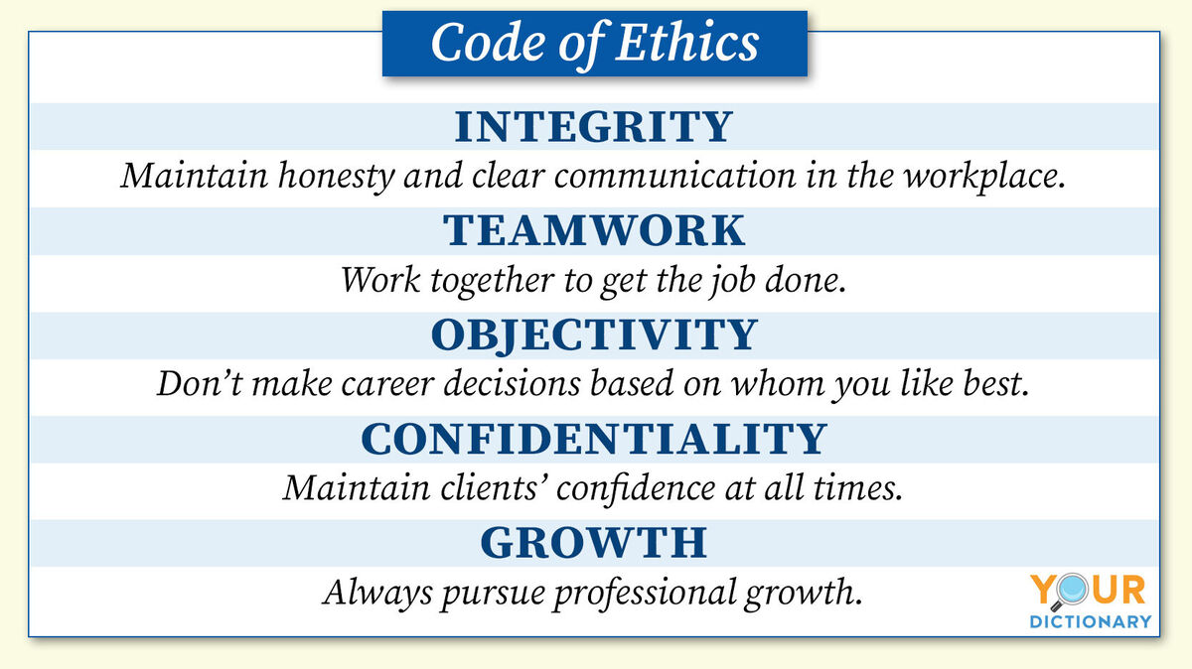

Slide 8
Principles of Medical Ethics
Ethical practice is based on four principles
Autonomy respects patient choice
Beneficence means doing good
Non-maleficence avoids harm and ensures fairness
Justice

Slide 9
Autonomy
Patients have the right to make decisions
Doctors must respect patient wishes
Patients must be informed properly
Consent must be voluntary and informed

Slide 10
Beneficence
Doctor should act for patient benefit
Treatment should improve health condition
Care should be given with kindness
Doctor must always think of patient welfare

Slide 11
Non-Maleficence
Doctor should not cause harm to patient
Avoid careless or wrong treatment
Risks should be minimized
Patient safety is very important

Slide 12
Justice
All patients should be treated equally
No discrimination based on gender or wealth
Resources should be used fairly
Every patient deserves proper care

Slide 13
Confidentiality
Patient information must be kept private
Medical details should not be shared
Disclosure only with patient permission
Maintaining secrecy builds patient trust

Slide 14
Informed Consent
Patient should know about treatment
Doctor explains risks and benefits
Patient agrees freely without pressure
Consent is both ethical and legal

Slide 15
Type of Consent | Meaning
Implied | Shown by actions
Express Consent | Clearly stated consent (oral or written)
Informed Consent | Consent given after full explanation
Tacit Consent | Silent approval without objection
Proxy Consent | Consent given by guardian/relative
Blanket Consent | General consent taken at admission

Slide 16
Professional Ethics
Health workers must be honest
They should maintain good behavior
Respect patients and colleagues
Continuous learning is necessary

Slide 17
Ethical Issues in Healthcare
Some situations create ethical problems
Examples include end-of-life care
Organ donation decisions
Abortion and euthanasia cases
Notes:
Euthanasia means ending a person’s life on purpose to stop severe pain or suffering,

Slide 18
Medical Law
Medical law controls medical practice
Defines duties of health professionals
Punishes unethical or illegal acts
Ensures safe healthcare services

Slide 19
Negligence
Negligence means careless treatment
Failure to give proper medical care
Doctor does not follow standards
It causes harm to the patient

Slide 20
Malpractice
Malpractice is professional misconduct
Wrong or illegal medical treatment
Patient can take legal action
Doctor may face punishment
Notes:
wrong body part
wrong patient
wrong procedure
Leaving surgical instruments
wrong medication
Ignoring a patient's known allergies
overdose or underdose

Slide 21
Patient Rights
Patients have right to information
They can give or refuse consent
They have right to privacy
They deserve safe treatment

Slide 22
Doctor–Patient Relationship
Relationship is based on trust
Doctor must act honestly
Patient must cooperate with doctor
Good communication improves care

Slide 23
Legal Documentation
Medical records must be maintained
Consent forms are very important
Documents act as legal proof
Proper records protect doctors

Slide 24
Ethics Committees
Group of medical experts
They discuss ethical problems
Help in difficult medical decisions
Support healthcare professionals

Slide 25
Ethics in Decision Making
Ethics guides complex medical decisions
Helps balance benefit and risk
Protects patient dignity
Supports responsible medical practice

Slide 26
Challenges in Ethical Practice
Limited medical resources
Cultural and religious differences
Advanced technology issues
Pressure in emergency situations

Slide 27
Conclusion
Medical ethics and law are essential
They guide safe healthcare practice
They protect patients and professionals
Every health worker must follow them

Slide 28


