Slide 1

Peripheral nervous system
BS-PSY
1ST SEMESTER
Ms. Shehwar Saeed

Slide 2
Peripheral Nervous System
The autonomic nervous system (ANS) is a crucial component of the nervous system that regulates involuntary physiological functions.
It plays a significant role in psychology by influencing emotional responses and stress management.

Slide 3
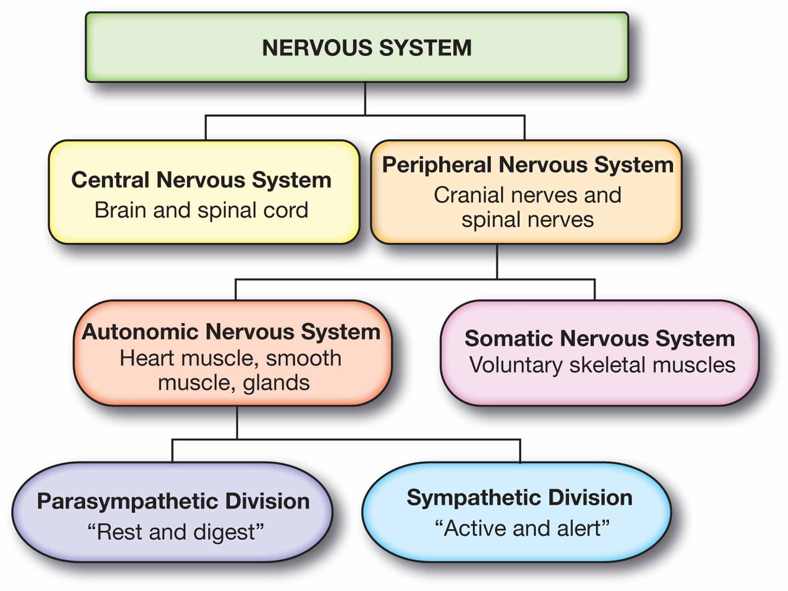
Divisions of the Peripheral Nervous System
The somatic nervous system (SNS)
The autonomic nervous system (ANS)

Slide 4
Somatic Nervous System
The somatic nervous system is responsible for conscious, voluntary movements, like walking, talking, or typing. It includes two types of nerves:
Sensory neurons (afferent neurons): Carry information from sensory organs (skin, eyes, ears, etc.) to the central nervous system (CNS)
Example: When you touch a hot stove, sensory neurons alert the brain.

Slide 5
Somatic Nervous System
Motor neurons (efferent neurons): Transmit signals from the CNS to skeletal muscles, enabling movement.
Example: Your brain sends motor commands that help you lift a cup or run.
This system also controls reflex actions through a structure called the reflex arc, which allows for fast, automatic responses without involving the brain.

Slide 6
Autonomic Nervous System
The autonomic nervous system manages involuntary processes—functions you don’t consciously control, like heartbeat, digestion, or breathing.
Sympathetic nervous system (“fight or flight”):
Prepares the body for stressful situations. It increases heart rate, opens airways, dilates pupils, and slows digestion.
Parasympathetic nervous system (“rest and digest”):
Calms the body after stress. It reduces heart rate, promotes digestion, and restores energy balance.

Slide 7
Central nervous system vs peripheral nervous system
The CNS, consisting of the brain and spinal cord, acts as the body’s command center and is protected by bone and protective membranes.
The PNS comprises nerves branching throughout the body, lacking bony protection and thus more vulnerable to injury.
While the CNS processes and makes decisions, the PNS functions as a messenger network through sensory and motor neurons.

Slide 8
Central nervous system vs peripheral nervous system
CNS neurons also have limited regenerative capacity, making injuries often permanent. PNS neurons, however, can regenerate under certain conditions, allowing for potential recovery from peripheral nerve damage.

Slide 9
Nerves in the Peripheral Nervous System
The PNS is made up of nerve cells (neurons) that carry messages back and forth between the CNS and the muscles, organs, and senses in the body’s periphery.
Within the PNS, some nerves are attached to the spinal cord (spinal nerves), and others are attached directly to the brain (cranial nerves).

Slide 10
Spinal nerves
There are 31 pairs of spinal nerves, which emerge from the spinal cord and branch out to serve different areas of the body. These nerves carry:
Sensory signals from the skin, muscles, and organs to the spinal cord and brain
Motor commands from the brain and spinal cord to the muscles and glands

Slide 11
Cranial nerves
Unlike spinal nerves, cranial nerves connect directly to the brain, bypassing the spinal cord.
There are 12 pairs of cranial nerves, and most are involved in sensory and motor functions of the head and neck.
Functions of Cranial Nerves:
Transmit sensory input from the eyes, ears, nose, tongue, and face
Send motor signals to muscles involved in facial expression, chewing, swallowing, and speech

Slide 12
Cranial nerves
Send motor signals to muscles involved in facial expression, chewing, swallowing, and speech
For example, when eating:
Cranial nerves help you chew and swallow (motor function)
They also relay taste signals back to the brain (sensory function)

Slide 13
Why the Peripheral Nervous System Matters
It Powers Everyday Actions
It Keeps Your Body in Balance
It Can Regenerate After Injury
It Reflects Your Overall Health
It Includes the “Second Brain”

Slide 14

Any Question?

Slide 15


