Slide 1
Physiology
BS Hons
Awais Hamza

Slide 2
Resistance and immunity
An individual is under constant attack from an enormous range of potentially harmful invaders, from the months spent in the womb to the end of his life.
These invaders include such diverse entities as bacteria, viruses, cancer cells, parasites and foreign (non-self) cells, e.g. in tissue transplant.

Slide 3
Immunity (Definition)
- Immunity is the body’s ability to resist and overcome infection.
- It involves defence mechanisms that prevent entry of microbes and destroy those that enter.
- Includes both non‑specific (innate) and specific (adaptive) responses

Slide 4
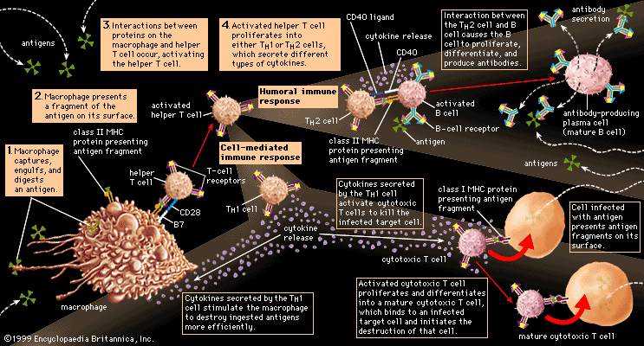

Slide 5
Immunity
Immunity is the ability of the body to resist and eliminate potentially harmful foreign materials such as microorganisms, toxins, and foreign tissues.
It is the defense mechanism that protects the body from disease‑causing agents (pathogens).
Immunity involves cells, tissues, and molecules that work together to recognize and neutralize foreign substances.
The immune system distinguishes self from non‑self, preventing harmful reactions against the body’s own tissues.

Slide 6
Categories
Non-specific defence mechanisms.
These protect against any of an enormous range of possible dangers.
Specific defence mechanisms.
These are grouped together under the term immunity. Resistance is directed against only one particular invader. In addition, immunological memory develops, which confers long-term immunity to specific infections. An antigen is anything that stimulates an immune response.

Slide 7
Innate Immunity
Innate immunity is the body’s first line of defense that provides immediate, non‑specific protection against all types of pathogens.
- Present from birth
- No memory (response does not improve with repeated exposure)
- Rapid response (minutes to hours)
- Non‑specific (same response to different pathogens

Slide 8
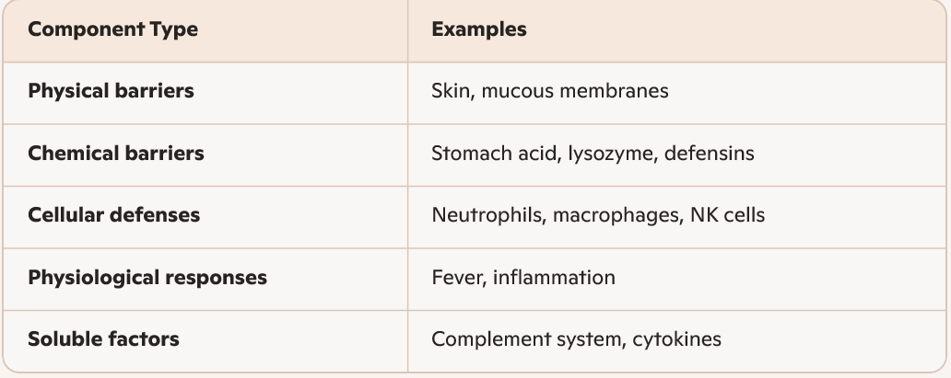
Components

Slide 9
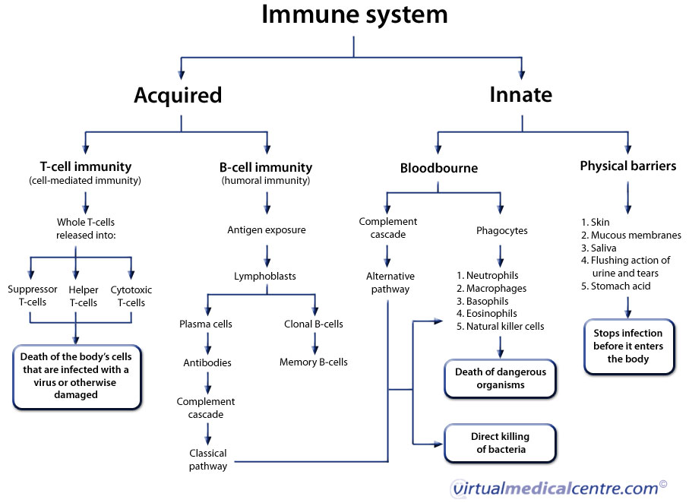

Slide 10
Innate Immunity
- First line of general defence.
- Prevents entry and limits spread of microbes.
- Main mechanisms include:
- Defence at body surfaces
- Phagocytosis
- Natural antimicrobial substances
- Inflammatory response
- Acts non‑selectively against many types of foreign material.

Slide 11
Adaptive Immunity
Adaptive immunity is the part of the immune system that provides specific, long‑lasting, and memory‑based defense against pathogens.
Develops after exposure to an antigen
Highly specific to each pathogen
Has memory (stronger and faster response on re‑exposure)
Slower initial response (days)

Slide 12
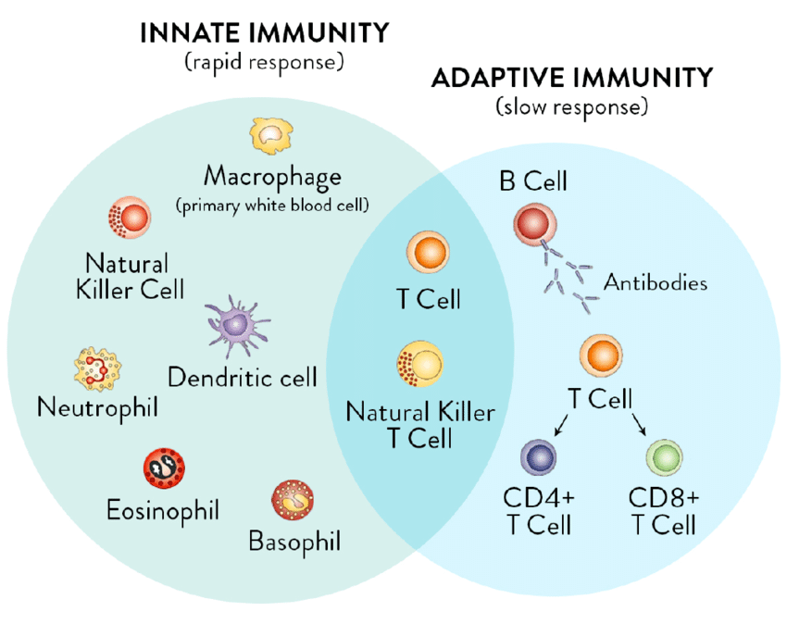

Slide 13
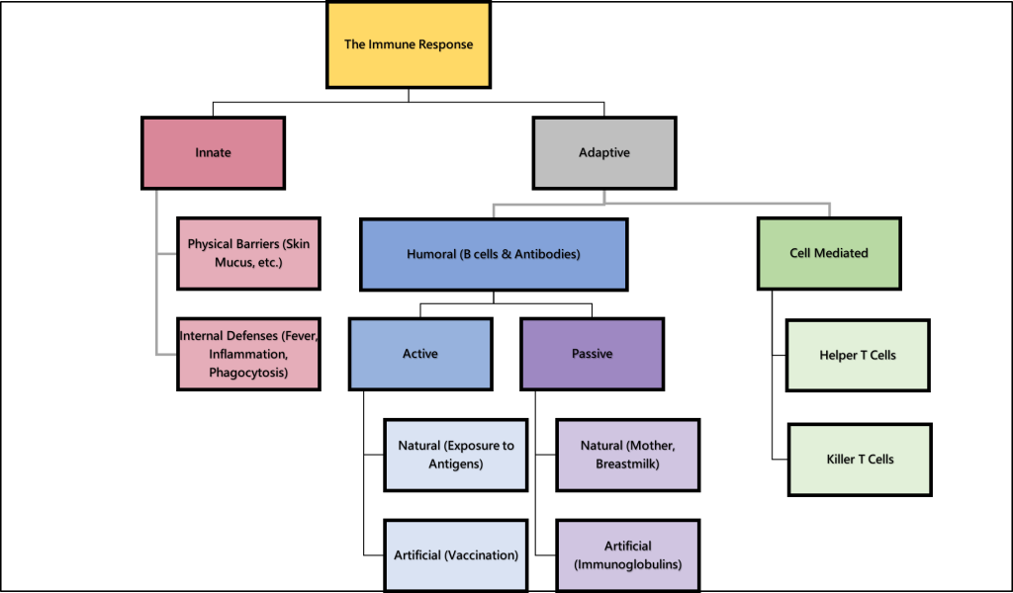

Slide 14
Antigens
An antigen is any foreign substance capable of triggering an immune response.
• Antigens may come from:
• Microbes, Abnormal body cells (e.g., cancer cells), Toxins
• For T‑lymphocytes, antigens must be presented by antigen‑presenting cells such as macrophages.
• Macrophages digest the antigen and display its most antigenic fragment on their surface to activate T‑cells.

Slide 15
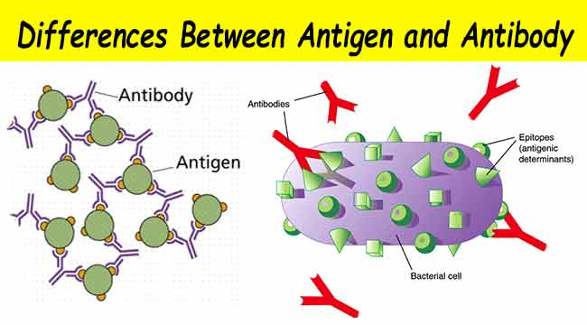
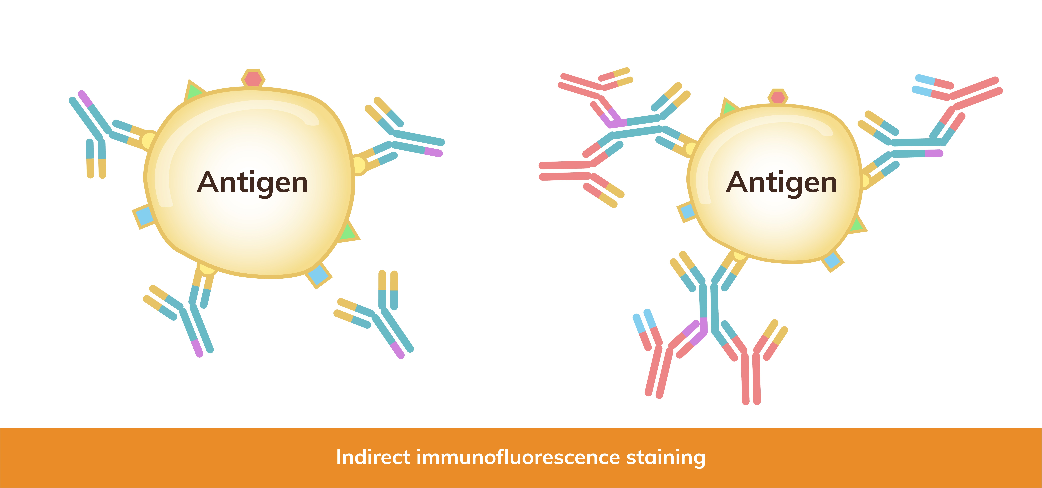
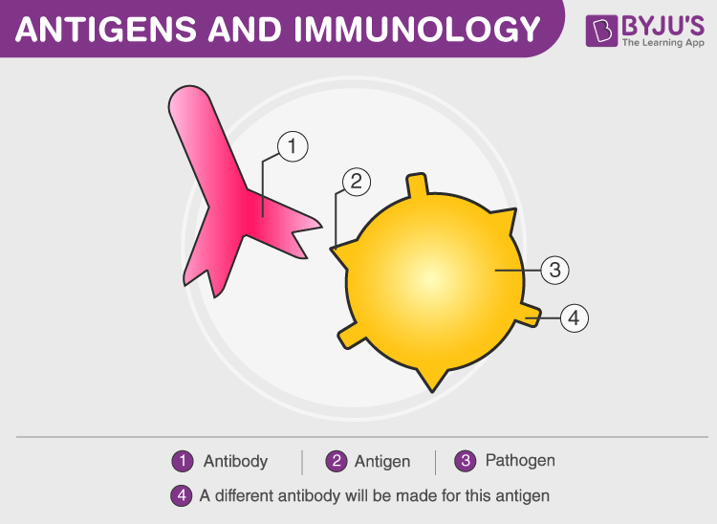
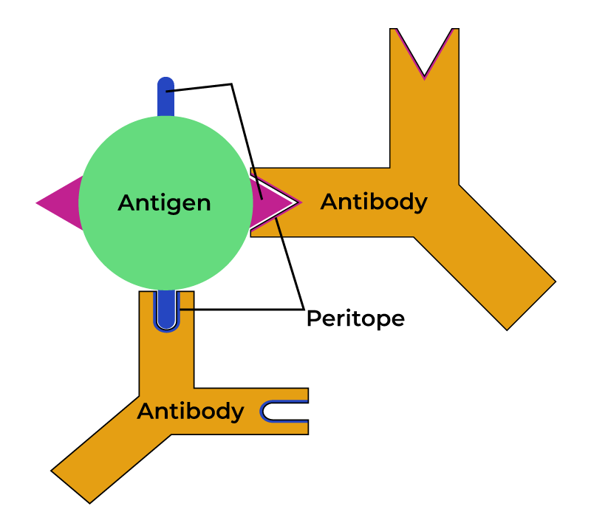

Slide 16
Antibodies
• Antibodies are proteins (immunoglobulins) produced by B‑lymphocytes.
• Each antibody reacts with one specific antigen only.
• Functions include:
• Binding to antigens and marking them for destruction
• Neutralising bacterial toxins
• Activating complement proteins
• Antibodies circulate in blood and tissues, while B‑lymphocytes remain in lymphoid organs.

Slide 17
Primary Immune Response
- Occurs when the body encounters an antigen for the first time.
- B‑lymphocytes become plasma cells and begin producing antibodies.
- Antibody levels rise slowly, taking about two weeks to reach detectable levels.
- After the infection is controlled, antibody levels fall.
- Memory B‑cells remain in the body, prepared for future exposure.

Slide 18
Secondary Immune Response
- Triggered when the same antigen enters the body again.
- Memory B‑cells respond rapidly and produce large amounts of antibodies.
- Antibody levels rise much faster and reach much higher levels than in the primary response.
- This strong, rapid response forms the basis of long‑term immunity and vaccination.

Slide 19
Cell‑Mediated Immunity
- Provided by T‑lymphocytes, which are processed in the thymus under the influence of thymosin.
- Each T‑cell recognises one antigen only.
- Antigen must be displayed on antigen‑presenting cells or abnormal body cells.
- Activation leads to clonal expansion, producing three major T‑cell types:
1. Memory T‑cells
- Long‑lived
- Provide rapid response on re‑exposure

Slide 20
Cytotoxic T‑cells and Helper T‑cells
- 2. Cytotoxic T‑cells
- Destroy infected or abnormal cells by releasing toxins, Important in viral infections and cancer defence
3. Helper T‑cells
- Produce cytokines (interleukins, interferons)
- Support cytotoxic T‑cells and macrophages, Stimulate B‑lymphocytes to produce antibodies
- Essential for both arms of immunity, Loss of helper T‑cells (e.g., HIV infection) severely weakens the immune system.

Slide 21
Antibody‑Mediated Immunity
- Provided by B‑lymphocytes, which remain in lymphoid tissues.
- B‑cells can bind antigens directly without antigen‑presenting cells.
- With help from helper T‑cells, B‑cells undergo clonal expansion into:
1. Plasma cells
- Short‑lived
- Produce large quantities of antibodies
- Each plasma cell produces only one type of antibody

Slide 22
Antibody‑Mediated Immunity
2. Memory B‑cells
  Long‑lived
  Respond rapidly on re‑exposure
Antibodies circulate throughout the body to neutralise and destroy antigens.

Slide 23
Role of Lymphocytes in Immune Regulation
T‑Lymphocytes
- Helper T‑cells coordinate immune responses by releasing cytokines.
- Cytotoxic T‑cells directly destroy infected or abnormal cells.
- Memory T‑cells ensure rapid future responses.
B‑Lymphocytes
- Produce antibodies through plasma cells.
- Memory B‑cells maintain long‑term immunity.

Slide 24
Role of Lymphocytes in Immune Regulation
- T‑ and B‑lymphocytes work in close cooperation.
- Helper T‑cells are essential for activating both cytotoxic T‑cells and B‑cells.
- A balanced interaction prevents overreaction or autoimmunity.
- Disturbances in this balance can lead to immune deficiency or autoimmune disease.

Slide 25
The blood
Blood is a connective tissue. It carries: • oxygen from the lungs to the tissues and carbon dioxide from the tissues to the lungs for excretion • nutrients from the alimentary tract to the tissues and cell wastes to the excretory organs, principally the kidneys • hormones secreted by endocrine glands to their target glands and tissues • heat produced in active tissues to other less active tissues • protective substances, e.g. antibodies, to areas of infection • clotting factors that coagulate blood, minimising its loss from ruptured blood vessels

Slide 26
Plasma
The constituents of plasma are water (90 to 92%) and dissolved substances, including:
• plasma proteins: albumins, globulins (including antibodies), fibrinogen, clotting factors
• inorganic salts (mineral salts): sodium chloride, sodium bicarbonate, potassium, magnesium, phosphate, iron, calcium, copper, iodine, cobalt
• nutrients, principally from digested foods, e.g. monosaccharides (mainly glucose), amino acids, fatty acids, glycerol and vitamins
• organic waste materials, e.g. urea, uric acid, creatinine
• hormones • enzymes, e.g. certain clotting factors
gases, e.g. oxygen, carbon dioxide, nitrogen

Slide 27
Plasma proteins
Plasma proteins, which make up about 7% of plasma, are normally retained within the blood, because they are too big to escape through the capillary pores into the tissues.
They are largely responsible for creating the osmotic pressure of blood (normally 25 mmHg or 3.3 kPa*), which keeps plasma fluid within the circulation.
If plasma protein levels fall, because of either reduced production or loss from the blood vessels, osmotic pressure is also reduced, and fluid moves into the tissues (oedema) and body cavities

Slide 28
Globulins/Fibrinogen & Clotting Factors
Mostly produced in the liver; some in lymphoid tissue.
Functions:
Immunoglobulins (antibodies): neutralise antigens.
Transport: carry hormones (e.g., thyroxine) and minerals (e.g., iron via transferrin).
Enzyme inhibition: e.g., α₂‑macroglobulin inhibits proteolytic enzymes.
Fibrinogen made in the liver; essential for blood clotting.
Clotting factors required for coagulation.
Serum = plasma without clotting factors.

Slide 29
Plasma Composition & Functions
Plasma Viscosity
- Determined mainly by albumin and fibrinogen.
- Used clinically to assess disease activity.
Inorganic (Mineral) Salts: Needed for cell formation, muscle contraction, nerve impulses, secretions, and acid–base balance.
- Blood pH maintained between 7.35–7.45 by buffering systems.
Nutrients
- Absorbed from digestion: sugars, amino acids, fatty acids, glycerol, vitamins.

Slide 30
Other Plasma Components
Organic Waste Products: Urea, creatinine, uric acid from protein metabolism → carried to kidneys.
- Carbon dioxide → transported to lungs for excretion.
Hormones
- Produced by endocrine glands; enter blood directly, Transported to target tissues to regulate activity.
Gases
- Oxygen, carbon dioxide, nitrogen dissolved in plasma.
- Most O₂ carried by haemoglobin; most CO₂ as bicarbonate.

Slide 31
Cellular content of blood
There are three types of blood cells
• erythrocytes or red cells
• thrombocytes or platelets
• leukocytes or white cells.
All blood cells originate from pluripotent stem cells and go through several developmental stages before entering the blood. Different types of blood cells follow separate lines of development. The process of blood cell formation is called haemopoiesis

Slide 32
Erythrocytes (red blood cells)
These are circular biconcave non-nucleated discs with a diameter of about 7 microns.
Measurements of red cell numbers, volume and haemoglobin content are routine and useful assessments made in clinical practice
Erythrocyte count. This is the number of erythrocytes per litre (1) or per cubic millimetre (mm3) of blood. Packed cell volume or haematocrit. This is the volume of red cells in 1 litre or 1 mm3 of whole blood.

Slide 33
Erythrocytes (red blood cells)
- Most numerous formed elements.
- Biconcave, flexible cells without nuclei.
- Contain haemoglobin for oxygen and carbon dioxide transport.
- Lifespan: ~120 days.
- Destroyed by macrophages in spleen, liver, and bone marrow.

Slide 34
White Blood Cells (Leukocytes)
- Larger but fewer than RBCs.
- Provide defence and immunity.
- Types:
- Granulocytes: neutrophils, eosinophils, basophils
- Agranulocytes: lymphocytes, monocytes
- Capable of diapedesis and phagocytosis (neutrophils, macrophages).

Slide 35
Platelets (Thrombocytes)
- Small, disc‑shaped cell fragments.
- Formed from megakaryocytes in bone marrow.
- Lifespan: 7–10 days.
- Essential for clot formation, platelet plug formation, and release of clotting factors

Slide 36
Functions of Formed Elements
- RBCs: gas transport, acid–base balance.
- WBCs: immunity, inflammation, phagocytosis.
- Platelets: haemostasis, clotting, vessel repair.
- Together maintain oxygenation, defence, and prevention of blood loss.

Slide 37
STAGES OF CELL DEVELOPMENT
- Formation of blood cells in red bone marrow.
- All formed elements arise from pluripotent stem cells.
- Differentiation controlled by growth factors and hormones

Slide 38
Erythropoiesis (RBC Formation)
- Stem cell → proerythroblast → erythroblast → normoblast → reticulocyte → RBC.
- Nucleus lost at normoblast stage.
- Stimulated by erythropoietin (kidneys).
- Requires iron, vitamin B₁₂, folic acid.

Slide 39
Leukopoiesis (WBC Formation)
- Myeloid stem cells → granulocytes & monocytes.
- Lymphoid stem cells → lymphocytes.
- Influenced by colony‑stimulating factors and interleukins.
- Lymphocytes further mature in thymus (T‑cells) or bone marrow (B‑cells).

Slide 40
Thrombopoiesis (Platelet Formation)
- Stem cell → megakaryoblast → megakaryocyte → platelets.
- Regulated by thrombopoietin (liver & kidneys).
- Megakaryocytes fragment to release thousands of platelets.

Slide 41
Regulation of Cell Development
- Controlled by:
- Oxygen levels (erythropoietin release)
- Infection/inflammation (WBC production)
- Blood loss (increased RBC and platelet formation)
- Bone marrow responds rapidly to body needs.

Slide 42
BLOOD GROUPING
Blood groups depend on antigens on RBC membranes.
Two major systems:
  ABO system
  Rh system
Important for transfusion safety.

Slide 43
ABO Blood Group System
- Determined by presence of A and B antigens.
- Groups:
- A: A antigen, anti‑B antibodies
- B: B antigen, anti‑A antibodies
- AB: both antigens, no antibodies
- O: no antigens, both antibodies
- Incorrect transfusion → haemolysis.

Slide 44
Rh Blood Group System
- Based on presence of Rh (D) antigen.
- Rh‑positive: D antigen present
- Rh‑negative: D antigen absent
- Rh incompatibility important in pregnancy (haemolytic disease of newborn).

Slide 45
Cross‑Matching
- Donor RBCs tested against recipient serum.
- Prevents transfusion reactions.
- Ensures compatibility of ABO and Rh systems.

Slide 46
COAGULATION MECHANISM
- Haemostasis prevents blood loss.
- Three main steps:
- Vasoconstriction
- Platelet plug formation
- Coagulation (clotting)
- Involves platelets, clotting factors, and vessel wall.

Slide 47
Vasoconstriction
When platelets come in contact with a damaged blood vessel, their surface becomes sticky and they adhere to the damaged wall.
They then release serotonin (5-hydroxytryptamine), which constricts (narrows) the vessel, reducing blood flow through it.
Other chemicals that cause vasoconstriction, e.g. thromboxanes, are released by the damaged vessel itself.

Slide 48
Platelet plug formation.
The adherent platelets clump to each other and release other substances, includ ing adenosine diphosphate (ADP), which attract more platelets to the site.
Passing platelets stick to those already at the damaged vessel and they too release their chemicals.
This is a positive feedback system by which many platelets rapidly arrive at the site of vascular dam age and quickly form a temporary seal — the platelet plug.

Slide 49
Coagulation (blood clotting).
This is a complex process that also involves a positive feedback system and only a few stages are included here
Blood clotting results in formation of an insoluble thread-like mesh of fibrin which traps blood cells and is much stronger than the rapidly formed platelet plug.
In the final stages of this process prothrombin activator acts on the plasma protein prothrombin converting it to thrombin.

Slide 50
Coagulation (blood clotting).
The extrinsic pathway occurs rapidly (within seconds) when there is tissue damage outside the circulation.
Damaged tissue releases a complex of chemicals called thromboplastin or tissue factor, which initiates coagulation.
The intrinsic pathway is slower (3-6 minutes) and is confined to the circulation. It is triggered by damage to a blood vessel lining (endothelium) and the effects of platelets adhering to it. After a time the clot shrinks, squeezing out serum, a clear sticky fluid that con sists of plasma from which clotting factors have been removed.

Slide 51
Fibrinolysis
After the clot has formed the process of removing it and healing the damaged blood vessel begins.
The breakdown of the clot, or fibrinolysis, is the first stage.
An inactive substance called plasminogen is present in the clot and is converted to the enzyme plasmin by activators released from the damaged endothelial cells.
Plasmin initiates the breakdown of fibrin to soluble products that are treated as waste material and removed by phagocytosis. As the clot is removed, the healing process restores the integrity of the blood vessel wall.

