Slide 1
Applied Science
Awais Hamza
Fsc Medical Technology

Slide 2
What is a Solution?
A solution is a homogeneous mixture composed of:
Solute: substance being dissolved
Solvent: substance that dissolves the solute
Examples:
Salt in water (NaCl + H₂O)
Sugar in tea
Oxygen dissolved in blood

Slide 3
What is Concentration?
Concentration is the measure of the amount of solute present in a given amount of solution or solvent.
It indicates how strong or dilute a solution is.

Slide 4
Weight Percentage (% w/w)
Formula:
% w/w = (Mass of solute / Mass of solution) × 100
Example:
10 g salt dissolved in 90 g water
Total mass = 100 g
% w/w = (10 / 100) × 100 = 10%

Slide 5
Volume Percentage (% v/v)
Used for liquid–liquid solutions.
Formula:
% v/v = (Volume of solute / Volume of solution) × 100
Example:
20 mL alcohol in 100 mL solution
% v/v = (20 / 100) × 100 = 20%

Slide 6
Weight/Volume Percentage (% w/v)
Common in medicine and laboratories.
Formula:
% w/v = (Mass of solute in g / Volume of solution in mL) × 100
Example:
5 g glucose in 100 mL solution = 5% w/v

Slide 7
Molarity (M)
Molarity = moles of solute per liter of solution
Formula:
M = numer of moles of solute / Volume of Solution(dm3)
Where:
n = moles of solute
V = volume of solution in liters

Slide 8
Key Components
Solute → substance being dissolved (e.g., NaCl)
Solution → solute + solvent
Volume → total volume of the solution (not just solvent)
Unit: mol/L or M

Slide 9
Molarity Example
Calculate molarity of 5 moles NaCl dissolved in 2 L solution:
M = 5 / 2 = 2.5 M

Slide 10
Molality (m)
Molality = moles of solute per kilogram of solvent
Formula:
m = number of mole of solute / mass of solvent (kg)
Used when temperature changes affect volume.

Slide 11
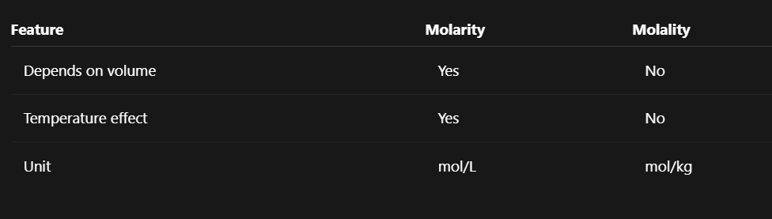
Difference Between Molarity and Molality

Slide 12
Key Components
Solvent mass only (not total solution)
Mass measured in kilograms
Unit: mol/kg or m

Slide 13
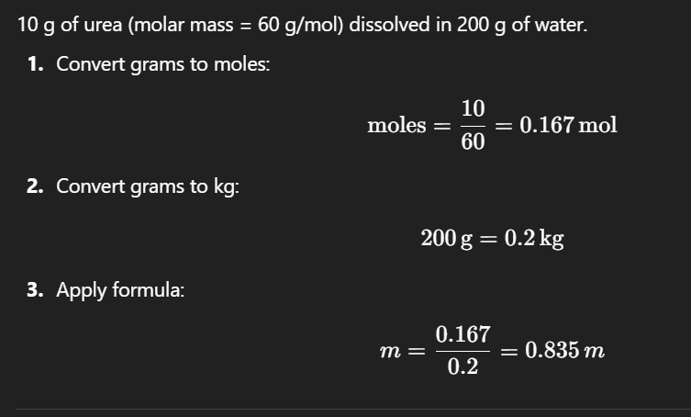
Example
10 g of urea (molar mass = 60 g/mol) dissolved in 200 g of water.
Convert grams to moles:

Slide 14
Molarity vs Molality
Feature | Molarity (M) | Molality (m)
Based on | Volume of solution | Mass of solvent
Unit | mol/L | mol/kg
Temperature effect | Affected | Not affected
Used in | Lab reactions, titrations | Colligative properties
Accuracy | Less at high T | More precise

