Slide 1




Computer networks
Submitted by: Haiqa Tanveer
Submitted to: Sir Adnan Ramzan

Slide 2
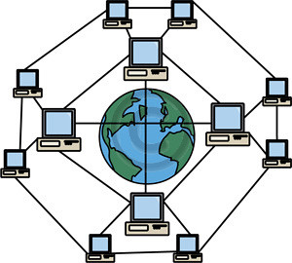
Computer network
ThePhoto by PhotoAuthor is licensed under CCYYSA.

Slide 3
What is computer network?
A computer network is a system in which two or more computers or devices are connected together.
To share,
Data
Internet
Resources
Applications

Slide 4
Why do we use computer networks?
Communicate easily
Stores data centrally
Share large amount of data quickly
Access shared devices

Slide 5
Types of computer networks
LAN (local Area Network) small area, high speed.
MAN (Metropolitan Area Network) covers a city or campus.
WAN (Wide Area Network) internet is the world biggest WAN.
PAN (Personal area network) very small, few meters.

Slide 6
POINTS OF COMPARISION | LAN | MAN | WAN | PAN
AREA COVERS | FEW METERS TO A FEW KILOMETERS | A CITY AND ITS VICINITY | ENTIRE COUNTRY, CONTINENTS,OR GLOBE | SMALL AREA
ERROR RATES | LOWEST | MODERATE | HIGHEST | LOWEST
TRANSMISSION SPEED | HIGH SPEED | MODERATE SPEED | LOW SPEED | HIGH SPEED
NETWORKING COST | INEXPENSIVE | MODERATE EXPENSIVE EQUIPMENT | EXPENSIVE | NEGLIGIBLE

Slide 7
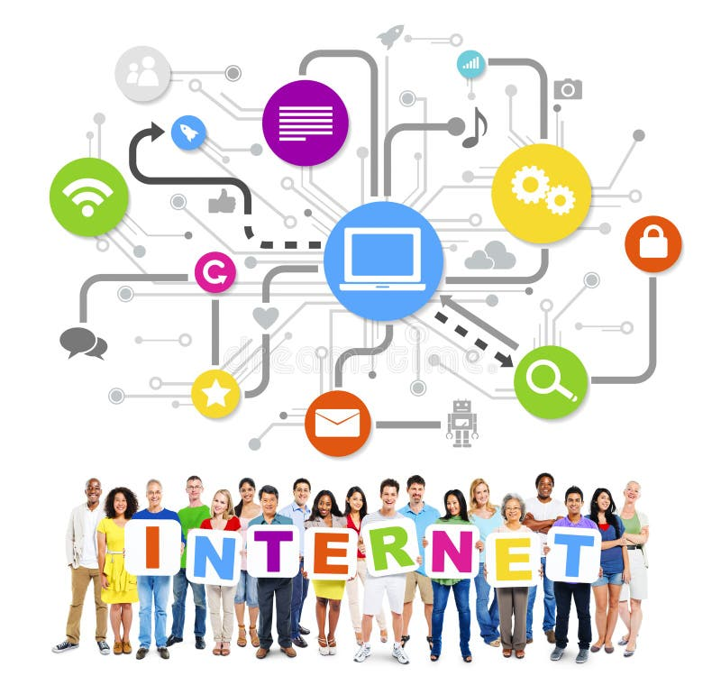
Internet

Slide 8
Internet
The internet is a global network of millions of computers and devices connected together.
It allows,
Communicate
Shares information
Access

Slide 9
How does the internet works?
The internet works by connecting devices through,
Routers
Servers
Cables
Wireless signals

Slide 10
Uses of internet
Communication
Online learning
Online shopping and banking
Entertainment
Cloud storage

Slide 11
Internet safety
To stay safe online,
Use strong passwords
Avoid sharing personal information
Beware of fake links
Use antivirus software

Slide 12

Artificial Intelligence
ThePhoto by PhotoAuthor is licensed under CCYYSA.

Slide 13
What is AI (Artificial intelligence)?
AI is the ability of a computer or machine to think, learn, and make decisions like human.
AI helps machines,
Understand data
Recognize patterns
Solve problems

Slide 14
Types of AI
Narrow AI (Weak AI) Designed to perform a specific task eg. Alexa, Siri.
General AI (Strong AI) has human like intelligence.
Super AI more intelligent than human.
can think , reason, and make decisions on its own.

Slide 15
Applications of AI
Healthcare (disease diagnosis)
Education (smart learning system)
Business (chatbots, data analysis)
Transportation (self-driving cars)
Banking (fraud detection)

Slide 16
Benefits of AI
Fast decisions-making
Reduces human errors
Saves times
Works 24/7
Improves efficiency

Slide 17
Where is AI used
Face unlock
Disease detection
Smart learning apps
Robots in factories
CCTV analytics

Slide 18
Advantages & disadvantages
Advantages
High efficiency and accuracy
Reduces human errors
Disadvantages
Job displacements
Dependence on machines

Slide 19

ThePhoto by PhotoAuthor is licensed under CCYYSA.

Slide 20

ThePhoto by PhotoAuthor is licensed under CCYYSA.

