Slide 1

Poetic Devices
Presented by: Anila Khalid

Slide 2
Our Goal
To analyze how poets use language to create
rhythm, sound, and deeper meaning.

Slide 3
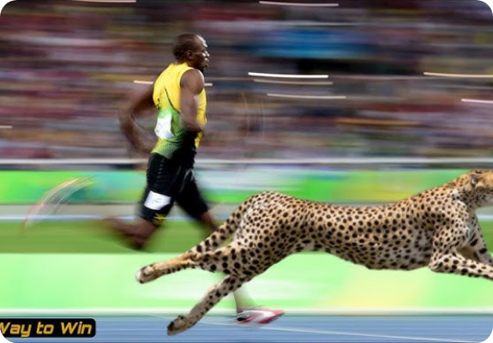
1. Simile
Comparison with "Like" or "As"
Definition: A direct comparison between two unlike things using the connecting words "like" or "as".
Function: Creates an explicit link to help the reader visualize the subject.
"He is as brave as a lion."
"Her smile is like the sun."

Slide 4
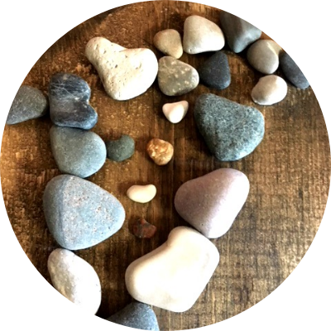
2. Metaphor
Direct Identification
Definition: A direct comparison stating that one thing is another, without using "like" or "as".
Function: Creates a stronger, more abstract identity between two distinct things.
Time is a thief.
The classroom was a zoo.

Slide 5
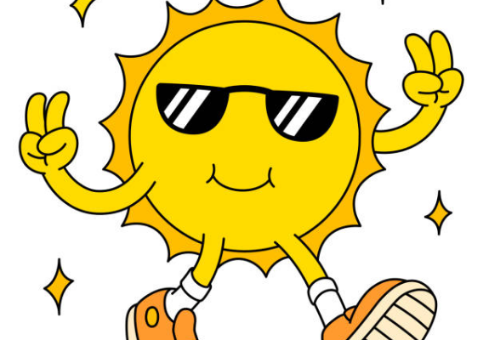
3. Personification
Bringing Objects to Life
Definition: Giving human qualities, emotions, or actions to non-human objects, animals, or abstract ideas.
Function: Makes inanimate objects feel alive and relatable.
"The wind howled in the night."
"The flowers danced in the breeze."

Slide 6




4. Imagery
Descriptive language that appeals to the five senses.
Visual
Auditory
Olfactory
"The golden sunset glowed."
"The buzzing bee flew by."
"The scent of fresh rain."

Slide 7



Sound Patterns
Alliteration
Assonance
Consonance
Repetition of initial consonant sounds.
Repetition of vowel sounds within words.
Repetition of consonant sounds anywhere.
"Peter Piper picked..."
"Try to light the fire."
"Pitter, patter."

Slide 8
Repetition & Refrain
Repetition
Refrain
Repeating words, phrases, or lines to emphasize an idea or build urgency.
A phrase or group of lines repeated at specific intervals (like a chorus), reinforcing the theme.
"Rage, rage against the dying of the light."
"And miles to go before I sleep."

Slide 9

Other Key Devices
Hyperbole
Onomatopoeia
Extreme exaggeration for emphasis or humor.
A word that imitates the sound it represents.
"I am so hungry I could eat a horse."
"Buzz", "Hiss", "Bang", "Crash"

Slide 10

Advanced Devices
Oxymoron
Symbolism
A combination of two contradictory terms.
Using an object or action to represent an abstract idea.
"Deafening silence"
Dove: Peace
"Bittersweet"
Black: Death or Evil
"Open secret"
Rose: Love

Slide 11
Knowledge Check
"The world is a stage" is an example of a Metaphor.
"The leaves danced in the wind" demonstrates Personification.
"Sheep should sleep in a shed" uses Alliteration.
"The silence was deafening" is an Oxymoron.

Slide 12


