Slide 1

Organization
BS-PSY
1ST SEMESTER
Ms. Shehwar Saeed

Slide 2
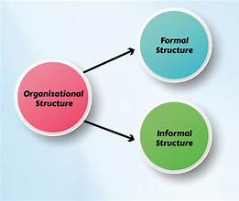
Organizations
Organizations are structured groups of individuals working together to achieve specific goals.

Slide 3
Types of Organization
Formal Organization
Definition: Deliberately created, planned structures with specific objectives, defined roles, and established authority. (e.g., businesses, schools).
Structure: Hierarchical, with clear chains of command and official channels.
Purpose: Achieve organizational goals (e.g., profit, service delivery).
Rules: Governed by formal rules, policies, and procedures.
Communication: Follows official, top-down, or scalar chain.
Examples: Government agencies, corporations, universities, military.

Slide 4
Types of Organization
Informal Organization
Definition: Spontaneous social structures arising from personal interactions and relationships.
Structure: Loosely structured, no formal hierarchy.
Purpose: Satisfy social, emotional, and psychological needs (belonging, support).
Rules: Governed by group norms, values, and beliefs.
Communication: Free-flowing, grapevine, unofficial channels.
Examples: Lunchtime cliques, friend groups, social networks within a workplace.
Key Sociological Relationship

Slide 5
Types of Organization
Interdependence: The informal organization develops within the formal one, often complementing or sometimes challenging its formal structures.
Influence: While formal organizations dictate what needs to be done, informal groups often influence how it gets done and foster workplace culture.

Slide 6
Key Differences
Structure: Formal organizations have a defined structure; informal organizations do not.
Communication: Formal organizations rely on official channels; informal organizations use personal interactions.
Goals: Formal organizations focus on specific objectives; informal organizations may prioritize social connections.

Slide 7

Any Question?

Slide 8


