Slide 1

BASIC MEDICAL SCIENCE
FSC MEDICAL TECHNOLOGIES I
DR DANISH

Slide 2
HORMONES OF TESTIS
The testes are male reproductive organs that produce sperm (spermatogenesis) and secrete male sex hormones called androgens.
The primary and most important androgen is testosterone, which drives male reproductive physiology and secondary sexual characteristics.

Slide 3
1. Testosterone
Structure: steroid hormone of the androgen group.
Synthesis: produced mainly in Leydig cells located in the interstitial tissue around the seminiferous tubules of the testes.
Regulation: production is controlled by luteinizing hormone (LH) from the anterior pituitary, which is released in response to gonadotropin‑releasing hormone (GnRH) from the hypothalamus.

Slide 4
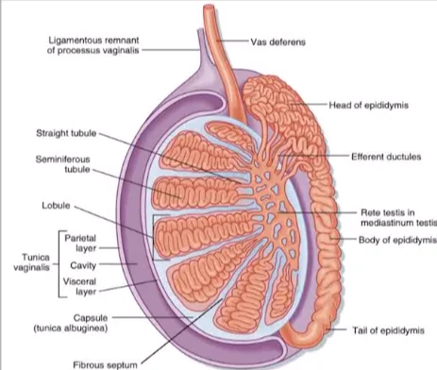

Slide 5
Functions
Spermatogenesis: essential for initiation & maintenance of sperm cell production.
Secondary Sexual Characteristics: develops male traits – facial & body hair, deepened voice, increased muscle mass & strength, enlargement of male reproductive organs.
Libido: regulates sex drive & sexual function.
Bone Density: maintains bone strength in men.
Mood & Energy: influences mood, energy levels, and overall well‑being.

Slide 6
2. Dihydrotestosterone (DHT)
Conversion: formed from testosterone by the enzyme 5‑alpha reductase.
Potency: DHT is a more powerful androgen than testosterone.
Drives development of male external genitalia during fetal growth and facial/body hair growth at puberty.
Regulates prostate gland growth & function.

Slide 7
Main functions of testosterone
Development of male external genitalia.
Promotion of facial and body hair growth.
Regulation of prostate gland function.

Slide 8


Slide 9


