Slide 1
Cardiac Event Monitor
ADNAN RAMZAN
FSC(OT)

Slide 2
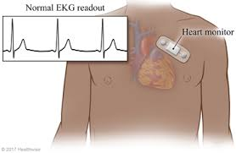
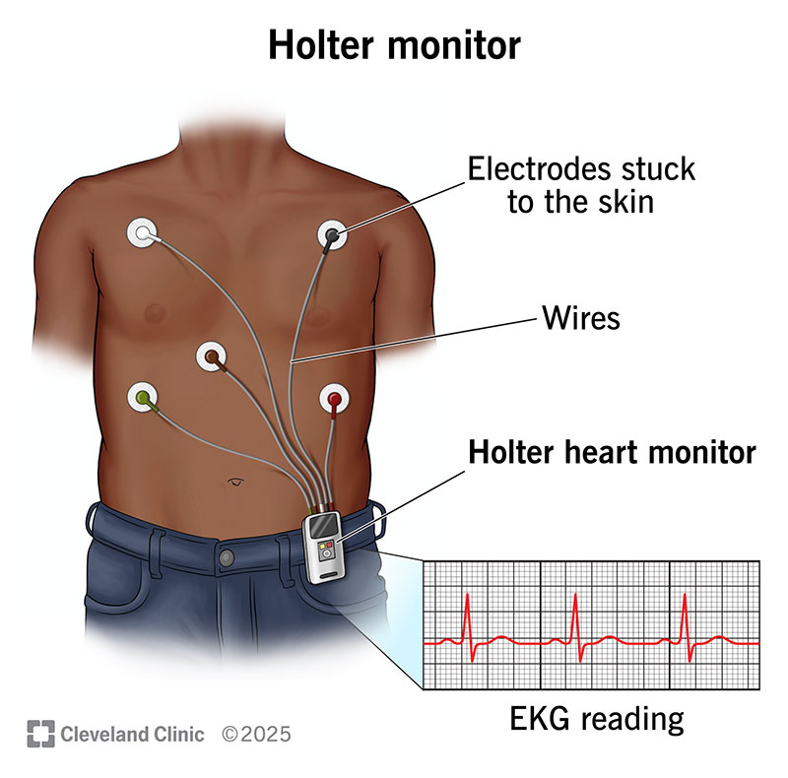

Slide 3
Cardiac Event Monitor
Small wearable device to record heart rhythm over time
Detects abnormal rhythms that don’t happen daily
Works like ECG but for long-term monitoring
Battery-powered and portable
Notes:
a standard cardiac monitor (like a Holter) records continuously (24/7) for a short period (days), while a cardiac event monitor is worn longer (weeks) but only records when you press a button or it detects an issue, capturing specific symptomatic episodes rather than constant data

Slide 4
Types of Cardiac Event Monitors
Patch Recorder
patch recorder (or cardiac patch monitor) is a small, adhesive, wireless device worn on the chest to continuously record your heart's electrical activity (ECG) for days or weeks
worn for up to 2 weeks
Symptom Event Monitor – activated by patient when symptoms start
Loop Memory Monitor – records before & after events
Implanted Loop Recorder – under the skin for years
Notes:
implantable loop recorder (ILR) is a small device that a healthcare provider places in your chest, just beneath the skin. It monitors your heart rate and rhythm and records anything that's abnormal. Most stay implanted for up to three years, but it may come out sooner if your provider gets the information they need.
insert or fix (tissue or an artificial object) in a person's body, especially by surgery.

Slide 5
When is It Used?
Symptoms that happen rarely
Irregular heartbeats not seen in hospital
To diagnose hidden cardiac issues
To monitor heart over weeks/months

Slide 6
Reasons for Use
Fainting, chest pain, dizziness
Palpitations After heart attack or stroke
Risk of arrhythmia
Notes:
Heart palpitations (pal-pih-TAY-shuns) are feelings of having a fast-beating
(fainting)fast onset, short duration, and spontaneous recovery
irregularities in the heartbeat,

Slide 7
Cardiac Event Monitor vs Holter Monitor
Feature | Holter Monitor | Event Monitor
Duration | 24–48 hours | Weeks to months
Recording | Continuous | Only during symptoms
Use | Frequent symptoms | Rare symptoms

Slide 8
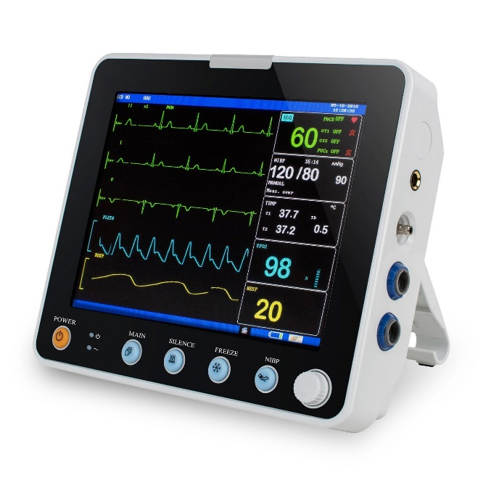
What is a Cardiac Monitor?
Bedside monitor showing heart’s electrical activity
Used in hospitals (ICU, OT, ER)
Provides continuous real-time readings

Slide 9
Purpose of Cardiac Monitor
Shows ECG waves continuously
Measures oxygen saturation & blood pressure
Alerts staff if readings become abnormal
Helps emergency detection and treatment

Slide 10
Components
Monitor screen
ECG cables & electrodes
Pulse oximeter probe
Blood pressure cuff

Slide 11
Additional Easy Points
Improves patient safety
Helps doctors make quick decisions
Reduces hospital stay & complications
Patient-friendly, safe and painless

Slide 12


